Slide 1
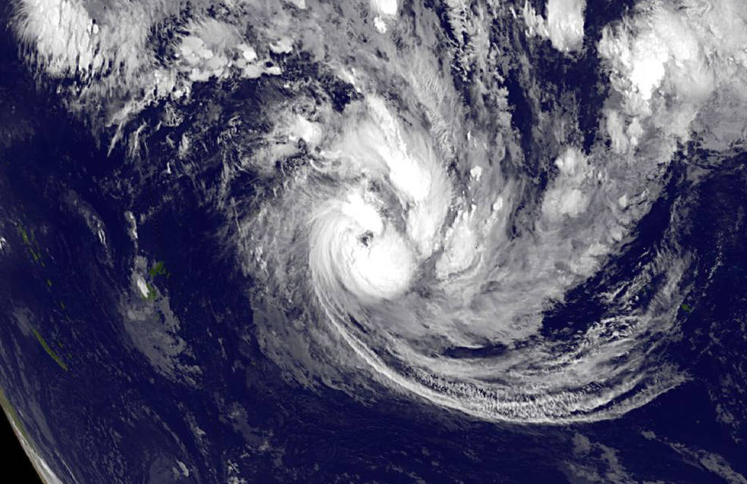


Knowledge Graph Project
Progress and Vision
May 2020

Slide 2
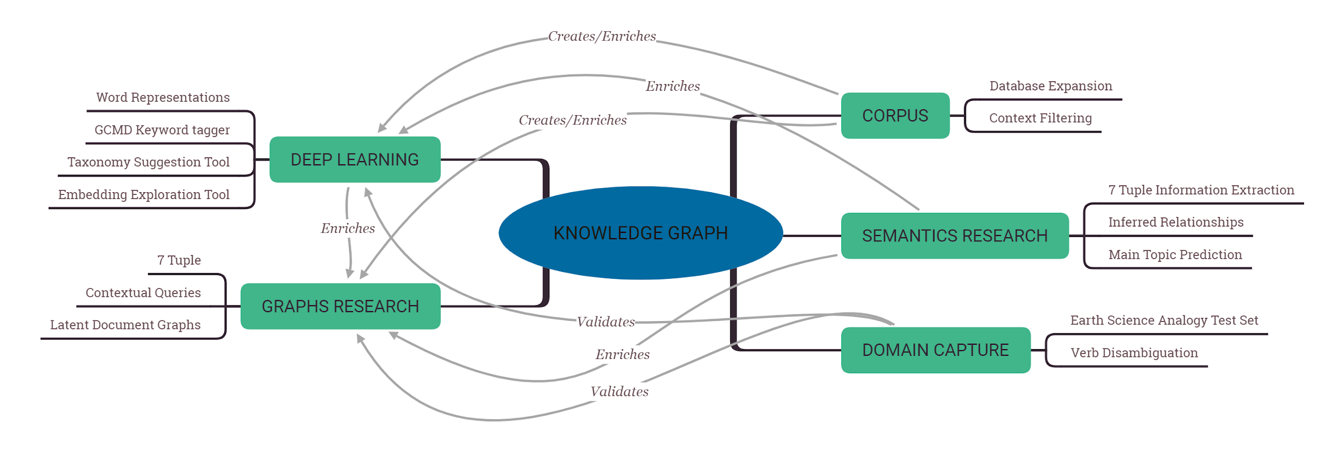
Knowledge Graph: Road Map

Slide 3
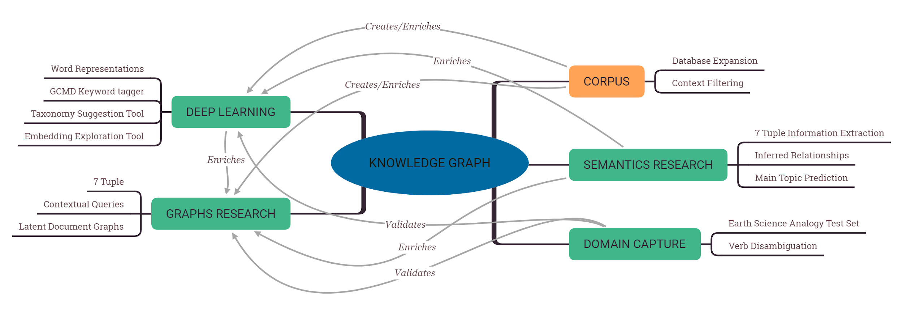
Corpus

Slide 4
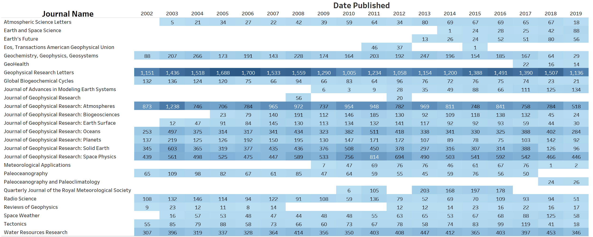
Corpus
88,410 documents 530 million words 5.5 million unique words
Notes:
‘urban hydrology’ results
22k corpus - 4 papers
88k corpus - 1990 papers

Slide 5
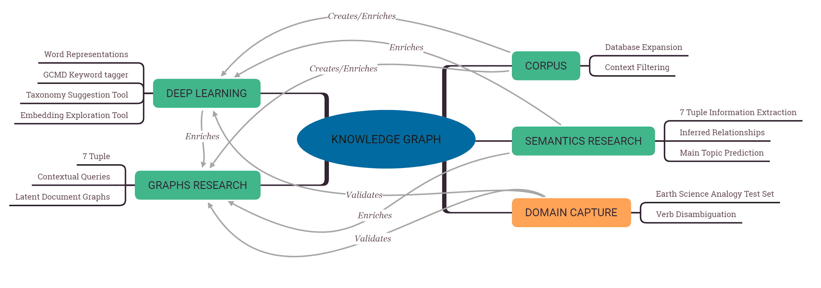
Domain Capture

Slide 6
Domain Capture: Earth Science Analogy Test Set
Word pairs are the foundation of synonym resolution, term generalization, and analogy test sets.
Word pair categories extracted from ENVO:
is_a
formed_as_result_of
part_of
participates_in
has_part
has_quality
composed_primarily_of
partially_surrounded_by
adjacent_to
continuous_with
overlaps
partially_overlaps
located_in
location_of
distributary_of
output_of
derives_from
disconnected_from
attached_to
connects
contains_process
determined_by
surrounded_by
tributary_of
has_increased_levels_of
generates
has_role
determines
has_function
bounding_layer_of
has_input
has_output
has_participant
causally_downstream_of_or_within
causally_upstream_of_or_within
occurs_in
contained_in
has_end_location
inheres_in
has_part_that_occurs_in
results_in_formation_of
contains
has_disposition
negatively_regulates
has_causal_agent
has_active_participant
derives_into
realized_in
has_member
results_in_expansion_of
results_in_proliferation_of
ends
regulates_(processual)
preceded_by
causally_upstream_of
starts_during
during_which_ends
bearer_of
determined_by_part_of
member_of
produced_by
has_habitat
develops_from
disjoint_from
synonym_EXACT
synonym_RELATED
synonym_NARROW
synonym_BROAD
Word pair groupings

Slide 7
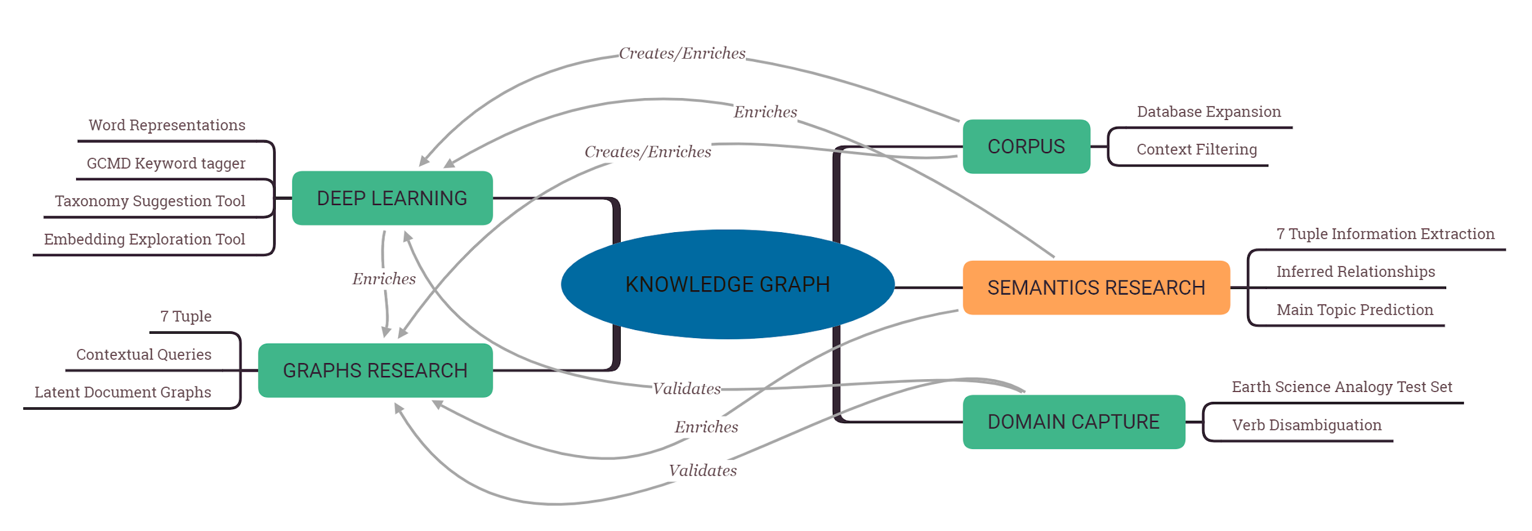
Semantics Research

Slide 8
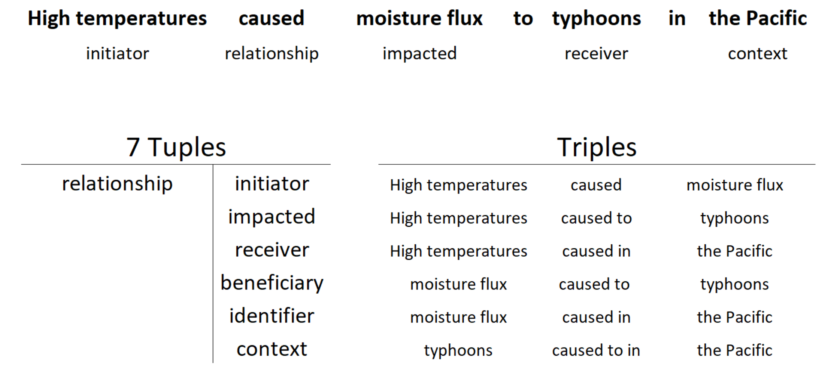
Semantics Research: 7-Tuple Information Extraction

Slide 9
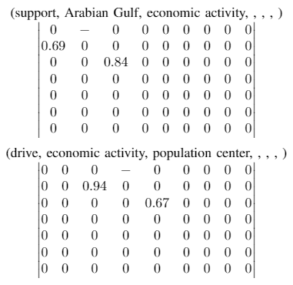
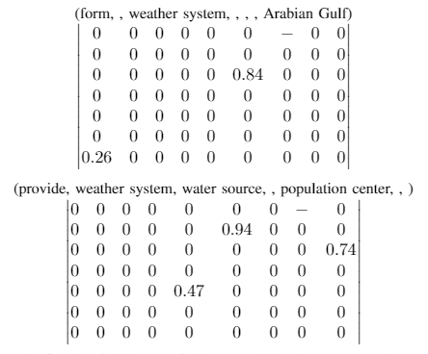
Semantics Research: Main Topic/Idea Prediction
The Arabian Gulf supports intense economic activity driving numerous population centers. The weather systems formed over the Arabian Gulf provide a water source for these population centers.

Slide 10
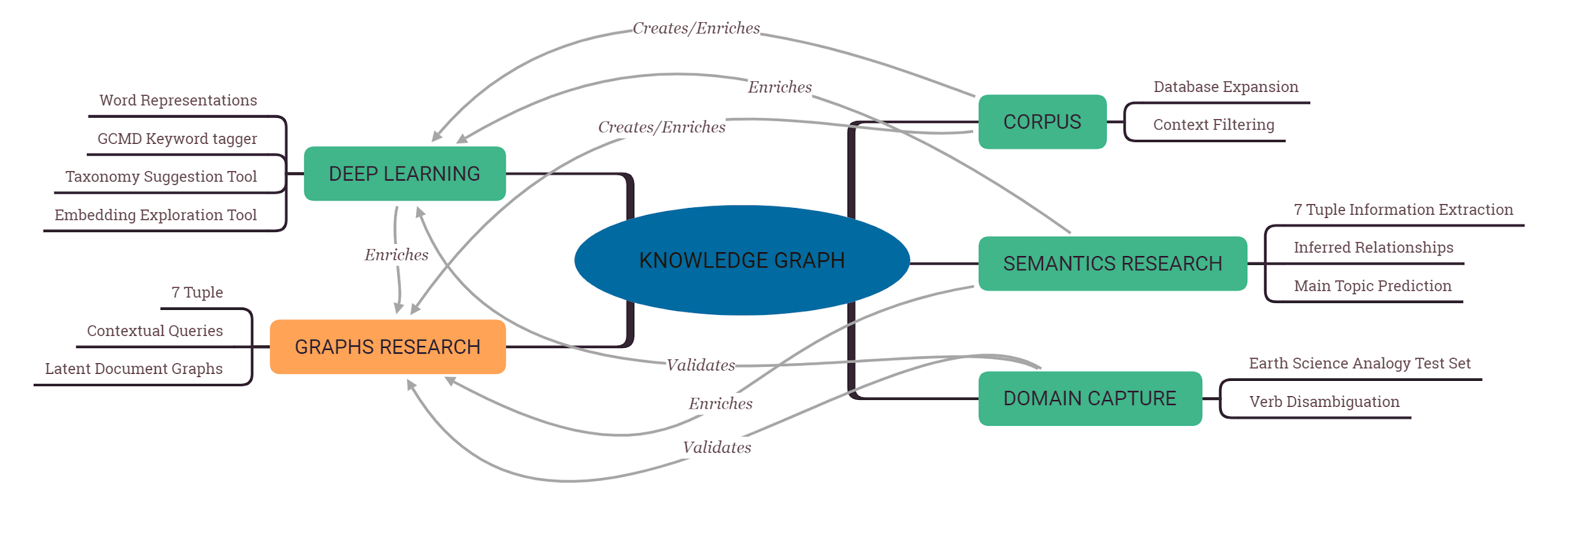
Graphs Research

Slide 11
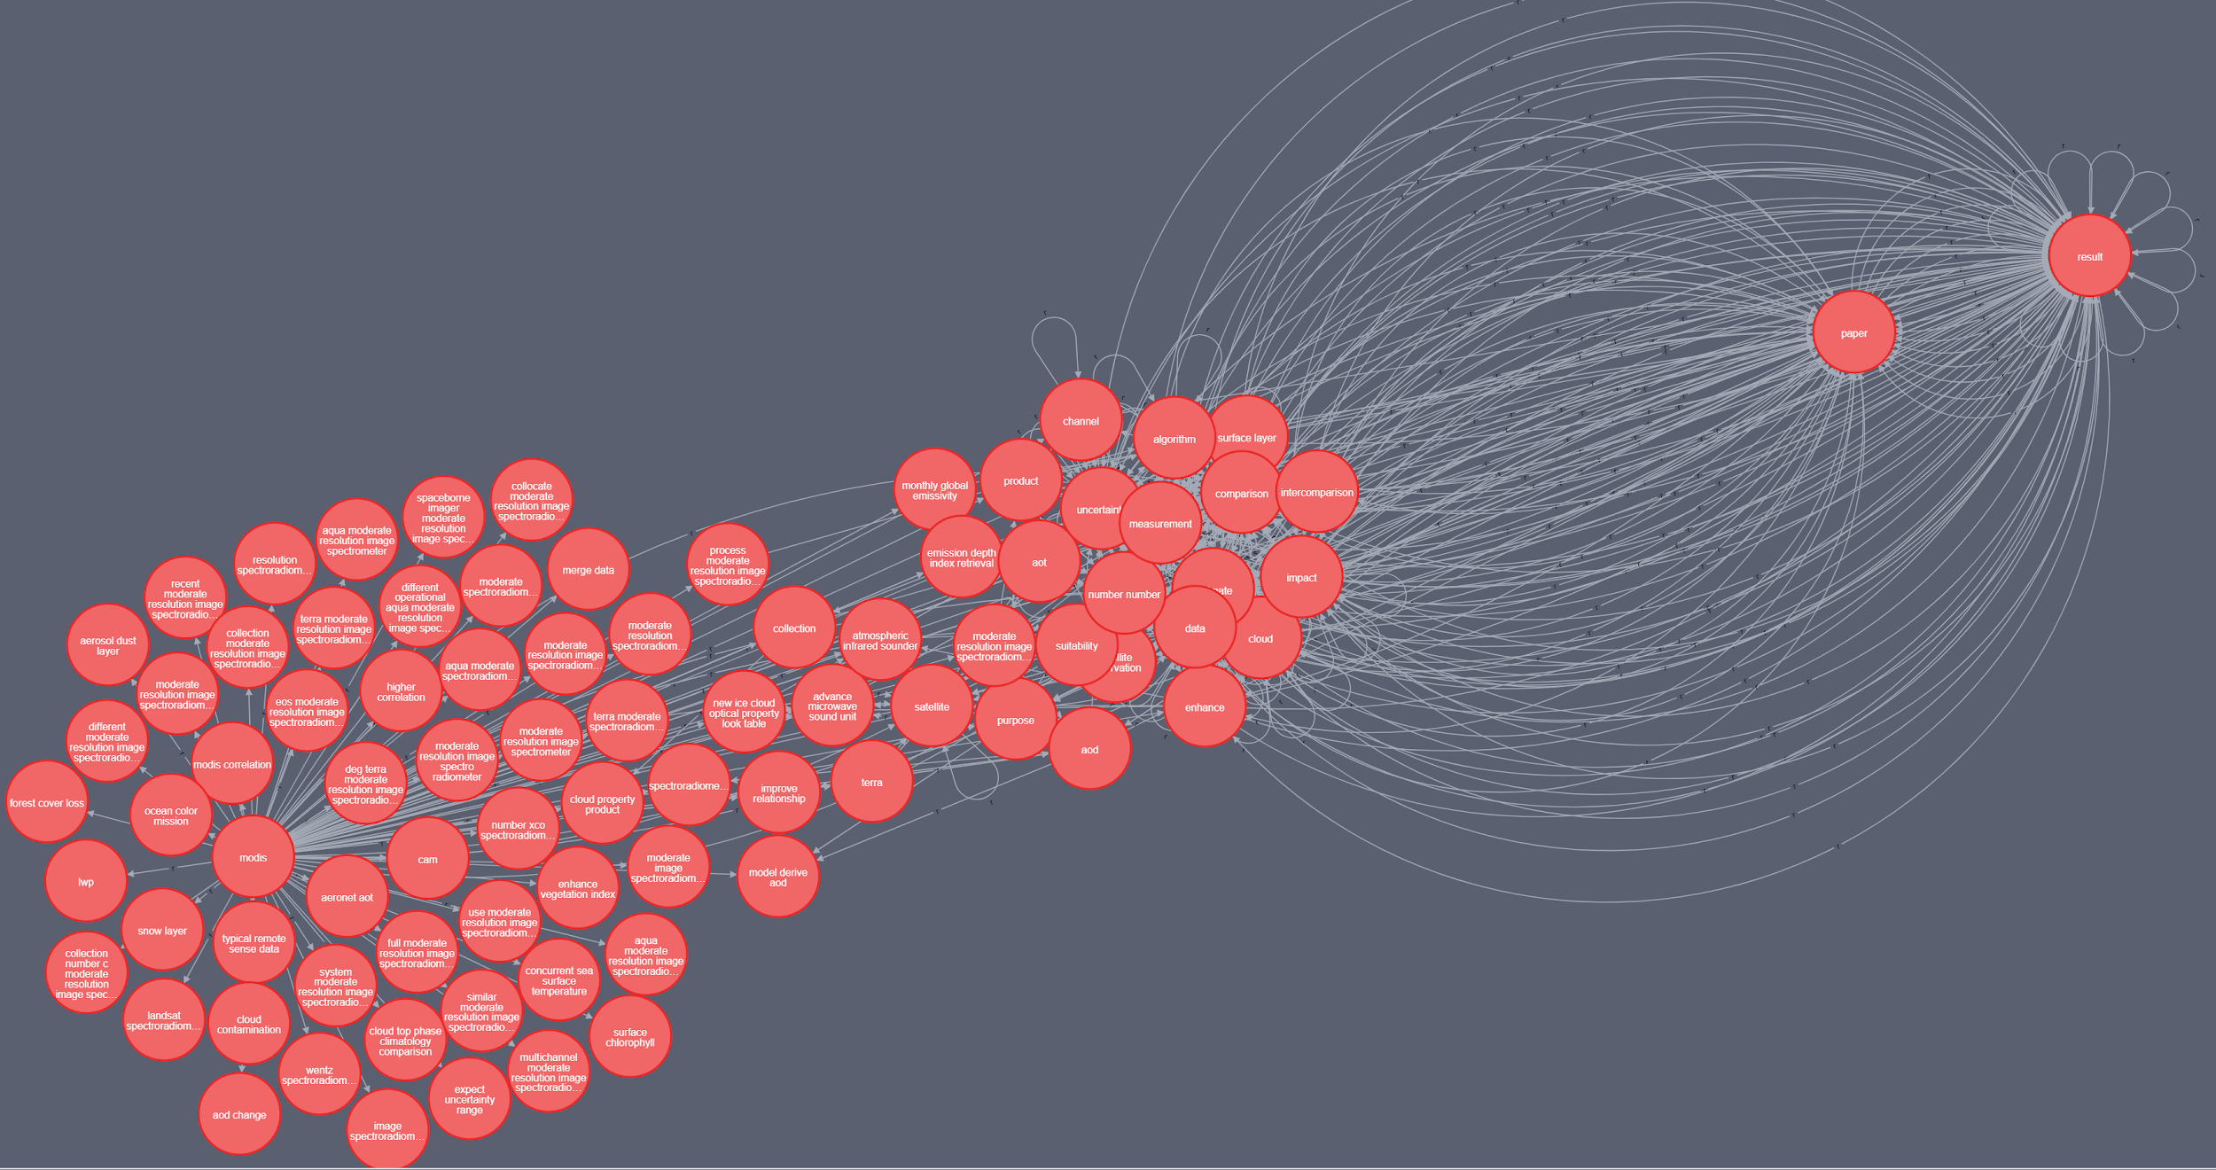
Graphs Research: 7-Tuple
What are all the entities connected to MODIS?

Slide 12
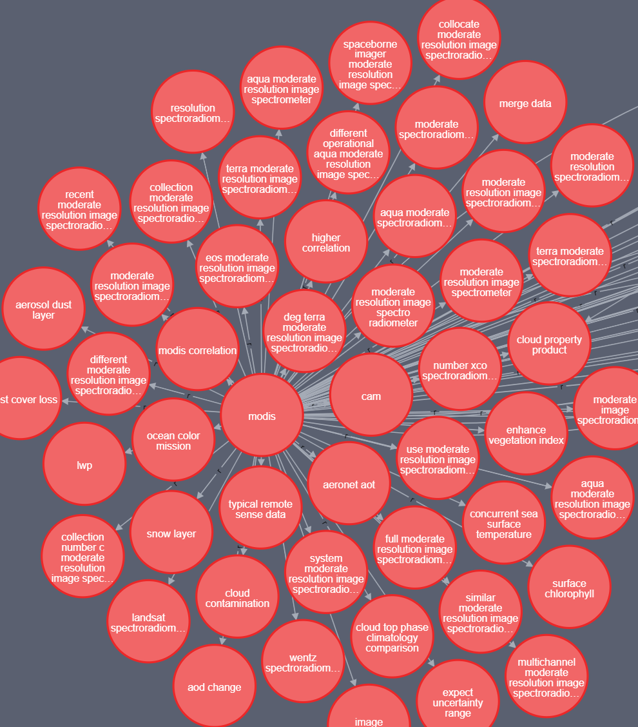
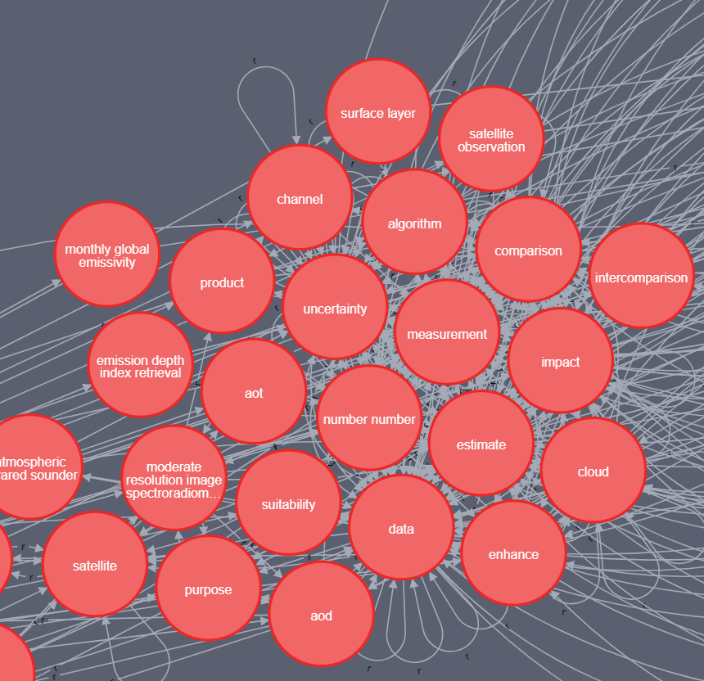
Graphs Research: 7-Tuple
Main Cluster
Intermediate Cluster

Slide 13
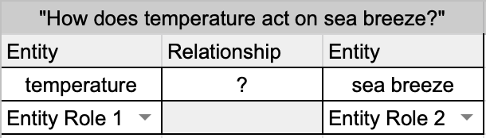
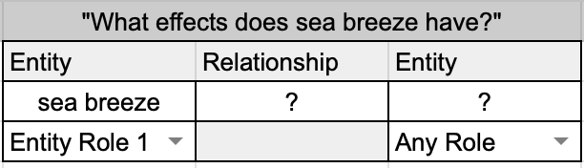
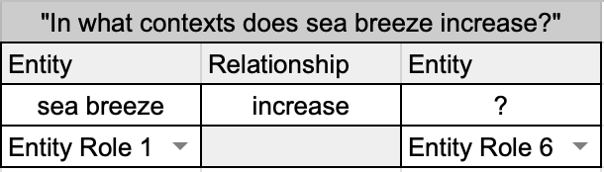
Graphs Research: Semantic Queries
Entity Role 1: Gives rise to the relationship
Entity Role 2: Directly acted on by the relationship
Entity Role 3: Receives the outcome of the relationship
Entity Role 4: Benefits from the relationship
Entity Role 6: The context of the relationship

Slide 14
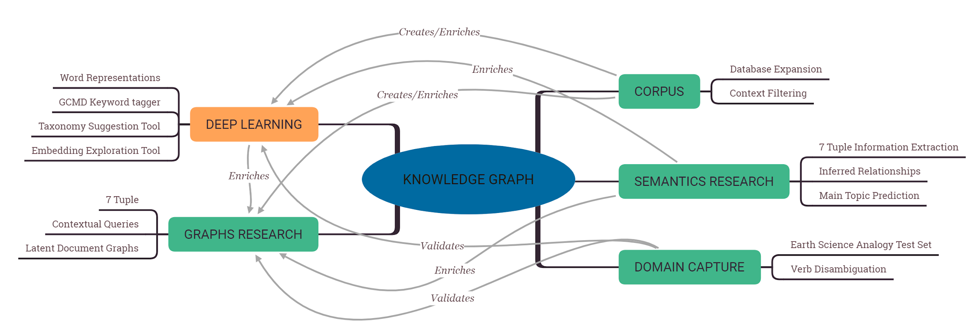
Deep Learning

Slide 15
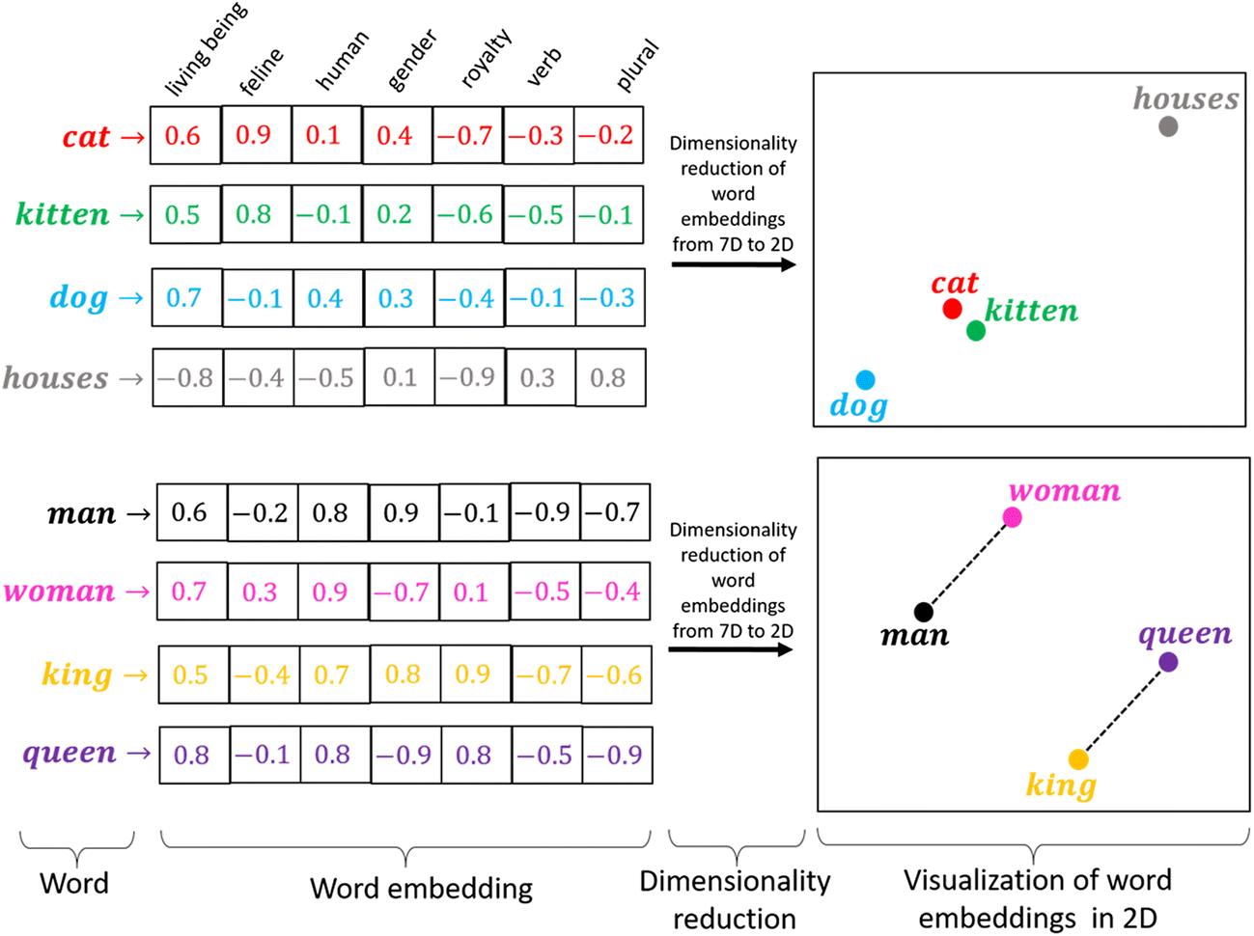
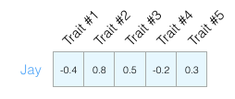
Word Embeddings
Numerical representation of text
Maps words or phrases from the vocabulary to vectors of real numbers
Can be used for:
compact and machine readable representation of words in a corpus
performing statistical analysis on corpus
embedding text as input into ML models
Types of word embeddings:
Count Vectors (CV)
Tf-idf Vectors (TF)
Word2Vec (W2V)
Latent Dirichlet Allocation (LDA)
Utilized Word2Vec: trained on a corpus of ~23,000 Earth science journal articles
An example of word embeddings [1]
In this example each trait is one of the ‘Big Five’ personality traits (openness to experience, Conscientiousness, extraversion, agreeableness, neuroticism) [2]
Notes:
Word embeddings:
Count Vectors from Descriptions (CV)
simple count of words present in corpus.
Tf-idf Vectors from Descriptions(TF)
Importance of word pertaining to corpus.
Word2Vec built from science corpus (W2V)
embedding that captures linguistic relationships between words in corpus.
Our implementation was trained on a corpus of ~23000 Earth Science related journals
Latent Dirichlet Allocation from corpus (LDA)
embedding that groups words with similar (latent) topics.

Slide 16
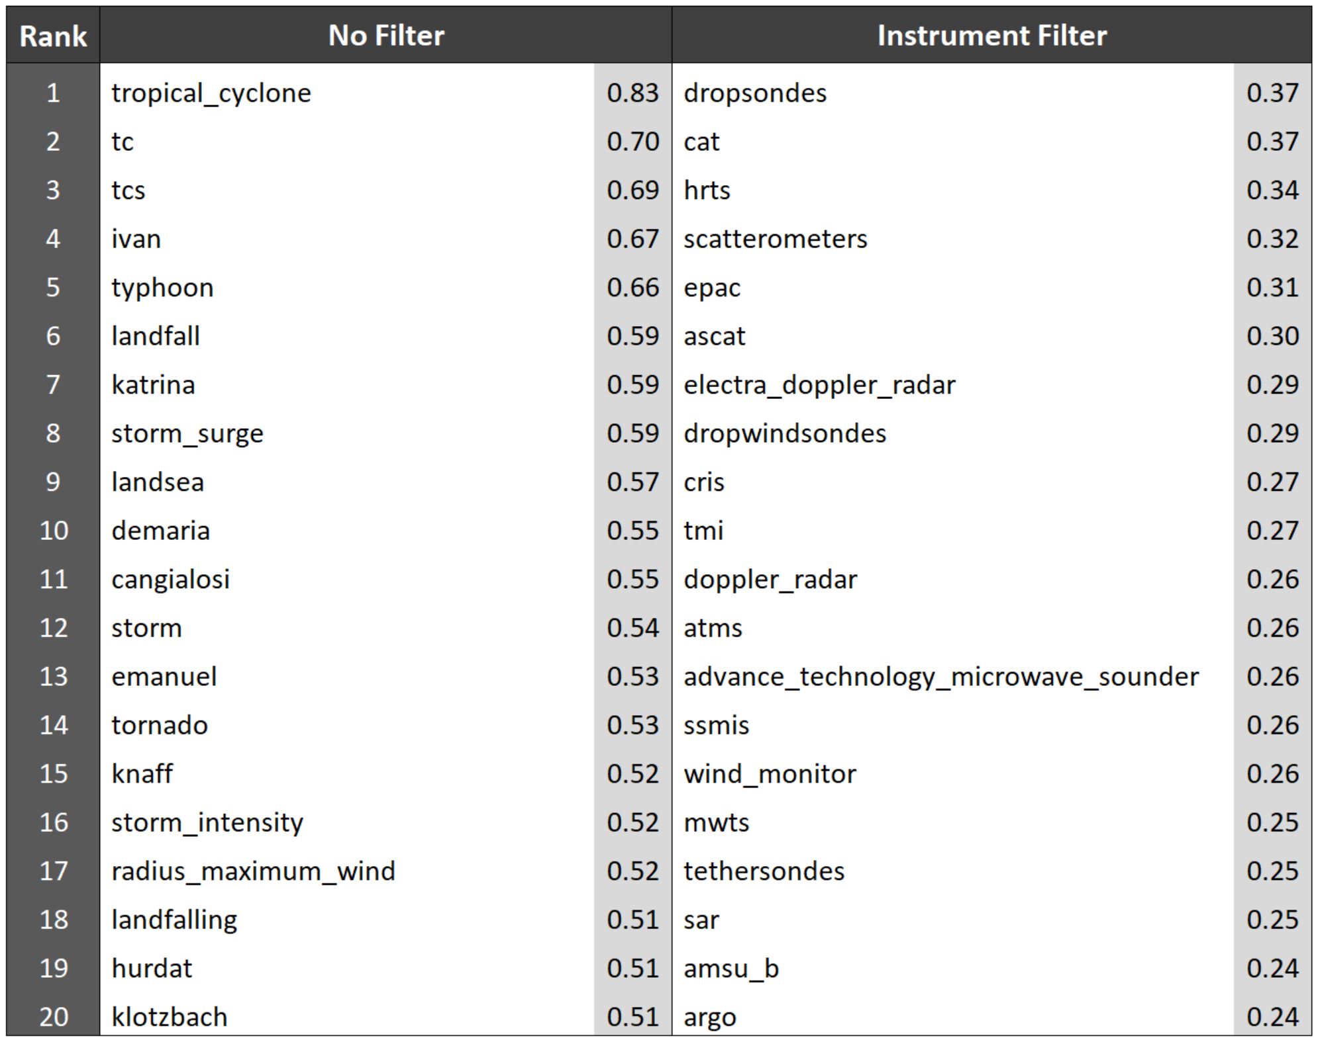
Deep Learning: Embedding Exploration Tool
Search for a topic such as hurricane
Filter by subject: instruments, human activity, land region, phenomena, property, representation, science key words, etc.
-----------------------
General Results
Broad topics
Synonyms (tc, tcs, typhoon, etc)
Hurricane names (Katrina, Ivan)
Researchers (Demaria, Cangialosi, Knaff, Landsea, etc)
Example Instrument Filter
Relevant instruments used in hurricane research
Notes:
A user can search the corpus for a topic of interest such as hurricane. They can then filter on multiple categories such as: instruments, human activity, land region, phenomena, property, representation, science key words, etc.
In this search for hurricane, the main results contain broad topics such as rough synonyms for hurricane (tc, tcs, typhoon, etc), hurricane names (Katrina, Ivan), and, interestingly, multiple prominent hurricane researchers (Demaria, Cangialosi, Knaff, Landsea, etc)
By filtering on instrument, a user can retrieve highly relevant instruments used in hurricane research

Slide 17
Metadata Keyword Prediction: Problem Space
Assigning science keywords is currently a manual process, which is prone to human error and inconsistencies:
Metadata managed across a network of multiple data centers (i.e. keywords not assigned by a central entity)
Keywords may be assigned by non-subject matter experts (SMEs)
SMEs assigning keywords may not be familiar with GCMD keywords or how keywords are used in search engines
Science keywords are meant for data discovery across a broad range of users and may not encompass highly specific scientific variables
Notes:
Keywords are vital to data discovery
Need a reliable automated way to tag metadata with keywords

Slide 18
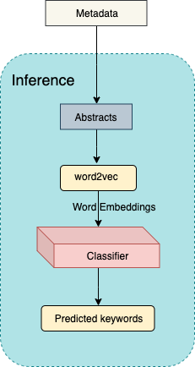
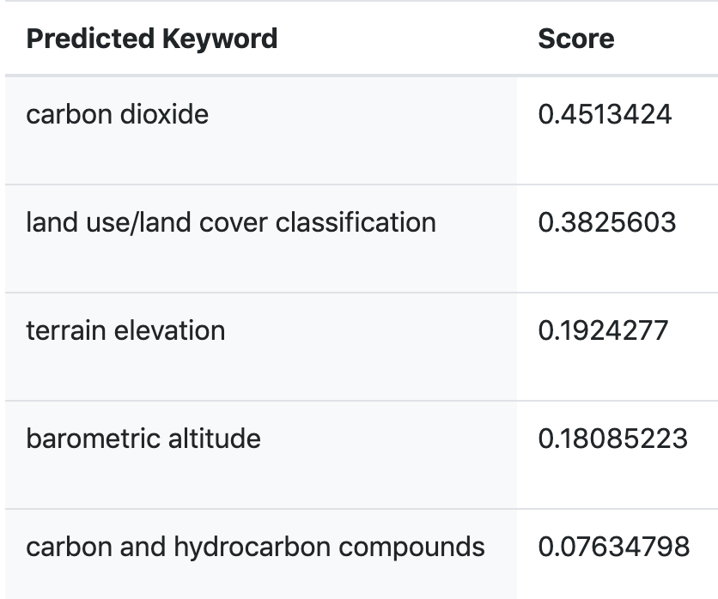
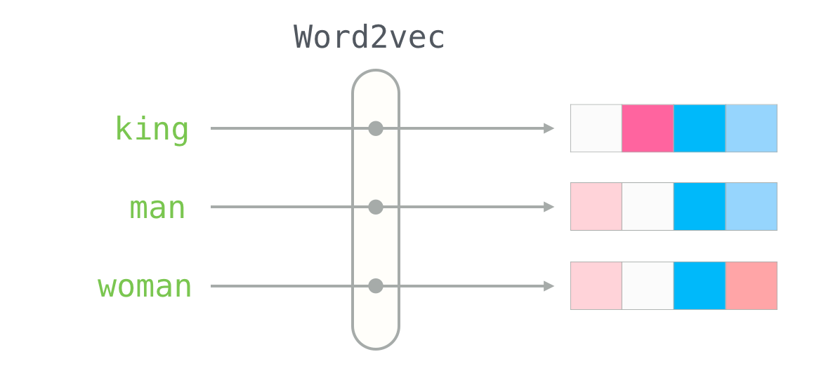
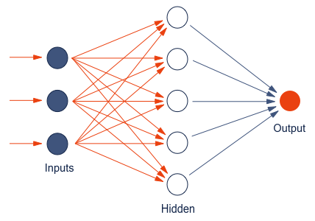
Deep Learning: GCMD Keyword tagger
Version 7.3 is the current version of the data set. Version 3.5 is no longer available and has been superseded by Version 7.3. This data set is currently provided by the OCO (Orbiting Carbon Observatory) Project. In expectation of the OCO-2 launch, the algorithm was developed by the Atmospheric CO2 Observations from Space (ACOS) Task as a preparatory project, using GOSAT TANSO-FTS spectra. After the OCO-2 launch, “ACOS” data are still produced and improved, using approaches applied to the OCO-2 spectra. The “ACOS” data set contains Carbon Dioxide (CO2) column averaged dry air mole fraction for all soundings for which retrieval was attempted. These are the highest-level products made available by the OCO Project, using TANSO-FTS spectral radiances, and algorithm build version 7.3. The GOSAT team at JAXA produces GOSAT TANSO-FTS Level 1B
Word2vec
Classifier
Notes:
word2vec is also a neural network, this result of the word2vec layer is fed into a 2nd neural network

Slide 19

Demo: https://gcmd.nasa-impact.net/

