Slide 1

An Introduction of the WMO Stewardship Maturity Matrix for Climate Data (SMM-CD)
Ge Peng, PhD
North Carolina State University, Cooperative Institute for Climate and Satellites–NC (CICS-NC) at NOAA’s National Centers for Environmental information (NCEI)
ESIP IQC Telecon, November 13, 2018
Based on the presentation at the 46th Meeting of
the Working Group on Information Systems & Services
German Aerospace Center (DLR), Oberpfaffenhofen, Germany
October 22, 2018

Slide 2
WMO & WMO Information System (WIS):
Specialized agency of the United Nations (weather, water, and climate): 191 member countries and territories;
Committed to free exchange of data and products;
Dedicated to ensuring the highest possible quality (data, information, and services) and providing effective access to authoritative, trusted datasets for science, policy and decision-making support.
SMM-CD is developed by the SMM-CD Working Group
Ge Peng (CICS-NC/NCEI, USA), lead;
William Wright (BOM, Australia), co-lead;
Christina Lief (WMO);
Omar Baddour (WMO);
Valentin Aich (GCOS)
under the WMO High-Quality Global Data Management Framework for Climate (HQ-GDMFC), in collaboration with the members of an ad hoc International Expert Group on Climate Data Modernisation (IEG-CDM)
To Help Address Some of the Challenges Facing WMO & WIS
Notes:
WMO has defined the reguirements on open data and data sharing; quality and access of the data products; More and more requirements on those supporting policy and decisions. However, the implementation has been up to individual programs or member countries.
William from Australia Bureau of Meteorology.
William: co-chair of Focus Are of Climate Monitoring, Data and Assessment of WMO Commission for Climatology.
Christina: IEG-CMD lead and Lead of Expert Team of Data Development and Stewardship (ET-DDS) (WMO/CCl);
Omar: Chief, World Climate Data and Monitoring;
Valentin: GCOS scientist; GCOS: Global Climate Observing System
WMO: a specialized agency of the United Nations in the field of weather, water and climate

Slide 3
HQ-GDMFC
Inter-Programme Initiative Led by WMO CCl/CBS (Commission for Climatology/Commission for Basic Systems);
Other Key Sponsors & Stakeholders:
WCRP (World Climate Research Programme);
JCOMM (Joint WMO-IOC Technical Commission for Oceanography and Marine Meteorology);
CHy (WMO Commission for Hydrology);
GCOS (Global Climate Observing System)
Notes:
IOC: Intergovernmental Oceanographic Commission http://www.unesco.org/new/en/natural-sciences/ioc-oceans/high-level-objectives/climate-change/);

Slide 4
HQ-GDFMC
A collaborative Framework that enables an effective development and exchange of high-quality climate data based on reliable underpinning infrastructure at the global, regional, and national levels.
Building blocks
Data Management Standards
Promoting data management standards and best practices for ensuring high quality datasets for use in climate policy and services
Data Maturity Assessment
Analyzing the maturity of the climate data management, identifying gaps, and fixing stewardship issues. SMM-CD: a mechanism for allowing compliance to WMO and internationally agreed stewardship standards
3. Access to High Quality Datasets
Enabling a quick discovery and access of high quality datasets using a federated cataloguing service compatible with the WMO Information System and international search engines
(Courtesy of Omar Baddour)

Slide 5
HQ-GDMFC
High Quality-Global Data Management Framework for Climate
Catalogue
Matrix
Discovery and Access System
Goal: high-quality global climate data source for science, policy, and decision-making support
Goal: consistent maturity information of data management, stewardship, and governance practices
Goal: quick discovery and access of usable, high-quality, and authoritative climate datasets
Notes:
A catalogue (high-quality data source identified by domain experts);
A maturity matrix (high-quality of data management, stewardship and governance by adopting domain standards and best practices);
A system (high-quality of data discovery and access via improved metadata and technology)

Slide 6
HQ-GDMFC
High Quality-Global Data Management Framework for Climate
Catalogue
SMM-CD
Stewardship Maturity Matrix for Climate Data
Discovery and Access System
Goal: high-quality global climate data source for science, policy, and decision-making support
Goal: consistent maturity information of data management, stewardship, and governance practices
Goal: quick discovery and access of usable, high-quality, and authoritative climate datasets
WMO Information System
Guidance: Reference Manual
Discoverable, Accessible, Usable, Authoritative,
High-Quality, and Well-Managed Climate Datasets
Notes:
Reference Manual sets a strong regulatory foundation for consistent definitions, clearly identified data management operations
and guidance on related governance and policies.

Slide 7
HQ-GDMFC
High Quality-Global Data Management Framework for Climate
Catalogue
SMM-CD
Stewardship Maturity Matrix for Climate Data
Discovery and Access System
Goal: high-quality global climate data source for science, policy, and decision-making support
Goal: consistent maturity information of data management, stewardship, and governance practices
Goal: quick discovery and access of usable, high-quality, and authoritative climate datasets
Sub-Group A
IEG-CDM
Sub-Group B
IEG-CDM
Sub-Group C
IEG-CDM
IEG-CDM
International Expert Group on Climate Data Modernisation
The group met at KNMI (Royal Netherlands Meteorological Institute),
16–18 April 2018

Slide 8
HQ-GDMFC
High Quality-Global Data Management Framework for Climate
Catalogue
SMM-CD
Stewardship Maturity Matrix for Climate Data
Discovery and Access System
Goal: high-quality global climate data source for science, policy, and decision-making support
Goal: consistent maturity information of data management, stewardship, and governance practices
Goal: quick discovery and access of usable, high-quality, and authoritative climate datasets
Sub-Group A
Initial Set of 16 Datasets
Sub-Group B
Initial SMM-CD Scope & Draft
Sub-Group C
Key Metadata Requirements
(https://wiswiki.wmo.int/tiki-index.php?page=WWIM-Data-2018-1)
Notes:
Sub-Group A consists of domain SMEs and identified 16 initial datasets: well-established and utilized; also largely based the GCOS effort.
Sub-Group B: Maturity matrix experts, data managers and scientific stewards, defined initial SMM-CD scope and first rough draft of definitions;
Sub-Group C: metadata standards and IT experts; defined key metadata requirements and identified discovery and access bests practices.

Slide 9
HQ-GDMFC
High Quality-Global Data Management Framework for Climate
Catalogue
SMM-CD
Stewardship Maturity Matrix for Climate Data
Discovery and Access System
Goal: high-quality global climate data source for science, policy, and decision-making support
Goal: consistent maturity information of data management, stewardship, and governance practices
Goal: quick discovery and access of usable, high-quality, and authoritative climate datasets
Sub-Group A
IEG-CDM
Sub-Group B
IEG-CDM
Sub-Group C
IEG-CDM
The SMM-CD
Working Group

Slide 10
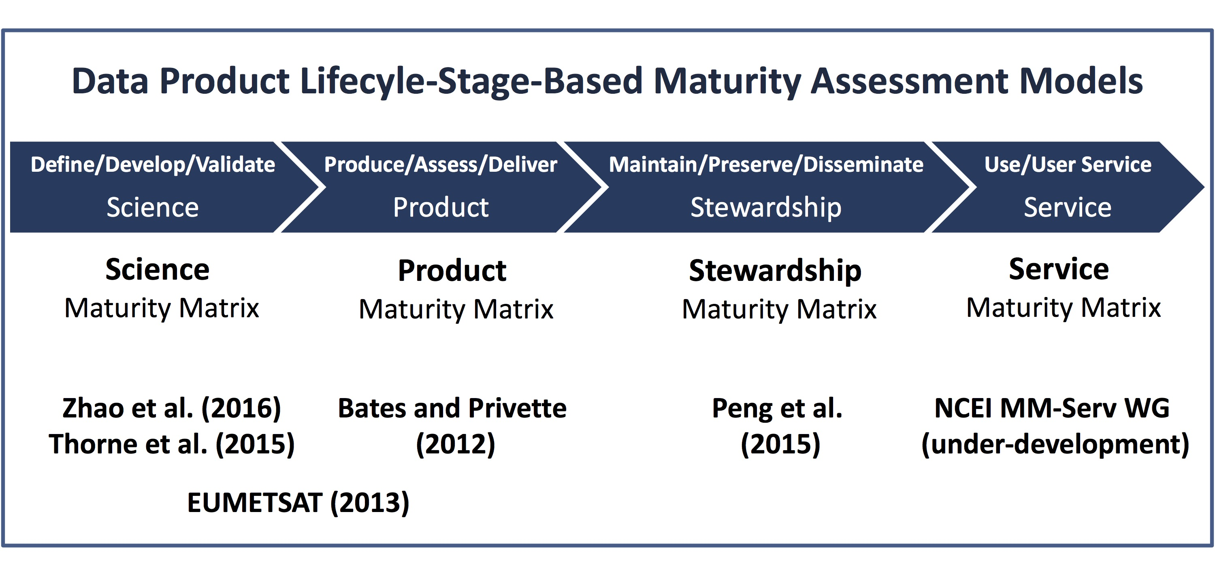
Dataset Quality: Multi-dimensional
Scientifically sound and utilized
Fully documented and transparent
Well-preserved and integrated
Readily obtainable and usable
(Peng 2018, Data Science Journal)
Notes:
At the KNMI team meeting, we have reviewed the current maturity assessment models.
To define a maturity matrix, one has to define its scope first.
The quality of datasets is multi-dimensional, multi-perspective.
For example, shown in this diagram, the quality of datasets is categorized into four dimensions throughout the life cycle of a dataset according to Ramapriyan et al (2017) paper. Correspondingly, we can categorize maturity assessment models according to each dimension.
I will not go into the details of those maturity assessment models, which are described in my review paper published by Data Science Journal.
But to state that the maturity models help us ensure datasets we are managing are …

Slide 11
The Scope of SMM-CD
SMM-CD
DSMM
CORE-CLIMAX PSMM
WGISS DMSMM is one of the references for the SMM-CD
Notes:
The current scope of the matrix are primarily based on NCEI/CICS-NC Data Stewardship Maturity Matrix (DSMM) and CORE-CLIMAX Production System Maturity Matrix (PSMM), plus some additional aspects such as Discoverability and Governance.
WGISS Data Management and Stewardship Maturity Matrix is one of the additional models that we have used as references.

Slide 12
The Structure of SMM-CD
SMM-CD Category
Data Access | Usability & Usage | Quality Management | Data Management
Discoverability | Data Portability | Quality Assurance & Control | Preservation
Accessibility | Documentation | Quality Assessment | Metadata
 | Usage | Uncertainty Analysis | Governance
 |  | Data Integrity
Aspect
The state or ability to locate (Discoverability) and get to the dataset (Accessibility)
How easily the data product may be understood and integrated by users; the usage and impact of the dataset
The state of quality assurance, control, and assessment; data uncertainty and reliability, and data fixation
The state of the dataset preservation, metadata completeness, and governance practices
Notes:
Four categories are agreed on by the SMM-CD Working Group and the members of the expert group.

Slide 13
SMM-CD: Maturity Scale Structure
Level 5: Optimal
Level 4 +
Measured, Controlled, Audited
Open
Managed
Trusted
Level 4: Advanced
Well-Managed; Well-Defined;
Fully Implemented
Level 3: Intermediate
Managed; Defined;
Partially Implemented
Level 2: Minimal
Limit Managed; Not Defined
Level 1: Ad Hoc
Not Managed
Risk
Ad Hoc
Reference Maturity Level Structure
Capability Maturity Model Integration (CMMI)
Levels of Maturity of Digital Repository
Notes:
It is adopted from that of DSMM, which referenced maturity level structure, not the definitions, from CMMI and Level of maturity of digital repository.

Slide 14
SMM-CD: Maturity Level Definitions
Level 5: Optimal
Available on an international catalogue, prominently displayed online, and routinely updated
Level 4: Advanced
Complete set of collection-level discovery metadata;
minimal granule metadata
Level 3: Intermediate
Minimal catalogue-level metadata; Dataset searchable online
Level 2: Minimal
Limited dataset information, such as scientific description of the methodology, in the literature
Level 1: Ad Hoc
By personal contact only; Dataset information not discoverable
Aspect: Discoverability
Category: Data Access
Notes:
I’ll not go through all aspects but a few. Here is for the Discoverability aspect - The state of locating the dataset, under the Data Access Category.
At Level 1: Dataset information not discoverable and users have to know who the right person is to find the data;
At Level 2: Journal articles; technical reports; user guides are available;
At Level 3: It is possible to search datasets online; Compliant with the WMO CORE Metadata Profile at the collection-level;
At Level 4: Complete collection-level standard-based discovery metadata;
At Level 5: Complete granule-level standard-based metadata; data are on an international catalogue and routinely updated.
Collection: refers to a minimum citable unit of data; a grouping of environmental data or products that share common characteristics, is represented by a single metadata record, and consists of one or more granules.
Ganule: the smallest aggregation of data that can be independently managed (described, inventoried, and retrieved)

Slide 15
SMM-CD: Maturity Level Definitions
Level 5: Optimal
Level 4 + Online tutorial on using and analysing the dataset; Complete production system information available online
Level 4: Advanced
Full documentation based on a standard template
and available online
Level 3: Intermediate
Document on how the data product was created and how to use it
is available online
Level 2: Minimal
Limited online documentation (e.g., User Guide)
Level 1: Ad Hoc
Product information not publicly available online
Aspect: Documentation
Category: Usability and Usage
Notes:
Notes on Level 1: Documents, such as Readme or user guide could exist but not publicly availabe but one has to know the right person to obtain them;
Level 2: Just basic information for users to know what variables in the file are and how to read data ;
Level 3: Including additional product information such as input data sources and processing steps;
Level 4: Compliant to WMO documentation requirements on transparency and traceability;
At this level, documents should be under document management (e.g., assigned a unique ID and version controlled);
Level 5: Enough information including provenance for users to reproduce the data product

Slide 16
SMM-CD: Maturity Level Definitions
Level 5: Optimal
Full uncertainty assessment published
in peer-reviewed journal
Level 4: Advanced
Full uncertainty budget available with all assumptions; Estimates of accuracy of trend available
Level 3: Intermediate
Uncertainty estimates presented with partial explanation
Level 2: Minimal
Uncertainty estimates presented without explanation
Level 1: Ad Hoc
Uncertainty estimates not available
Aspect: Uncertainty Analysis
Category: Quality Management
Notes:
Uncertainty Analysis Aspect is particularly controversial on if it should be included in the SMM-CD and may be potentially challenging in assessment.
Notes for Level 1: Either uncertainty analysis has not yet been done or results are not available publicly;
Level 2: e.g. +/- x% without further explanation; Level 3: Some of the underlying assumptions and the method used e.g. “error propagation”

Slide 17
SMM-CD: Maturity Level Definitions
Level 5: Optimal
Level 4 + Archiving process performance controlled, measured, and audited;
Future archiving standard changes planned
Level 4: Advanced
Level 3 + Conforming to community archiving standards. Comprehensive retention policy defined and implemented
Level 3: Intermediate
Designated archive; Basic retention policy publicly defined;
Routine backups made, including offsite copy
Level 2: Minimal
Non-designated repository; Backup copy of electronic data is made
Level 1: Ad Hoc
Any storage location; Data only; Data not backed up
Aspect: Preservation
Category: Data Management
Notes:
The state of being preserved

Slide 18
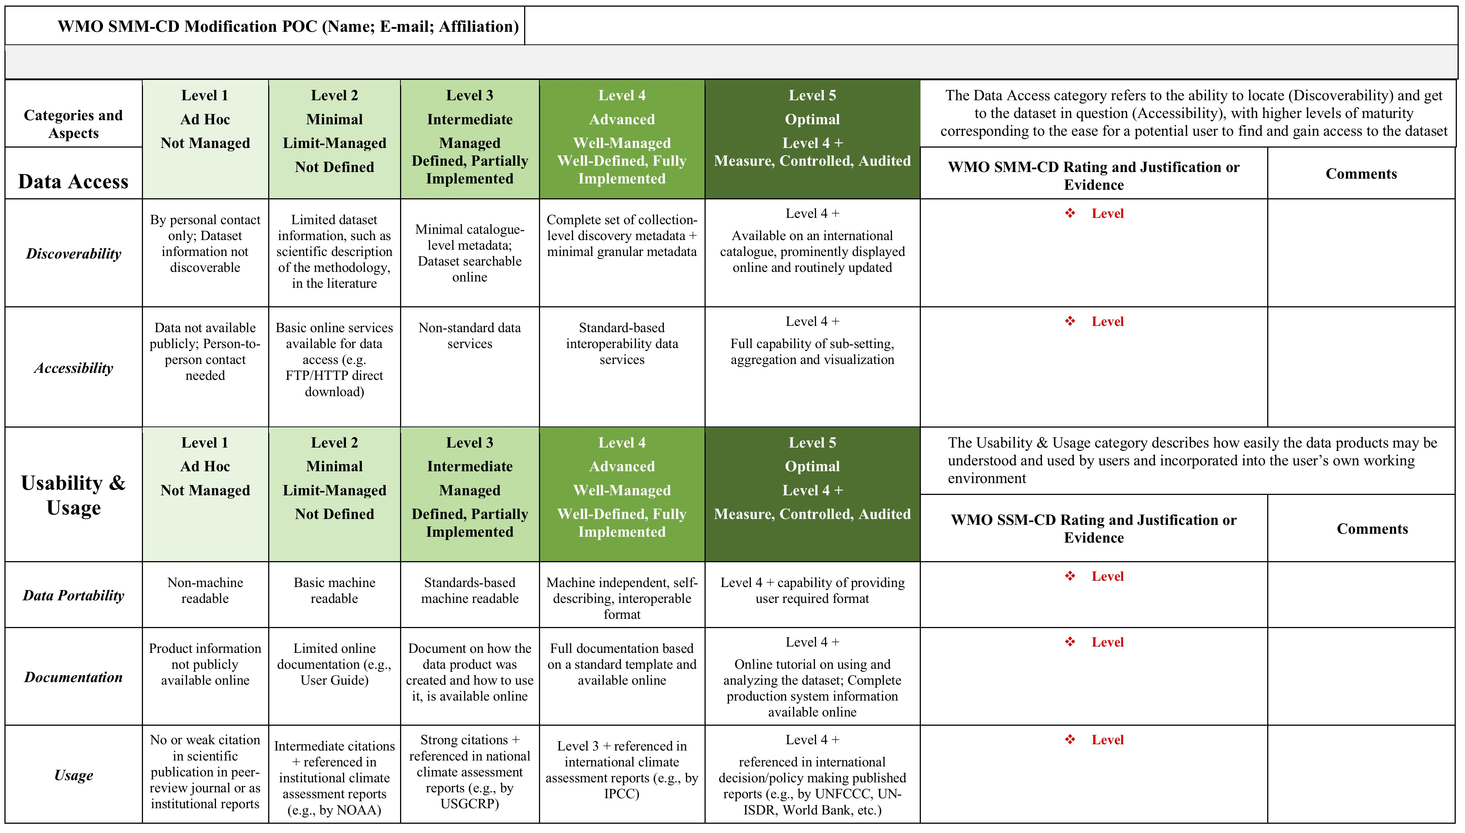
Outcomes
A Matrix and A Guidance Booklet
Internal IEG-CDM team review
External community-wide reviews:
Invited international domain experts (science, data management, and stewardship);
GCOS secretariat;
ESIP (Earth Science Information Partner) community – a working session at the ESIP 2018 summer meeting in July
An Evaluation Template
Notes:
We started with one matrix but ended up with three documents.

Slide 19
Current Status
SMM-CD documents have been baselined;
Use case of 16 global datasets identified by IEG-CDM Sub-Group A is underway (Two more added)
(Datasets: http://www.wmo.int/pages/prog/wcp/ccl/opace/opace1/meetings/documents/DraftMeetingReport.pdf)
Five Sixteen assessments completed;
A couple Two more near completion.
Notes:
All three documents have been baselined.
The road-test of 16 global datasets identified by the sub-group A is underway.

Slide 20
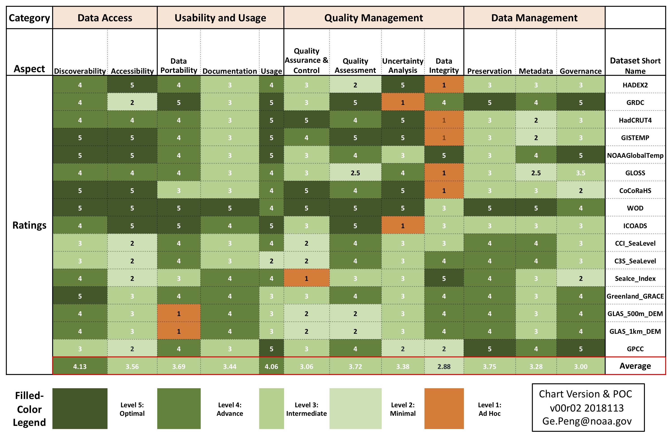
A Preliminary Summary of SMM-CD Ratings (as of 11/13/2018)

Slide 21

The latest unofficial version of three SMM-CD documents are available at Figshare.com.
The short URLs:
Matrix: bit.ly/SMM-CD
Guidance Booklet: bit.ly/SMM-CD-Manual
Template: bit.ly/SMM-CD-Template

Slide 22
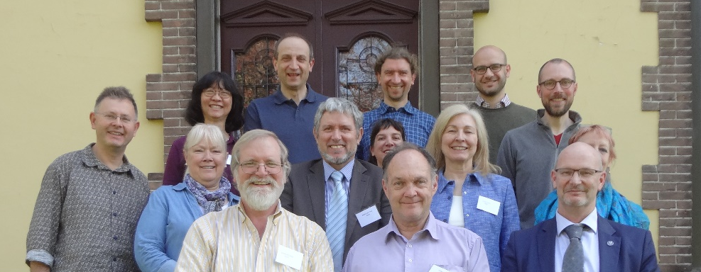
Acknowledgement
The members of IEG-CDM (in alphabetical order)
AICH, Valentin (GCOS)
BADDOUR, Omar (WMO)
BERGERON, Cedric (ECMWF)
BEROD, Dominique (WMO)
BUSSELBERG, Thorsten (DWD)
CAZENAVE, Anny (LEGOS)
DUNN, Robert (Met Office/Hadley Center)
GALLAHER, David (NSIDC)
GATES, Lydia (DWD)
LIEF, Christina (WMO, lead)
MILAN, Anna (NOAA/NCEI)
PENG, Ge (NCSU/CICS-NC, NOAA/NCEI)
ROBERTS, Kate (BOM)
SIEGMUND, Peter (KNMI)
VERVER, Ge (KNMI)
WRIGHT, William (BOM)
ZIESE, Markus (DWD)
Notes:
Hope that has provided you all with some basic description of the WMO SMM-CD. I’d now like to acknowledge …

Slide 23
Acknowledgement
Discussions with and feedback from the following domain SMEs are beneficial:
Iolanda Maggio, Peter Thorne, Simon Eggleston, Darren Ghent, Jörg Schulz, Nancy Ritchey, Kenneth Kehoe, Imke Durre, Carolin Richter, Ruth Duerr
Special THANKS to
Christina Lief, William Wright, Omar Baddour, and Valentin Aich;
Management of NCEI’s Center for Weather and Climate;
Management of CICS-NC;
NCEI Communication Team for copyediting the slides
Notes:
Discussions and feedback from many domain SMEs, especially those that I have listed here.
I’d like to give special thanks to …

Slide 24
References
CORE-CLIMAX Production System Maturity Matrix (PSMM):
EUMETSAT 2013 CORE-CLIMAX Climate Data Record Assessment Instruction Manual. Version 2, 25 November 2013.
NCEI/CICS-NC Scientific Data Stewardship Maturity Matrix (DSMM):
Peng, G, Privette, JL, Kearns, EJ, Ritchey, NA, and Ansari, A 2015 A unified framework for measuring stewardship practices applied to digital environmental datasets. Data Science Journal, 13. doi:10.2481/dsj.14-049.

Slide 25
An EGU 2019 Session
For science data centers and repositories:
Establishing trustworthiness and fitness for purpose, i.e., suitability, at the level of individual data products and services
For end-users:
Finding content-rich, interoperable, and accessible quality descriptive information
Call for approaches, frameworks, workflows, best practices, tools, etc., that are under development or being implemented towards:
systematically evaluating quality attributes of individual data products and services,
automatically generating content-rich quality descriptive information that is interoperable and discoverable.
https://meetingorganizer.copernicus.org/EGU2019/session/30950
Notes:
Doing so in a scalable fashion is a biggest challenge. It requires close collaborations of everybody: scientists, data producers, data stewards, and technology stewards, to tie the knowledge, standards, and efficiency together. Of cause it can not be accomplished with management support. And We got EVERYONE here!
If you have approaches, frameworks, workflows, best practices, tools, etc., that are under development or being implemented towards systematically evaluating quality attributes of individual data products and services, and automatically generating content-rich quality descriptive information that is interoperable and discoverable

Slide 26
Thank you!
Any Comments or Suggestions?
Ge.Peng@noaa.gov
Notes:
Thanks you very much for your time and Iolanda for inviting me.
If no more question: if you have any addition questions or suggestions or would like to get any additional information on SMM-CD
or maturity model in general, please feel free to contact me at

Slide 27
Backup Slides

Slide 28

Data Maturity Assessment Models
Why do we need them?
WMO Resolution 40 (Cg-XII)
WMO commits itself to broadening and enhancing the free and unrestricted international exchange of meteorological and related data and products
WMO Quality Management Framework
WMO, through its Programmes and activities, is dedicated to ensuring the highest possible quality of all meteorological, climatological, hydrological, marine and related environmental data, products and services
(https://public.wmo.int/en//our-mandate/how-we-do-it/Quality-Management-Framework)
WIS Objective for Global Climate Data Access
Authoritative, trusted data sets for informing on key climate indicators for global policy users of climate change information
Notes:
Why do we need data maturity assessment models? Why are they beneficial?
WMO is committed to free exchange of data and products;
WMO has dedicated to ensuring the high quality of data, products, and services.
The WMO Information System (WIS) objective for global climate data access is to provide authoritative, trusted datasets
WMO data and products support high influential scientific findings. These findings support policy decisions with significant societal impact. These data and products are required to be, not only scientific sound, but also traceable and transparent to ensure their trustworthiness. Therefore, we need to demonstrate to our users that our data, products and services are in fact high quality. But how? If not, how to improve?

Slide 29
Data Maturity Assessment Models
Why do we need them?
WMO Requirements and Commitments
Open Data & Data Sharing
High-Quality and Trusted Data
WMO management: Do WMO data, products, and services meet these commitments?
Data producers/providers: What do they mean? How do I know? What to do to be compliant?
Notes:
So WMO has made the commitments. How does WMO management know?
Data producers or providers: what do these mean? How do I know if I am compliant not? If not, what do I need to do?
WMO data and products support high influential scientific findings. These findings support policy decisions with significant societal impact. These data and products are required to be, not only scientific sound, but also traceable and transparent to ensure their trustworthiness. Therefore, we need to demonstrate to our users that our data, products and services are in fact high quality. But how? If not, how to improve?

Slide 30
Support Compliance Verification and Reporting – Consistent and quantitative measures.
Data Maturity Assessment Models
Why are they beneficial?
Provide Guidance – Progressive, incremental improvement utilizing cross-disciplinary best practices.
Provide Structure – Necessary for systematic implementation and integration.
Allow for Tiered Quality Requirements – ECVs vs non-ECVs. GCOS vs non-GCOS variables and stations. Core vs non-core production systems.
Manage Data Stewardship Activity – Knowing where you are, where you need to go, and how to get there.
Notes:
Here are some of the benefits of maturity models
So you will say, that’s great and let’s have a MM for measuring dataset maturity and be done with it!
Unfortunately, there are big challenges for developing and implementing a MM.
ECVs – Essential Climate Variables (air temperature, precipitation, atmospheric motion (i.e. winds), air pressure, humidity and solar radiation)
GCOS – Global Climate Observing Systems.

Slide 31
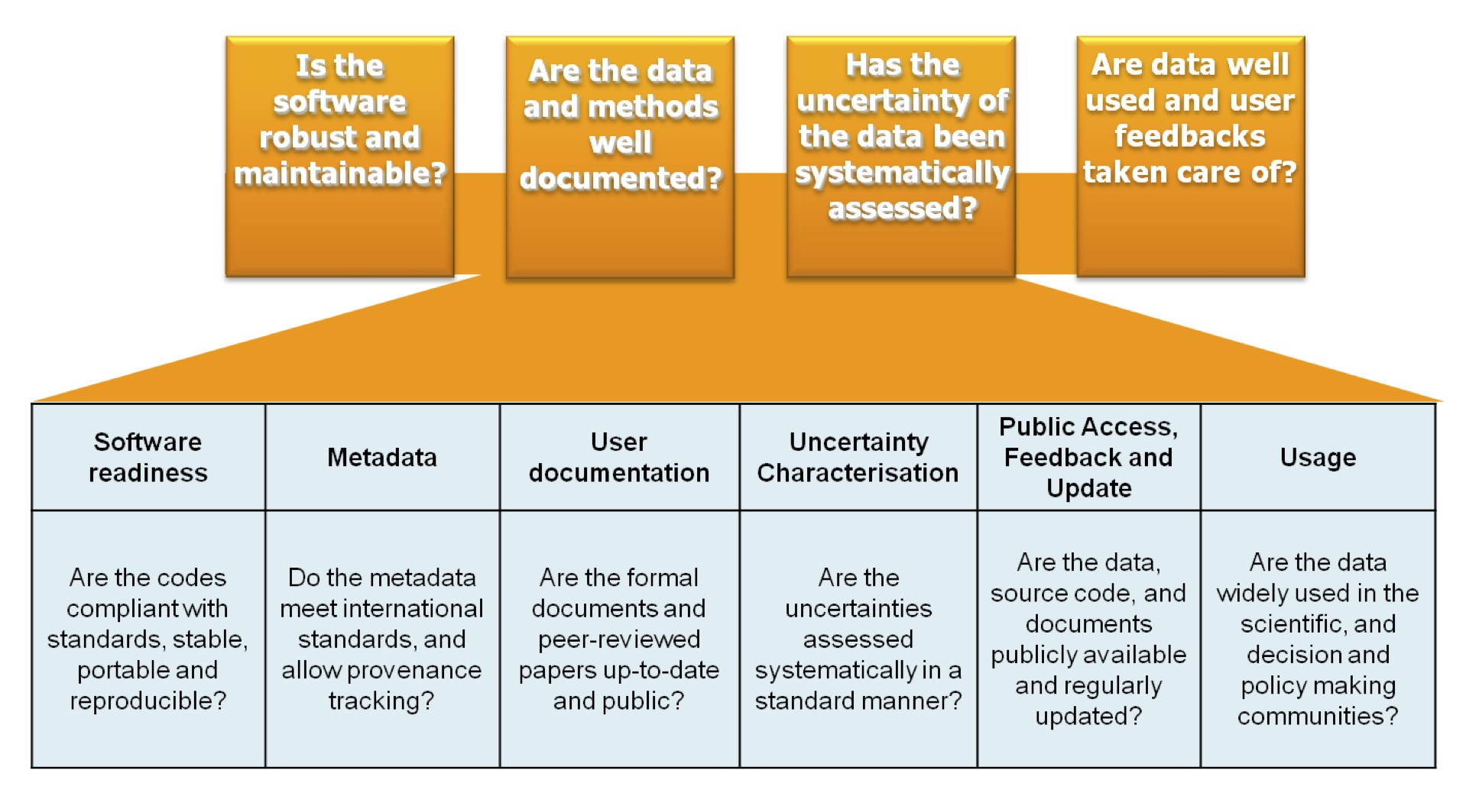
CORE-CLIMAX Production System MM
(Six Key Areas)
(EUMETSAT 2015, Core-Climax Deliverable D2.25)

Slide 32
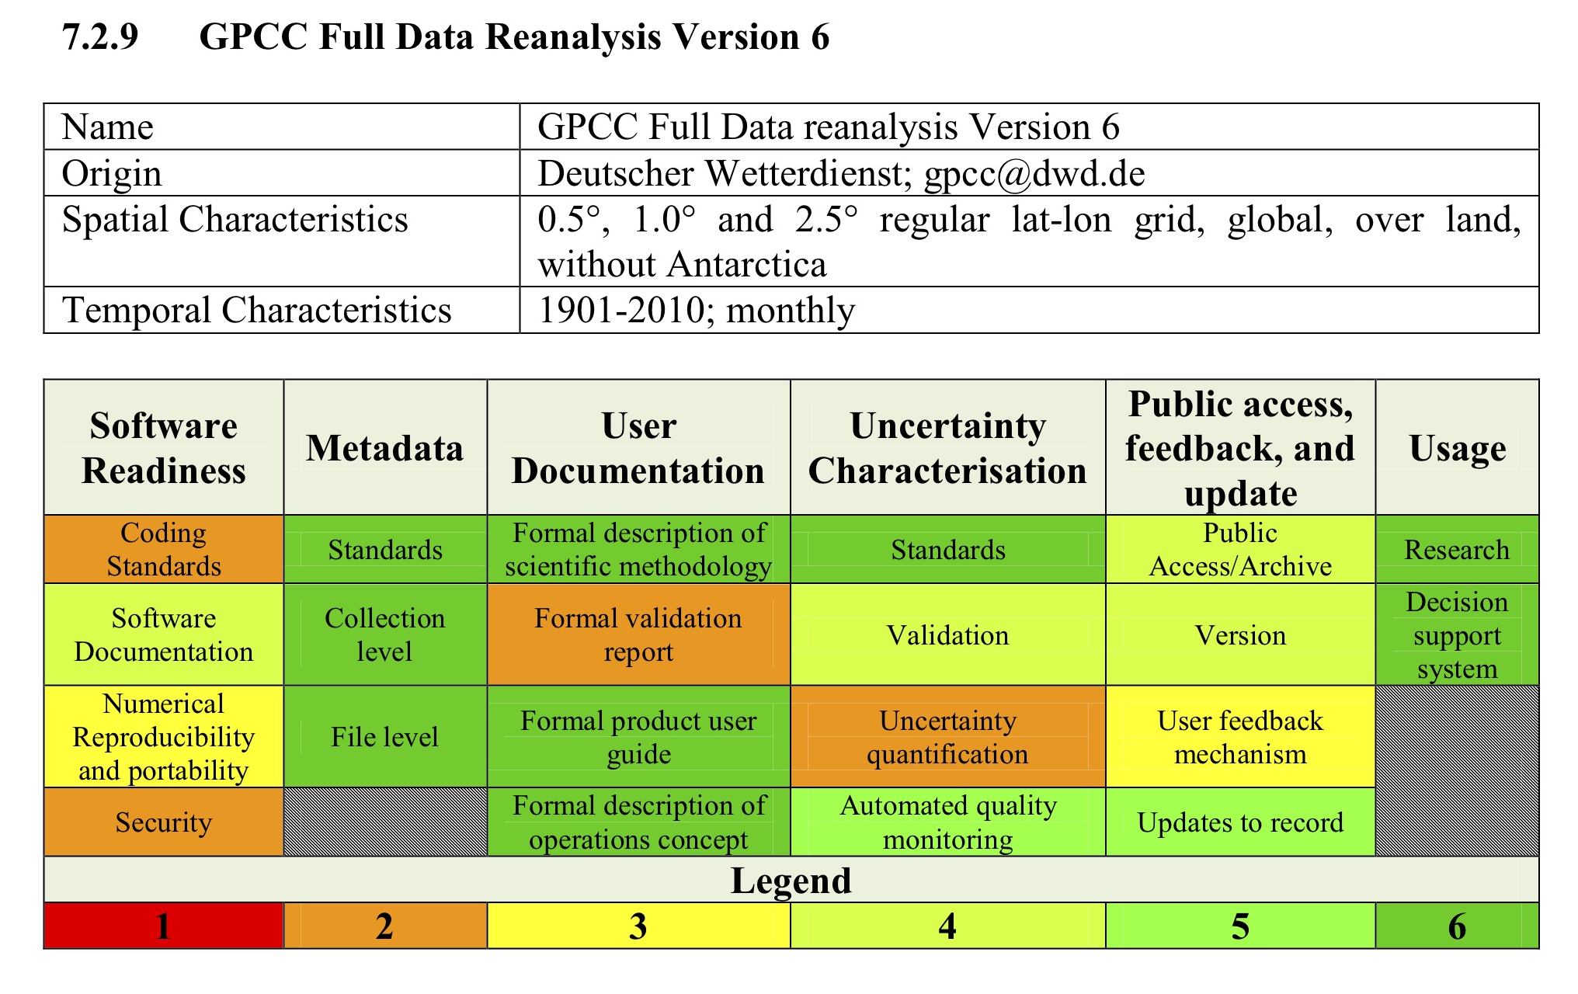
CORE-CLIMAX Production System MM
(EUMETSAT 2015, Core-Climax Deliverable D2.25)

Slide 33
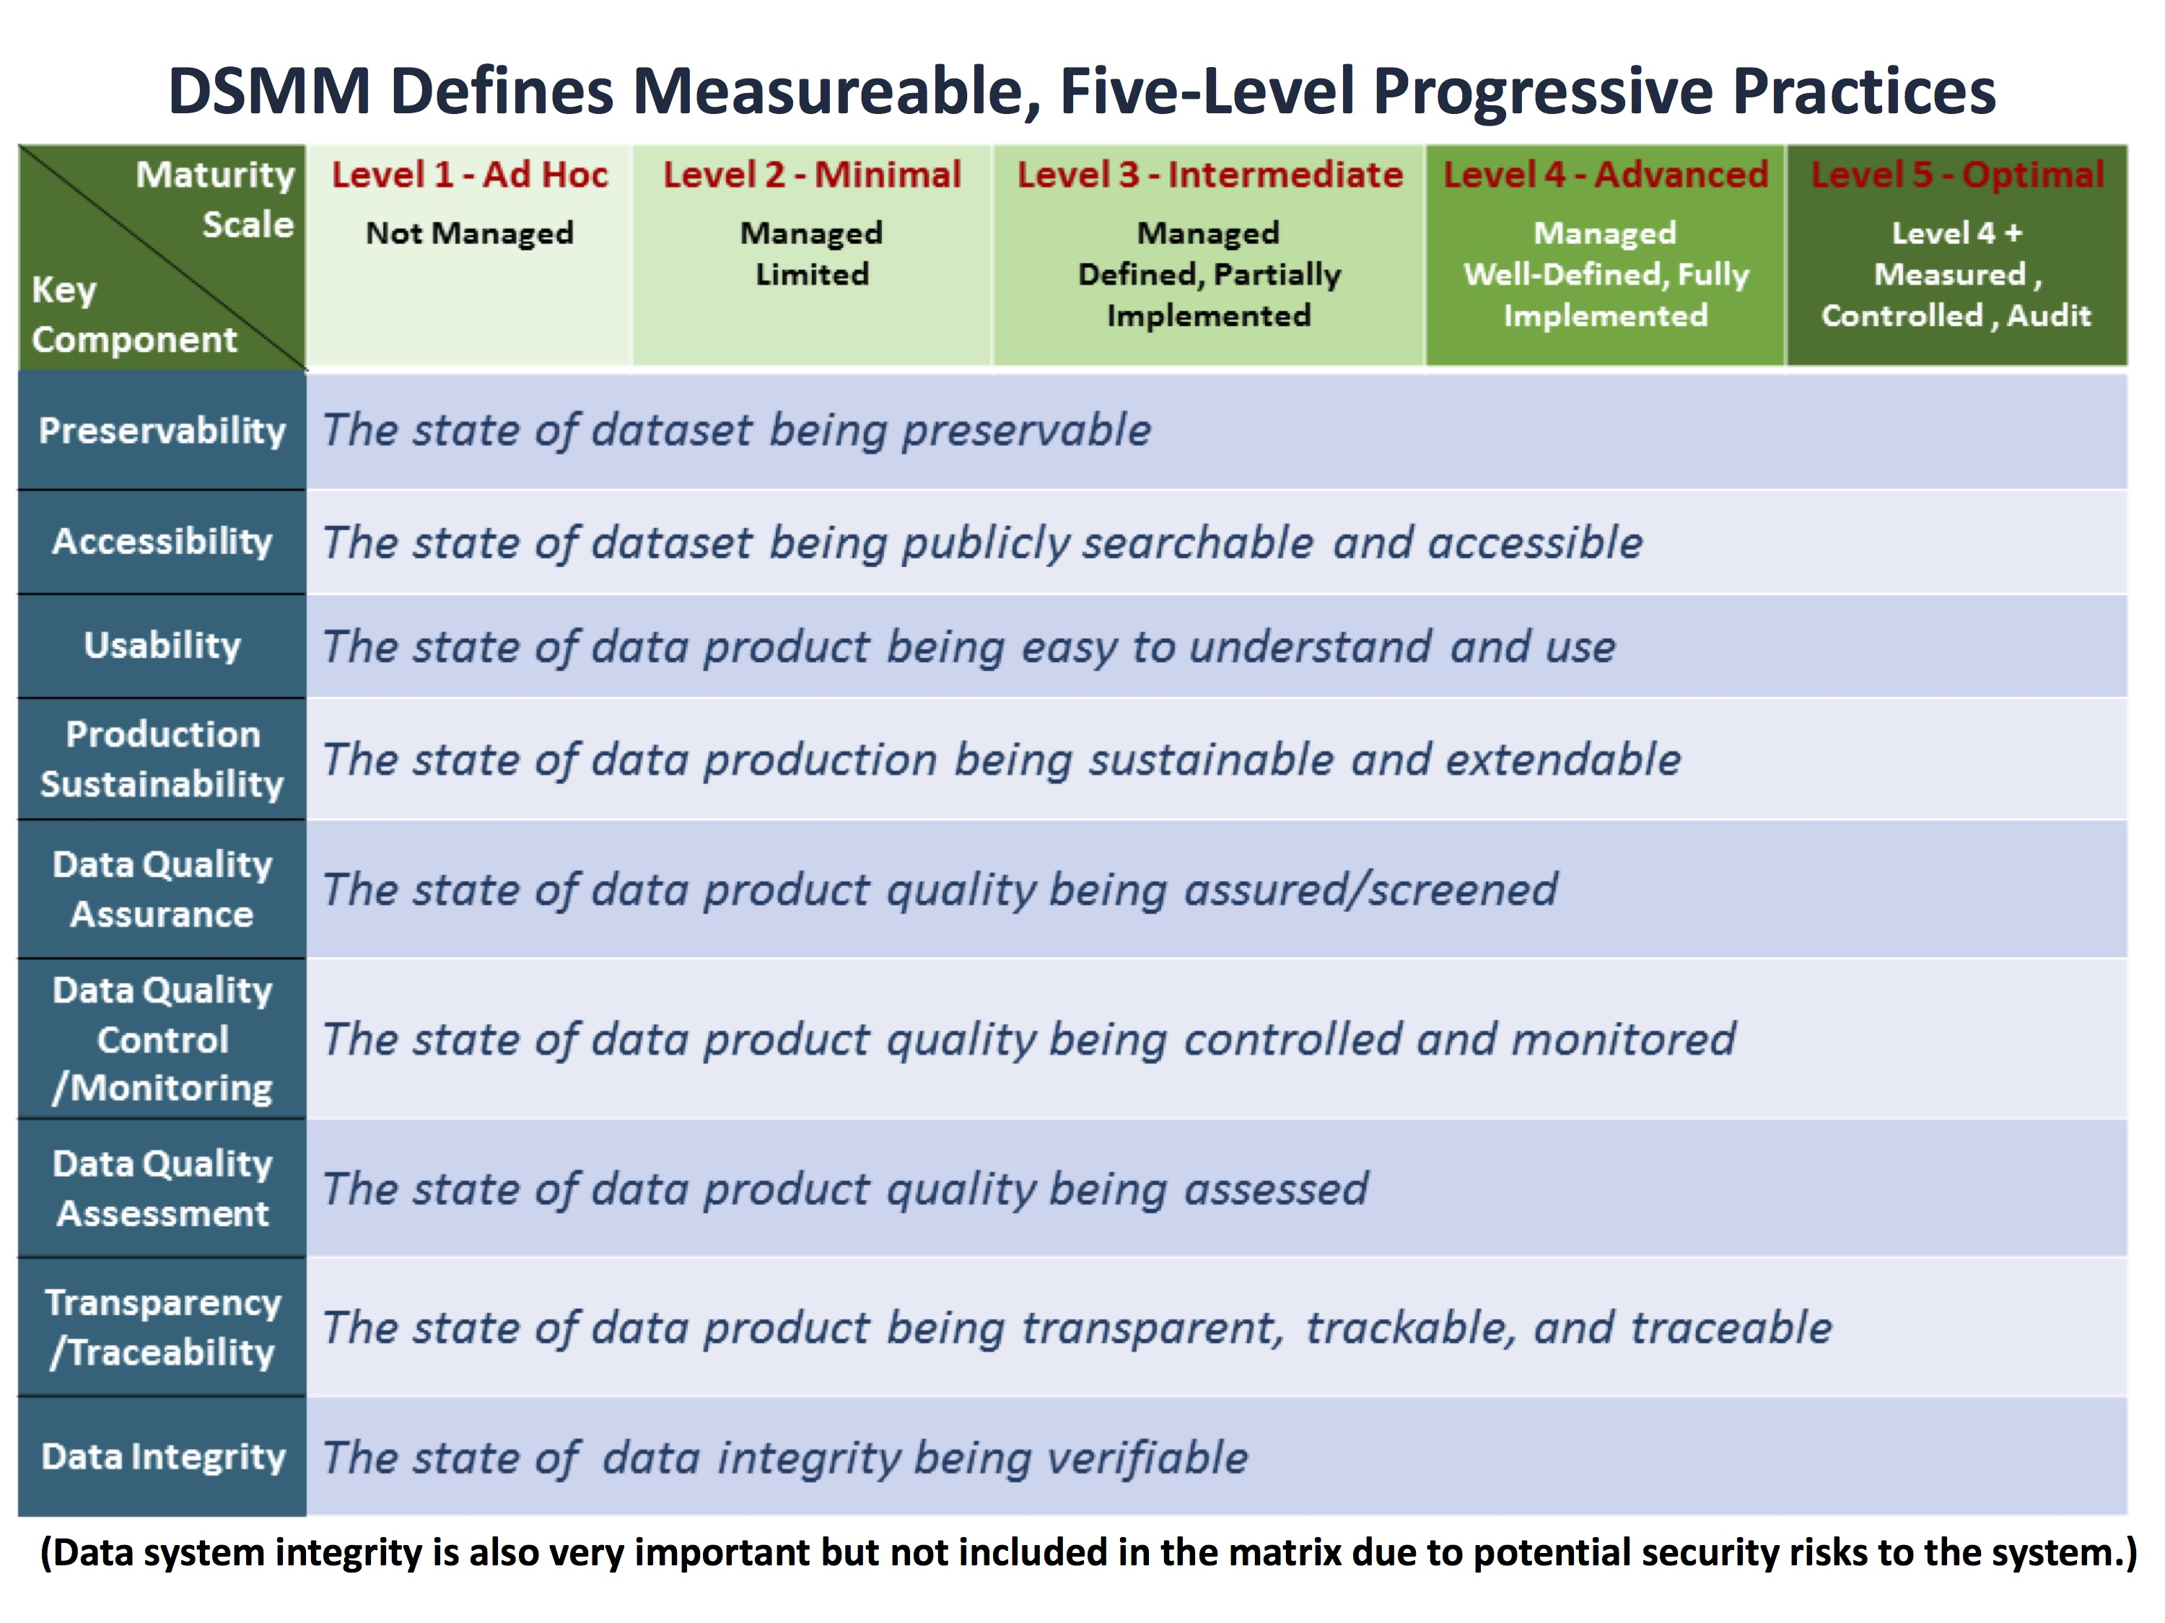
NCEI/CICS-NC Data Stewardship MM (DSMM)
[Nine Key Components within Functional Entities of
the Open Archival Information System (OAIS) RM]
(Getting to know DSMM: tinyurl.com/DSMM-FlowChart)

Slide 34
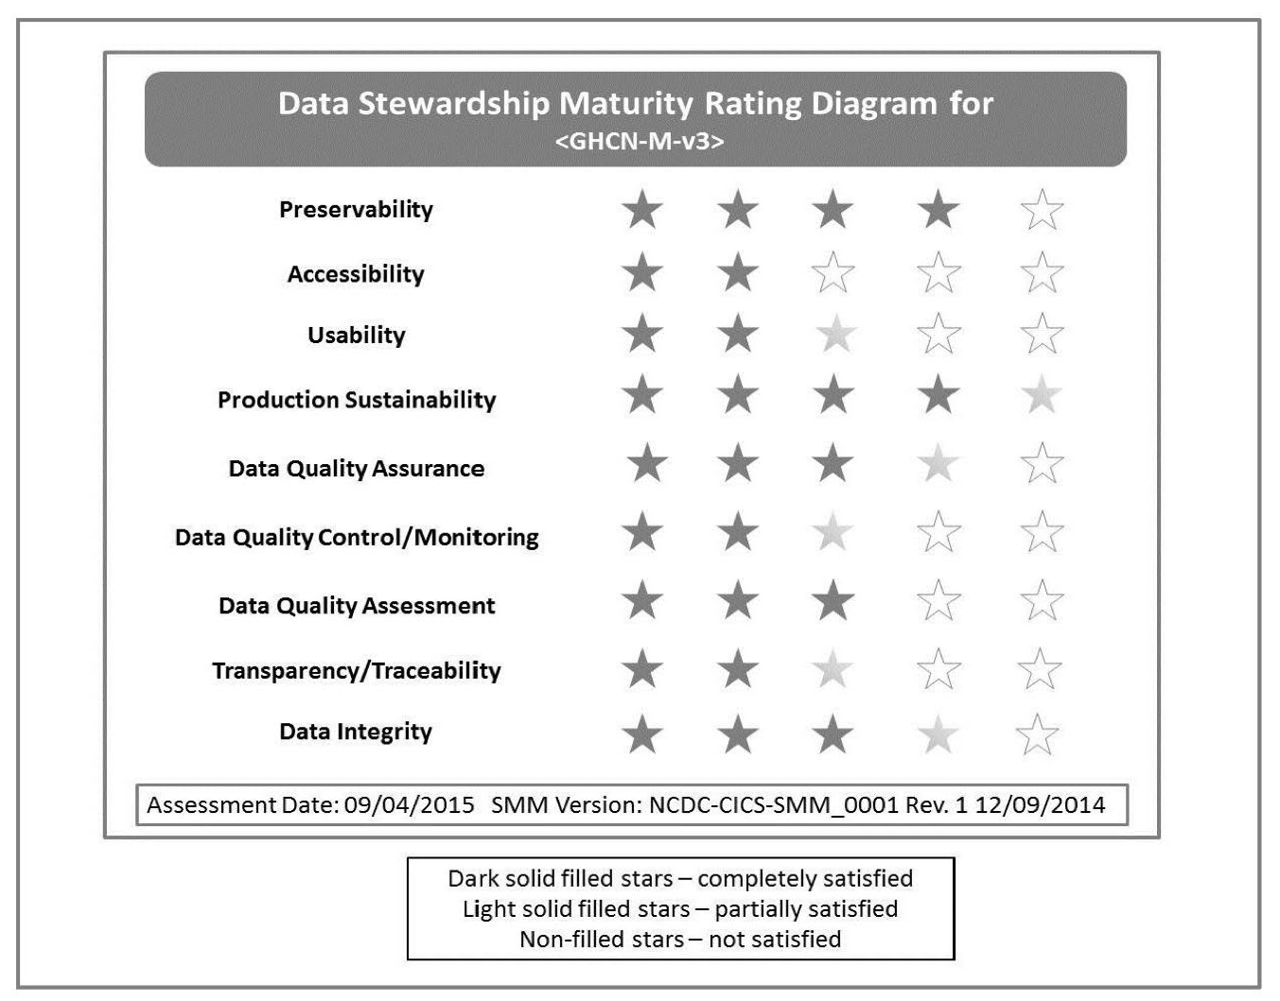
MM-Stew Rating Diagram of GHCN-Monthly v3
Notes:
GHCN - Global Historical Climatology Network

Slide 35
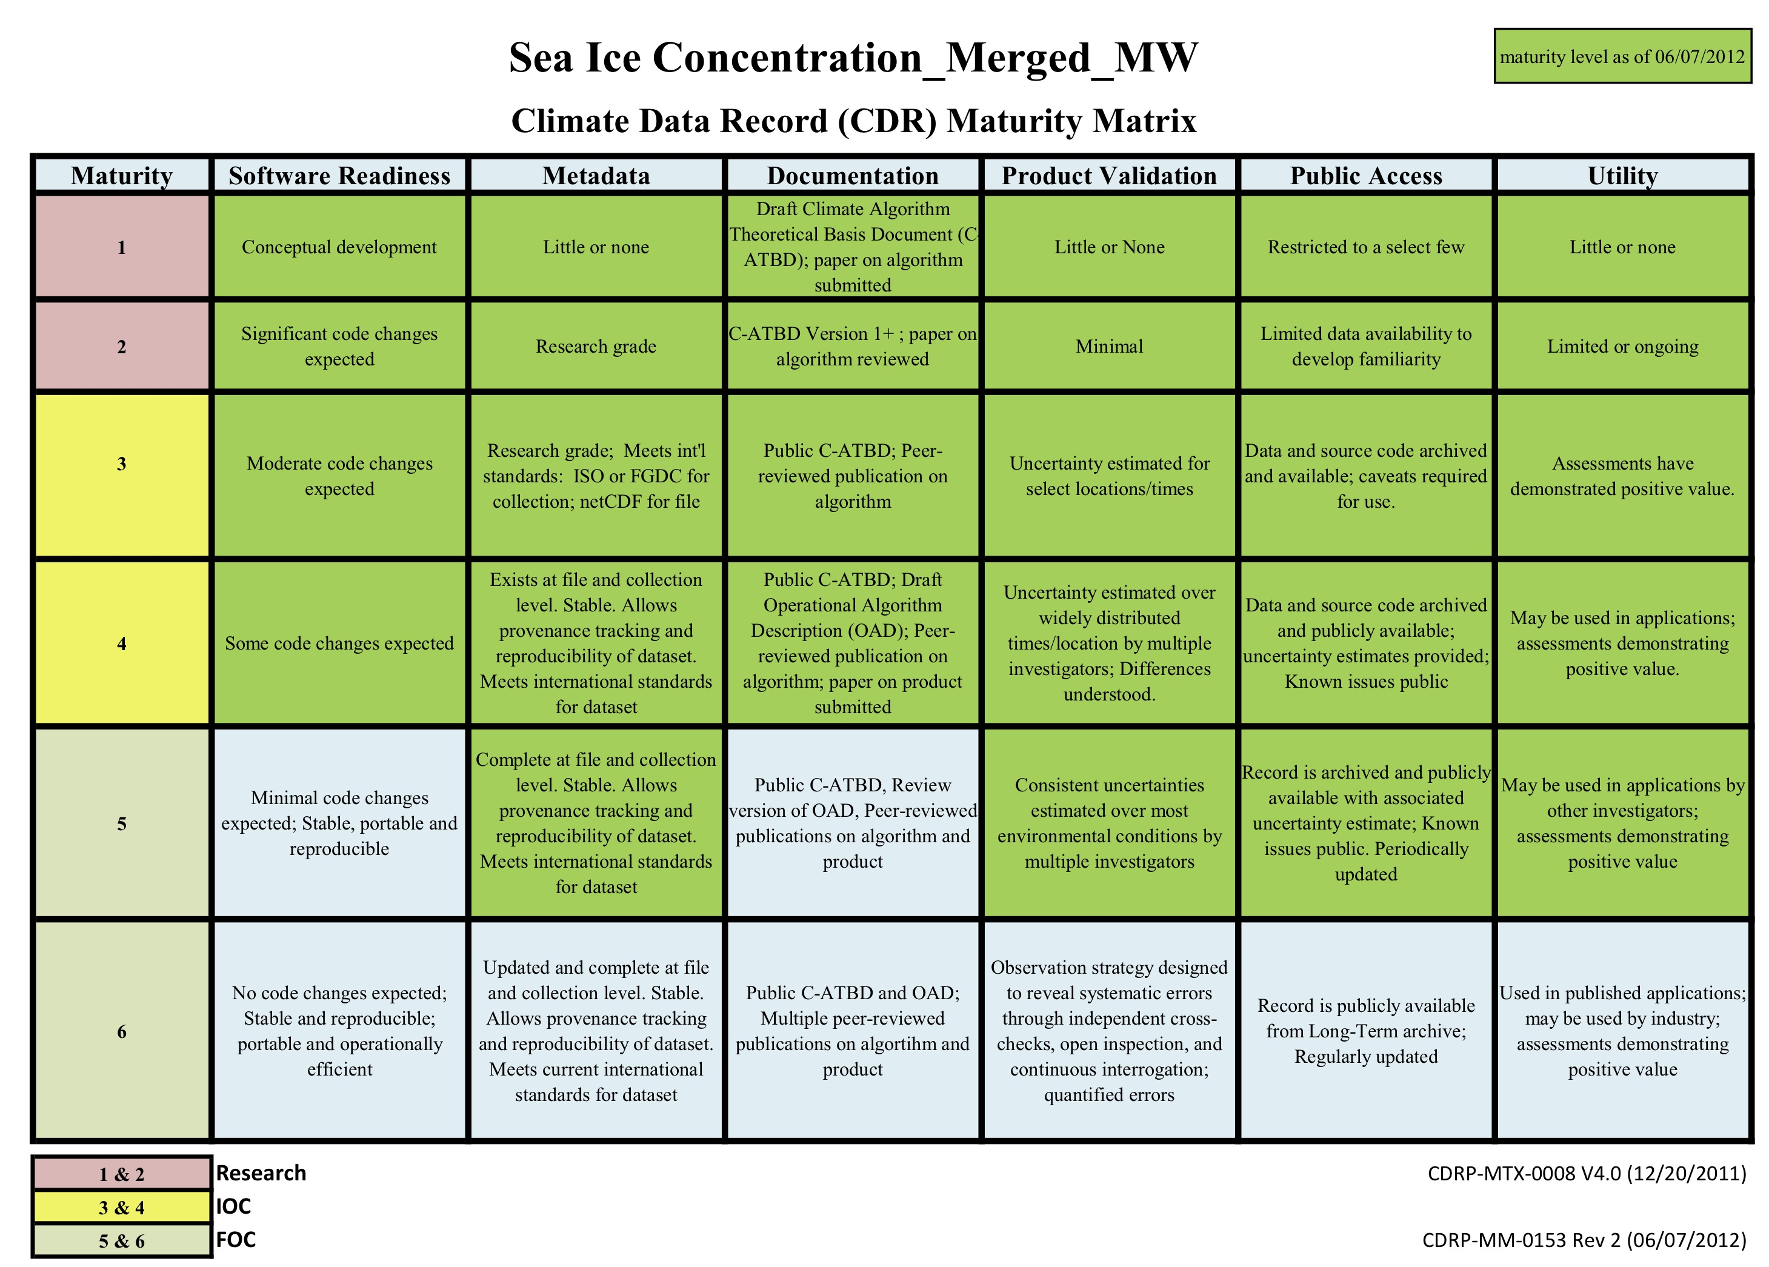
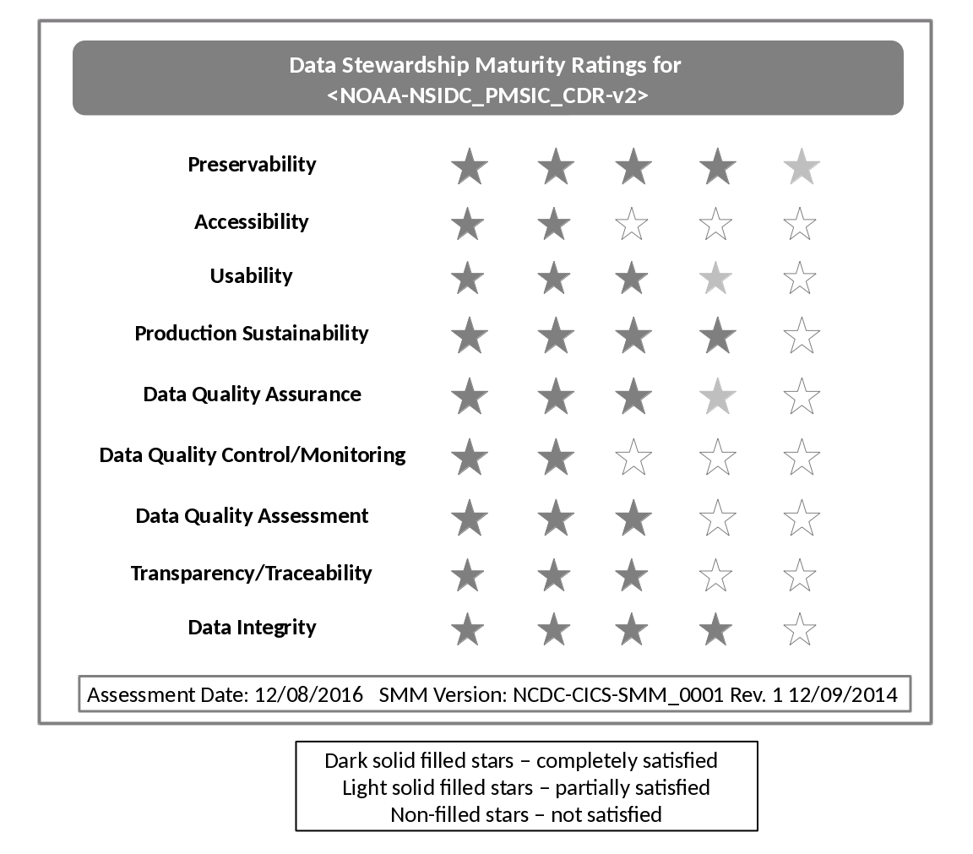
Maturity Ratings of Sea Ice Concentration CDR v2
MM-Stew (DSMM)
CDR MM-Prod
35

Slide 36
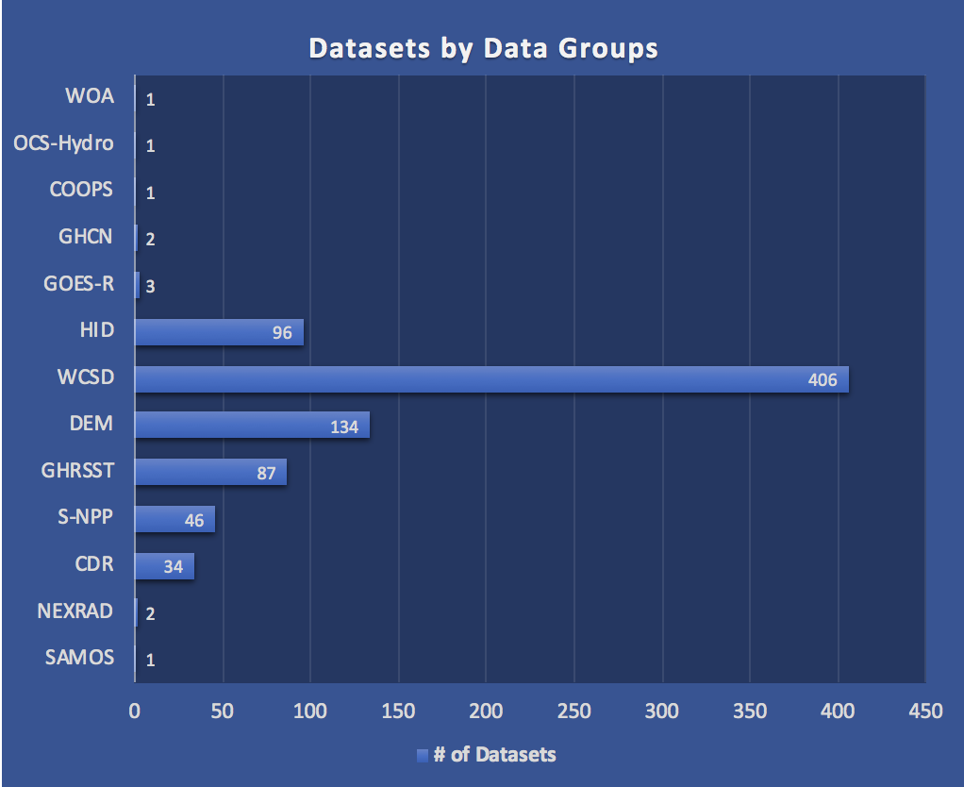
NOAA OneStop Application of the DSMM
NOAA datasets by data groups whose stewardship maturity has been assessed as of 6/30/2018 (Peng et al. 2018: submitted to Data Science Journal; Preprint available at: https://osf.io/fp3js/)
Notes:
GHCN - Global Historical Climatology Network

