Slide 1





The Challenge of Location and How Discrete Global Grid Systems can enable Spatial Data Integration
Dr Matthew B. J. Purss – Geoscience Australia

Slide 2



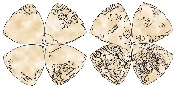



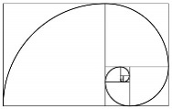

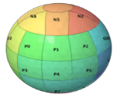






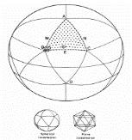

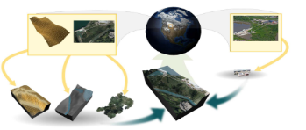
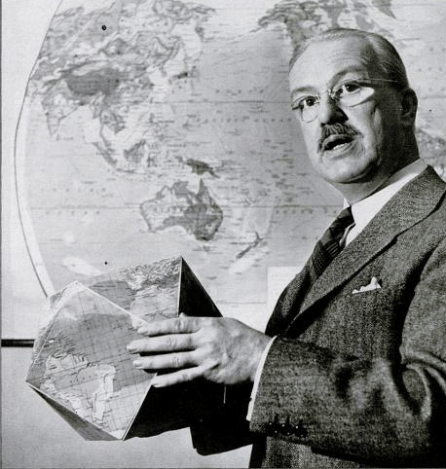

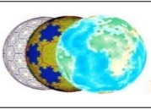
A Condensed History of DGGS
From the Golden Ratio towards widespread
use of DGGS…
Level of Interest and Activity in DGGS
1500’s
1940’s
1950’s
1980’s
1990’s
2000’s
Today

Slide 3





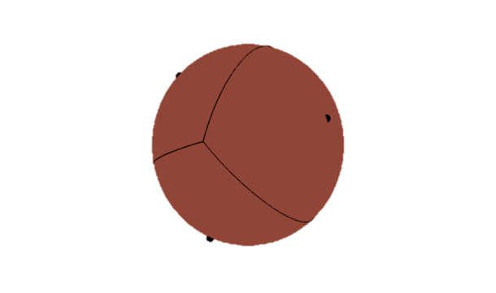
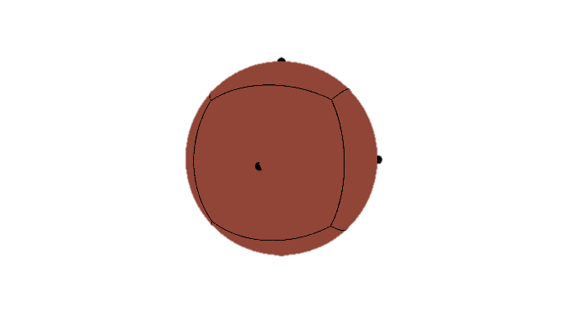
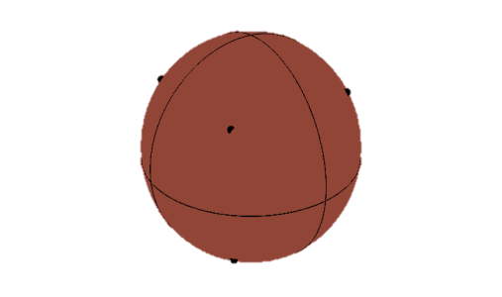
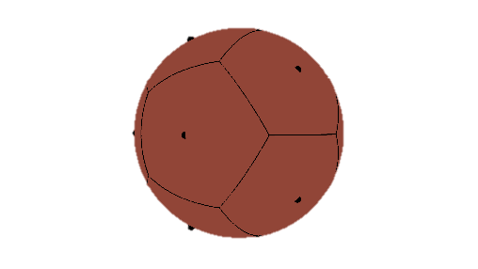
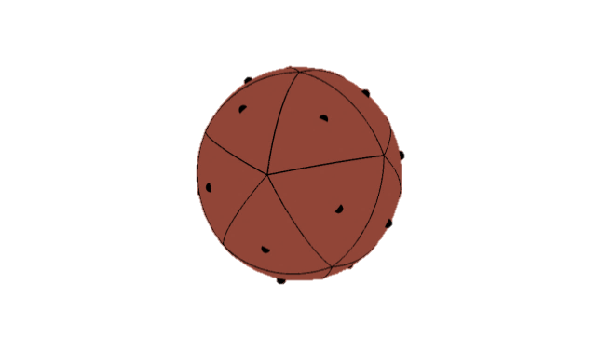

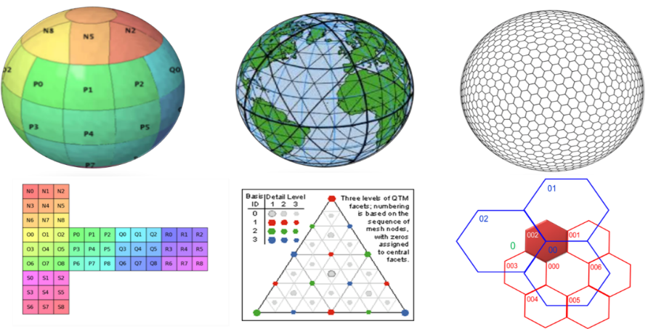
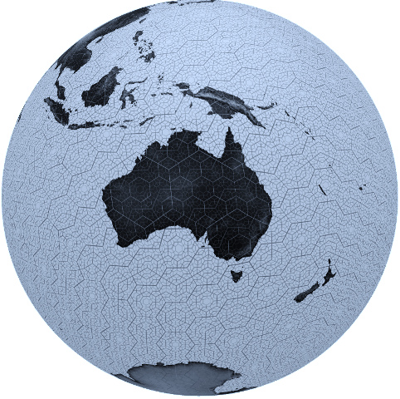
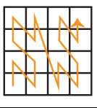
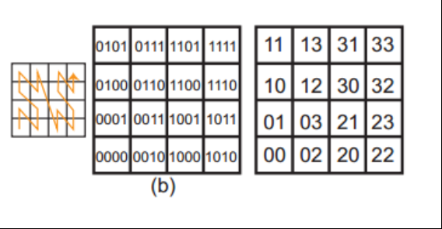
Brief overview of DGGS technologies
Equal Area
Tessellations
of the
Earth
Tetrahedron
Cube
Octahedron
Dodecahedron
Icosahedron
Fixed Cell Hierarchy
Simple cell
Types:
Rectangular
Triangular
Hexagonal
Massively Scalable
nD Spatial Analyses
↓
1D Array Processes
Globally Unique Cell Indices
00 | 01 | 02 | 03 | 10 | 11 | 12 | 13 | 20 | 21 | 22 | 23 | 30 | 31 | 32 | 33

Slide 4


DGGS and the Raster/Vector Divide
How should we define a road?
Is it a vector?
Or…
Is it a coverage?

Slide 5


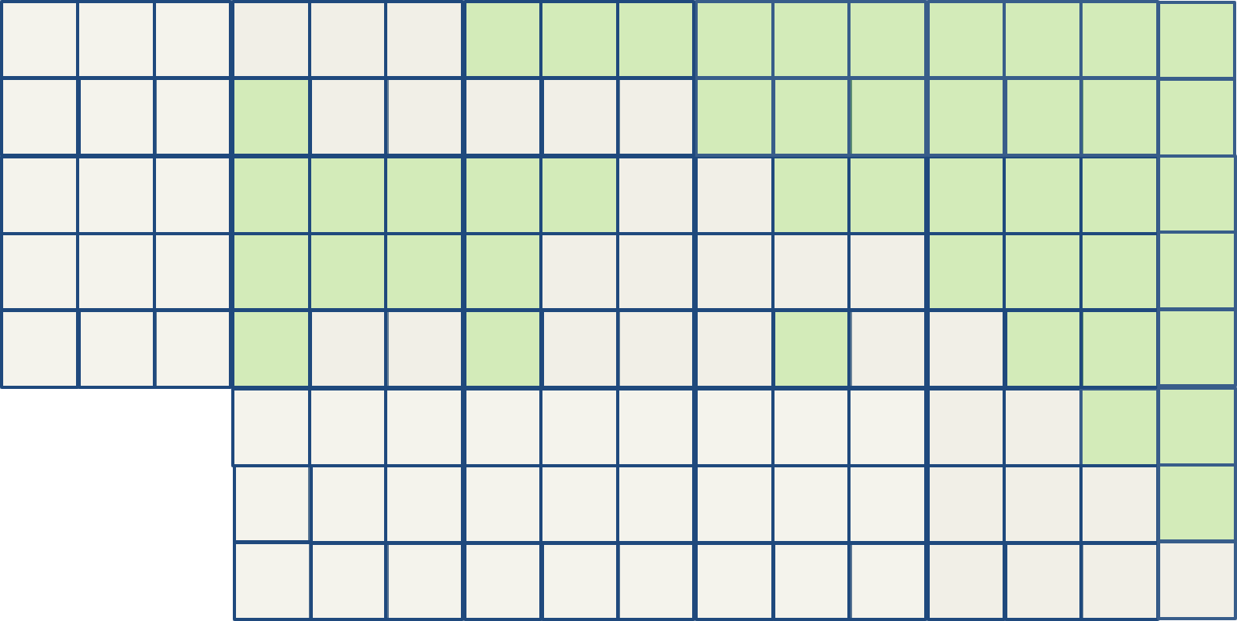
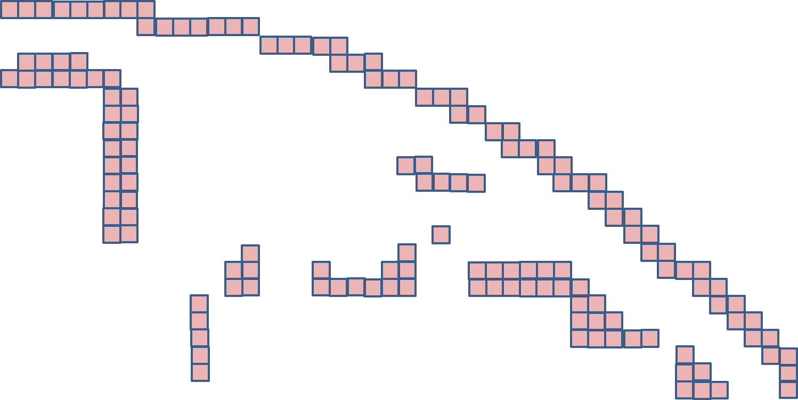

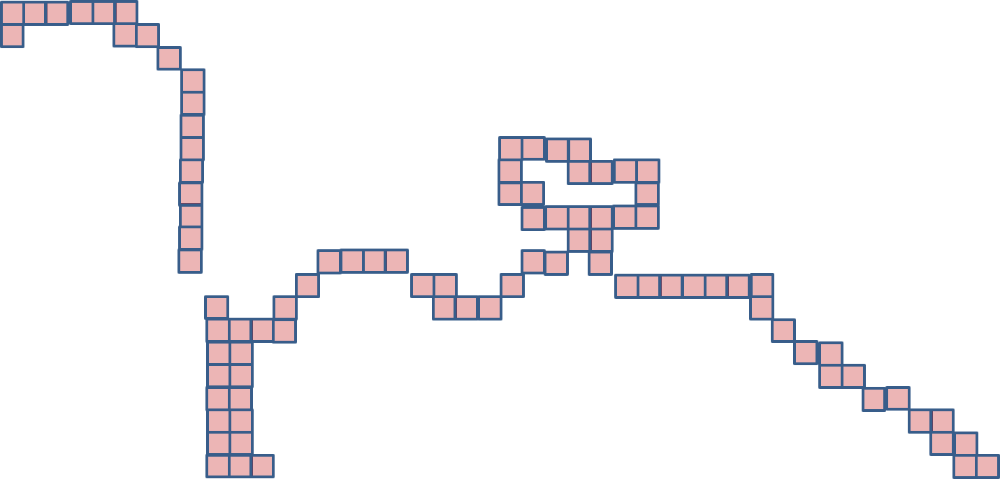
DGGS Bridge the Vector/Raster Divide
FeatureID: 61
FeatureType: Lake
FeatureName: Lake Burley Griffin
FeatureID: 11
FeatureType: Road
FeatureName: Parks Way
Red: Road
Blue: Lake
Vector world
Raster world
DGGS world
FeatureID: 11
FeatureType: Road
FeatureName: Parks Way
FeatureID: 61
FeatureType: Lake
FeatureName: Lake Burley Griffin

Slide 6
DGGS Spatial Enablement Options
Tightly Coupled
Data Cells
Each observation sampled to an individual DGGS Cell
Data Tiles
Observations aggregated and “clipped” to an individual DGGS Cell
Loosely Coupled
Tags
Coordinates
DGGS Cell IDs are “tagged” to observations/features
Each coordinate tuple of an observation/feature is mapped to a DGGS Cell ID

Slide 7
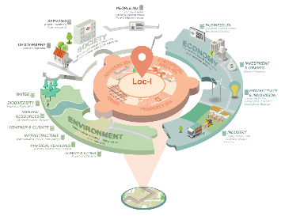
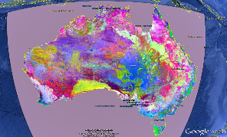
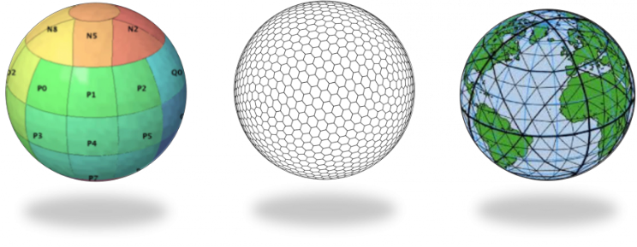
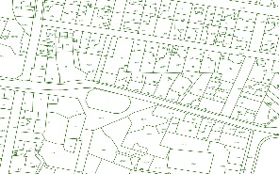
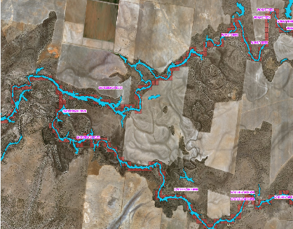
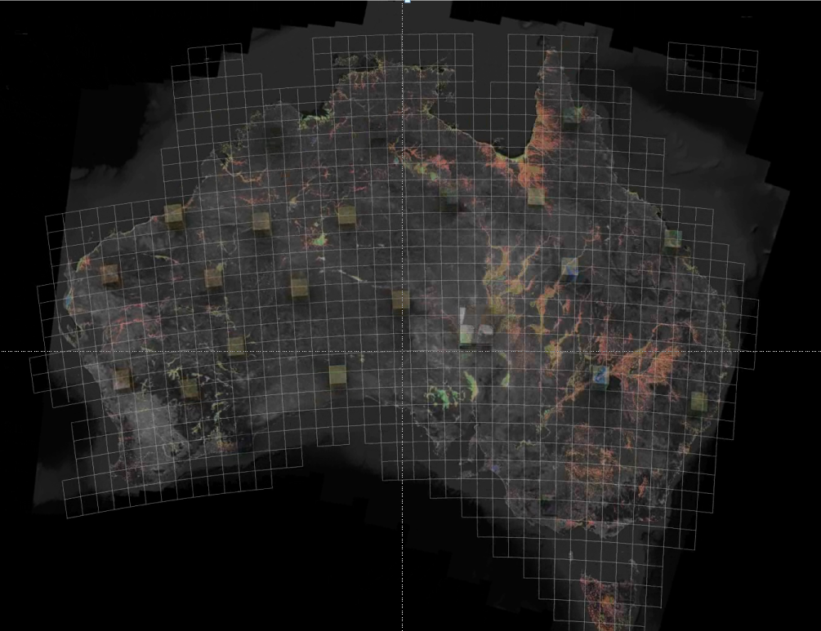
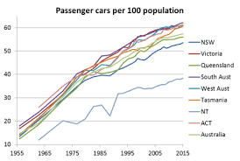

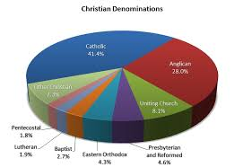

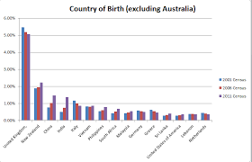
A Basic Data Integration Workflow using DGGS
“Siloed”
Data
Spatially/DGGS
Enabled Data
Dataset 1
DGGS enabled
Integrated
Information
Dataset 2
DGGS enabled
DGGS Query
DGGS Engine
Dataset 3
DGGS enabled
Dataset n
DGGS enabled

Slide 8
Why Standardise Discrete Global Grid Systems in the first place?
A Lesson from Globalisation

Slide 9
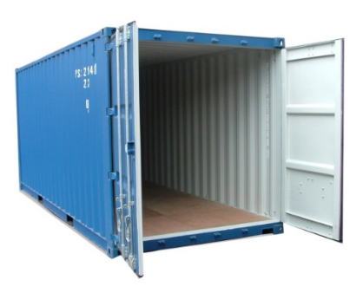

A Lesson from Globalisation
What has boosted global commerce more:
free trade or containerisation?
A bilateral free-trade agreement boosts trade by 45% over 20 years, and membership of the General Agreement on Tariffs and Trade (GATT) raises it by 285%.
“Containerisation” is associated with a 320% increase in bilateral trade over the first five years and 790% over 20 years.
In other words,
“Containers have boosted globalisation far more than all trade agreements in the past 50 years put together.”
http://www.economist.com/node/21578207 based on: Bernhofen et al., “Estimating the effects of the container revolution on world trade”, Journal of International Economics 98 (2016) 36–50

Slide 10
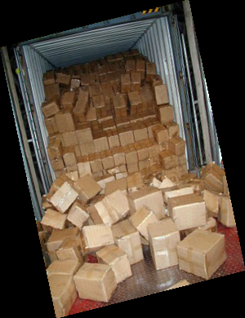

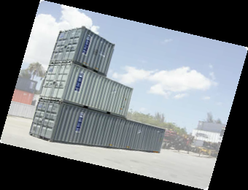
Container Power
Containers:
Fit seemlessly together
Allow (certain) different sizes
Save time and avoid losses inherent to re-packaging
Addressable, traceable, exchangeable, arrangeable …
Imagine trying to ship a container that’s slightly (e.g. 10%) different in size compared to the standard!

Slide 11
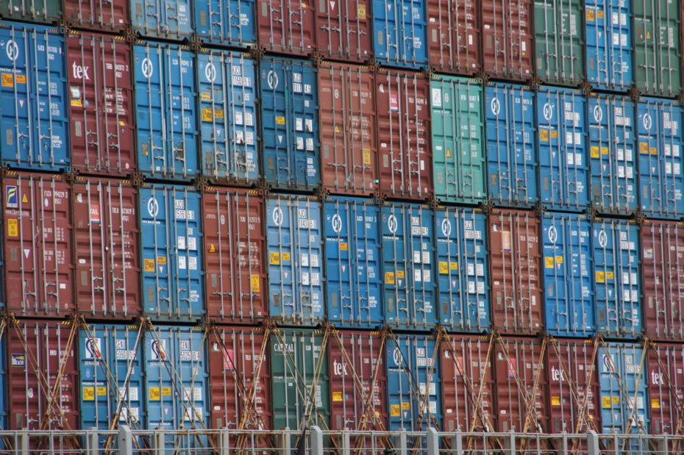
What does this remind you of????....

Slide 12
DGGS are Disruptive!
Lat, Long was developed for analogue navigation,
ISO19107:2003 only provided for planar geometries,
ISO19111:2007 only recognises coordinates (eg x,y) for spatial location,
ISO19123:2005 coverages (rasters, grids, mesh, lattices, polygons, lines, TINs, Voronoi etc) have to use projections & flat earth geometry,
Coordinates sit uncomfortably with modern linked data systems,
Vectors, rasters, point clouds, social tag clouds are held at arms length by their disparate data models and processing algorithms.
No common data model for spatio-temporal precision & uncertainty
No common data model for data provenance
DGGS are designed to support global approaches to rapidly solving
multi-disciplinary big-data problems in a data agnostic, digital first, fully networked world.
Their efficiency has spinoff for smaller problems too.

Slide 13
Discrete Global Grid Systems:
Bridging the Gap between Spatial and Non-spatial Data

Slide 14



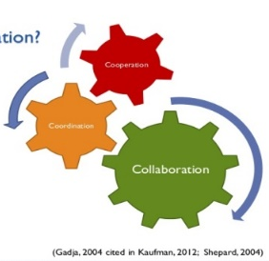
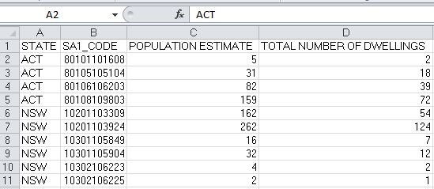
Why integrate statistical and geospatial data?
Unlocking new insights and data relationships that would not have been possible by analysing socio‐economic, environmental or geospatial data in isolation of each other;
Promoting investment and capability building in geospatial and statistical information;
Building institutional collaboration between geospatial and statistical communities.
A
B
1970s
1990s

Slide 15


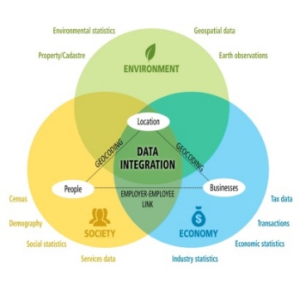

Why integrate statistical and geospatial data?
Local, sub‐national, national, regional, and global decision making processes
Measuring and monitoring the targets and global indicator framework for the Sustainable Development Goals (SDGs)
Supporting data sharing between institutions and enhancing the interoperability of geospatial and statistical information
(Samavati, F., & Runions, A., 2016, fig.3)

Slide 16

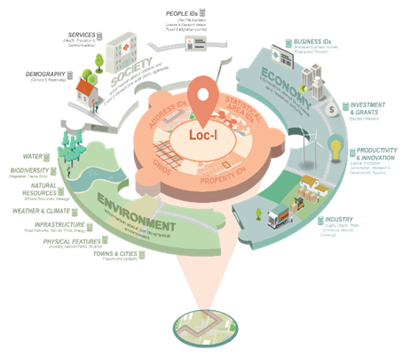
LOC-I is the jigsaw piece to connect society, economy and the environment layers
The Location Index creates a system to support:
Decisions based on fit for purpose data with
Known authoritative sources
Using best technology and
Available on demand from a device of choice
Enabler for linking spatial and non-spatial data

Slide 17


Slide 18


