Slide 1
Addressing and Presenting Quality of Satellite Data
Gregory Leptoukh
ESIP Information Quality Cluster
Notes:
1

Slide 2
Why now?
In the past, it was difficult to access satellite data.
Now, within minutes, a user can find and access multiple datasets from various remotely located archives via web services and perform a quick analysis.
This is the so-called Data Intensive Science.
The new challenge is to quickly figure out which of those multiple and easily accessible data are more appropriate for a particular use.
However, our remote sensing data are not ready for this challenge – there is no consistent approach for characterizing quality of our data.
This is why data quality is hot now

Slide 3
Discussion points
Data intensive science → urgent need for Data Quality framework
Mention: AGU session on Data Quality
DQ aspects
Terminology
Quality Indicators (orig fact, derived facts, assessed from the data,…, user “stars”…)
Science quality vs. format/file/checksum… )
Difficult “by design”: science paper paradigm vs. standardization of validation results
Delivery of data quality
SPG
Citizen science – may discuss later (Pandora box)
Near-term objective: assessment and analysis of DQ requirements and best practices
Ultimate goal: develop a DQ framework for remote sensing data

Slide 4



Different perspectives on data quality
Science Teams
We have good data
MISR
We have good data
MODIS
MLS
OMI
TES
I need good data … and quickly
Attention deficit…

Slide 5
Challenges in dealing with Data Quality
Why so difficult?
Quality is perceived differently by data providers and data recipients.
Many different qualitative and quantitative aspects of quality.
No comprehensive framework for remote sensing Level 2 and higher data quality
No preferred methodologies for solving many data quality issues
Data quality aspect had lower priority than building an instrument, launching a rocket, collecting/processing data, and publishing a paper using these data.
Each science team handled quality differently.
Notes:
5

Slide 6

Data usability aspect
Remember the missing battery case?
Take home message from Kevin Ward:
Data needs to be easy to use!
Package data for non-PIs
Keep datasets lossless (as possible)
Need dataset consistency (best practices)
Don’t compromise data by packaging
Lower hurdles as much as possible
Notes:
Missing/incomplete/cryptic documentation

Slide 7
Aspects of Data Quality
Data quality vs. Quality data – remember Nick Mangus’s “Food quality vs. Quality food”
Liability drives quality (EPA):
  Reliability, accuracy, consistency
Responsibility aspect: who is responsible for quality of value-added data (who customizes)
User-friendliness … down to addressing quality of tools (!)
Provenance helping data quality but …
Consistency of data in the archive:
  Checksums to data versioning…

Slide 8
Science data quality
Error budget
Propagating uncertainties
Simulating uncertainties
Uncertainty avalanche
Multi-sensor intercomparison
Action items:
Need to have best practices described

Slide 9
Data quality needs: fitness for purpose
Measuring Climate Change:
  Model validation: gridded contiguous data with uncertainties
  Long-term time series: bias assessment is the must , especially sensor degradation, orbit and spatial sampling change
Studying phenomena using multi-sensor data:
  Cross-sensor bias is needed
Realizing Societal Benefits through Applications:
  Near-Real Time for transport/event monitoring - in some cases, coverage and timeliness might be more important that accuracy
  Pollution monitoring (e.g., air quality exceedance levels) – accuracy
Educational (users generally not well-versed in the intricacies of quality; just taking all the data as usable can impair educational lessons) – only the best products

Slide 10
Data Quality vs. Quality of Service
A data product could very good,
But if not being conveniently served and described, is perceived as not being so good…
User perspective:
There might be a better product somewhere but if I cannot easily find it and understand it, I am going to use whatever I have and know already.

Slide 11
Examples of Quality Indicators
Terminology: Quality, Uncertainty, Bias, Error budget, etc.
Quality Indicators:
  Completeness:
    Spatial (MODIS covers more than MISR)
    Temporal (Terra mission has been longer in space than Aqua)
    Observing Condition (MODIS cannot measure over sun glint while MISR can)
  Consistency:
    Spatial (e.g., not changing over sea-land boundary)
    Temporal (e.g., trends, discontinuities and anomalies)
    Observing Condition (e.g., exhibit variations in retrieved measurements due to the viewing conditions, such as viewing geometry or cloud fraction)
  Representativeness:
    Neither pixel count nor standard deviation fully express how representative the grid cell value is
    ……

Slide 12
Finding data quality information?
What do we want to get from the documentation?
The known quality facts about a product presented in a structured way, so computers can extract this information.
Algorithm Theoretical Basis Document (ATBD):
More or less structured
Usually out-of-date
Represents the algorithm developer perspective
Describes quality control flags
Does not address the product quality aspects

Slide 13
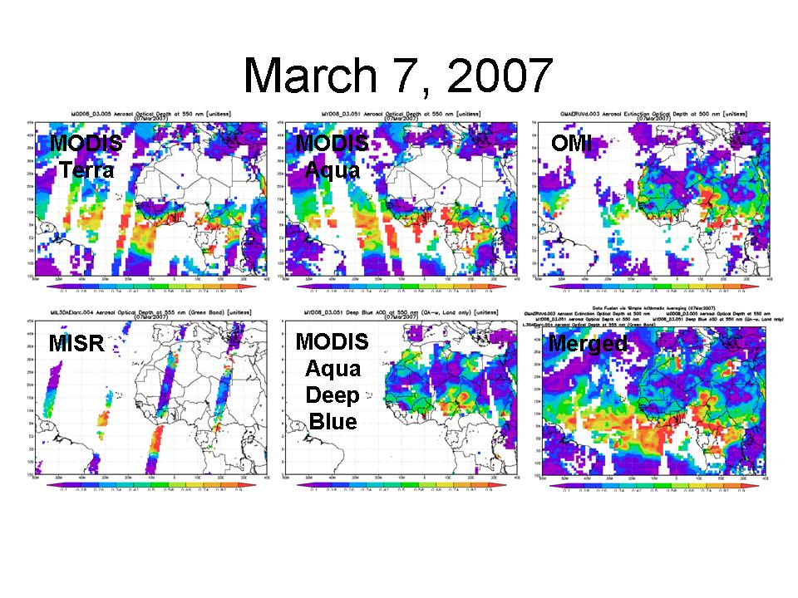
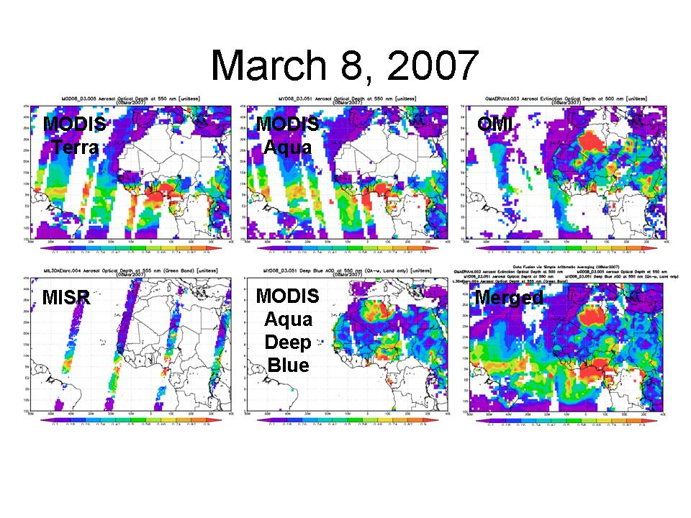
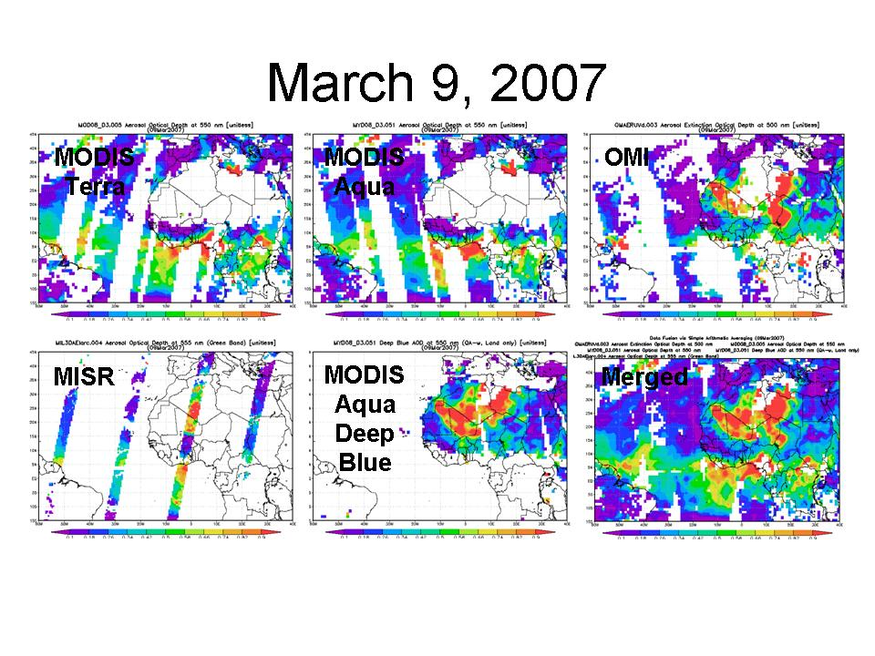
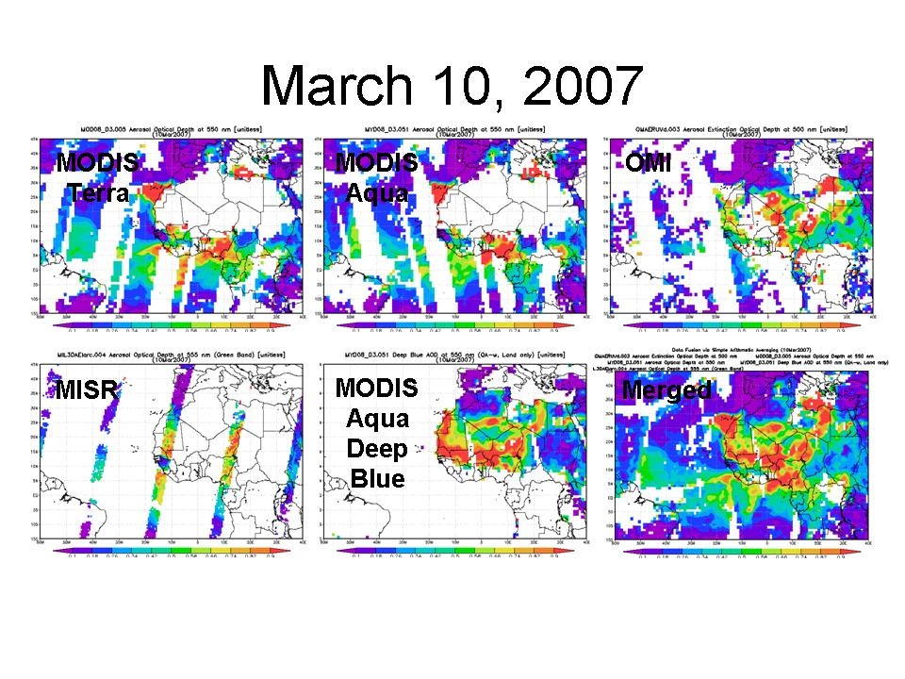
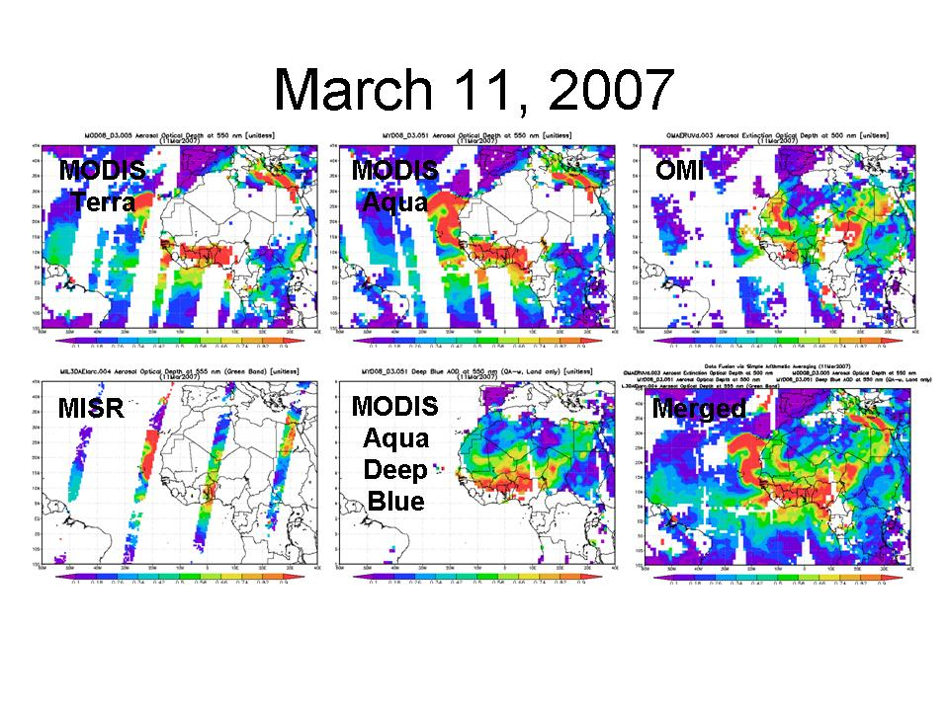
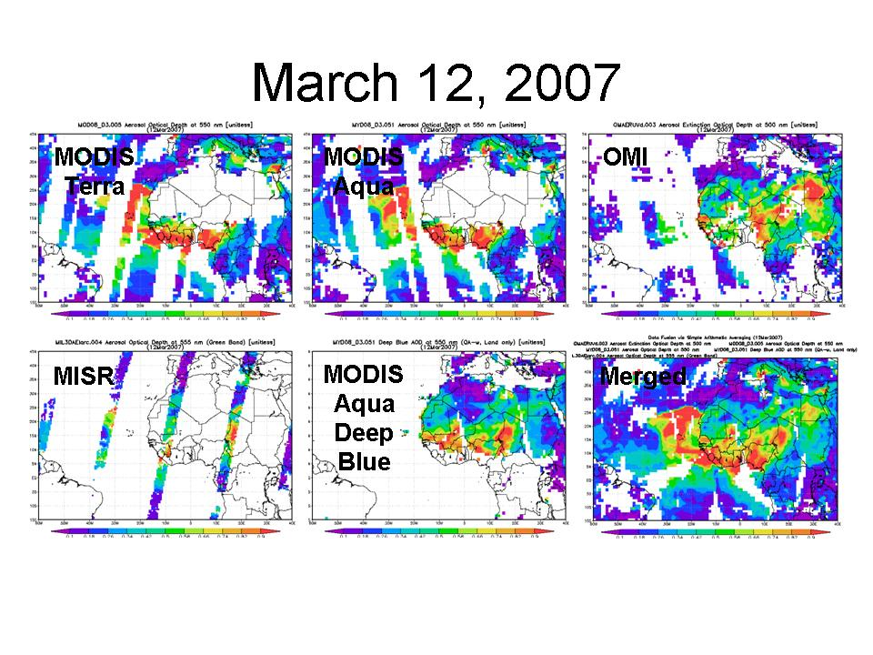
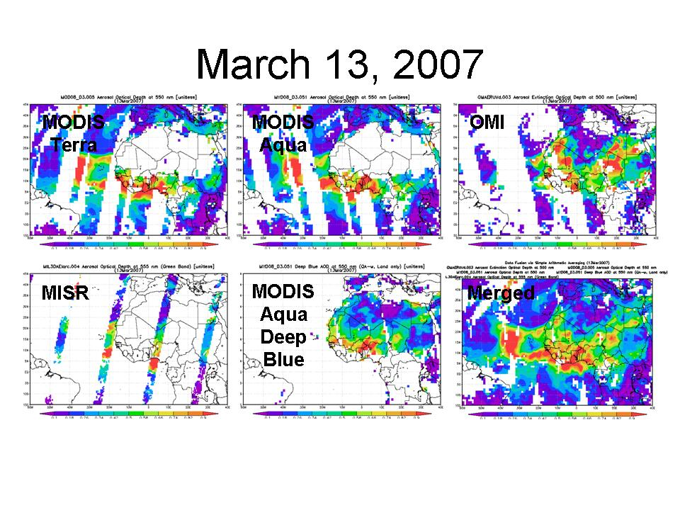
Data merging example: aerosols from multiple sensors
Merged AOD data from 5 retrieval algorithms (4 sensors: MODIS-Terra, MODIS-Aqua, MISR, and OMI) provide almost complete coverage.
Caveat: this is just the simplest merging prototype in Giovanni

Slide 14
What is Level 3 data quality?
It is not well defined in Earth Science….
If Level 2 errors were known, the corresponding Level 3 error could have been computed, in principle
Processing from L2→L3 daily → L3 monthly may reduce random noise but can also exacerbate systematic bias and introduce additional sampling bias
At best, standard deviations and sometimes pixel counts are provided
However, these standard deviations come from convolution of natural variability with sensor/retrieval uncertainty and bias – need to be disentangled
Biases are not addressed in the data themselves

Slide 15
Why can’t we just apply L2 quality to L3?
Aggregation to L3 introduces new issues where aerosols co-vary with some observing or environmental conditions – sampling bias:
Spatial: sampling polar areas more than equatorial
Temporal: sampling one time of a day only (not obvious when looking at L3 maps)
Vertical: not sensitive to a certain part of the atmosphere thus emphasizing other parts
Contextual: bright surface or clear sky bias
Pixel Quality: filtering or weighting by quality may mask out areas with specific features

Slide 16
Factors contributing to uncertainty and bias in L2
Physical: instrument, retrieval algorithm, aerosol spatial and temporal variability…
Input: ancillary data used by the retrieval algorithm
Classification: erroneous flagging of the data
Simulation: the geophysical model used for the retrieval
Sampling: the averaging within the retrieval footprint

Slide 17
Error propagation in L2 data
Instruments are usually well calibrated according to the well established standards.
In the majority of cases, the instrument uncertainty very rarely is propagated through L2 processing.
As a result, L2 uncertainty is assessed only after the fact.
Validation is performed only in few locations, and then the results are extrapolated globally.
In the absence of computed uncertainty, various methods have been recently applied to emulate L2 data uncertainty
Perturbing the retrieval algorithm parameters
Bootstrap simulation
…..

Slide 18
Quality Control vs. Quality Assessment
Quality Control (QC) flags in the data (assigned by the algorithm) reflect “happiness” of the retrieval algorithm, e.g., all the necessary channels indeed had data, not too many clouds, the algorithm has converged to a solution, etc.
Quality assessment is done by analyzing the data “after the fact” through validation, intercomparison with other measurements, self-consistency, etc. It is presented as bias and uncertainty. It is rather inconsistent and can be found in papers, validation reports all over the place.

Slide 19
Different kinds of reported data quality
Pixel-level Quality: algorithmic guess at usability of data point
  Granule-level Quality: statistical roll-up of Pixel-level Quality
Product-level Quality: how closely the data represent the actual geophysical state
Record-level Quality: how consistent and reliable the data record is across generations of measurements
  Different quality types are often erroneously assumed having the same meaning
  Ensuring Data Quality at these different levels requires different focus and action

Slide 20
General Level 2 Pixel-Level Issues
How to extrapolate validation knowledge about selected Level 2 pixels to the Level 2 (swath) product?
How to harmonize terms and methods for pixel-level quality?
AIRS
Quality Indicators
MODIS Aerosols Confidence Flags
Ocean
Land
0 Best Data Assimilation
Good Climatic Studies
Do Not Use
Very Good
2 Good
1 Marginal
0 Bad
Very Good
2 Good
1 Marginal
0 Bad
Use these flags in order to stay within expected error bounds
Match up the recommendations?
Purpose
Ocean
Land
±0.03 ± 0.10 t
±0.05 ± 0.15 t

Slide 21
Data validation

Slide 22
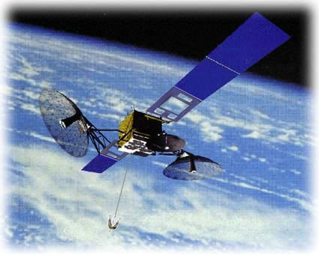



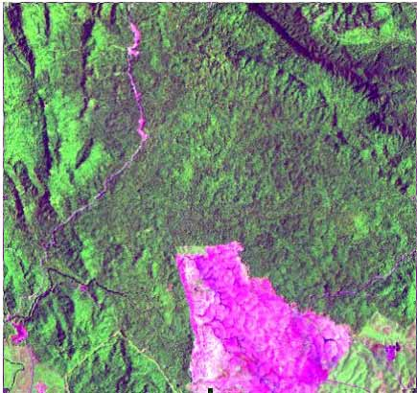
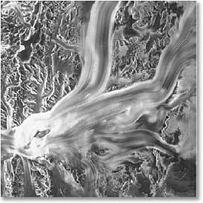
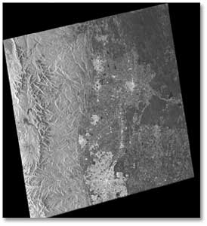
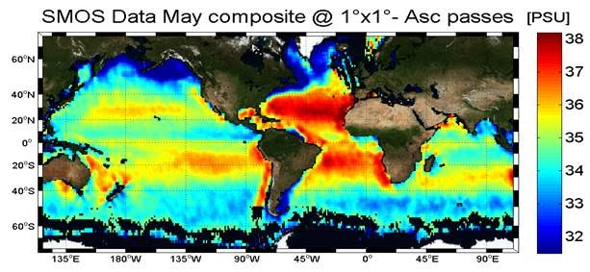
User
Communities
Satellite
Value-Added
Processing
Instrument
Level 0
Level 1
Level 2
Level 3
Calibration
No Validation
Validation
“Validation”

Slide 23
Levels of validation
Validate in few points
Extrapolate to the whole globe – how?
What is Level 3 validation?
Self-consistency

Slide 24
QA4EO and other data quality activities

Slide 25
QA4EO Essential Principle
Measurement/processes are only significant if their “quality” is specified
In order to achieve the vision of GEOSS, Quality Indicators (QIs) should be ascribed to data and products, at each stage of the data processing chain - from collection and processing to delivery.
  A QI should provide sufficient information to allow all users to readily evaluate a product’s suitability for their particular application, i.e. its “fitness for purpose”.
  To ensure that this process is internationally harmonised and consistent, the QI needs to be based on a documented and quantifiable assessment of evidence demonstrating the level of traceability to internationally agreed (where possible SI) reference standards.

Slide 26
QA4EO Essential Principle
Data and derived products shall have associated with them an indicator of their quality to enable users to assess its suitability for their application.
“fitness for purpose”
QA4EO
Essential Principle
Quality Indicators (QIs) should be ascribed to data and Products.
A QI should provide sufficient information to allow all users to readily evaluate its “fitness for purpose”.
Quality Indicators
QI needs to be based on a documented and quantifiable assessment of evidence demonstrating the level of traceability to internationally agreed (where possible SI) reference standards.
Traceability

Slide 27
What QA4EO is…
it’s a general framework
based on 1 essential principle
and composed of 7 key guidelines
These are “living documents” (i.e. v.4.0) and
they offer a flexible approach to allow
the effort for the tailoring of the guidelines to be
commensurate with the final objectives.
It is a user (costumer) driven process.

Slide 28
…and what is not
…not a certification body
…not a set of standards for QC/QA activities and processes that would limit competitiveness or innovation and evolution of technology and methodologies
…not a framework developed with a top-down approach
…the QA4EO process and its implementation should
not be judgemental and bureaucratic

Slide 29
QA4EO Definitions
Quality Indicator
  A mean of providing “a user” of data or derived product, (i.e. which is the results of a process) sufficient information to assess its suitability for a particular application.
  This “information” should be based on a quantitative assessment of its traceability to an agreed reference measurement standard (ideally SI) but can be presented as numeric or text descriptor providing the quantitative linkage is defined
Traceability
  Property of a measurement result whereby the result can be related to a reference through a documented unbroken chain of calibrations each contributing to the measurement uncertainty.

Slide 30
Many Quality Assurance Players – what is the real definition?
GEO - Group on Earth Observations
CEOS – Committee on Earth Observation Satellites
QA4EO - (GEO/CEOS)
ASPRS – American Society for Remote Sensing and Photogrammetry
ISPRS – International Society for Remote Sensing and Photogrammetry
JACIE – Joint Agency Commercial Imagery Evaluation http://calval.cr.usgs.gov/collaborations_partners/jacie/
Inter-agency Digital Imagery Working Group (IADIWG)
ESIP IQ Cluster - http://wiki.esipfed.org/index.php/Information_Quality
NASA QA Groups -
NGA Geospatial Working Group
CALCON
AGU

Slide 31
Many Quality Assurance Players – what is the real definition?
ISO -
IEEE -
GeoViQua - http://www.geoviqua.org/
GMES Quality - GMES Requirement Definition for Multi-Mission Generic Quality Control Standards – ESA Study by NPL to review existing quality assurance/control practices and propose strategies
Global Space-based Inter-Calibration System (GSICS)
  http://gsics.wmo.int/
EGIDA - http://www.egida-project.eu/
Many More

Slide 32
NASA perspective

Slide 33

Data Quality NASA Management Context
  Data Quality Issue Premise
    This issue has very high visibility among the many Earth science/remote sensing science issues explored by our science and data system teams.
    NASA recognizes the very real need for researchers and other interested parties to be exposed to explanatory information on data product accuracy, fitness of use and lineage.
    NASA seeks to address this broad issue in concert with our US agency partners and other national space agencies and international organizations.
  NASA's Data Quality Management Framework
    Program Managers at NASA HQ have stated their support for NASA pertinent projects, teams and activities to address data quality (most of these are funded activities).
    NASA ESDIS Project is taking a leadership role for the agency in the coordination of persons and activities working data quality issues. To date:
      Identified NASA CS and contractors who are qualified and available to support this effort.
      Assembled a DQ team to develop strategies and products that further characterize DQ issues and coordinate/solicit for support for these issues.
      Begun our agency coordination of DQ issues with our established interagency and international science and data system bodies.
33

Slide 34
Data Quality NASA Management Context - 2
  What's needed, what's next?
    Our first step is to complete a near-term 'inventory' of current data quality mechanisms, processes and system for establishing and capturing data quality information. Initial focus in on existing projects who have established practices that are found to be of value to their specific user communities (success oriented).
    From this base information a follow on set of documents will be developed around the gaps and 'tall pole' topics that emerge from the inventory process. These products will serve as a basis for organizing and coordinating DQ topics coupled to available resources and organizations to address these topics.
    NASA intends to use currently planned meetings and symposia to further the DQ issue discussion and a forum for learning of other practices and community needs.
  To make headway in DQ NASA is seeking interested partners in joining our established teams and/or helping us coordinate and collaborate with other existing teams working these issues.
34

Slide 35
Best practices

Slide 36
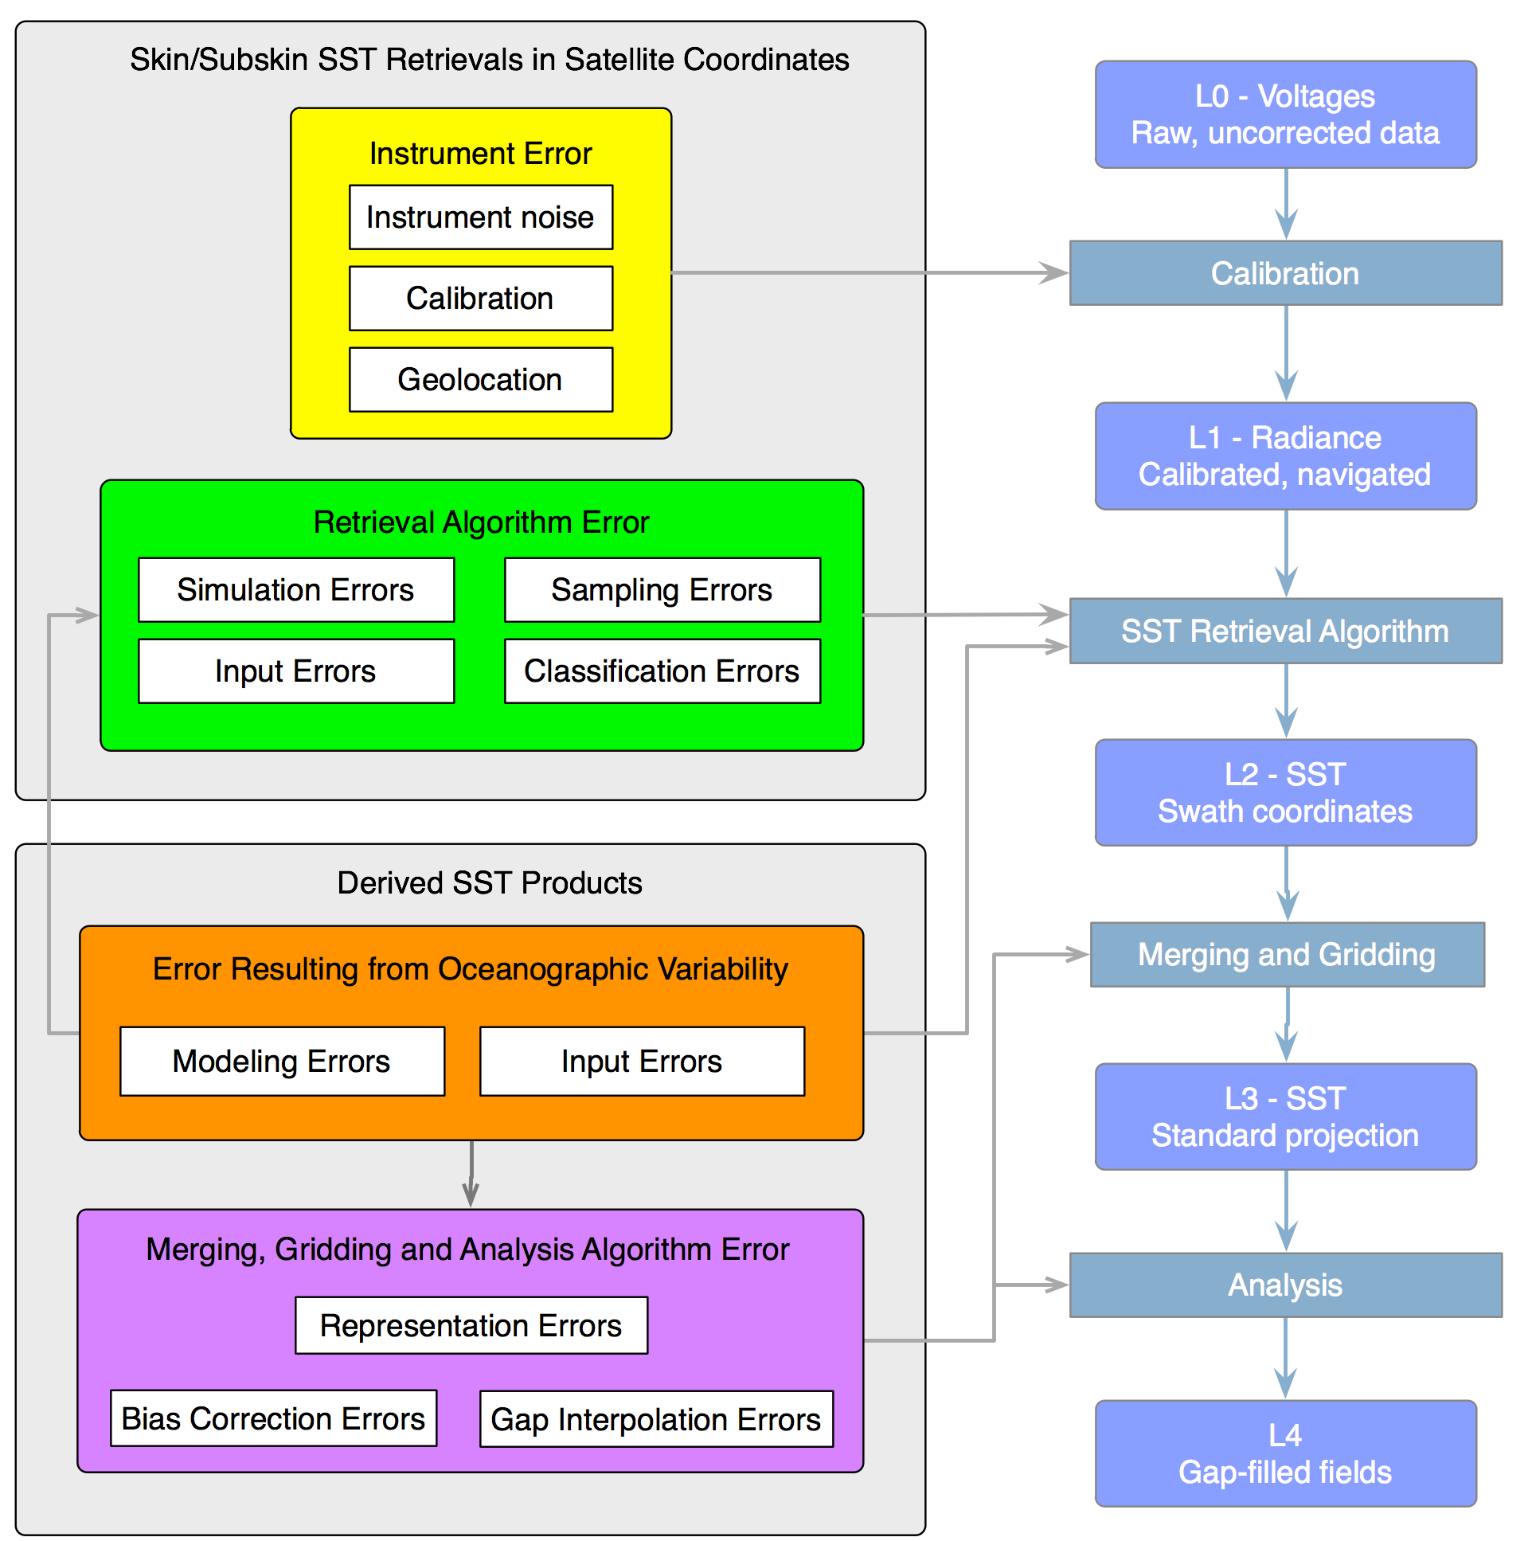
Sea Surface Temperature Error budget

Slide 37
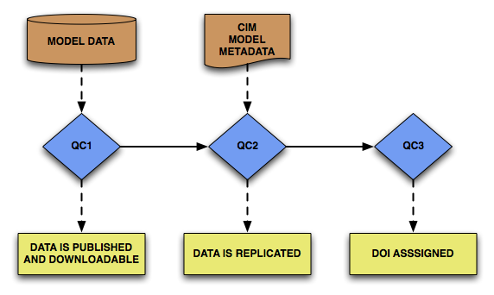
CMIP5 Quality Assessment Procedure
(courtesy of Luca Cinquini, JPL)
The CMIP5 archive will have extensive social and political impact > model output published to the ESGF must undergo a rigorous Quality Assurance process
QC1: “Automatic Software Checks on Data, Metadata”
CMOR compliance (integrity of CF metadata, required global attributes, controlled vocabulary, variables conform to CMOR tables, DRS layout)
ESG Publisher processing
QC2: “Subjective Quality Control on Data, Metadata”
      Metadata: availability and technical consistency of CIM metadata from Metafor
      Data: data passes additional consistency checks performed by QC software developed @ WDC Climate
QC3: “Double and Cross Checks on Data, Metadata”
Scientific Quality Assurance (SQA): executed by the author who manually inspects the data and metadata content
Technical Quality Assurance (TQA): automatic consistency checks of data and metadata executed by WDC Climate (World Data Center for Climate)
Notes
QC flag assigned after each stage
All changes to data result in new version
All files are check-summed
Similar QC process for NASA observations
Notes:
Because IPCC-AR5 will have important political and social impact, rigorous procedures must be followed to QC the CMIP5 data and metadata.

Slide 38
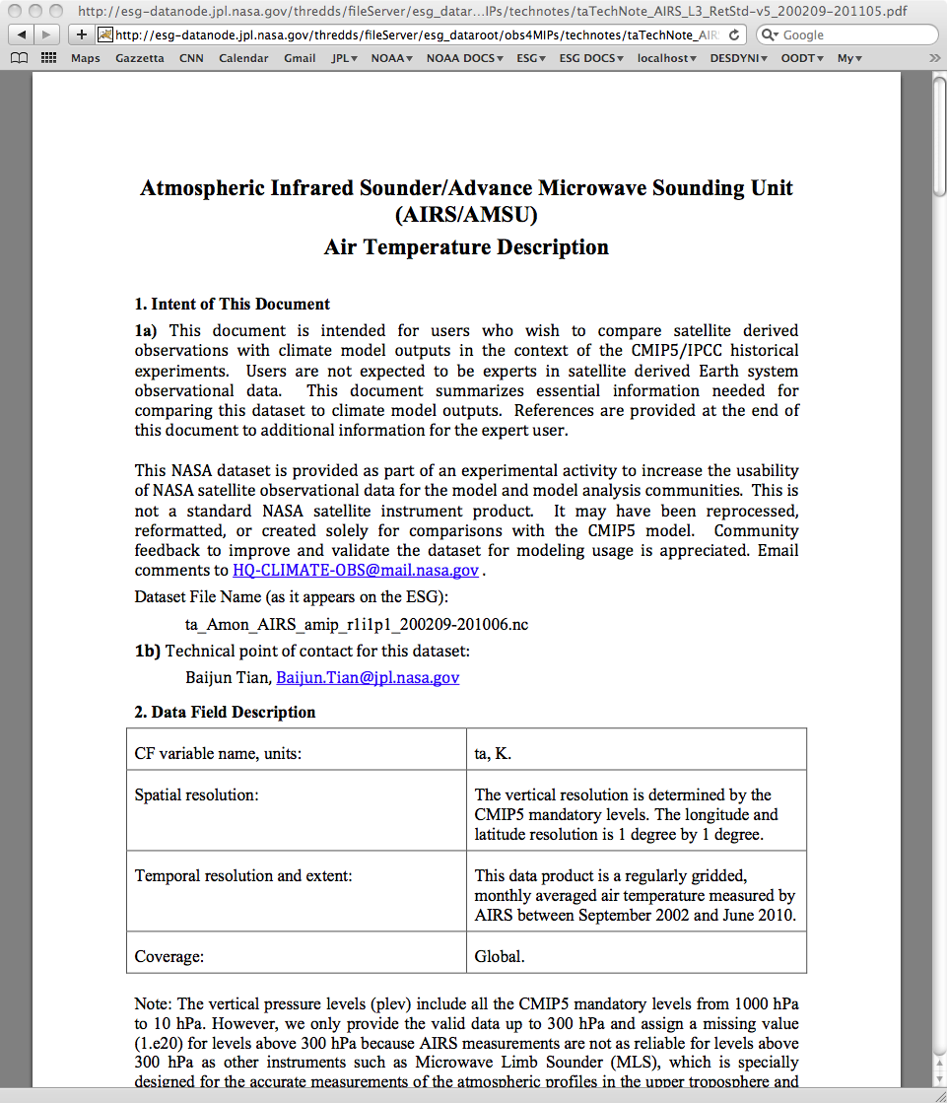
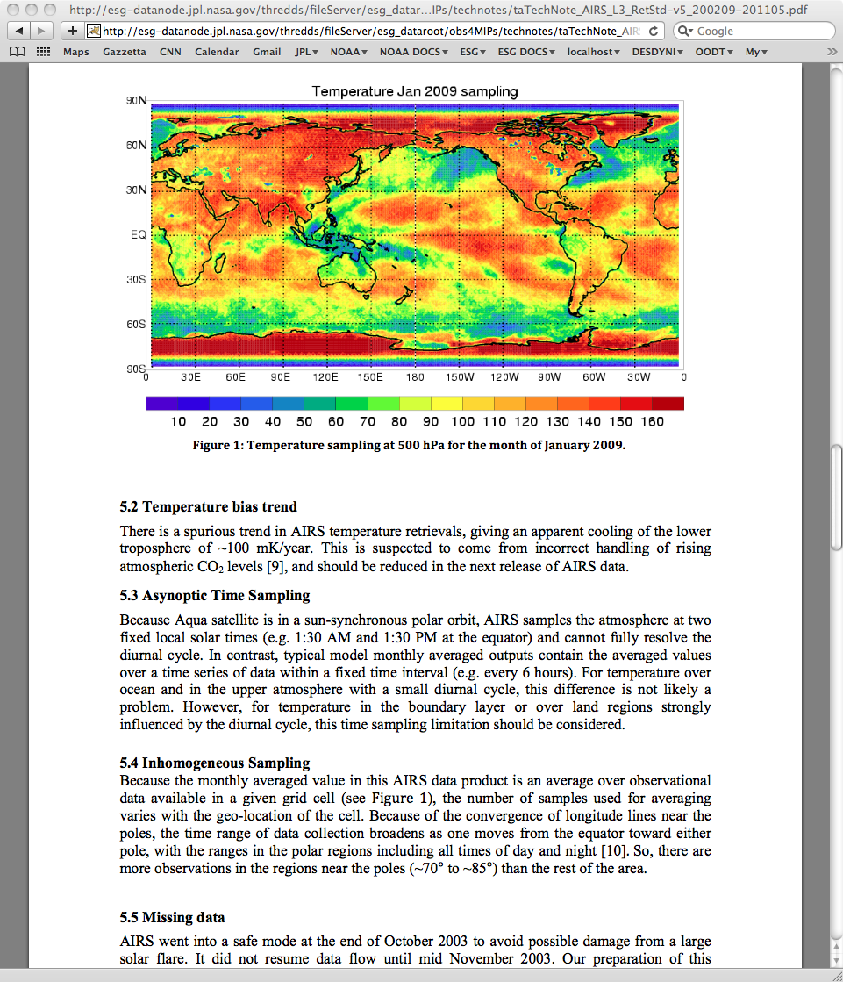
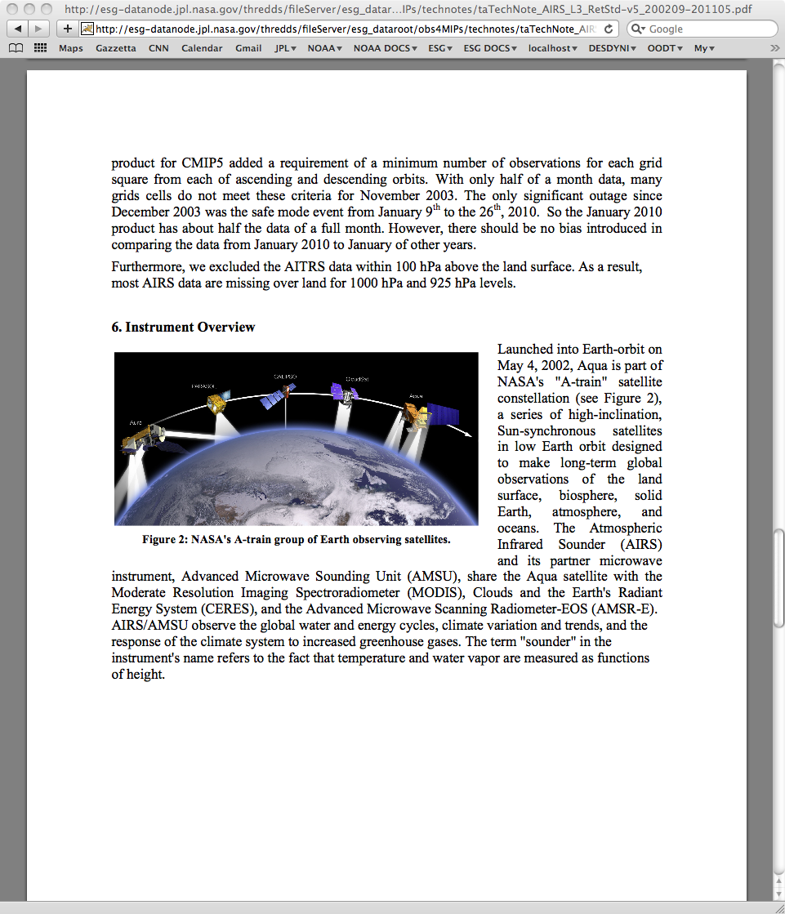
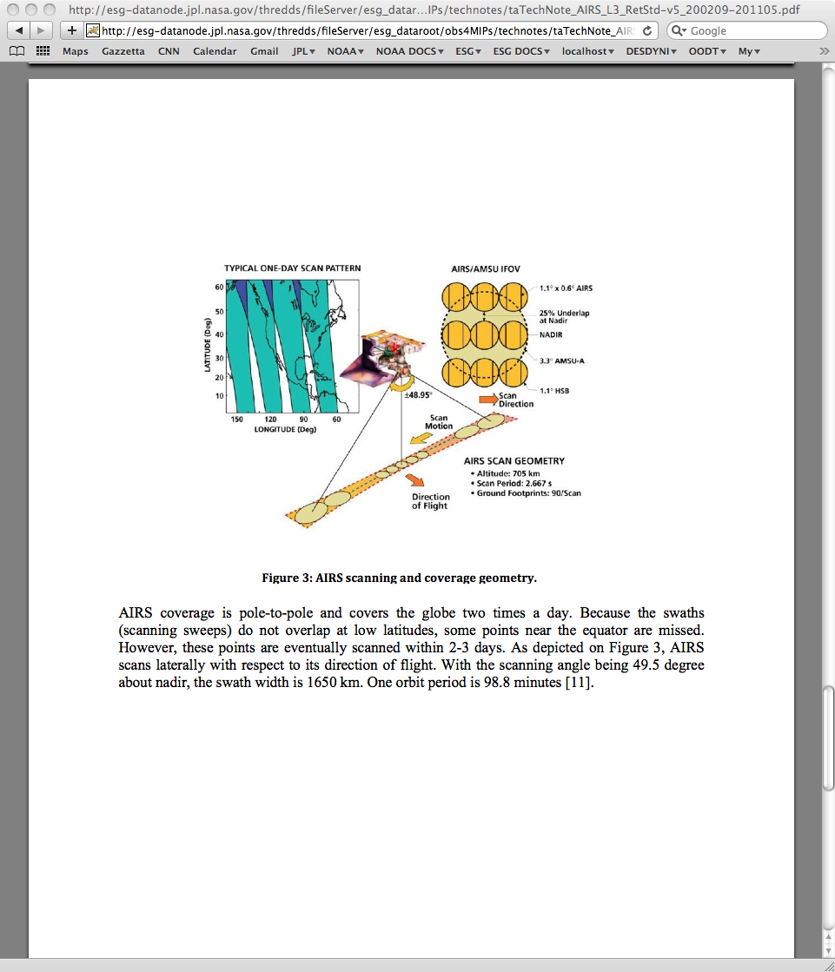
Technical Notes for Observations
Standard Table of Contents
      Purpose, point of contact
      Data field description
      Data origin
      Validation
      Considerations for Model-Observation comparison
      Instrument Overview
      References
      Example: AIRS Air Temperature tech note

Slide 39
EPA Data Quality Objectives (DQOs)
The DQO are based on the data requirements of the decision maker who needs to feel confident that the data used to make environmental decisions are of adequate quality.
The data used in these decisions are never error free and always contain some level of uncertainty.
From: EPA QA Handbook Vol II, Section 3.0, Rev. 1, Date: 12/08

Slide 40
Uncertainty
The estimate of overall uncertainty is an important component in the DQO process. Both population and measurement uncertainties must be understood.
Population uncertainties
Representativeness: the degree to which data accurately and precisely represent a characteristic of a population, a parameter variation at a sampling point, a process condition, or a condition. Population uncertainty, the spatial and temporal components of error, can affect representativeness. It does not matter how precise or unbiased the measurement values are if a site is unrepresentative of the population it is presumed to represent.

Slide 41
Measurement uncertainties
Examples:
• Precision - a measure of agreement among repeated measurements of the same property under identical, or substantially similar, conditions. This is the random component of error. Precision is estimated by various statistical techniques typically using some derivation of the standard deviation.
• Bias - the systematic or persistent distortion of a measurement process which causes error in one direction. Bias will be determined by estimating the positive and negative deviation from the true value as a percentage of the true value.
• Detection Limit - The lowest concentration or amount of the target analyte that can be determined to be different from zero by a single measurement at a stated level of probability. Due to the fact the NCore sites will require instruments to quantify at lower concentrations, detection limits are becoming more important. Some of the more recent guidance documents suggest that monitoring organizations develop method detection limits (MDLs) for continuous instruments and or analytical methods. Many monitoring organizations use the default MDL listed in AQS for a particular method. These default MDLs come from instrument vendor advertisements and/or

Slide 42
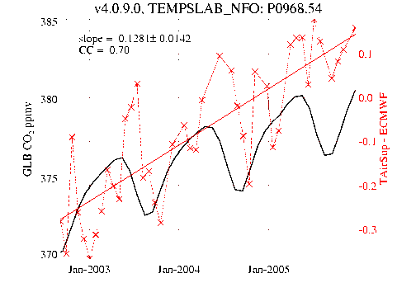
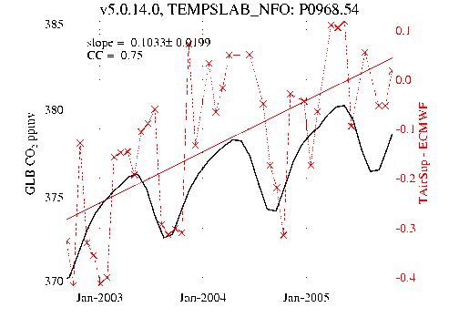
AIRS Temperature trend reflects trend in an ancillary input data (CO2)
Temperature trend: 0.128 → 0.103 after taking into account CO2 increase
Not sufficient but going into the right direction.

Slide 43
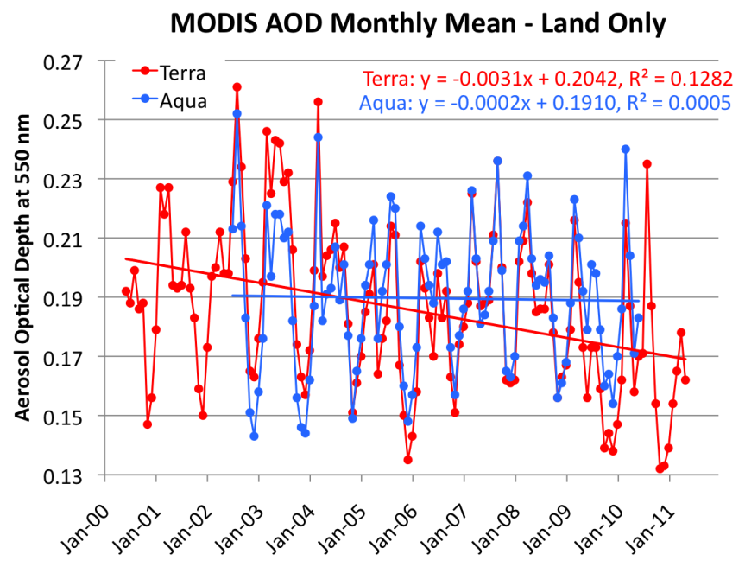
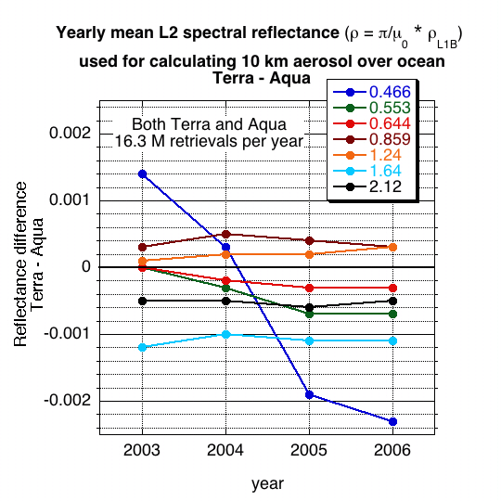
Instrument trends may lead to artificial aerosol trends
In Collection 5, Monthly mean AOD from Terra and Aqua disagree. Trends are different over land.
Band #3 (466 nm) is used over land
Band #3 is reported but not applied over ocean
Differences in MODIS over-land AOD time series might be related to differences in band #3
From R. Levy, 2011

Slide 44
Data Knowledge Fall-off
Knowledge of data
Algorithm implementor
Algorithm PI
Processing team
Distance from Science Team

Slide 45
Challenges addressed
Identifying Data Quality (DQ) facets
Finding DQ facets
Capturing DQ facets
Classifying DQ facets
Harmonizing DQ facets
Presenting DQ facets
Presenting DQ via web services
Notes:
45

Slide 46
Data quality needs: fitness for purpose
Measuring Climate Change:
  Model validation: gridded contiguous data with uncertainties
  Long-term time series: bias assessment is the must , especially sensor degradation, orbit and spatial sampling change
Studying phenomena using multi-sensor data:
  Cross-sensor bias is needed
Realizing Societal Benefits through Applications:
  Near-Real Time for transport/event monitoring - in some cases, coverage and timeliness might be more important that accuracy
  Pollution monitoring (e.g., air quality exceedance levels) – accuracy
Educational (users generally not well-versed in the intricacies of quality; just taking all the data as usable can impair educational lessons) – only the best products

Slide 47
Data Quality vs. Quality of Service
A data product could very good,
But if not being conveniently served and described, is perceived as not being so good…
User perspective:
There might be a better product somewhere but if I cannot easily find it and understand it, I am going to use whatever I have and know already.

Slide 48
Examples of Quality Indicators
Terminology: Quality, Uncertainty, Bias, Error budget, etc.
Quality Indicators:
  Completeness:
    Spatial (MODIS covers more than MISR)
    Temporal (Terra mission has been longer in space than Aqua)
    Observing Condition (MODIS cannot measure over sun glint while MISR can)
  Consistency:
    Spatial (e.g., not changing over sea-land boundary)
    Temporal (e.g., trends, discontinuities and anomalies)
    Observing Condition (e.g., exhibit variations in retrieved measurements due to the viewing conditions, such as viewing geometry or cloud fraction)
  Representativeness:
    Neither pixel count nor standard deviation fully express how representative the grid cell value is
    ……

Slide 49
Finding data quality information?
What do we want to get from the documentation?
The known quality facts about a product presented in a structured way, so computers can extract this information.
Algorithm Theoretical Basis Document (ATBD):
More or less structured
Usually out-of-date
Represents the algorithm developer perspective
Describes quality control flags
Does not address the product quality aspects

Slide 50
Scientific papers as source
Regular papers:
To be published, a paper has to have something new, e.g., new methodology, new angle, new result.
Therefore, by design, all papers are different
Results presented differently
Structured for publication in a specific journal.
Depending on a journal, the focus is different or on climate
Version of the data not always obvious
Findings about the old version data usually are not applicable to the newest version
Validation papers:
Organized as scientific papers
Target various aspects of validation in different papers

Slide 51
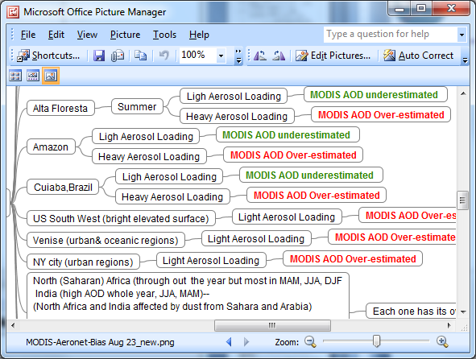
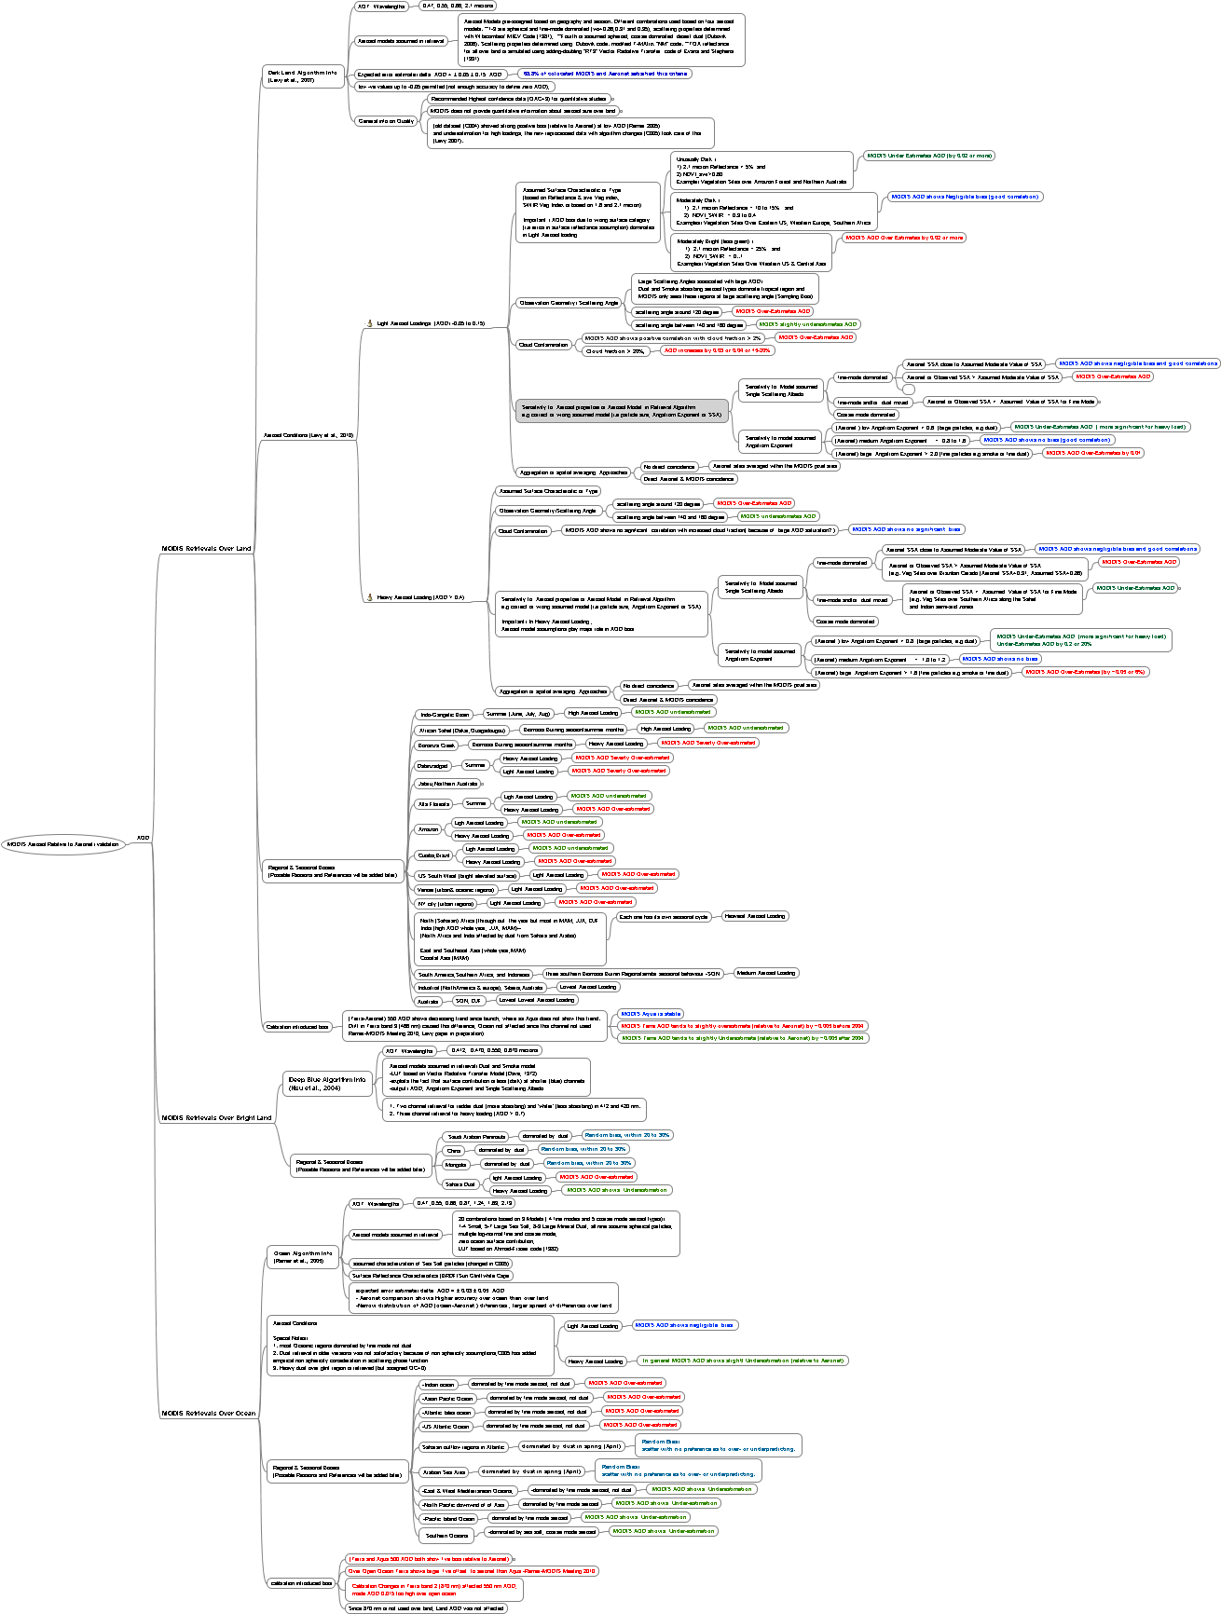
Capturing Bias information in FreeMind
FreeMind allows capturing various relations between various aspects of aerosol measurements, algorithms, conditions, validation, etc. The “traditional” worksheets do not support complex multi-dimensional nature of the task
from the Aerosol Parameter Ontology

Slide 52
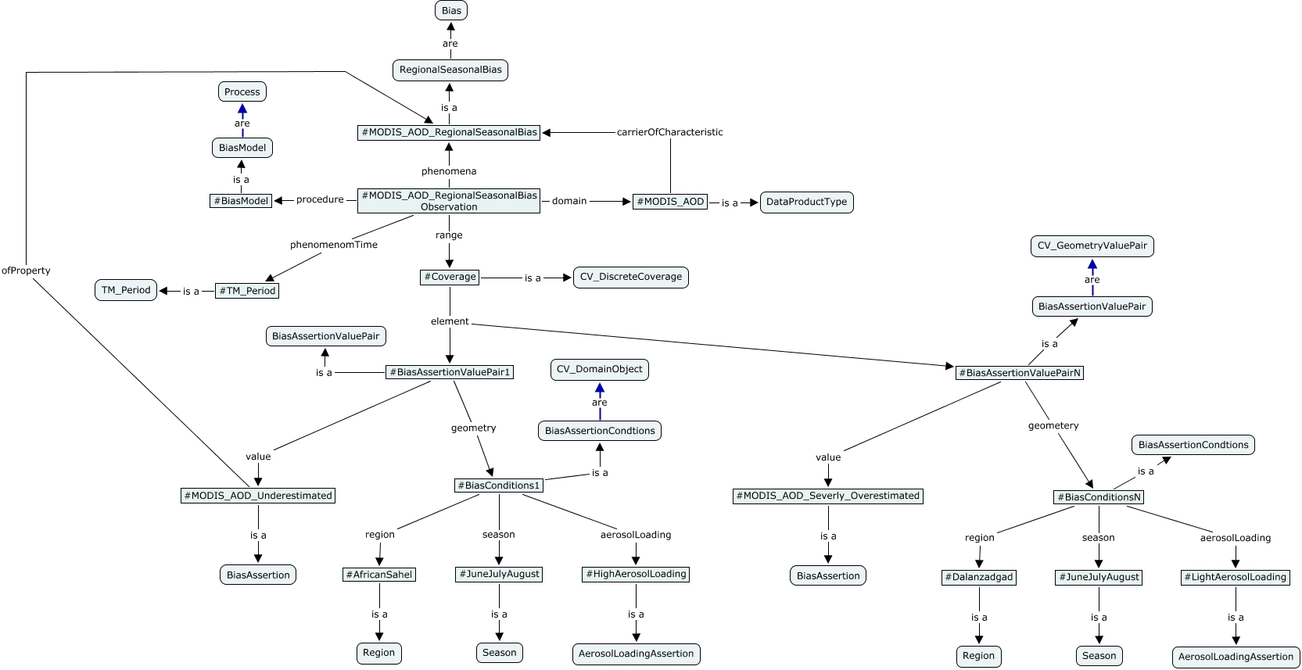
Data Quality Ontology Development (Bias)
http://cmapspublic3.ihmc.us:80/servlet/SBReadResourceServlet?rid=1286316097170_183793435_22228&partName=htmltext

Slide 53
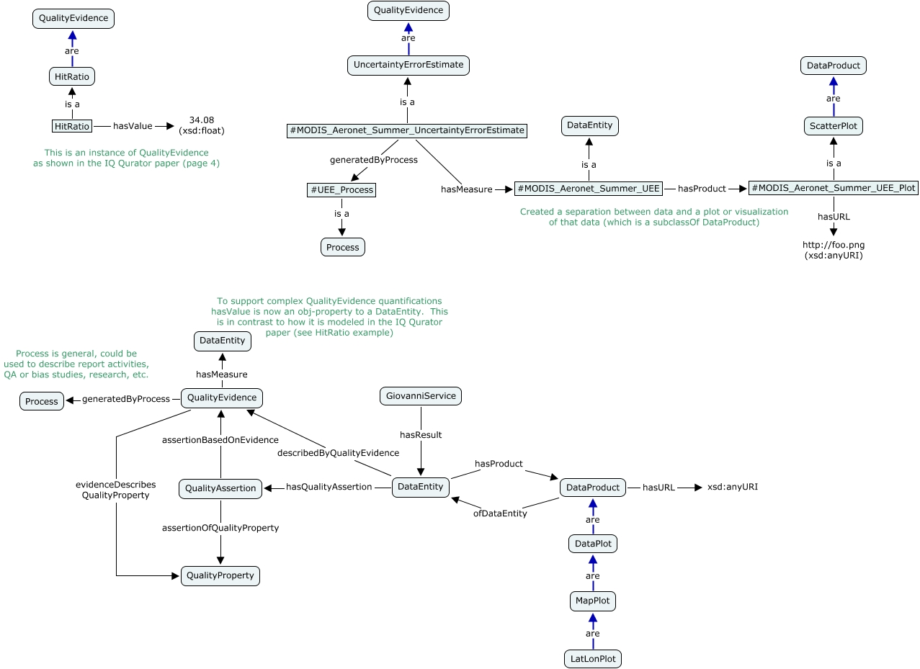
Modeling quality (Uncertainty)
Link to other cmap presentations of quality ontology:
http://cmapspublic3.ihmc.us:80/servlet/SBReadResourceServlet?rid=1299017667444_1897825847_19570&partName=htmltext

Slide 54
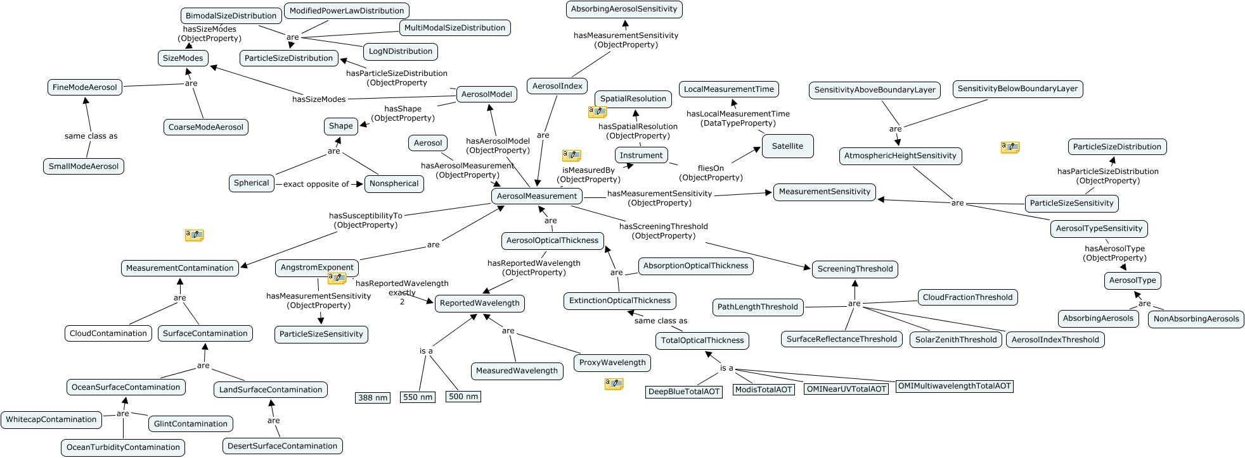
MDSA Aerosol Data Ontology Example
Ontology of Aerosol Data made with cmap ontology editor
Notes:
54

Slide 55
Presenting data quality to users
Data Quality Use Case: MODIS-Terra AOD vs. MISR-Terra AOD
Short Definition
Describe to the user caveats about multiple aspects of product quality differences between equivalent parameters in two different data products: MODIS-Terra and MISR-Terra.
Purpose
The general purpose of this use case is to inform users of completeness and consistency aspects of data quality to be taken into consideration when comparing or fusing them.
Assumptions
Specific information about product quality aspects is available in validation reports or peer-reviewed literature or can be easily computed.

Slide 56
Quality Comparison Table for Level-3 AOD (Global example)
Quality Aspect | MODIS |  | MISR
Completeness
Total Time Range | Platform Time Range |  | 2/2/200-present
 | Terra | 2/2/2000-present
 | Aqua | 7/2/2002-present
Local Revisit Time | Platform Time Range |  | Platform Time Range
 | Terra | 10:30 AM | Terra 10:30 AM
 | Aqua | 1:30 PM
Revisit Time | global coverage of entire earth in 1 day; coverage overlap near pole |  | global coverage of entire earth in 9 days & coverage in 2 days in polar region
Swath Width | 2330 km |  | 380 km
Spectral AOD | AOD over ocean for 7 wavelengths (466, 553, 660, 860, 1240, 1640, 2120 nm ); AOD over land for 4 wavelengths (466, 553, 660, 2120 nm (land) |  | AOD over land and ocean for 4 wavelengths (446, 558, 672, and 866 nm)
AOD Uncertainty or Expected Error (EE) | +-0.03+- 5% (over ocean; QAC > = 1) +-0.05+-20% (over land, QAC=3); |  | 63% fall within 0.05 or 20% of Aeronet AOD; 40% are within 0.03 or 10%
Successful Retrievals | 15% of Time |  | 15% of Time (slightly more because of retrieval over Glint region also)

Slide 57
Completeness: Observing Conditions for MODIS AOD at 550 nm Over Ocean
Region | Ecosystem | % of Retrieval Within Expected Error | Average Aeronet AOD | AOD Estimation Relative to Aeronet
US Atlantic Ocean | Dominated by Fine mode aerosols (smoke & sulfate) | 72% | 0.15 | Over- estimated (by 7%) *
Indian Ocean | Dominated by Fine mode aerosols (smoke & sulfate) | 64 % | 0.16 | Over- estimated (by 7% ) *
Asian Pacific Oceans | Dominated by fine aerosol, not dust | 56% | 0.21 | Over-estimated (by 13%)
“Saharan” Ocean | Outflow Regions in Atlantic dominated by Dust in Spring | 56% | 0.31 | Random Bias (1%) *
Mediterranean | Dominated by fine aerosol | 57% | 0.23 | Under- estimated (by 6% ) *
*Remer L. A. et al., 2005: The MODIS Aerosol Algorithm, Products and Validation. Journal of the Atmospheric Sciences, Special Section. 62, 947-973.

Slide 58
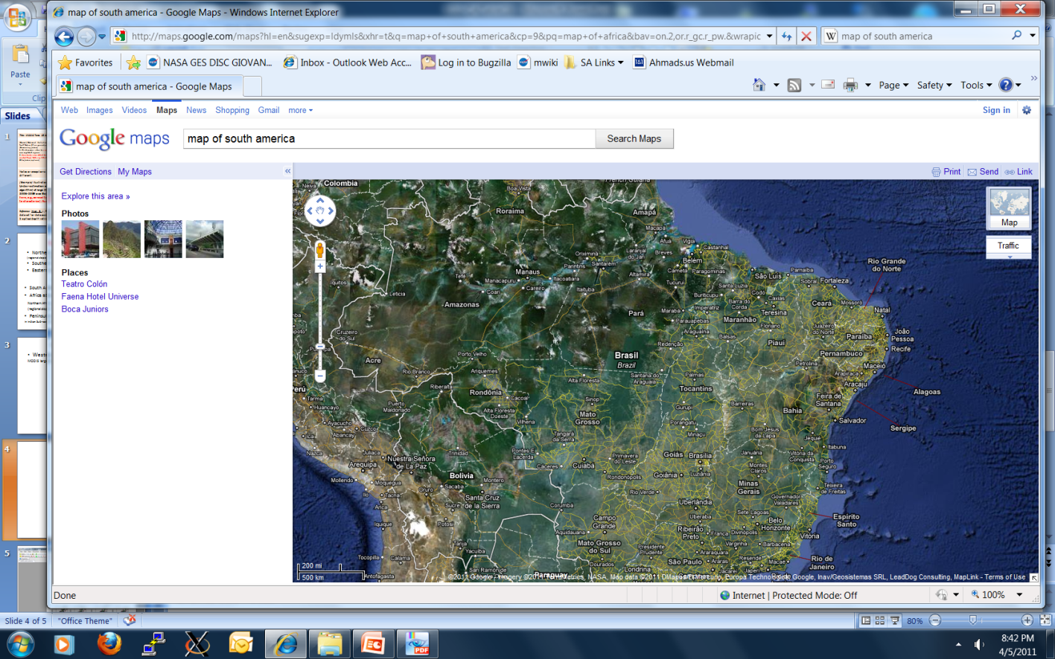
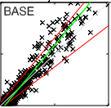
Title: MODIS Terra C5 AOD vs. Aeronet during Aug-Oct Biomass burning in Central Brazil, South America
(General) Statement: Collection 5 MODIS AOD at 550 nm during Aug-Oct over Central South America highly over-estimates for large AOD and in non-burning season underestimates for small AOD, as compared to Aeronet; good comparisons are found at moderate AOD.
Region & season characteristics: Central region of Brazil is mix of forest, cerrado, and pasture and known to have low AOD most of the year except during biomass burning season
* Alta Floresta
(Dominating factors leading to Aerosol Estimate bias):
Large positive bias in AOD estimate during biomass burning season may be due to wrong assignment of Aerosol absorbing characteristics.
(Specific explanation) a constant Single Scattering Albedo ~ 0.91 is assigned for all seasons, while the true value is closer to ~0.92-0.93.
[ Notes or exceptions: Biomass burning regions in Southern Africa do not show as large positive bias as in this case, it may be due to different optical characteristics or single scattering albedo of smoke particles, Aeronet observations of SSA confirm this]
2. Low AOD is common in non burning season. In Low AOD cases, biases are highly dependent on lower boundary conditions. In general a negative bias is found due to uncertainty in Surface Reflectance Characterization which dominates if signal from atmospheric aerosol is low.
* Mato Grosso
* Santa Cruz
Central South America
2
MODIS AOD
1
(Example) : Scatter plot of MODIS AOD and AOD at 550 nm vs. Aeronet from ref. (Hyer et al, 2011) (Description Caption) shows severe over-estimation of MODIS Col 5 AOD (dark target algorithm) at large AOD at 550 nm during Aug-Oct 2005-2008 over Brazil. (Constraints) Only best quality of MODIS data (Quality =3 ) used. Data with scattering angle > 170 deg excluded. (Symbols) Red Lines define regions of Expected Error (EE), Green is the fitted slope
Results: Tolerance= 62% within EE; RMSE=0.212 ; r2=0.81; Slope=1.00
For Low AOD (<0.2) Slope=0.3. For high AOD (> 1.4) Slope=1.54
0 1 2 Aeronet AOD
Reference: Hyer, E. J., Reid, J. S., and Zhang, J., 2011: An over-land aerosol optical depth data set for data assimilation by filtering, correction, and aggregation of MODIS Collection 5 optical depth retrievals, Atmos. Meas. Tech., 4, 379-408, doi:10.5194/amt-4-379-2011

Slide 59
Presenting Data Quality via Web service
Once we know what to present, and how to present, and where to get the information from, we can build a service that on a URL request can return an XML, from which a well-organized web page can be rendered.
This is just one step towards an ideal situation when all the aspects of quality can reside in separate modules that can be searched for based on ontology and rulesets, and then assembled and presented as html page based on user selection criteria.

Slide 60
Proposed activities
Collect facts and requirements for data usability (Kevin Ward’s example)
Identify and document best practices for error budget computations – precipitation and SST? Utilize EPA practices?
Identify potential use cases for implementing best practices
Engage the Standards and Processes Group (SPG)
White paper: start with NASA remote sensing data inventory, include best practices from EPA and NOAA, then move to analysis, and then to recommendations for future missions
Notes:
60

Slide 61
White Paper On Remote Sensing Data Quality
OBJECTIVE:
Compile inventory of data quality requirements, challenges and methodologies utilized by various communities that use remote sensing data
Caveat: Concentrate on Level 2 and 3 only (build on instrument and Level 0/1 calibration).
Near-term:
Inventory of what is going on within the different disciplines with regard to data quality.
What are the challenges, methodologies, etc. that are being addressed within the different communities?
Develop a lexicon of terminology for common usage and interoperability. find out what the various communities use to define data quality (ISO, standards, etc).
Intermediate:
Evaluate the similarities and differences, with emphasis on the most important topics that are common to the various disciplines.
Systematize this non-harmonized information (the precipitation community needs are different from the sea-surface temperature community or aerosol community).
Long-term:
Build a framework of recommendations for addressing data quality, the various methodologies and standards throughout the different communities. ..for the future missions.

Slide 62
Conclusions
The time is ripe for addressing quality of satellite data
Systematizing quality aspects requires:
  Identifying aspects of quality and their dependence of measurement and environmental conditions
  Piling through literature
  Developing Data Quality ontology
  Developing rulesets to infer pieces of knowledge to extract and assemble
Presenting the data quality knowledge with good visual, statement and references
Needs identified:
An end-to-end approach for assessing data quality and providing it to users of the data framework
Recommendations for future missions on how to address data quality systematically

