Slide 1


Providing Access to Your Data
Matthew Mayernik
National Center for Atmospheric Research
Version 1.0
Review Date
Notes:
Modules should be 3-7 minutes long

Slide 2
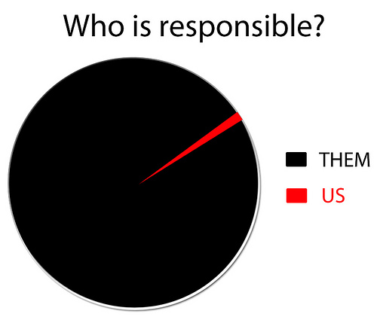
Overview
Arguments for making data openly available
Funding agency requirements
Making data accessible
Who’s responsible for providing access to your data?
Hint: this isn’t the answer
http://www.flickr.com/photos/smemon/6032417950/

Slide 3
Arguments for Making Data Accessible
Scientific considerations. Increasing access to data, facilitating reproducibility and transparency of science and data, reducing data collection effort/costs, crowd sourcing, greater potential for reuse of data in interdisciplinary applications.
Legal considerations. Data produced through public investments are public goods and should properly be in the public domain.
Socio-economic considerations. Open online access is the most efficient way to disseminate data in order to maximize their value to the public.
Ethical considerations. The public has already paid for the production of data, and thus should be able to access the data.
Good governance considerations. Transparency of data and scientific activities are undermined by restricting access to and use of public data.

Slide 4
Funding Agency Requirements
National Science Foundation policy on “Dissemination and Sharing of Research Results”:
“Investigators are expected to share with other researchers, at no more than incremental cost and within a reasonable time, the primary data, samples, physical collections and other supporting materials created or gathered in the course of work under NSF grants. Grantees are expected to encourage and facilitate such sharing.” http://www.nsf.gov/pubs/policydocs/pappguide/nsf11001/aag_6.jsp#VID4
The NSF Geoscience directorate specifies data management requirements for Ocean Science, Earth Science, and Atmospheric and Geospace Sciences.
Data management planning requirements differ amongst the sciences
A number of data archives are suggested for each science
See http://www.nsf.gov/geo/geo-data-policies/index.jsp for details

Slide 5
Funding Agency Requirements
NASA “Data & Information Policy”:
“NASA commits to the full and open sharing of Earth science data obtained from NASA Earth observing satellites, sub-orbital platforms and field campaigns with all users as soon as such data become available.
There will be no period of exclusive access to NASA Earth science data…
NASA will make available all NASA-generated standard products along with the source code for algorithm software, coefficients, and ancillary data used to generate these products.
All NASA Earth science missions, projects, and grants and cooperative agreements shall include data management plans to facilitate the implementation of these data principles.” http://science.nasa.gov/earth-science/earth-science-data/data-information-policy/

Slide 6
Funding Agency Requirements
National Oceanic and Atmospheric Administration (NOAA)
“NOAA recognizes that open and unrestricted dissemination of high quality publicly funded information, as appropriate and within resource constraints, is good policy and is the law.” http://www.noaa.gov/partnershippolicy/
Data Policy, October 2011: “All NOAA Grantees must share data produced under NOAA grants and cooperative agreements in a timely fashion, except where limited by law, regulation, policy or security requirements. Grantees must address this requirement formally by preparing a Data Sharing Plan as part of their grant project narrative.” (NOAA Environmental Data Management Committee)
U.S. Geological Survey “Information Policy and Instructions”:
“USGS-authored or produced data and information are considered to be in the U.S. public domain.” http://www.usgs.gov/laws/info_policies.html

Slide 7
Sharing data
Responsibility of investigators to follow funding agency requirements and guidelines
Sharing data can be hard
It can be difficult to share data with people who aren’t familiar with your project
Preparing data for sharing requires time, resources, and expertise
Feelings of ownership and the need to publish on data may limit what is shared
Some data might be sensitive or restricted by contracts, and thus not shareable (or only partially shareable)
It might be difficult to determine who is responsible for sharing data, and who has permission to share data within a project

Slide 8
References
Data usage and sharing policies and principles
NOAA Environmental Data Management Committee. October 2011. NOAA Data Sharing Policy for Grants and Cooperative Agreements: Procedural Directive, Version 1.0. https://www.nosc.noaa.gov/EDMC/DAARWG/docs/EDMC_PD-Data_Sharing_Policy_v1.pdf
Uhlir, P.F., R.S. Chen, J.I. Gabrynowicz, and K. Janssen. 2009. “Toward Implementation of the Global Earth Observation System of Systems Data Sharing Principles.” Data Science Journal 8: GEO1-GEO91. http://dx.doi.org/10.2481/dsj.35JSL201
Organization for Economic Co-operation and Development (OECD). 2007. OECD Principles and Guidelines for Access to Research Data from Public Funding. http://www.oecd.org/science/scienceandtechnologypolicy/38500813.pdf

Slide 9
Resources
Data usage and sharing policies and principles
International Polar Year 2007-2008 Data Policy. http://classic.ipy.org/Subcommittees/final_ipy_data_policy.pdf
National Science Foundation Division of Earth Sciences Data Policy. 2010. http://www.nsf.gov/geo/ear/2010EAR_data_policy_9_28_10.pdf
NASA Data and Information Policy. http://science.nasa.gov/earth-science/earth-science-data/data-information-policy/
NOAA Partnership Policy. http://www.noaa.gov/partnershippolicy/
USGS Information Policy and Instructions. http://www.usgs.gov/laws/info_policies.html

Slide 10
Other Relevant Modules
Providing Access to Your Data: Rights
Providing Access to Your Data: Handling Sensitive Data
Preservation Strategies: Data Transfer and Submission Agreements
Responsible Data Use: Citation and Credit

