Slide 1
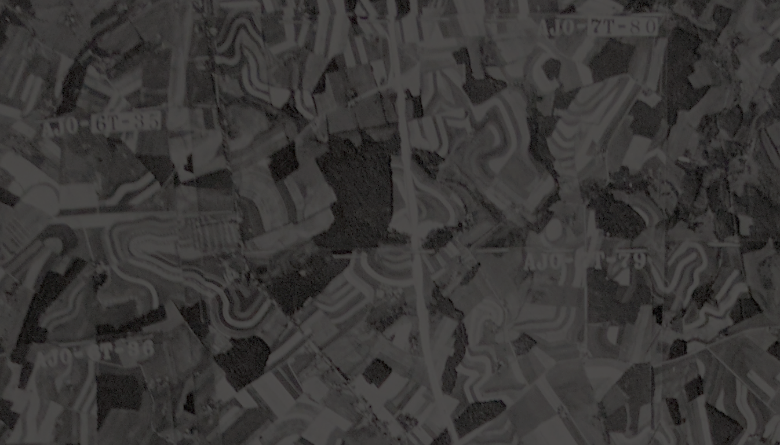

USDA National Agricultural Library GeoData Preview
Open Source Geospatial Catalog (GeoNetwork)
With Full Support ISO 19139, 19115-3
Jeffrey D. Campbell, Ph.D.
ESIP Documentation Webinar
November 26, 2018
Notes:
Title
Ag Data Commons: adding value to open agricultural research data
Public access to results of federally-funded research is a new mandate for large departments of the United States government. Public access to scholarly literature from U.S. investments is straightforward, with policies and systems like PubMed Central and PubAg (http://pubag.nal.usda.gov) already implemented. However, research data release is a more complex undertaking. Agricultural researchers make their data available in a patchwork of locations, if they share it at all, and metadata and data formats are far from standardized. Many data types overlap with basic science domains that have standards (e.g. biodiversity, genomics, hydrology) but have little in common with each other and are not tailored for agriculture. U.S. Department of Agriculture's prototoype system, the Ag Data Commons (http://data.nal.usda.gov), will meet the requirements of public access but should also go further to facilitate novel, data-intensive science. Aimed at researchers, Ag Data Commons uses DKAN, a Drupal-based catalog and repository (http://nucivic.com/dkan/), to enhance discoverability and access to well-curated resources (data files, databases, software) deposited in the system or held elsewhere. Core metadata fields are from Project Open Data v.1.1 (a requirement of the U.S. open data catalog athttp://data.gov) but we added fields and features to support scholarly research. We issue DataCite Digital Object Identifiers (DOIs), accept author ORCIDs (http://orcid.org/), apply National Agricultural Library thesaurus terms, and encourage citation of literature and linkage with related datasets and other online resources. While extremely detailed metadata are impractical given the breadth of agricultural domains, we can extract fields from sophisticated ISO 19115 geographic information metadata and extended metadata files can be posted and will be indexed. We are piloting the harvest of distributed metadata records. Towards data integration and standardization, we are developing guidelines for machine-readable data dictionaries, manifests of data elements in datasets not unlike Darwin Core Archives. We are exploring ways to enable basic interactive visualizations. Metadata are available in JSON (http://json.org/) and RDF (http://www.w3.org/RDF/), with dedicated feeds for publication links and (eventually) compliance checking. Many challenges remain before we can move from prototype to production. Among the challenges are how to provide easy API (application program interface) access to elements in data files, how to interface with related systems (e.g. Dryad, DataONE, EcoInforma, iPlant), how to leverage methods metadata and semantics, how to better support provenance and impact tracking, and how to ease the pain of both working with and preserving big data for high performance computing.

Slide 2
Agenda
Introduction
GeoNetwork Distinguishing Features
GeoData Implementation Features
Discussion

Slide 3
Introduction
Disclaimers
Not endorsing any particular project
Not representing any Federal entity
GeoData geodata.nal.usda.gov as a pilot system
not yet officially launched
“geoportal” architecture

Slide 5
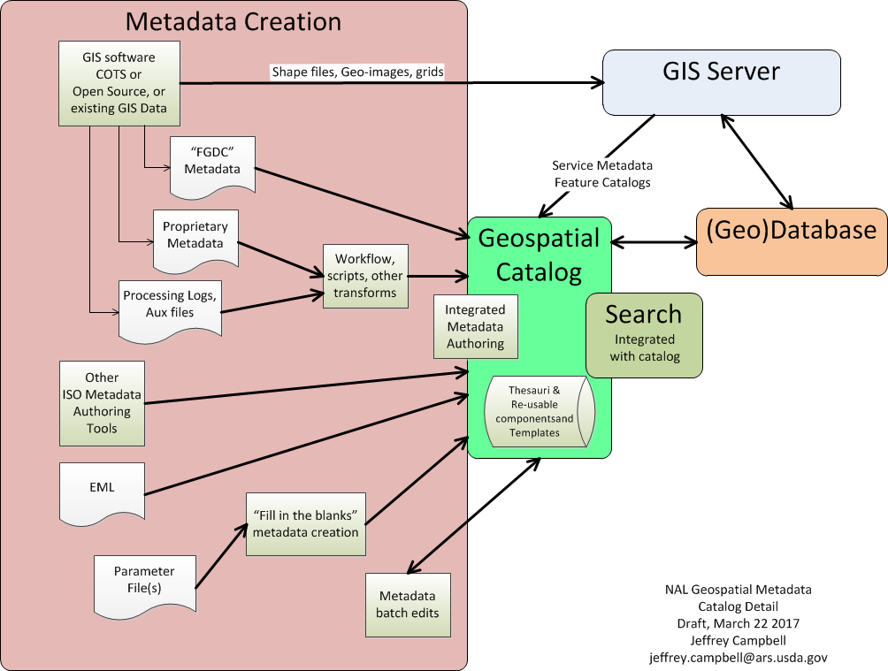
NAL Geospatial Architecture

Slide 6
GeoNetwork Distinguishing Features
ISO 19115 schema complete
Can ingest, store, display, and output any valid 19115/139 file
Tolerates some errors, but display, search, might not work
Resolves xlinks supporting re-usable metadata elements (aka, “snippets”, “components”)
User Interface
Allows nilreason entry
Multiple views with different levels of detail
Create and edit snippets (with access control)
Search/select keywords from thesauri, or as free text
Schema and schematron validation
Metadata templates as productivity aid

Slide 7
GeoNetwork Distinguishing Features
UI or batch import of records, including XML transforms if needed
Supports many catalog exchange standards including WCS.
Automatable harvesting workflow built in
Permits storing ancillary documents internally to be included with download of metadata.
Reasonable workflow, security groups out of the box
Usage Dashboard

Slide 8
GeoData Features
Relatively minor UI enhancements to meet USDA web guidelines, Section 508,
Thesauri, Thesauri, Thesauri
POD and other required info as “keywords” in “Thesaurus”
Enhanced ingest transforms for EML (versions, source stylistic differences)
Transforms 19139-2 to 19115-3
Storing metadata in source format as online resource
Responsibility snippets for both person and position

Slide 9
GeoData Features
Multi-lingual support as basis for easy modification of UI labels
Help documentation started from official docs
Cut down to user-related documentation (vs install, admin)
Updated screenshots for our UI modifications
Added local policy and best practices
Added validation error correction help
Includes location-specific data as well as traditional GIS.
Research network (18+ sites) accepted 19115 as their metadata standard
Have not (yet) used automated snippet extraction

Slide 10
Discussion - Notes
GCMD updates – how to incorporate; API, etc
Questions for the Documentation group:
ISO to data.gov
https://digital.gov/resources/how-to-get-your-open-data-on-data-gov/ (Kaylin Bugbee response)
19115-3 training materials?
ESIP ISO Explorer under development (various responses)

Slide 11
Contact
Acknowledgment of GeoData team and alumni
Jiabin Heng, Erin Antognoli, Jocelyn McNamara, Jonathan Sears, Melissa Lohrey, NAL ISD.
General metadata point of contact
NAL-geodata@ars.usda.gov
Jeff Campbell
jeff@campbellinformatics.com (until USDA account is re-activated)
Jeffrey.Campbell@ars.usda.gov (very soon)

Slide 12
Extra Slides
Thesauri Details
Three Thesauri Approaches
GeoData Thesauri
Screenshot examples for
Catalog display of metadata
Fill-in-the-blank template
Categorized keyword
Processing step metadata

Slide 13
Three Thesauri Approaches
Thesauri with RDF content
Select/search in UI for tems
Theasuri too large for UI
Trust but verify
User-defined thesaurus
Create snippet for standard citation and/or
Implement as supported thesaurus
Free text
Review for reasonableness

Slide 14
GeoData Thesauri
Strongly Recommended
National Agricultural Library Thesaurus
GCMD Locations
FIPS State/County Codes
GCMD Earth Science and Earth Science Services
Watershed (HUC)
EcoRegions
NRCS Major Land Resource Areas
USDA Plant Hardiness Zone
Soil Taxonomy
Omernik Ecoregions US
IGBP Vegetation Types
GCMD
Instruments, Platforms, Data Centers, Horizontal Resolution, Projects, Temporal Resolution, Vertical Resolution
Other
GeoNames (GeoNetwork default)
Koppen Climate Classification
GCOS Essential Climate Variables
World Meteorological Organization
USGS (CSDGM) – in process
Administrative and Internal Usage
Ag Data Commons Keywords
Data Source Affiliation (Research network ,etc)
Federal Program Inventory
OMB A-16 Geospatial Themes
OMB Bureau Codes

Slide 15
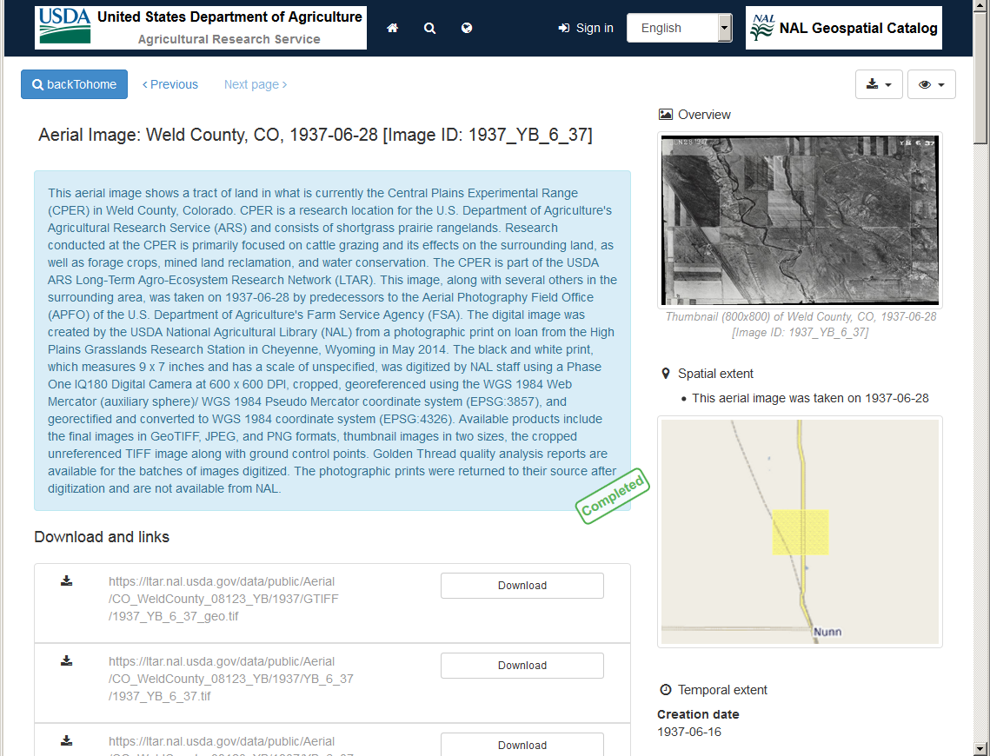

Slide 16

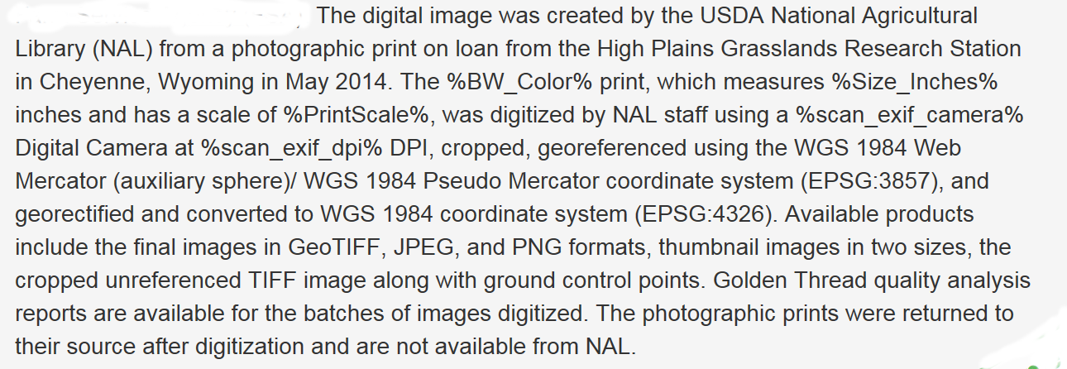
Fill in blank template

Slide 17
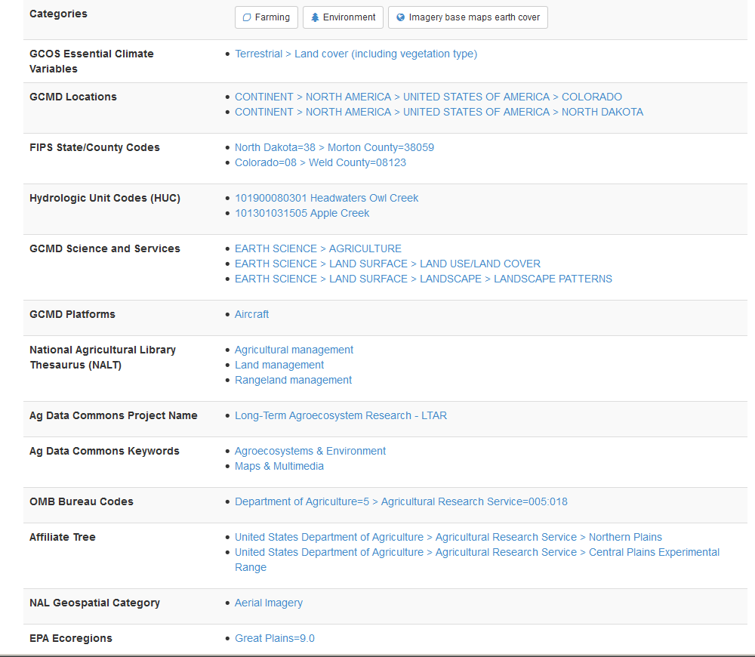
Categorized Keywords

Slide 18
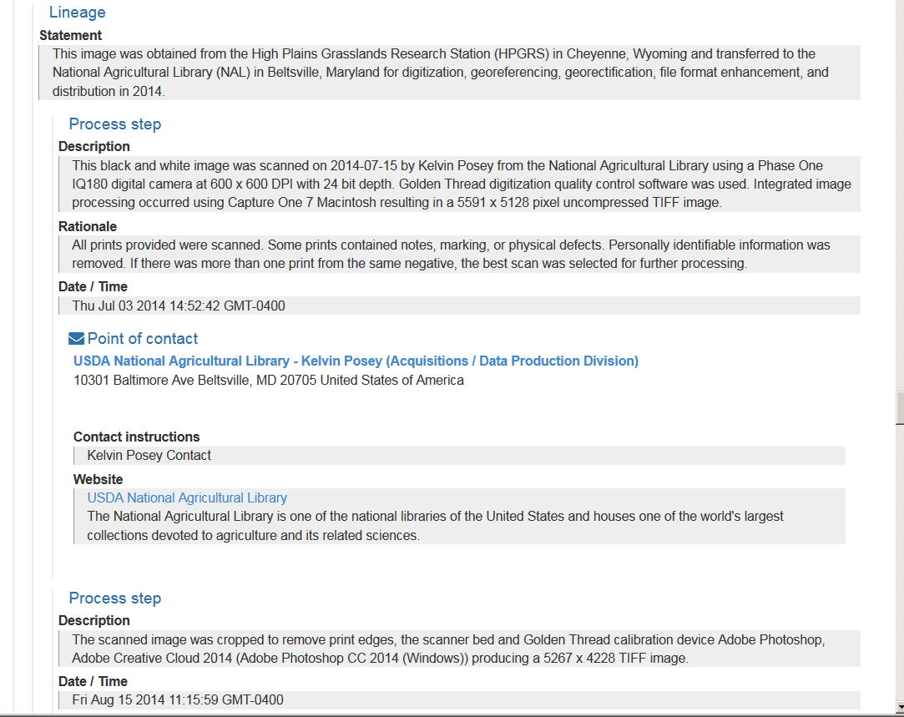
Processing Step Metadata

