Slide 1
Introduction to Exceptional Event Analyst Community
Erin Robinson Information and Virtual Community Director, Foundation for Earth Science Graduate Student, Washington University

Slide 2
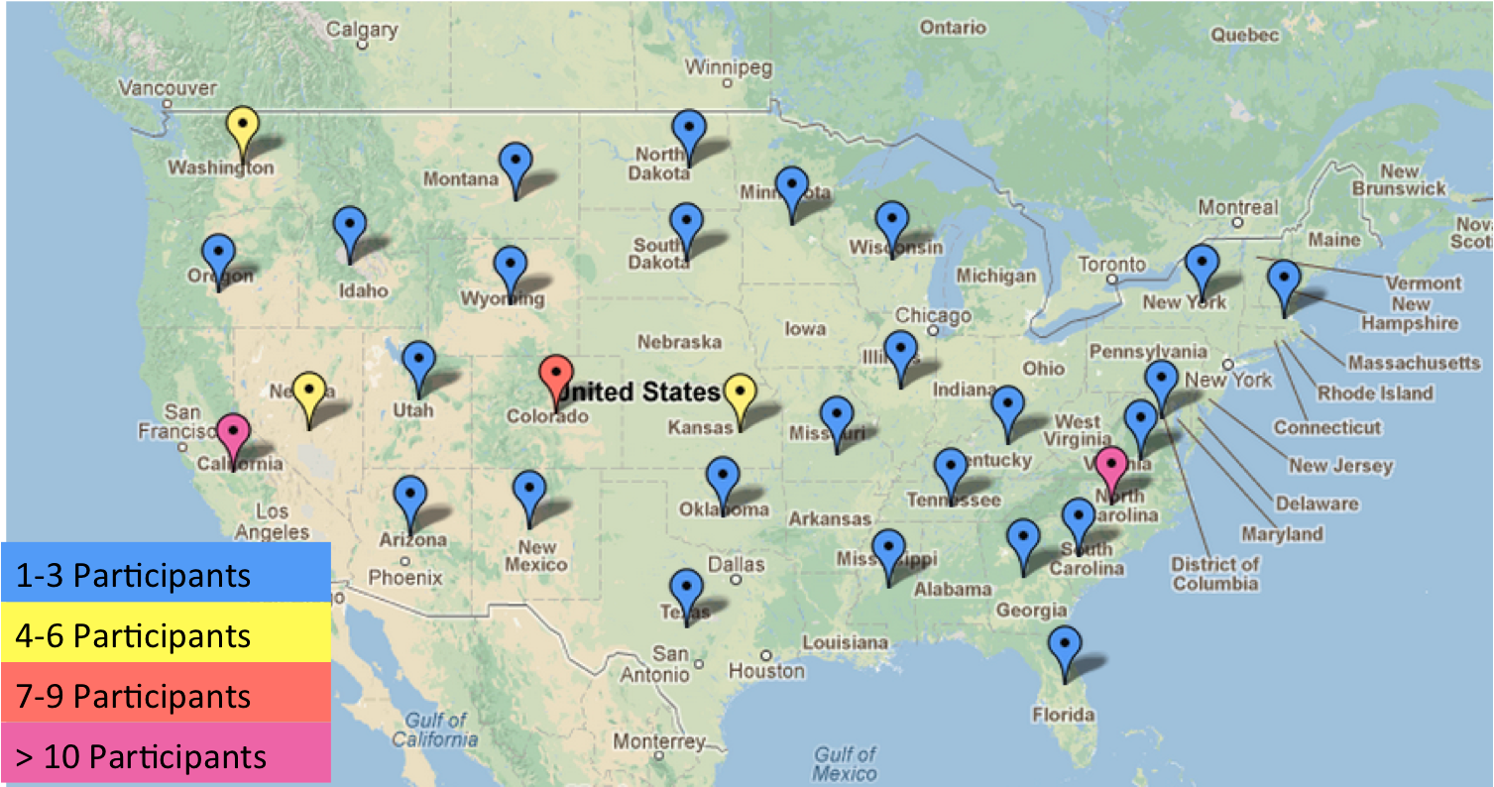
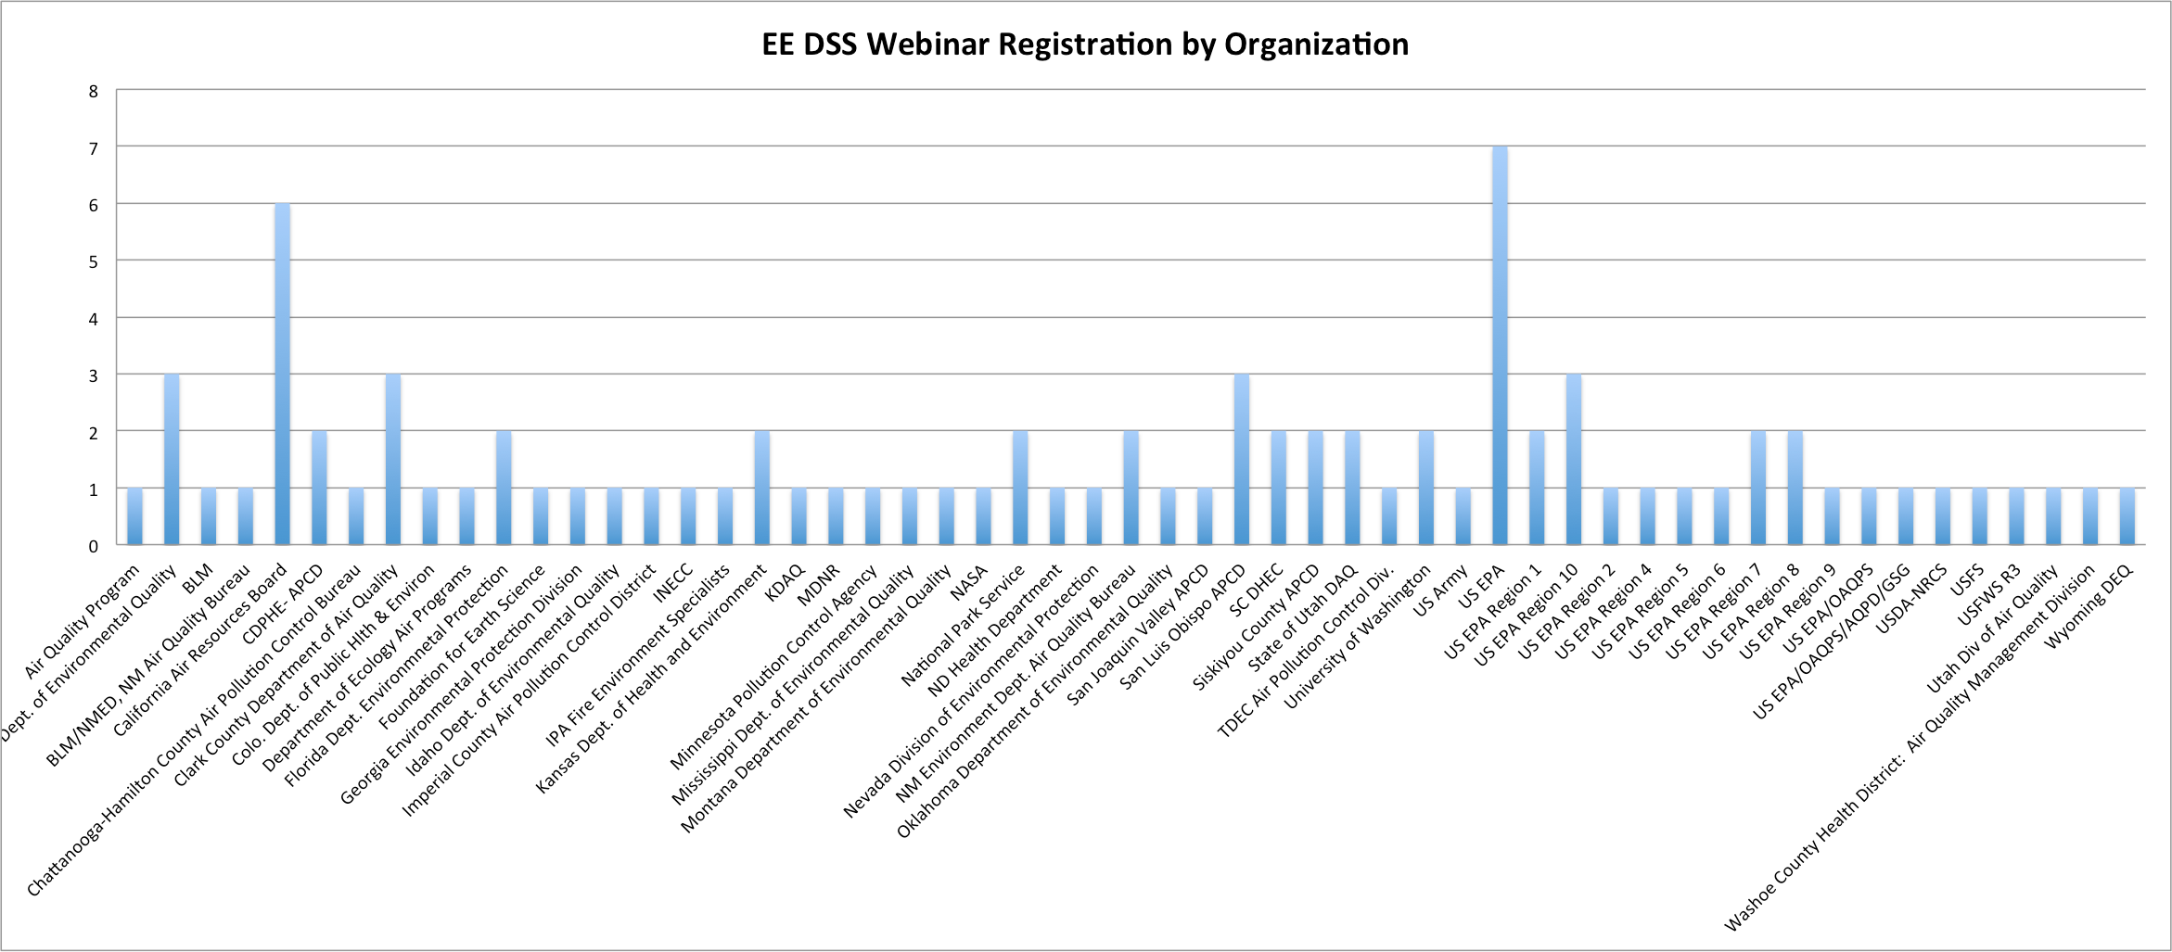
Registered Attendees for the EE DSS Webinar
140+ Registered Participants
From Over 50 Organizations
Notes:
One goal of the EE DSS tool is to foster a community of air quality analysts.

Slide 3

User Hurdles
“The user cannot find the [information];
If he can find them, he cannot access them;
If he can access them, he doesn't know how good they are;
if he finds them good, he can not merge them with other [information]”
The Users View of IT, NAS 1989
Notes:
Users are faced with a variety of hurdles

Slide 4
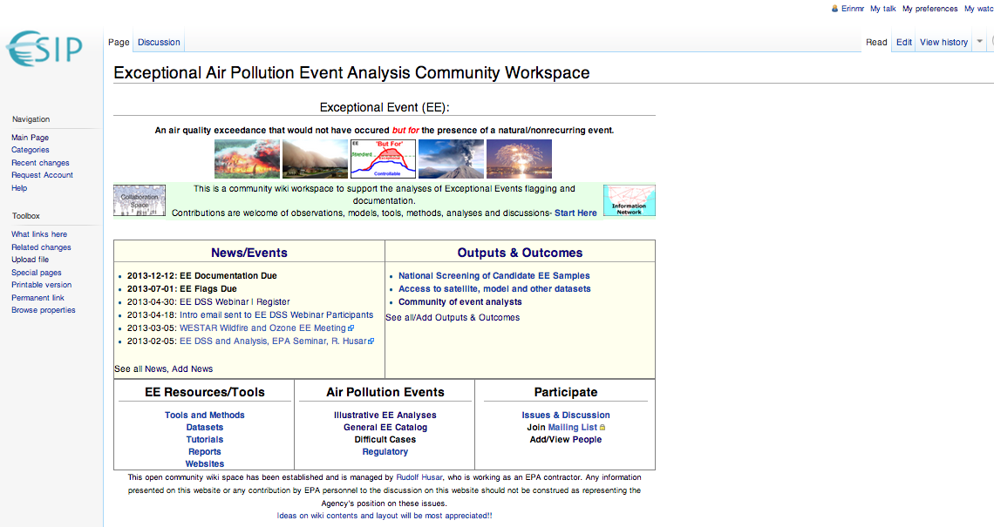
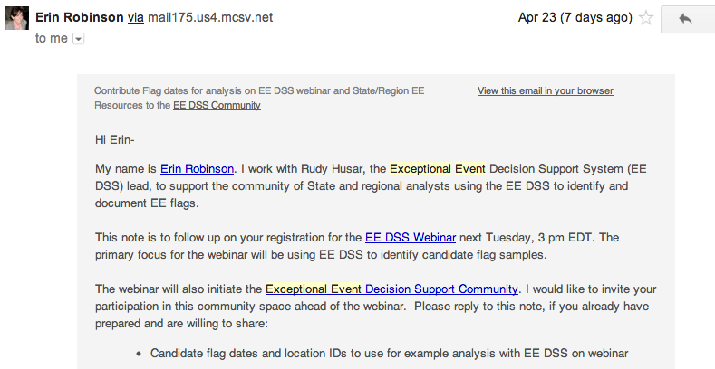
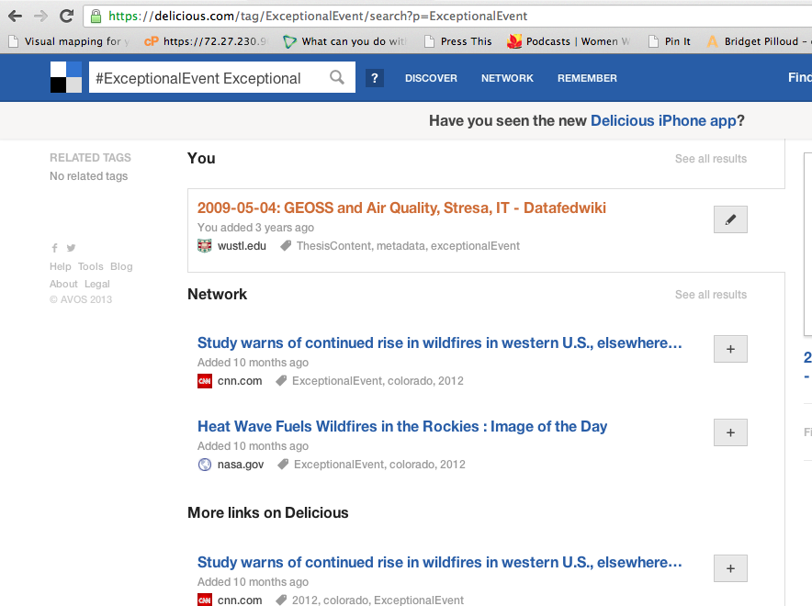
Beyond the EE DSS Tool

Slide 5
Hub for Community EE Analysis Activities
The wiki is editable
Participate by:
Adding your name to participant list
Sharing EE-content
Contributing to the discussions
http://wiki.esipfed.org/index.php/Exceptional_Air_Pollution_Event_Analysis_Community_Workspace

Slide 6
Share Resources with ExceptionalEvent Tag
Social Bookmarking tool
Allows collaborative curation of lists w/common tag
Tag EE Resources with: ExceptionalEvent
https://delicious.com/tag/ExceptionalEvent

Slide 7
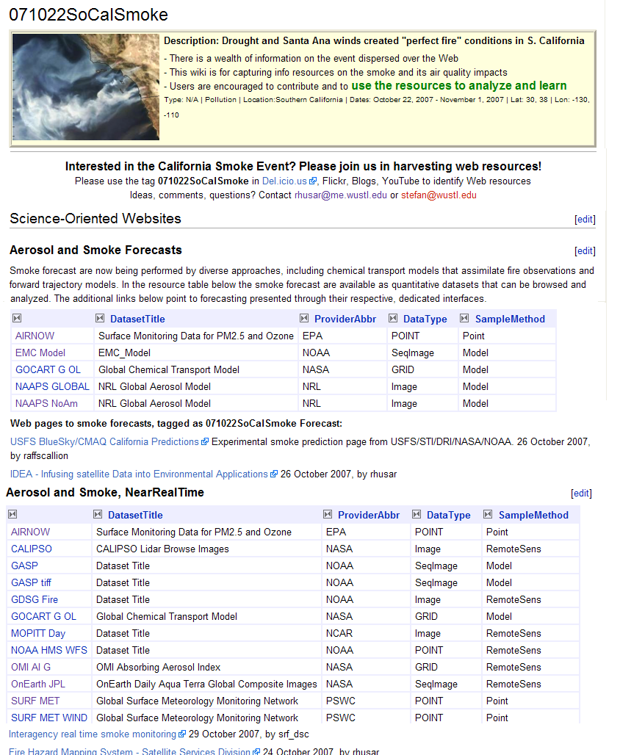
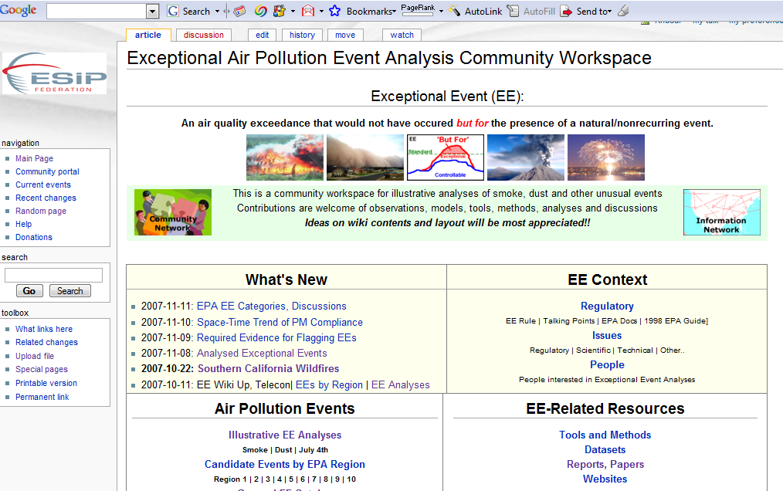
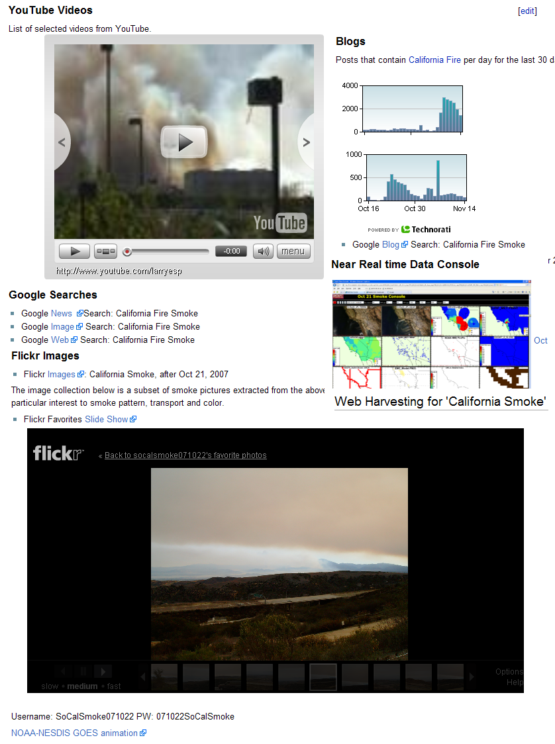
Application-Task-Centric Workspace Example: EventSpaces
Specific Exceptional Event
Catalog - Find Dataset
http://wiki.esipfed.org/index.php/ExceptionalEventList
Harvest Resources

Slide 8
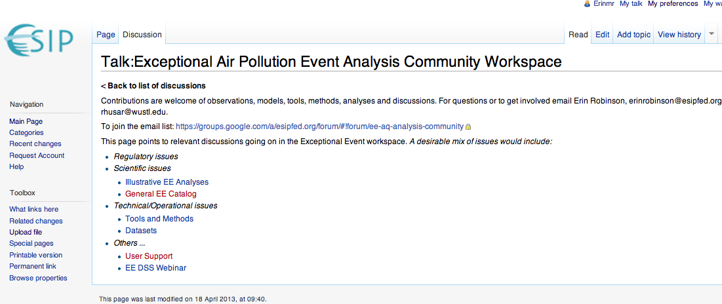
Feedback and Discussion
http://wiki.esipfed.org/index.php/Talk:Exceptional_Air_Pollution_Event_Analysis_Community_Workspace

Slide 9
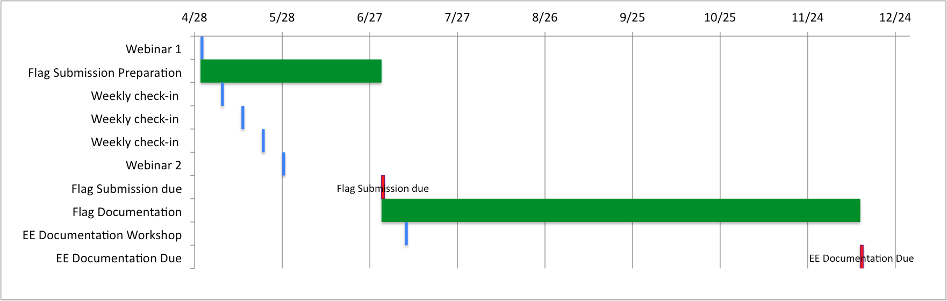
EE Flag Preparation and Submission Timeline for PM_{2.5}
April – EE Webinar #1 –Explanation and Application of EE DSS screening tool
May – EE Webinar #2 – User Feedback and Application Examples
July 1, 2013 – EE Flag Submission for PM_{2.5} for 2010, 2011, 2012
July 9-10 – EE Documentation Hybrid (w/Virtual) Workshop (ESIP)
Dec 12, 2013 – EE Documentation Submission for PM_{2.5}

Slide 10
Many Thanks:
Kari Hoijarvi, Washington University
Anshu Tirumali, Washington University
Rich Poirot, State of Vermont
Doug Westphal, Naval Research Lab
Neil Frank, EPA
Ali Omar, NASA Applied Sciences

Slide 11
Community Contacts
Rudy Husar, Washington University, Stl. rhusar@wustl.edu
Erin Robinson, Foundation for Earth Science, erinrobinson@esipfed.org
Neil Frank, EPA, Frank.Neil@epa.gov;
Mark Evangelista, EPA, Evangelista.Mark@epamail.epa.gov

