Slide 1
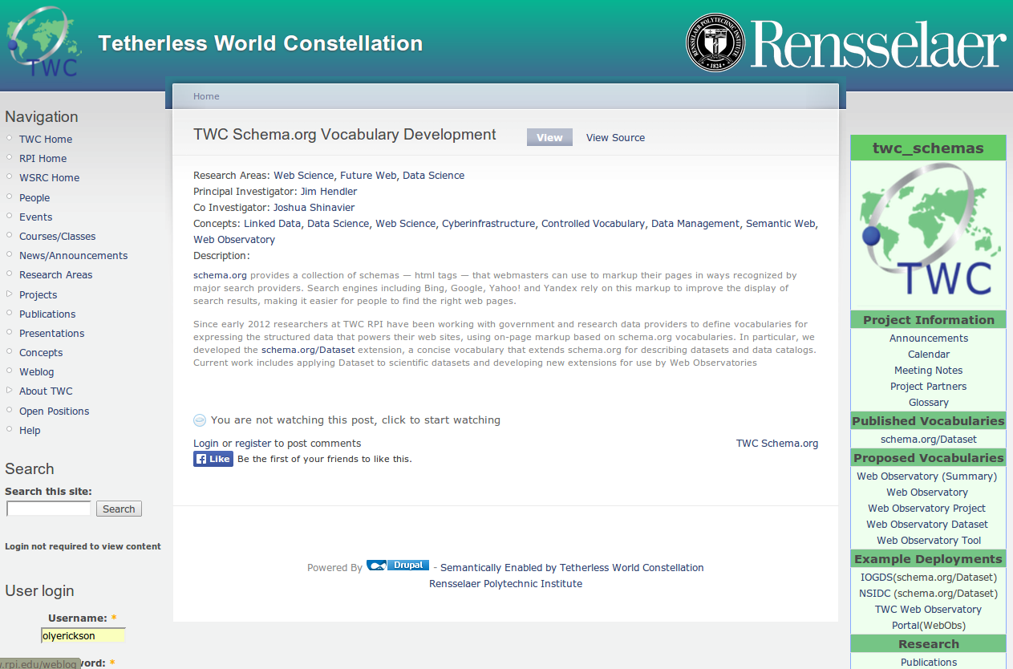
Vocabularies in
development
Demos of published
vocabs (esp. “Dataset”)
http://tw.rpi.edu/web/project/twc_schemas

Slide 2
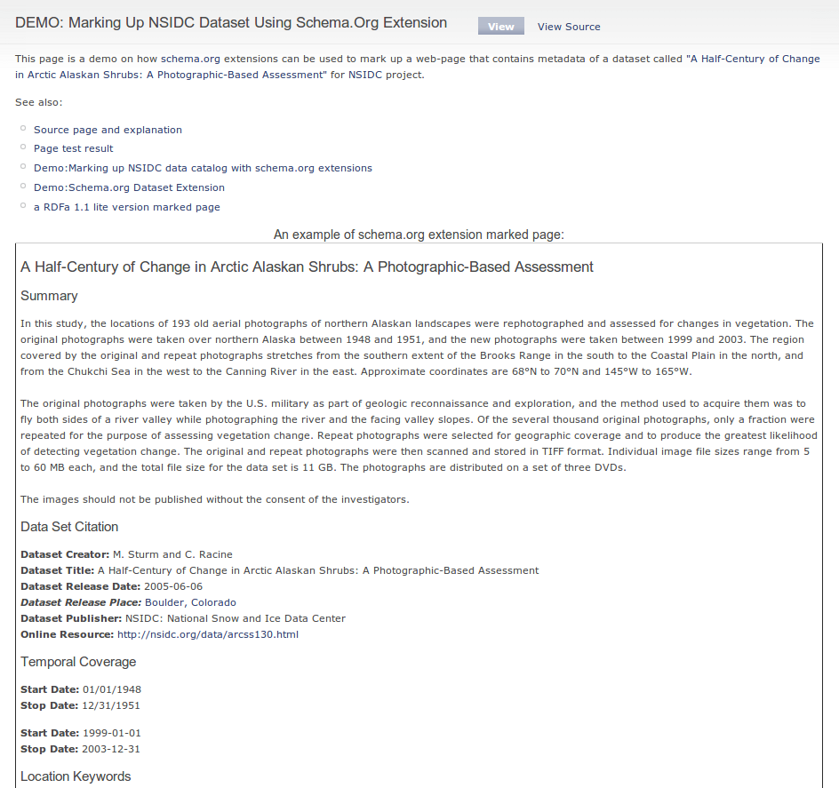
DEMO: Marking up a dataset info page
http://tw.rpi.edu/web/node/3558

Slide 3
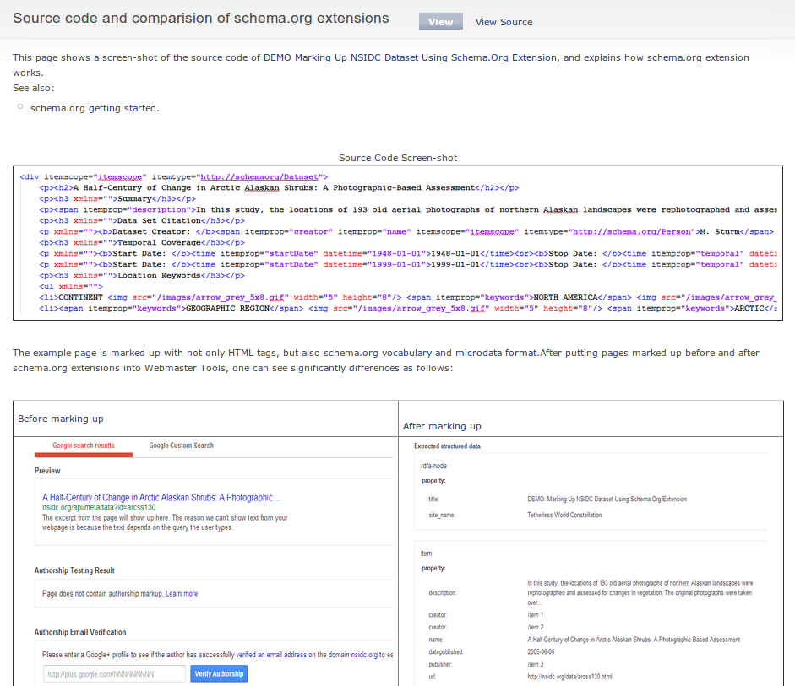
http://tw.rpi.edu/web/node/3568

Slide 4
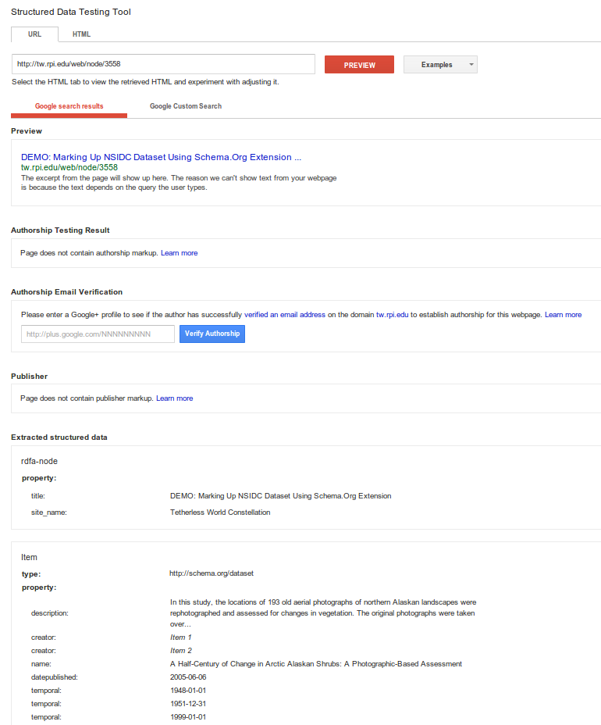
Google Structured DataTest Results
http://bit.ly/1izzqZr

Slide 5
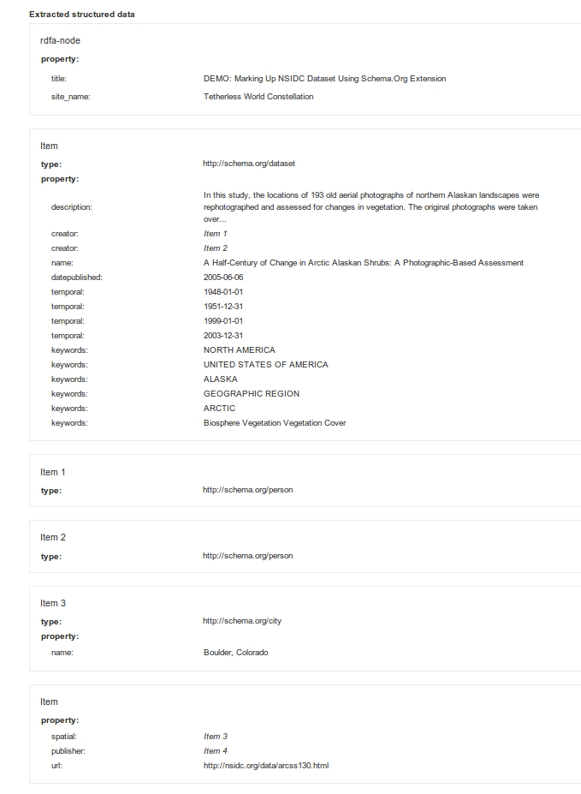
Google Structured Data Test Results
http://bit.ly/1izzqZr

Slide 6
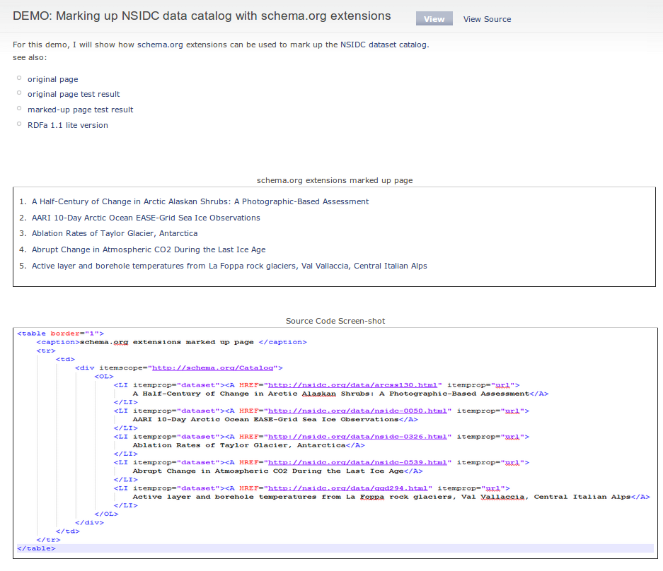
DEMO: Marking up data catalog page
http://tw.rpi.edu/web/node/3570

Slide 7
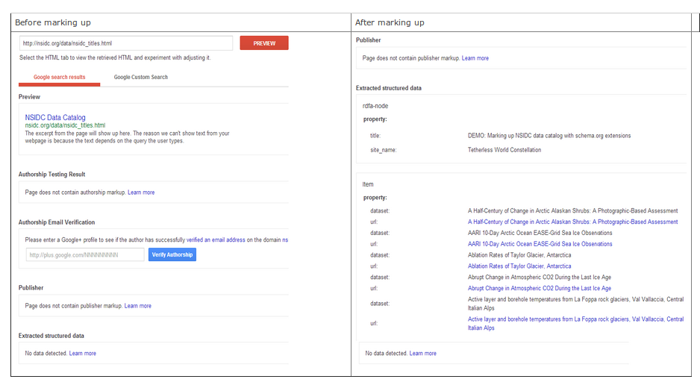
DEMO: Marking up data catalog page
http://tw.rpi.edu/web/node/3570

Slide 8
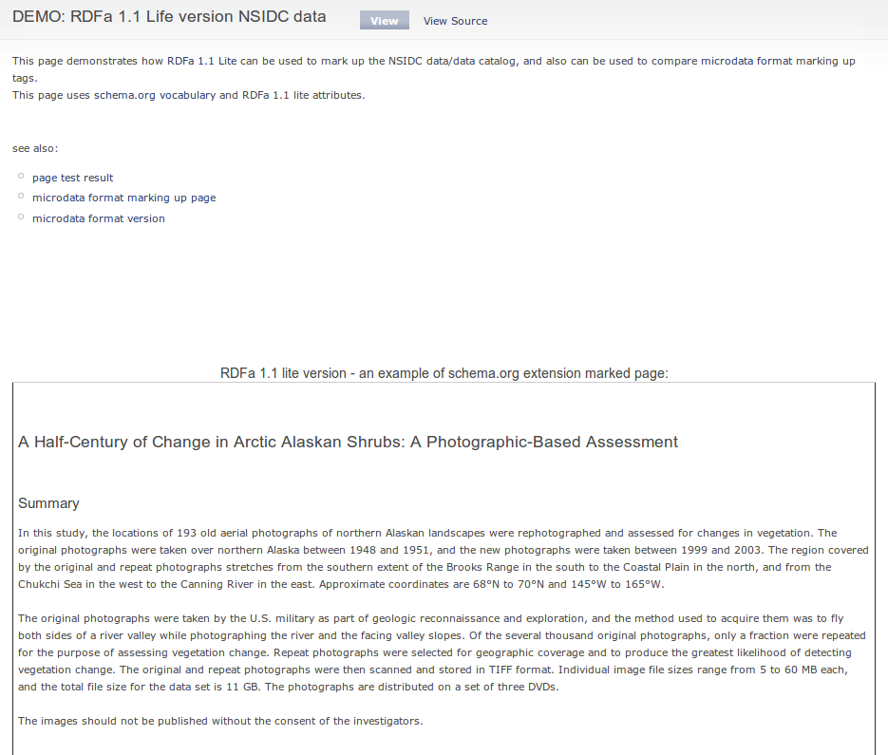
DEMO: RDFa 1.1. Lite variation of markup
http://tw.rpi.edu/web/node/3582

Slide 9
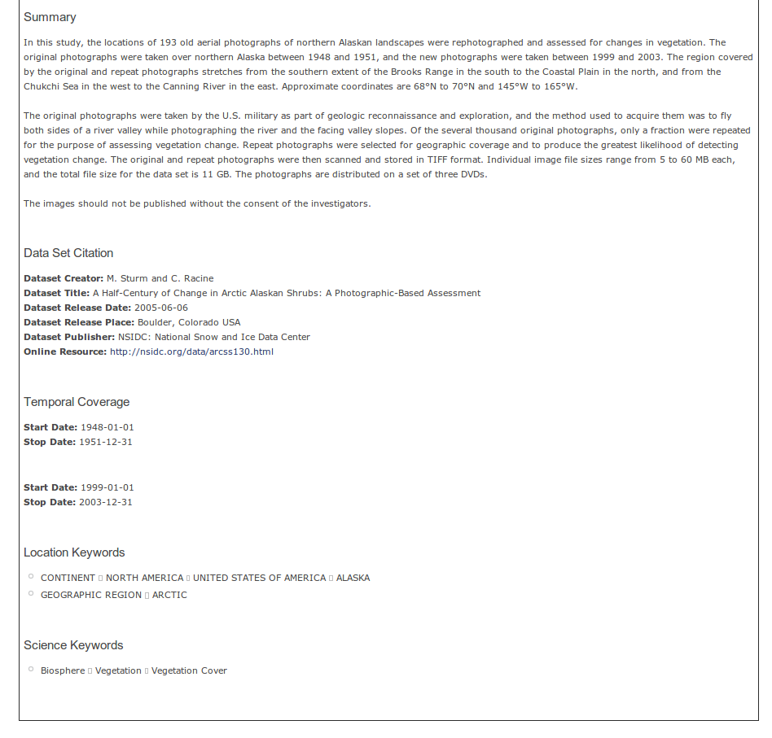
DEMO: RDFa 1.1. Lite variation of markup
http://tw.rpi.edu/web/node/3582

Slide 10
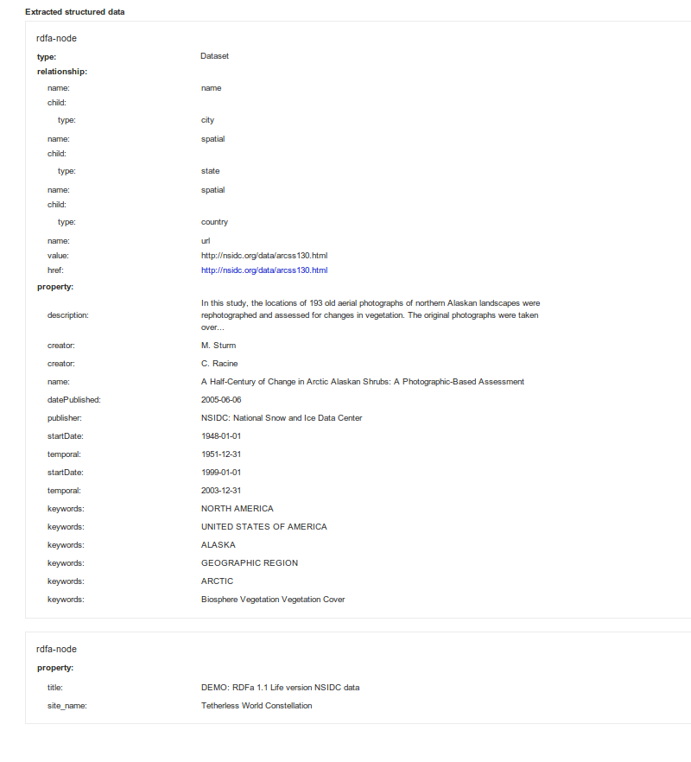
Google Test Result
http://bit.ly/1hA4rvY

Slide 11
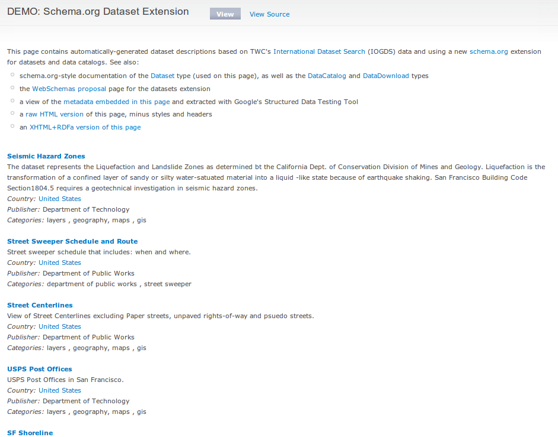
Schema.org/Dataset comprehensive demo & tutorial page
http://logd.tw.rpi.edu/schemaorg_dataset_extension

