Slide 1
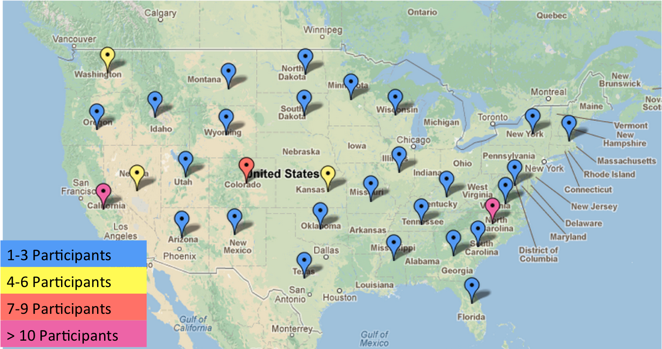
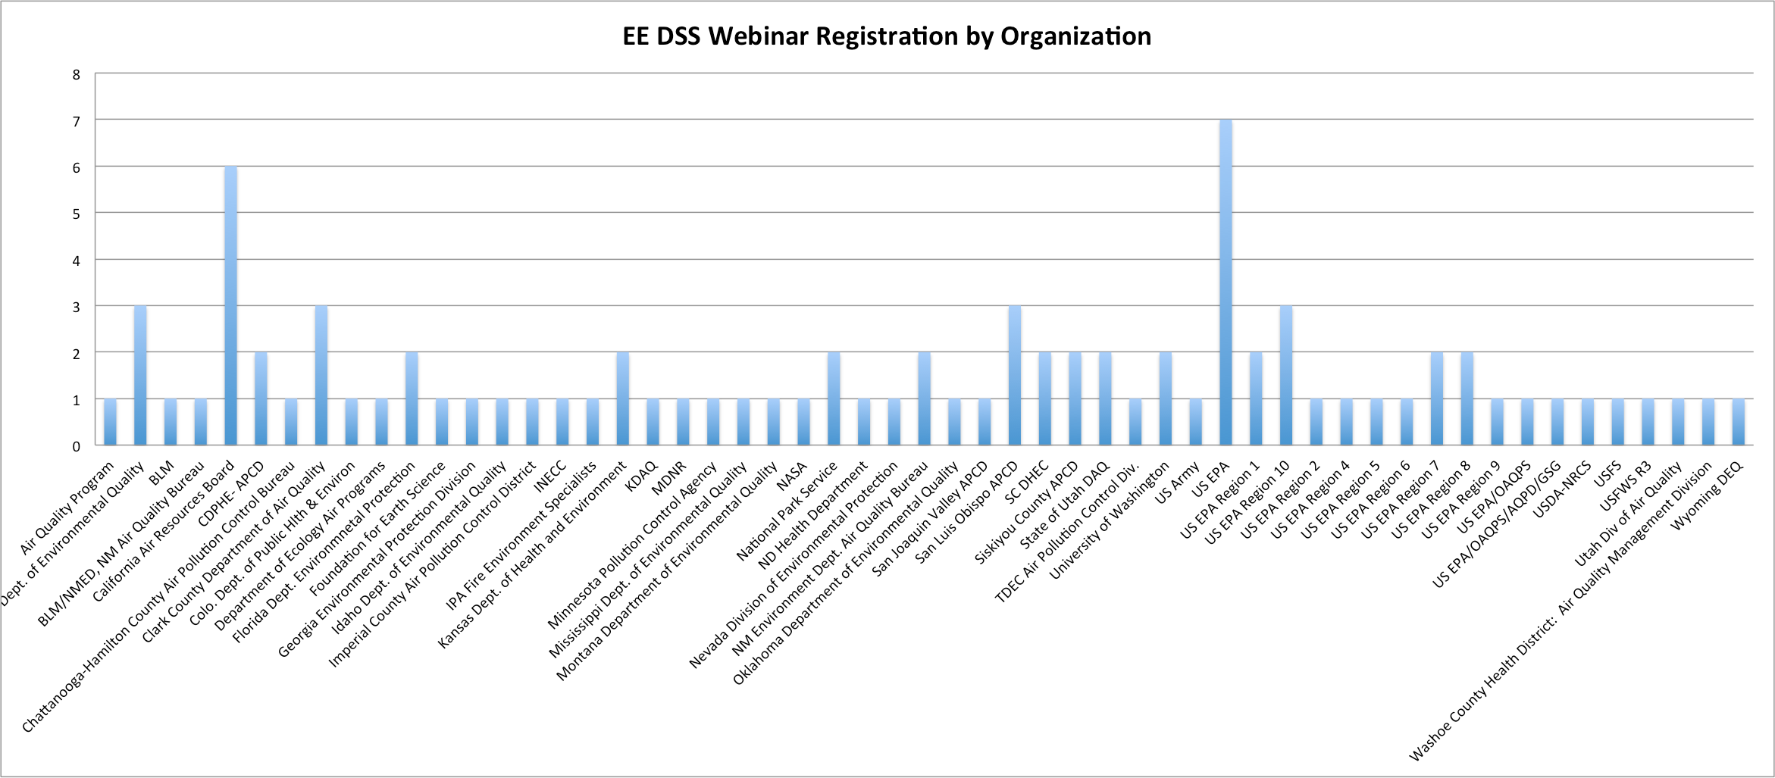
Community of Air Quality Analysts
118 Registered Participants
From Over 50 Organizations
Notes:
One goal of the EE DSS tool is to foster a community of air quality analysts.

Slide 2

User Hurdles
“The user cannot find the [information];
If he can find them, he cannot access them;
If he can access them, he doesn't know how good they are;
if he finds them good, he can not merge them with other [information]”
The Users View of IT, NAS 1989
Notes:
Users are faced with a variety of hurdles

Slide 3
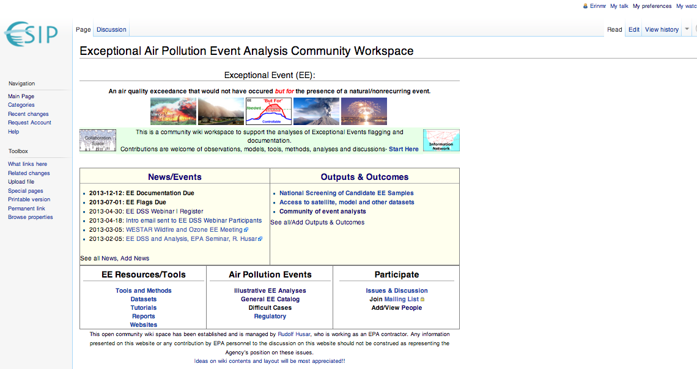
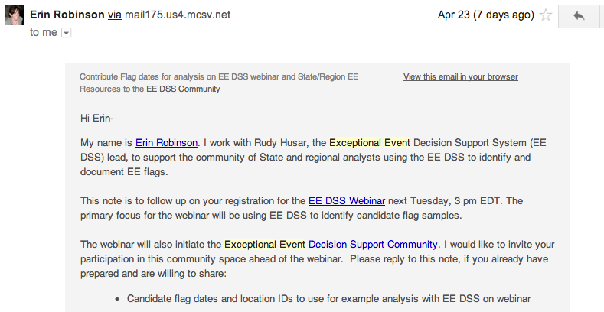
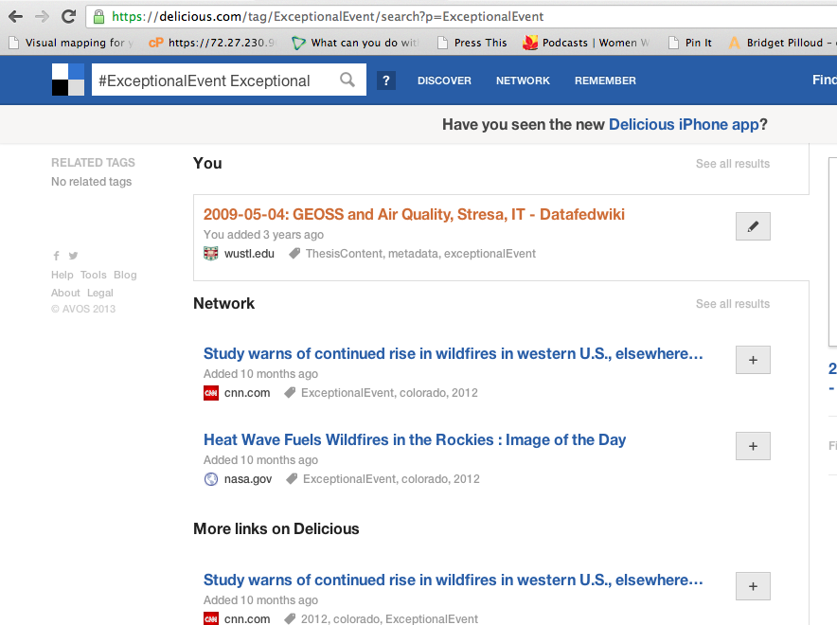
Beyond the EE DSS Tool

Slide 4
Hub for Community EE Analysis Activities
The wiki is editable
Participate by:
  Adding your name to participant list
  Sharing EE-content
  Contributing to the discussions
http://wiki.esipfed.org/index.php/Exceptional_Air_Pollution_Event_Analysis_Community_Workspace

Slide 5
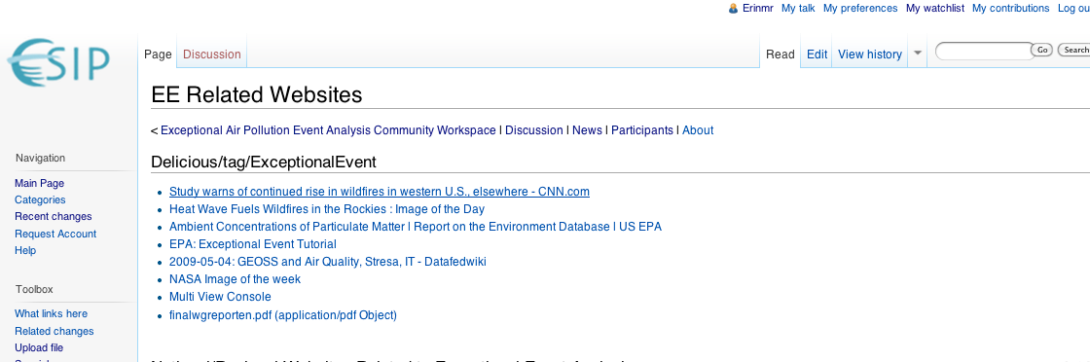
Share Resources with ExceptionalEvent Tag
Social Bookmarking tool
Allows collaborative curation of lists w/common tag
Tag EE Resources with: ExceptionalEvent
https://delicious.com/tag/ExceptionalEvent

Slide 6
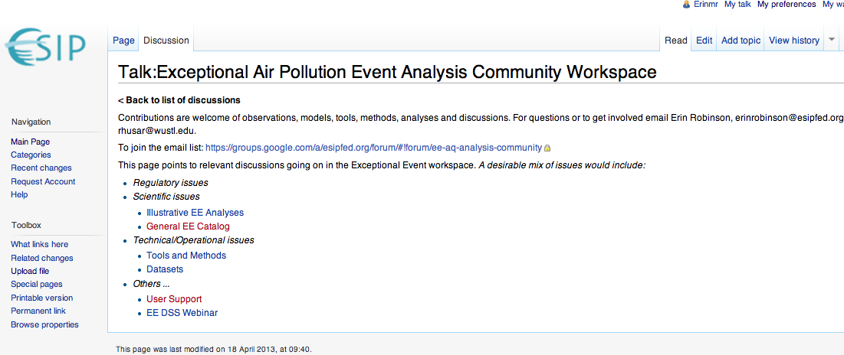
Feedback and Discussion

Slide 7
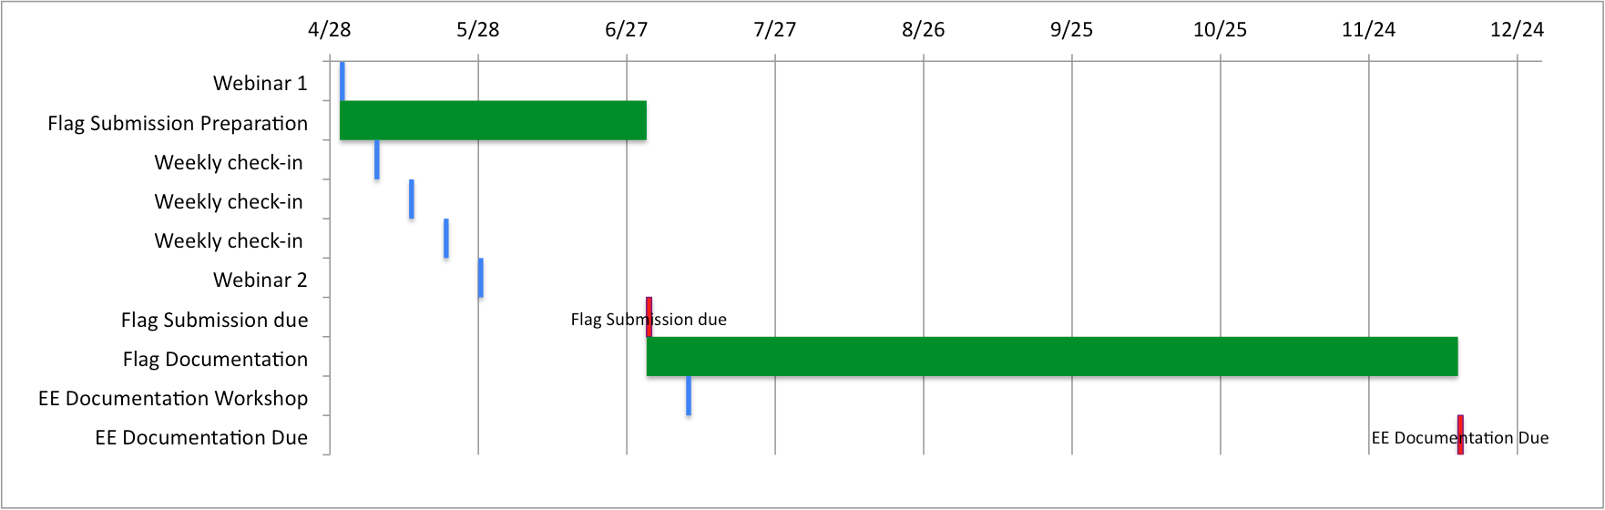
EE Flag Preparation and Submission Timeline
April – EE Webinar #1 –Explanation and Application of EE DSS screening tool
May – EE Webinar #2 – User Feedback and Application Examples
July 1, 2013 – EE Flag Submission
July 9-10 – EE Documentation Workshop (ESIP)
Dec 12, 2013 – EE Documentation Submission

Slide 8
Community Contacts
Rudy Husar, Washington University, Stl. rhusar@wustl.edu
Erin Robinson, Foundation for Earth Science, erinrobinson@esipfed.org
Neil Frank, EPA, Frank.Neil@epa.gov;
Mark Evangelista, EPA, Evangelista.Mark@epamail.epa.gov

