Slide 1
Update on the use of near real time and other data sets in partnership with the State of California:
Cascadia Rising 2016 and Vigilant Guard 17
ESIP Winter Meeting 2017
Maggi Glasscoe, Andrew Aubrey
NASA Jet Propulsion Laboratory, California Institute of Technology
Margaret.T.Glasscoe@jpl.nasa.gov
Anne Rosinski
California Geological Survey Menlo Park
James Morentz
JWMorentz LLC
Phil Beilin
City of Walnut Creek
Dave Jones
StormCenter Communications
© 2017. All rights reserved.

Slide 2
The Problem
Providing actionable data for situational awareness following a disaster is critical to decision makers
  Improves their ability to anticipate requirements and provide appropriate resources for response.
  Essential Elements of Information (EEI) necessary to achieve situational awareness are often generated from a wide array of organizations and disciplines, using any number of geospatial and non-geospatial technologies.
We must work to enable coordination between research scientists, applied scientists and decision makers in order to reduce duplication of effort, maximize information sharing, translate scientific results into actionable information for decision-makers, and increase situational awareness.
Notes:
Key information on the nature, magnitude and scope of damage, or Essential Elements of Information (EEI), necessary to achieve situational awareness are often generated from a wide array of organizations and disciplines, using any number of geospatial and non-geospatial technologies.

Slide 3
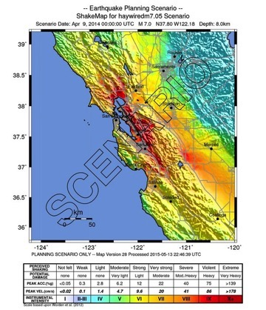
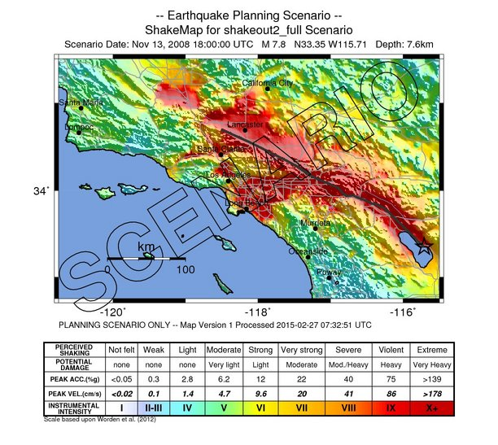
The Exercises
Cascadia Rising was a FEMA National Level Exercise held 7-10 June 2016
  The scenario included a M 9.0 earthquake resulting in the complete rupture of 700-mile Cascadia Subduction Zone that triggered a tsunami and multiple aftershocks
Vigilant Guard 17 was a Full Scale National Guard Exercise hosted by California and Nevada held 10-14 November 2016
  The scenario included a M 6.0 earthquake east of Las Vegas and a M 7.8 earthquake in southern California with multiple aftershocks
Haywired 2017 California Exercise is an earthquake scenario to model and study impacts on the San Francisco Bay area from a Mw 7.05 earthquake on the Hayward fault (planned early 2017)
  Builds upon understanding of the last large earthquake to occur on the Hayward fault in 1868
  Considers that modern urban infrastructures are made vulnerable by multiple layers of interdependencies between lifelines
  Also considers impacts from a sequence of aftershocks following the main earthquake

Slide 4
Cascadia Rising Goals and Objectives
  Enhance Disaster Response Joint-Operations – Test the local, state, tribal, and federal government as well as select private sector and non-government organizations’ ability to jointly respond to a Cascadia Subduction Zone M9.0 earthquake and tsunami with associated aftershocks along the West Coast of the U.S.
  Prepare for a Level-1 Catastrophic Earthquake Disaster – Link together Emergency Operations Centers (EOCs) throughout the Pacific Northwest to coordinate and mimic all facets of a complex, wide-area, response to a catastrophic disaster.
  Exercise the California Earthquake Clearinghouse – focus on interdependencies of critical infrastructure, information sharing, and coordination for response, recovery, and regional resiliency.

Slide 5
Vigilant Guard Goals and Objectives
Mission Statement
California and Nevada will host a Full Scale Exercise (Vigilant Guard 17-1) in the vicinity of Southern California and Nevada that stresses the region’s response capabilities from 14 - 20 November 2016 in order to train, develop, and refine joint functions by executing the Regional Response Plan, the Dual Status Commander process, and collaborating and integrating with state and federal partners.
Program Description
Vigilant Guard exercises support Interagency play and National Guard civil support/DSCA missions, by:
  Employing scenarios and events where National Guard forces can interact with Local, State, and Federal agencies
  Enabling planning efforts of civil agencies by incorporating their objectives and activities into the overall exercise
  Providing an exercise “jumping off” point for civilian partners internal exercise events, let them leverage this as much as possible

Slide 6
Participating Agencies:
Cascadia Rising
Over 50 counties and numerous cities across three states
19 tribes in OR and WA
Three state EOCs with all state ESF agencies represented
FEMA Region 10 RRCC with all Federal ESF and Interagency partners represented
FEMA NRCC with all Federal ESF and Interagency partners represented
U.S. TRANSCOM and U.S. NORTHCOM linked exercises and other military and USCG commands
British Columbia and Public Safety Canada
Private sector, hospitals, utilities, Non‐governmental Organizations etc.
California Earthquake Clearinghouse and partner organizations (EERI, USGS, NASA, San Jose Water Company, Humboldt County OES, San Diego Law Enforcement Coordination Center, California Department of Fish and Wildlife, Office of Spill Prevention and Response, California Department of Public Health, EF-8, California Environmental Protection Agency, EF-10, Bay Area Center for Regional Disaster Resilience, California Independent System Operator (Cal ISO), Single Automated Business Exchange for Reporting (SABER), California Office of Emergency Services, FEMA Region 9, FEMA Region 10, Cascadia Region Earthquake Working Group, City of Walnut Creek, California National Guard, State of Washington, Central U. S. Earthquake Consortium, Association of Engineering Geologists - Inland Empire, Inland Geological Society, Caltrans

Slide 7
Participating Agencies:
Vigilant Guard
Federal
  Federal Emergency Management Agency, Region 9
  Federal Emergency Management Agency, Region 10
  United States Geological Survey
  Federal Bureau of Investigation
  National Aeronautics and Space Administration Jet Propulsion Laboratory
State
  California Geological Survey
  California Environmental Protection Agency, EF/ESF 10
  California Department of Public Health, EF/ESF 8
  San Diego Law Enforcement Coordination Center
  California Air National Guard
  San Jose Water Company
  California Public Utilities Commission
  California Water/Wastewater Agency Response Network
  California Office of Emergency Services
  City of Walnut Creek
  City of Las Vegas
  Washington State Office of Emergency Services
  Oregon Dept. of Geology and Mineral Industries
  Arizona State University
  Arkansas Geological Survey
  Structural Engineers Association of Southern California
  Earthquake Engineering Research Institute
  National Association of Public Safety GIS Professionals – N. CA Chapter
  California Independent System Operators
  Geotechnical Extreme Events Response
Private Sector
  SpotOnResponse
  SABER, Single Automated Business Exchange for Reporting
  Sears Holdings (SABER member providing business status)
  Walmart (SABER member providing business status)
  Target (SABER member providing business status)
  Costco (SABER member providing business status)
  Macy’s (SABER member providing business status)
  Walgreens (SABER member providing business status)
  Southwest Gas
  Kern River Gas
  Southern California Edison
  BNSF Railway

Slide 8

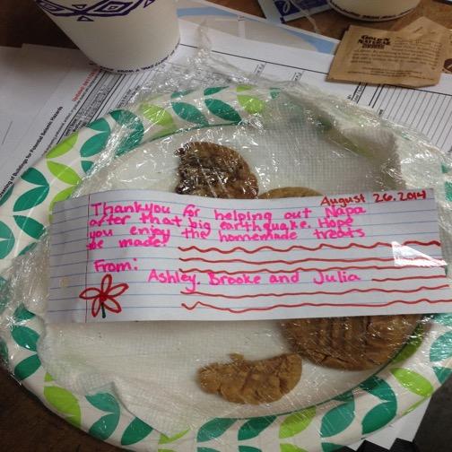
Clearinghouse Objectives
Facilitate field investigations by earth scientists, engineers and social scientists, who converge on the disaster site
Assist researchers in accessing perishable data through coordination with emergency management organizations and law enforcement
Provide a forum for sharing information via meetings at a physical location (field office) and through our new virtual Clearinghouse
Track fieldwork progress and minimize duplication of effort; organize data and imagery collected via various technologies and applications and synthesize information for response agencies
Clearinghouse does not direct or control activities of participants

Slide 9
Value of Clearinghouse Data Sharing Efforts
Time Savings
Information to support your COP
Two-way Information Sharing
Clearinghouse Technology Interoperability
Connect best tools and technologies
Decision Support
Not just for earthquakes
Situational Awareness

Slide 10












Information Sharing Between Multiple State, Federal, Local Organizations through XchangeCore connected applications
N. CA Chapter

Slide 11
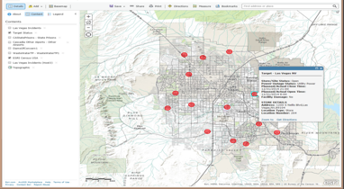
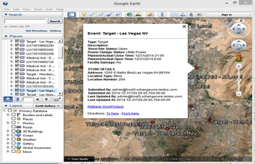
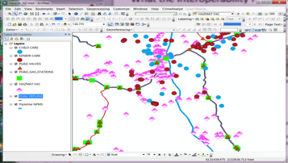
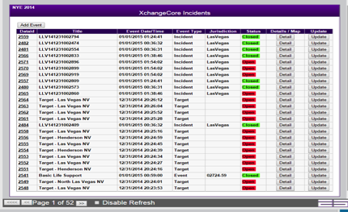

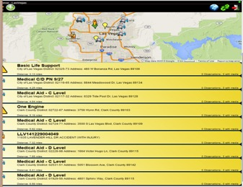
Incident Situational Awareness Exchanged
AGOL
Google Earth
ArcGIS
Web EOC
Common Operational DATA Shared to different technologies
Mobile Aps
Incidents Exchanged between WebEOC/CalEOC and SpotOnResponse

Slide 12
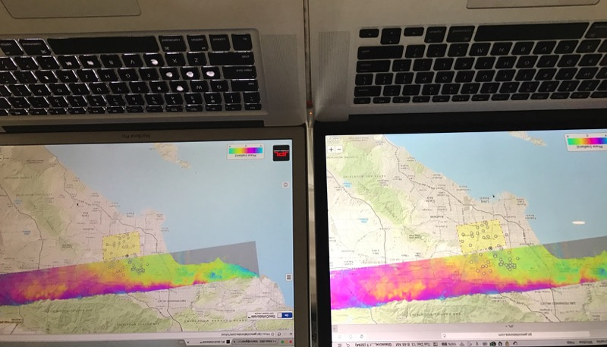
Real-time collaboration: GeoCollaborate®
GeoCollaborate® enables users to access, share, manipulate, and interact across disparate platforms
Connects public and private sector agencies and organizations rapidly on the same map at the same time
Allows improved collaborative decision making on the same datasets simultaneously
StormCenter and JPL, through the ESIP Disasters Cluster have been developing a testbed to demonstrate this capability
JPL Testbed with lead/follow displays
Leader
Follower

Slide 13
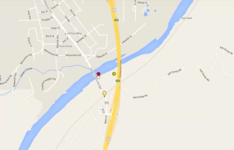
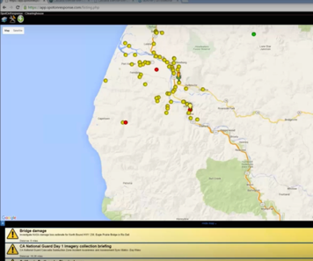
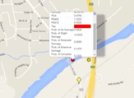
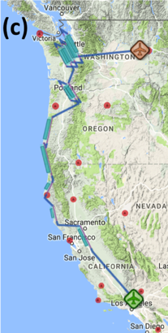
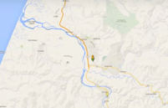


Data Sharing to the Clearinghouse: Cascadia Rising
2
The California Earthquake Clearinghouse held a parallel exercise focused on interdependencies of critical infrastructure, information sharing, and coordination for response, recovery, and regional resiliency
NASA participants supported the Clearinghouse through XchangeCore Web Service Data Orchestration and SpotOnResponse
Critical infrastructure is identified as sustaining high damage
1
Field responders identify incidents and deploy in the field
NASA data is shared via XchangeCore and SpotOnResponse to the Clearinghouse
Landslide
3
UAVSAR imagery was provided to the Clearinghouse in northern California and mock flight plans were created for the Pacific Northwest

Slide 14


Vigilant Guard 17
1
E-DECIDER Damage and Loss Estimation displayed with Clearinghouse field reports
The California Earthquake Clearinghouse, California National Guard, and partners (including NASA)
participated from 14-20 November 2016
NASA provided response products and remote sensing imagery to the Clearinghouse via XchangeCore Web Service Data Orchestration for integration with field response and decision support
NASA representatives also participated with National Guard imagery analysts at the
Joint Operations Center at Beale AFB to provide product integration and analysis support
NASA provided (1) rapid response assessment products from E-DECIDER and imagery from (2) Airborne Snow Observatory (ASO), (3) Uninhabited Aerial Vehicle Synthetic Aperture Radar (UAVSAR), and (4) AVIRIS (Airborne Visible/Infrared Imaging Spectrometer)
2
ASO Digital Terrain Model
3
4
Information Sharing Workflow
Products Generated
Users query products
(SpotOnResponse, NICS, Google Earth, etc)
Pass on to Decision Makers (local, state, federal)
UAVSAR interferogram with damage polygons identifying potential levee damage (red) and liquefaction (green)
Authoritative data securely shared
AVIRIS Methane

Slide 15
Some final thoughts…
Participation in exercises gives us the unique opportunity to both demonstrate capability, evaluate our response process, and improve for future disasters
Capacity building during and between exercises and leveraging partnerships (particularly such as our long-standing California State partnership) will allow better understanding of stakeholder needs
Technology interoperability and common operational data allow each organization to use the specialized tools and technologies that best support their roles and responsibilities in responding to a disaster—ANY disaster, not just earthquakes
Individuals liberated from the routine, mundane, critical, but very time consuming, tasks of moving, sharing, organizing and managing data, when you least have the time to do so, i.e. when you’re trying to prepare for an Executive Briefing!
Data experts and analysts have more time to perform the most critical and important tasks they need to complete to support disaster response efforts
Better coordination among participating organizations
EOC managers can make informed decisions about logistics and resources when they have real-time information about the disaster impacts

Slide 16
Thank you for your attention!
Questions?
Maggi Glasscoe
Margaret.T.Glasscoe@jpl.nasa.gov

