Slide 1

ESIP 202
Erin Robinson, @esipfed
February 2, 2015
http://esipfed.org

Slide 2
ESIP Community
Multiple Science Domains
Data Providers
Cross-Agency
Users
Data Archives
Application
Developers
Tool & System
Developers
Academia
Corporate
Notes:
Benefits of Engaging with Community:
Enhance staff knowledge through peer knowledge exchange
Take away new technologies
Identify new collaborations
Leverage scarce resources through reuse, repurpose
Help define community best practices

Slide 3
Types & Governance
Type I: data centers (21/24)
  NASA DAACs
  NOAA (NGDC, NODC, NCDC)
Type II: researchers and tool developers (46/74)
  Academia
  Government labs
Type III: application developers (28/62)
  Commercial
  Nonprofit
  Educational
Type IV: strategic partners (2/2)
  NASA
  NOAA
ESIP Assembly
  1 partner, 1 vote
  Annual Business Meeting at ESIP Winter Meeting
  Leadership elected from Assembly representatives

Slide 4
ESIP Groups
Standing Committees
  Data Stewardship
  Education
  Information Technology and Interoperability
  Products and Services
Administrative Committees
  Constitution and Bylaws
  Finance and Appropriations
  Partnership
Working groups
  Air Quality
  Climate Education
  Energy & Climate
  Visioneers
Clusters
  Cloud Computing
  Decisions
  Discovery
  Documentation
  Drupal
  Earth Science Collaboratory
  Geospatial
  Open Source
  Semantic Web
  Visualization
  And Yours?
http://esipfed.org/collaboration-areas

Slide 5
ESIP Collaboration Area Structure
Agriculture & Climate
Cloud
Decisions
Disasters
Discovery
Documentation
Earth Science Data Analytics
Energy & Climate
Info Quality
Science Software
Semantic Web
Features
  Formed by sending VP email
  For any reason
  Ends when the last person hangs up
Clusters
Least
Formality
Most

Slide 6
ESIP Collaboration Area Structure
Features:
  Created by
  Assembly or Committee
  Task-oriented
  Budget
Data Study
Drupal
Climate Education
Visioneers
Clusters
Work
Groups
Least
Formality
Most

Slide 7
ESIP Collaboration Area Structure
Features
  Chair elected by Assembly
  Chair serves on
  Executive Committee
  Budget
Standing Committees
  Data Stewardship
  Education
  Information Technology and Interoperability
  Products and Services
Administrative Committees
  Constitution and Bylaws
  Finance and Appropriations
  Partnership
Clusters
Work
Groups
Committees
Least
Formality
Most

Slide 8


Two Organizations: ESIP Federation & Foundation for Earth Science
ESIP Federation is the community.
Foundation for Earth Science provides management, operational and logistical services to the ESIP Federation.
In reality (up to 2013):
ESIP
Federation
Foundation for
Earth Science

Slide 9
Foundation for Earth Science Community Manger
Search for Community Manager began Jan. 2015. Will work primarily for ESIP
Details:
earthsciencefoundation.org/position-description-community-manager/

Slide 10
Strategic Plan
2014
  Revisited 2009 strategic plan and goals, documented accomplishmentshttp://wiki.esipfed.org/index.php/2009-2013_Strategic_Accomplishments
  Revised strategic goals based on community inputs
  Drafted action and performance oriented roadmaphttps://docs.google.com/spreadsheets/d/16f8heiZX3KoLCPfxMKTbROiG-es6y2I7m9zkuXP-964/edit#gid=0
2015
  Finalize strategic roadmap
    Get involved - Your inputs are important, and very much welcome
  Work with Committee and Collaboration Area leaders to align work plans with roadmap (mapping of goals and tasks)
  Create wiki page to document background, status, lessons learned, and to manage execution of the plan
Get Involved
  Contact Emily Law, Emily.Law@jpl.nasa.gov

Slide 11
Things ESIP Does
Community-generated Best Practices (e.g. Citation)
Testbed (e.g. Identifiers, Ontology)
Community Conventions (e.g. Discovery)
Professional Development
  Technical Workshops
  Non-technical Workshops (e.g. Evaluation, Communication)
  Data Management Short Course/Workshops
Outreach
  Education (e.g. annual teacher workshop on climate change)
  Professional Societies (e.g. AGU, GSA)
  International Efforts (e.g. GEO, ISRSE)
Provide Venue for Collaboration and Connections
  Both virtual and in-person
  Support with suite of collaboration tools
Provide mini-grants to make stuff happen
Notes:
Testbed activities:
Digital Identifiers Evaluation
Deploy a Testbed Portal
Esri Geoportal Server: Discovery Services and Clients: Interoperability Testing, Advertisement, and Assessment of Data to Service Broker
A Classification and Annotation Scheme for Data and Service Quality
Drupal Metadata Editing Tool Suite
Data Stewardship: Metadata and Identifier Mapping
ESIP Ontologies in the Cloud: Semantic Web Focus
ESIP DOES not build infrastructure – it enables other to leverage the work across the community to build better infrastructure

Slide 12

Products & Services Committee
2014 (Chair: Christine White)
          Testbed - http://testbed.esipfed.org
            Website rebranded (thanks Erin!)
            Groups documenting their projects on the site
            2 projects coming to close, 4 newly funded
          6 FUNding Friday awards
2015
  RFP for Testbed projects coming out in April, October
  Project hosting opportunities
  Strengthen connections between completed projects and ESIP member research/work
  Happy Hour FUNding Friday was a success, plan to repeat
Get involved
  Monthly Telecon - 3rd Tuesday at 2pm ET
  http://wiki.esipfed.org/index.php/Products_and_Services

Slide 13
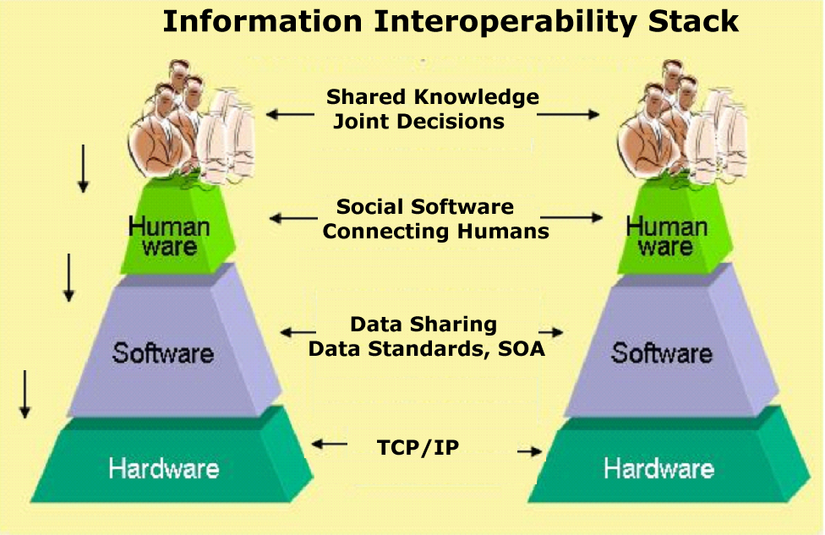
ESIP Transforms Earth Science
ESIP provides community coordination to support interoperability
Notes:
ESIP provides:
Forum for open, science data-centric community collaboration
Voluntary participation
Community of Practice – practitioners share expertise & technologies
Trusted authority, built by the community
Infrastructure for community collaboration
Collaborative workspace on web (Drupal, wiki, listservs)
Communications (coordinated, ad hoc, open)
Governance
Formal (constitution, bylaws, strategic plan)
Informal (cluster-based governance for consensus building)
*

Slide 14


ESIP Planks
ESIP Hub
List-servs
Wiki
Web Conference
Meetings
Notes:
Evolves over time, All of these pieces also evolve
Using mostly out of the box tools with minimal development

Slide 15





ESIP Planks
ESIP Hub
List-servs
ESIP Commons
Wiki
Web Conference
Social Media
Email Marketing
Meetings
Notes:
Evolves over time, All of these pieces also evolve
Using mostly out of the box tools with minimal development

Slide 16
List-servs
Add new users
Approve requests
Get confirmation that your note sent

Slide 17
WebEx
Schedule a meeting
Find the recording
  Convert recording to WMV/MP4
Process to get attendance
Presentation on WebEx in the Leadership Folder

Slide 18
Prototypical Virtual Workspace
Purpose
Events/Activities
Active Collabs
Resources
Get Involved
Notes:
The purpose of my talk is to describe the application of virtual workspaces to data, activities and tools being used by the air quality community to enable better collaborations. The prototypical workspace has 4 main parts:
All workspaces are characterized by their purpose such as adding additional metadata, coordinating and event or describing a tool
The resources gathered by the group provide relevant background and context for the space – resources can include pictures, links, papers, videos or datasets
Each workspace is equipped with a discussion page. Discussion ranges from functionality of the workspace to specifics of the purpose
Finally, there is a focus of the workspace which is the product or outcome.
The modularity of the pieces allows for some degree of reuse between workspaces. Furthermore the wiki platform is conducive to aggregate distributed web material through RSS feeds and embed tags common to blog posts, flickr and youtube.

Slide 19
Wiki Workspace Best Practices
Collect distributed, but related content and provide context
Workspaces are easily set up and evolve for group needs
Open nature of the wiki allows unanticipated contributions
Provides rich archive of artifacts:
discussion, resources, process & outcome
Allow new users to easily enter the group
Notes:
The wiki platform is conducive for this because it allows material distributed all over the web to be virtually 'mashed' together in one place through RSS feeds or iframe tags and elaborated on with relevant context and discussion.
The magic ‘edit’ button allows user to easily change space as needs change

Slide 20
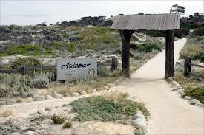
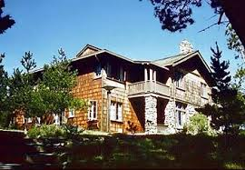
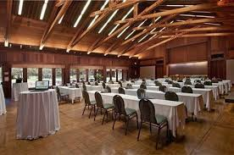
2015 ESIP Summer Meeting
Save the date!
  July 14-17, 2015
  Asilomar, CA (71 miles south of San Jose, 120 miles south of San Francisco)
  RFID Networking Experiment (Opt-in, of course!)
  Theme TBD – join us on the Visioneers call at the end of Jan

Slide 21
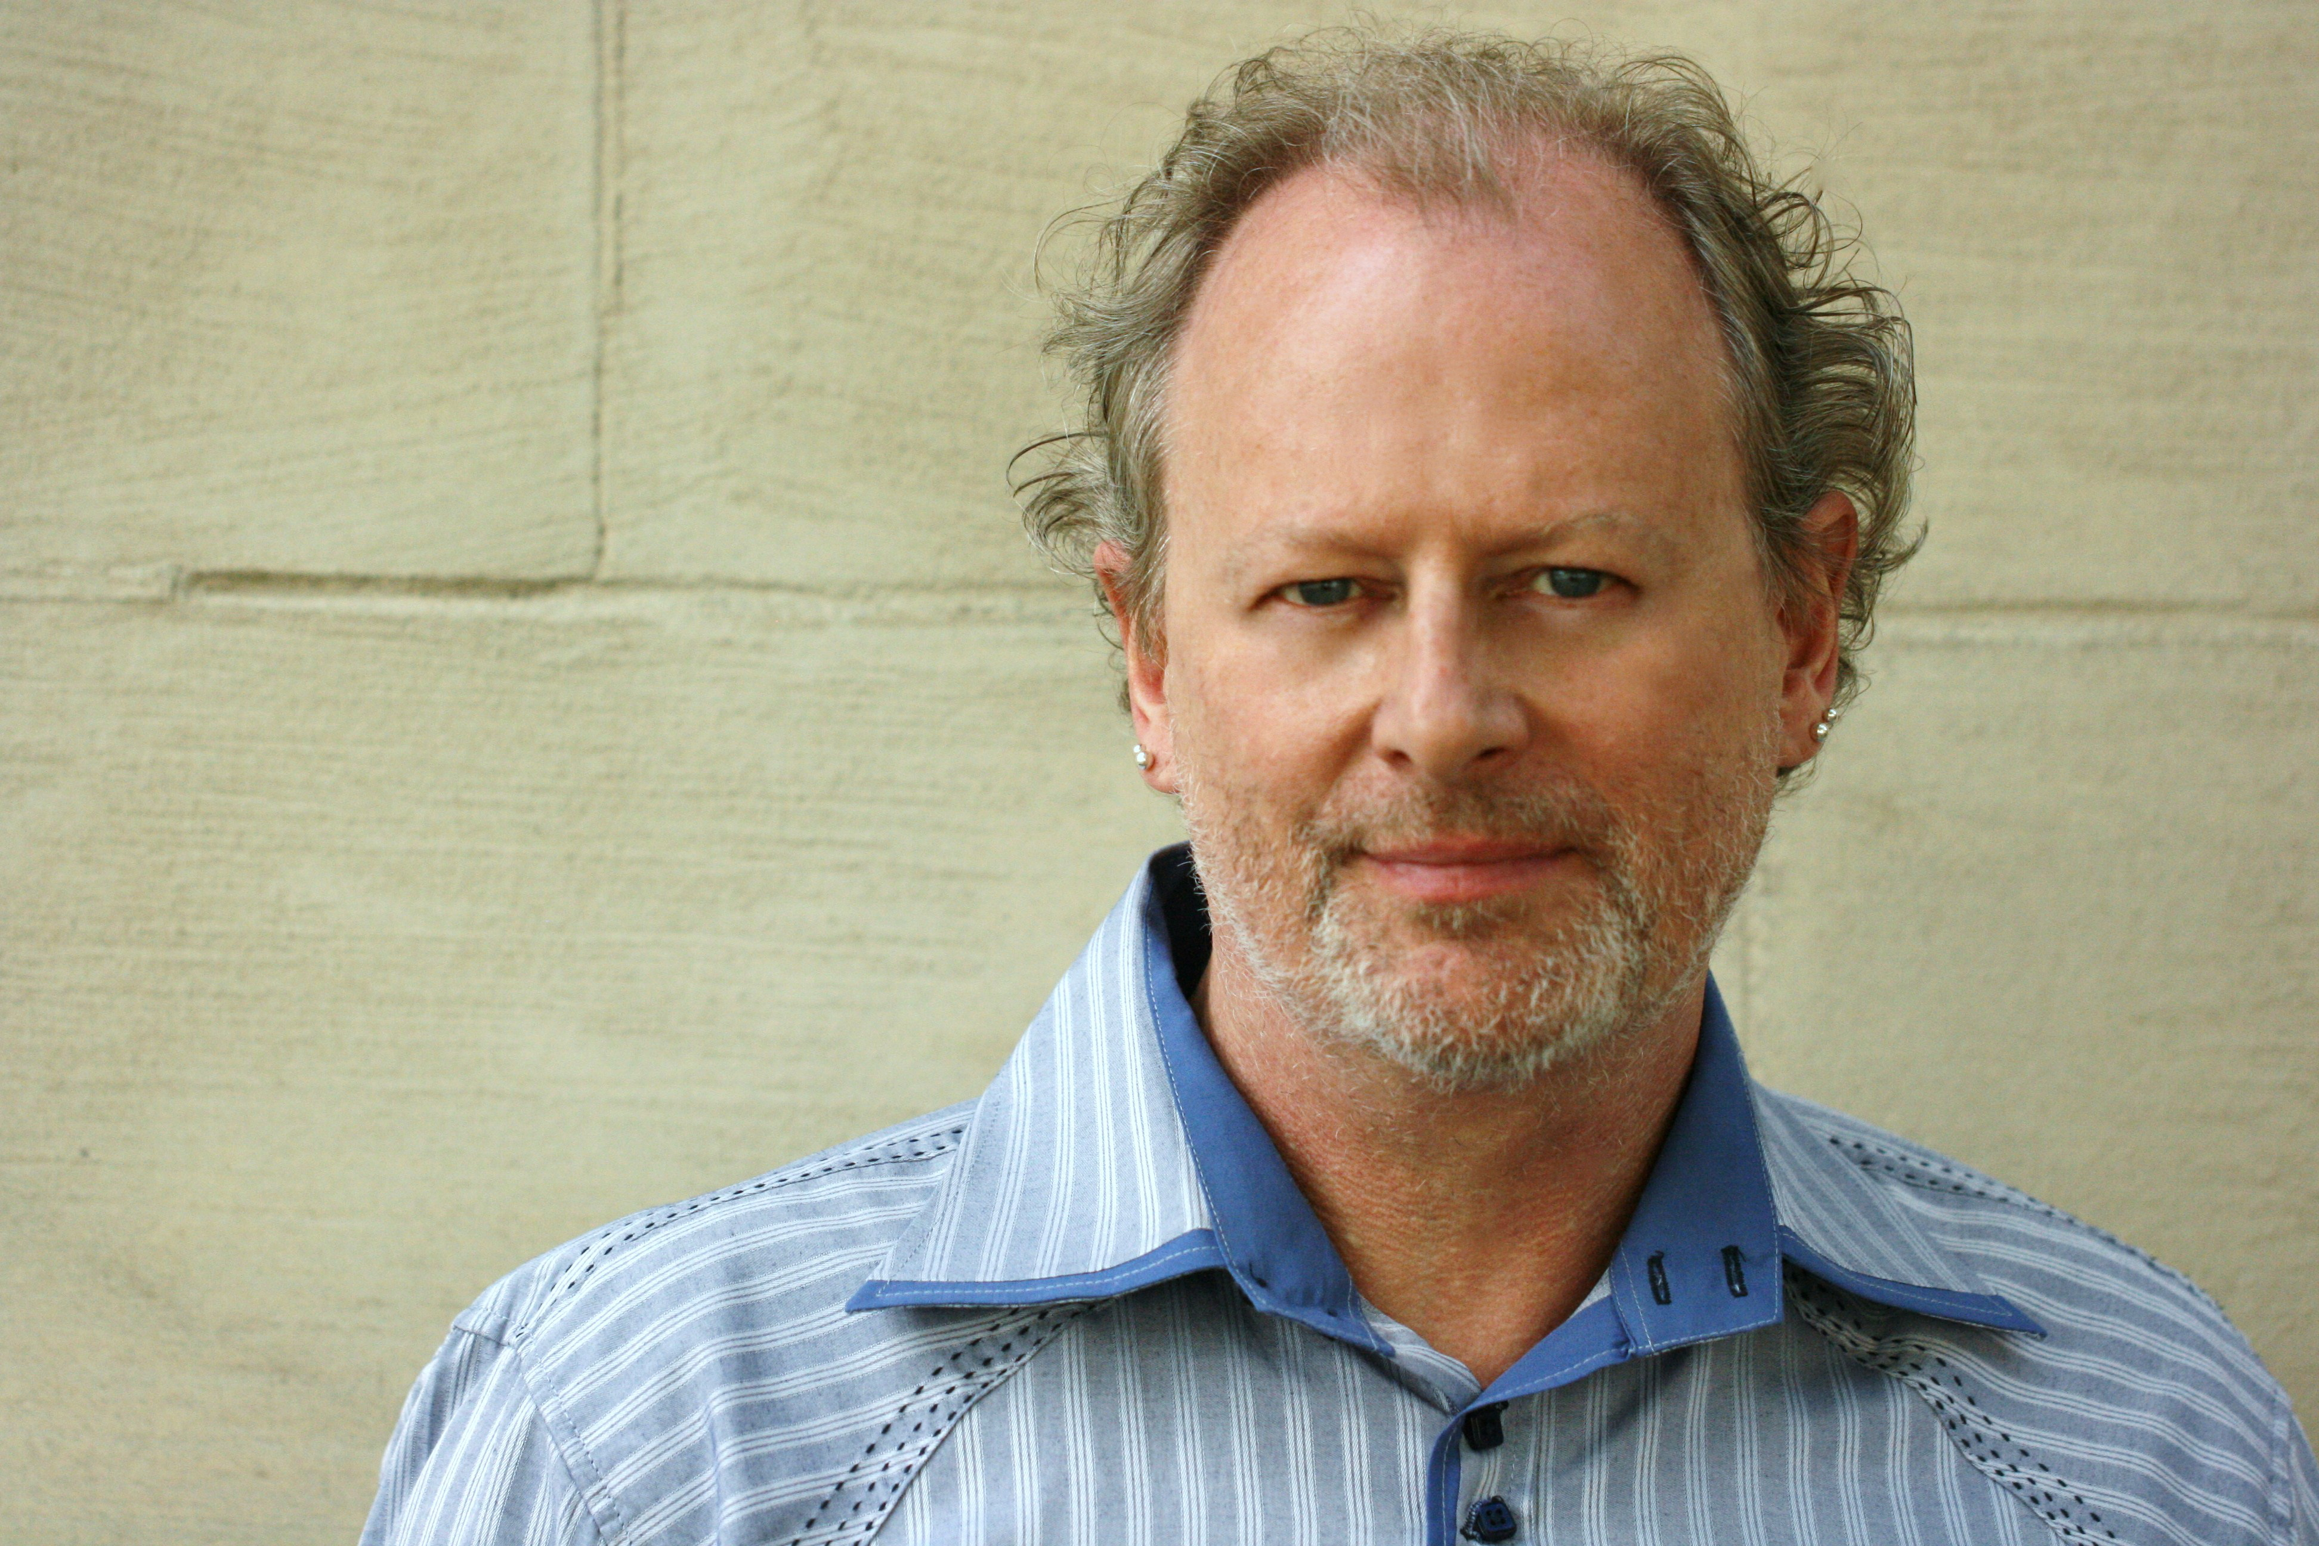
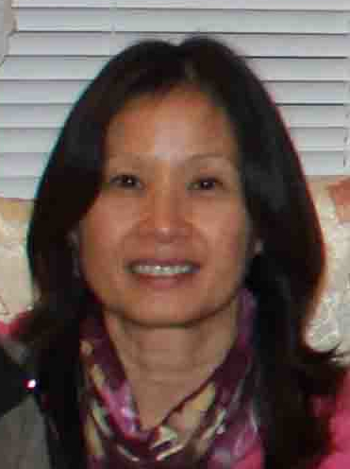
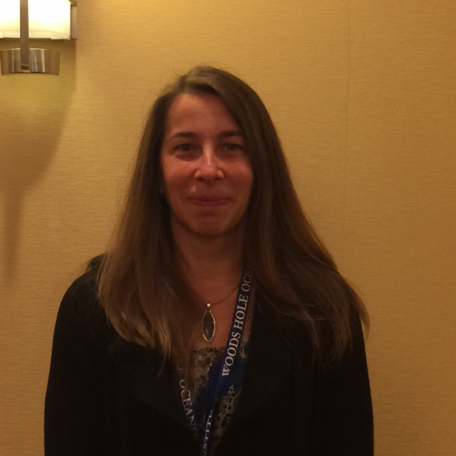
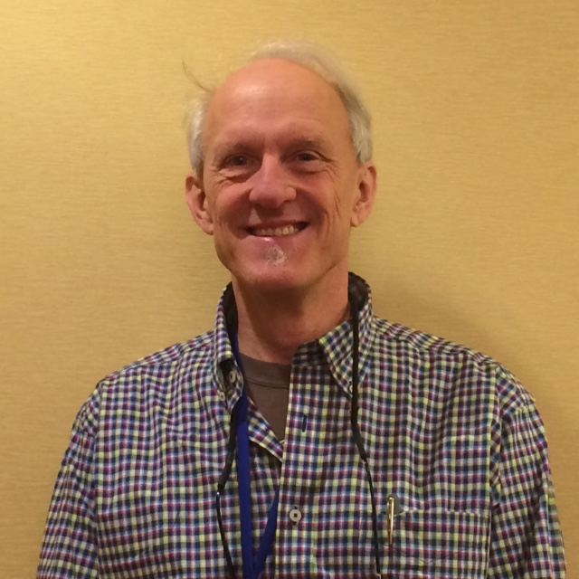
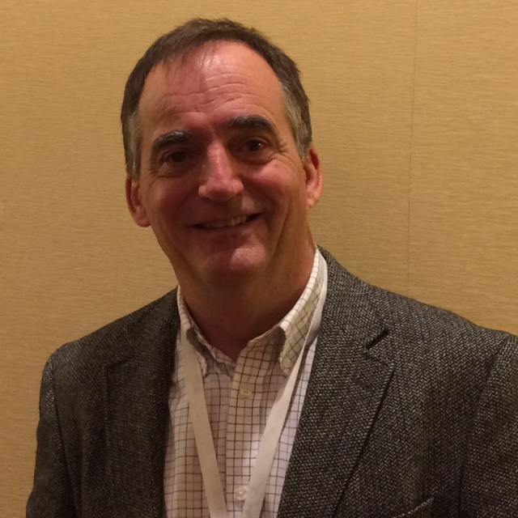
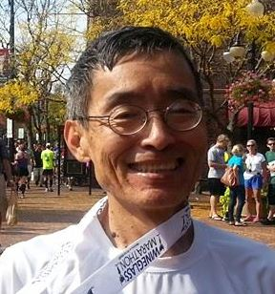






ESIP Leadership
2015
President & Vice President
ESIP Type Reps
Peter Fox
Emily Law
Type I
Dani Kinkade
Type II
Steve Richard
Type III
Ted Habermann
Administrative Committee Chairs
Bill Teng
Ken Keiser
Tyler Stevens
Standing Committee Chairs
LuAnn Dahlman
Ethan Davis
Christine White
Justin Goldstein
Notes:
ESIP works cross agencies, cross sectors, and cross science domains.

Slide 22
ESIP Federation Executive Committee Work 2015
A new arrangement between the Foundation and Federation
(financial and services)
An ESIP budget (and process)

Slide 23
ESIP Online
Home page
  http://esipfed.org
Wiki
  http://wiki.esipfed.org
Commons
  http://commons.esipfed.org
Facebook
  http://tinyurl.com/esip-facebook
Twitter
  #esipfed, @ESIPFed, @ESIPPres

Slide 24
Get ESIP’ed
Ongoing activities
  Clusters
    start a new one!
  Working groups
  Committees
Twice-yearly meetings
  Attend
  Next: July 14-17, 2015 in Asilomar, CA
  Present a talk or poster
  Chair a session
Partnership
  Join
  Invite your colleagues
Host a summer meeting
Consider ‘running’ for office
Jump in and get involved – that’s what makes it work!

Slide 25

Questions
Peter Fox, president@esipfed.org
Erin Robinson, erinrobinson@esipfed.org

