Slide 1



Local Data Management: Advertising your data
Nancy Hoebelheinrich
Knowledge Motifs LLC
Version 1.0
[Review Date]
Notes:
Modules should be 3-7 minutes long

Slide 2


Overview: Why advertise your data?
“Advertising” your data goes beyond
word of mouth notice
Usually done by publishing metadata
about your data
Publishing metadata can help your career
Can be required by funding agencies & institutions
Can be done by using an increasing number of methods
Often done in conjunction with the data center / archive where you are storing your data
Notes:
Relevance to Data Management Module: Voiceover Script for Slide 3
Now that you have an idea of what this module will cover, you might be wondering why these topics are important for data management. To answer that question, please consider the following:
At this point, it might seem that managing your data involves a lot more effort than may be warranted. If so, there are both incentives and warnings to share that might help motivate you to do your part for data management. As incentives, think about these possibilities:
On the other hand, a few warning thoughts might be in order. For instance:

Slide 3
Beyond word of mouth: publishing metadata
If metadata about your data are published:
Your work may become more well known (discoverable)
When found, a potential user could learn enough about your data to decide whether it’s appropriate for his / her re-use
Can help you establish your credibility & reputation
Means by which agencies & institutions evaluate grant proposals
Factors for hiring & tenure by academic institutions often include:
Survey of journals & publications in which you are published
The reputation of journals & publications in which your metadata are published
The number of times your metadata (in citation form) is used by others
One way in which your peers can found out about your research, thus leading to future opportunities for collaboration

Slide 4

Required by agencies & institutions
Many governmental agencies require the “dissemination” of your data by:
Publishing metadata in journals and publications in order to make data products available
Describing how your data will be “shared” in a data sharing and/or data management plan
Making the metadata publicly available from agency websites
Encouraging the publication of metadata to publicly available data catalogs on government portals or registries

Slide 5

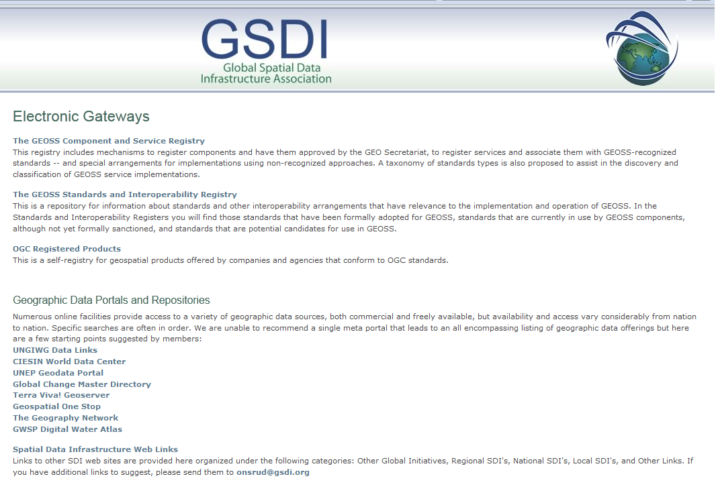
New ways to advertise your data
Formal Publication:
Journals & Publications, of course, but also
Public directories, data portals & metadata registries

Slide 6
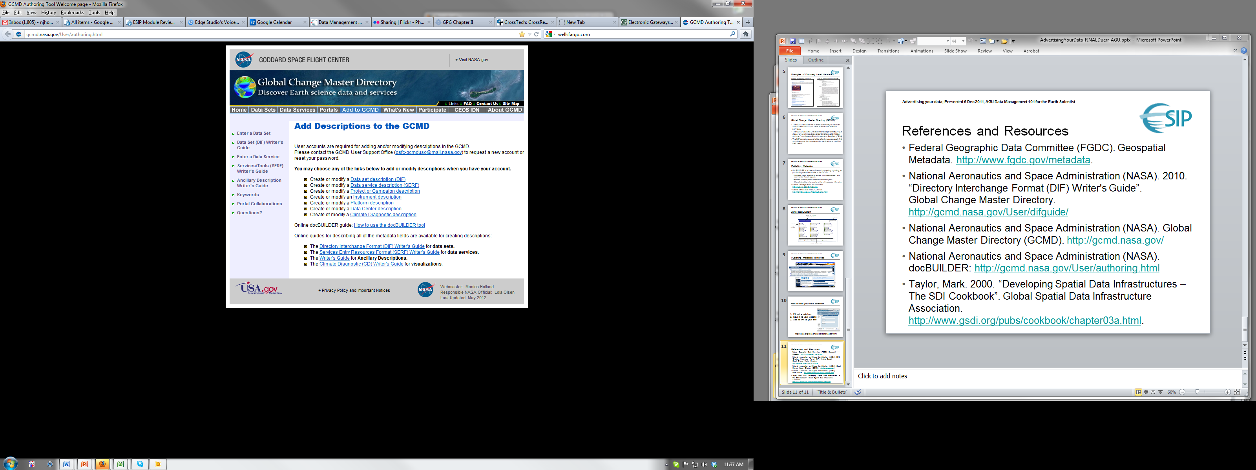
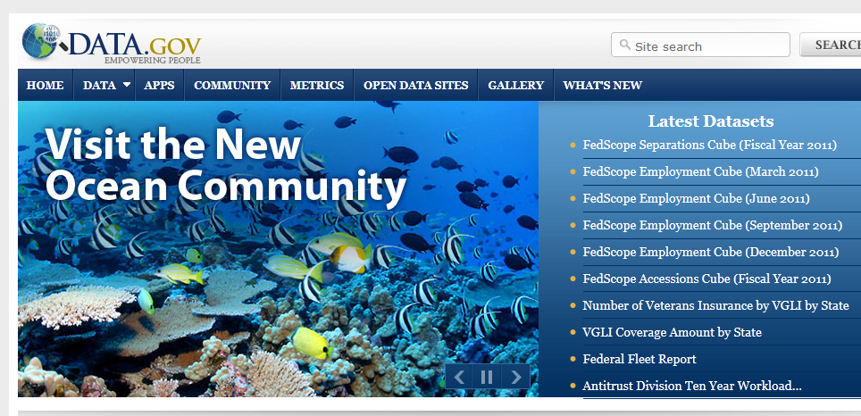
What are some relevant data portals / metadata registries for my data?
Global Spatial Data Infrastructure
http://www.gsdi.org/ElectronicGateways (internatl)
NOAA National Geophysical Data Center
http://www.ngdc.noaa.gov/metadata (metadata registry)
Global Change Master Directory
http://gcmd.nasa.gov/index.html
ECHO (The EOS Clearinghouse)
http://en.wikipedia.org/wiki/EOSDIS (metadata registry
for NASA’s Earth Observing System Data)
Data.gov http://www.data.gov/ (U.S. Federal data)

Slide 7
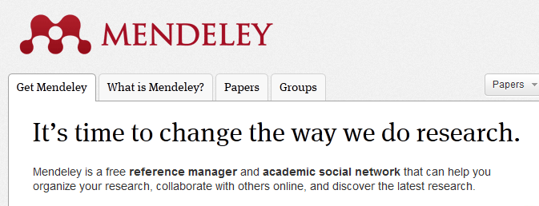
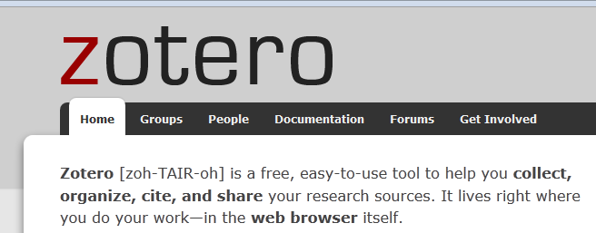
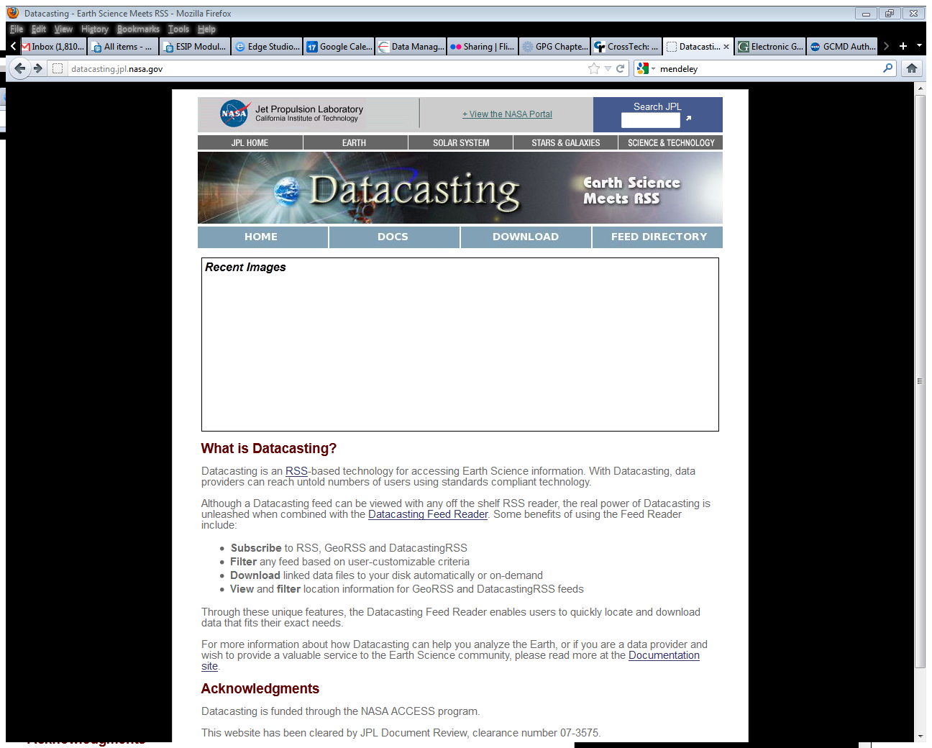
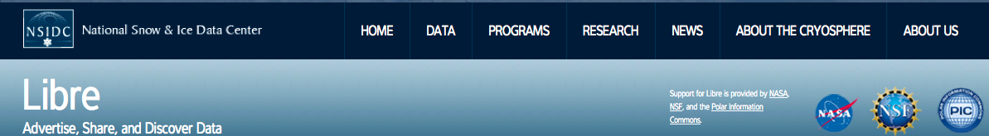
New ways to advertise your data
Informal Publication:
Domain specific blogs
Websites & notification services:
Twitter – announce at conferences
LinkedIn, Facebook – you decide!
Mendeley, Zotero – reference managers & academic social networks – list your own data sets
Datacasting tools & services – broadcast to the Web via RSS based technology

Slide 8
Resources
Global Change Master Directory: http://gcmd.nasa.gov/index.html
Global Spatial Data Infrastructure: http://www.gsdi.org/ElectronicGateways
NOAA National Geophysical Data Center: http://www.ngdc.noaa.gov/metadata
ECHO (The EOS Clearinghouse): http://en.wikipedia.org/wiki/EOSDIS
Data.gov http://www.data.gov/
Mendeley: http://www.mendeley.com/
Zotero: http://www.zotero.org/
NASA JPL Datacasting service: http://datacasting.jpl.nasa.gov/
NSIDC’s Libre tool: http://nsidc.org/libre/share/collectioncaster.html
****************************************
OpenBook_PearImage: http://homepage.mac.com/stott/ebay/studio/207/05.jpg
Attention Image: http://rankinwriting.files.wordpress.com/2012/03/hear_ye_hear_ye1.gif
Social Media Tag cloud image: http://www.google.com/imgres?start=160&hl=en&client=firefox-a&sa=X&rls=org.mozilla:en-US:official&biw=1280&bih=918&tbm=isch&prmd=imvnsz&tbnid=zksN_g66OPb0-M:&imgrefurl=http://apievangelist.com/industries/advertising.php&docid=edVo09iumi9ShM&imgurl=http://kinlane-productions.s3.amazonaws.com/ap-evangelist-site/industries/Tag-Cloud-Advertising.png&w=843&h=421&ei=m-CzT8utAqquiQKEmvjuAQ&zoom=1&iact=hc&vpx=805&vpy=383&dur=4581&hovh=159&hovw=318&tx=143&ty=53&sig=103899861293055568303&page=7&tbnh=119&tbnw=238&ndsp=25&ved=1t:429,r:18,s:160,i:212
Notes:
References Module: Voiceover script
Within this module, we've made reference to a number of published information sources that we think you may want to review when you want more in-depth information. The most relevant references are listed here.

Slide 9
Other Relevant Modules
Metadata for discovery – more information on creating descriptive metadata for your data
Developing a citation for your data – tips on what information is necessary to create a citation for your data
Metadata for access & use – what information is necessary to both allow use of and protect your data
Using portals & registries – more about how to publish metadata to specific data portals & registries
Agency / institution requirements for publishing metadata – more specifics from key U.S. federal agencies
Datacasting – more about how to use this informal method of advertising your data
Notes:
Other Relevant Modules Module: Voiceover script
The modules of the ESIP Data Management Course have been designed to complement and supplement each other. In light of this plan, we think you might find the following, related modules relevant to you and why as you gain a better understanding of data management:

