Slide 1
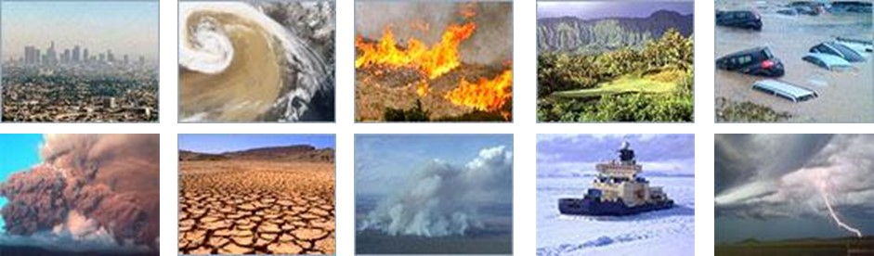
Outcomes of a NASA Workshop to Develop a Portfolio of Low Latency Datasets for Time-Sensitive Applications
27-29 September 2016
NASA Langley Research Center, Hampton VA
Diane K. Davies^{1,2}, Molly E. Brown³, David S. Green⁴, Karen A. Michael⁵, John J. Murray⁶, Christopher O. Justice³, Amber J. Soja^{6,7},
1- Science Systems and Applications, Inc, 2- Trigg-Davies Consulting, 3 – University of Maryland, 4 – NASA HQ, 5 - Goddard Space Flight Center, 6 - NASA Langley Research Center, 7- National Institute of Aerospace.

Slide 2
Workshop Charge
Develop a written (living) inventory of existing and planned/budgeted NASA/ESD Near-Real-Time data sets, information products, and associated discovery/distribution infrastructure
Identify any significant populations of supporters and/or potential benefits from our existing measurements and data sets, that are not being fulfilled because NASA/ESD products are being made available with too much delay
Notes:
From Mike Freilich

Slide 3

Definitions …..for the purpose of this presentation
Low latency, or Near real-time (NRT), data are made available much faster than routine processing allows.
Data latency refers to the time
between data acquisition and
the time the data is available to
the end-user.
Defining latency?
0-1 hour = Real-time
< 3 hours = Near real-time
3 – 24 hours = Low latency?
24 hours but quicker than routine = expedited?
Notes:
NASA held a workshop at the Langley Research Center in September, 2016 to identify, coordinate and focus attention on societally relevant applications with time-sensitive data needs. Data latency refers to the time between data acquisition and the time the data is available to the end-user. As support for Earth science applications has increased within NASA, users have begun requesting more near real-time (NRT) data products from a diverse set of sensors to improve the timing of decision-making across a variety of applications. Through provision of NRT data, NASA is ensuring the maximum societal value of its investment in Earth observation.

Slide 4
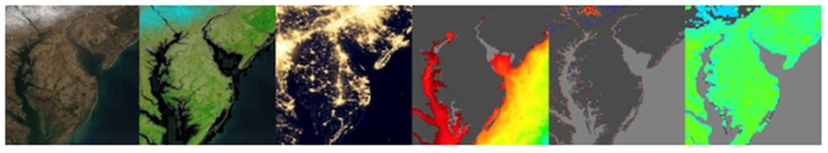
Meeting Overview
2.5 day meeting 104 Participants
Plenary sessions
NASA Headquarters
Existing systems for providing NRT data
Selected data providers and users
Breakout Groups
Completing the Inventory
Identifying opportunities and gaps in the provision and delivery of NRT data
75 | NASA
11 | Universities
11 | Other US government
4 | Private Sector
3 | Non-Government
Notes:
This meeting was supported by David Green from NASA AS and Kevin Murphy from NASA HQ
This meeting was the first time a group of NASA users, data producers and scientists have gathered to discuss the needs of time-sensitive applications and science communities.

Slide 5
NASA HQ Considerations: “Low-Latency” Principles in Earth Science Division Portfolio Development
NASA Earth Science Division (ESD) endeavors to provide low-latency data and products when it involves small additional costs
NASA ESD is primarily a science organization and science and non-real-time research objectives may outweigh support for near-real-time users when they are in direct conflict.
Notes:
Bottom line on NRT from ESD

Slide 6
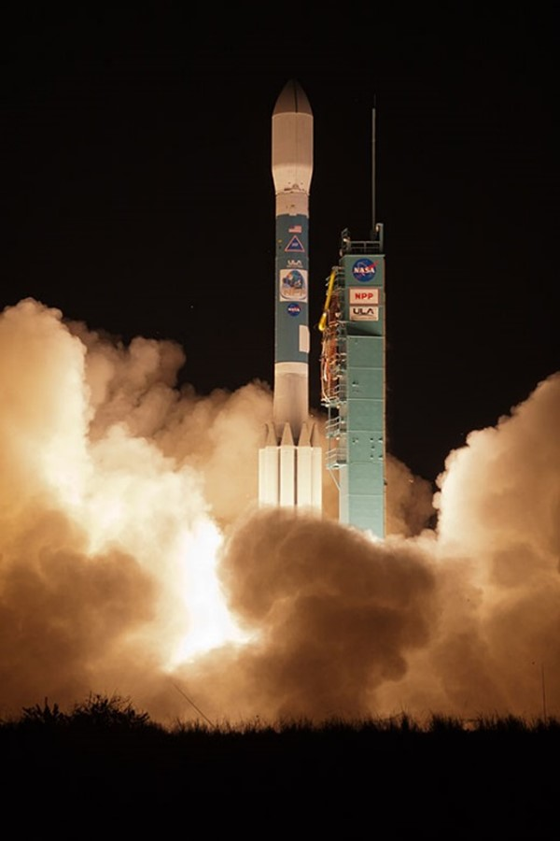
NASA Mission perspective on support for NRT data production
If NRT considerations should be part of the project trade space then cost/benefit should be considered when the project is in it’s embryotic stage
After design starts don’t expect changes in latency design
Latency can be improved during operations, but a non-project funding source will need to be identified.
Notes:
NASA Mission perspective from Christina Bonniksen

Slide 7
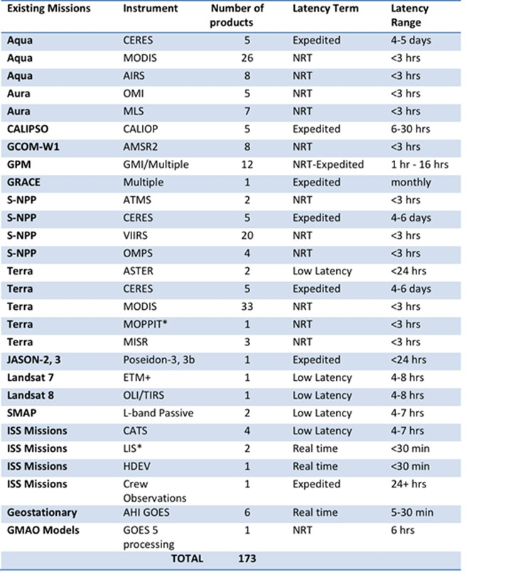
http://tinyurl.com/nhmv9ky
Inventory
Develop a written “living” inventory of existing and planned/budgeted NASA/ESD Near-Real-Time data sets, information products, associated discovery and distribution infrastructure.
Notes:
Overview of inventory

Slide 8
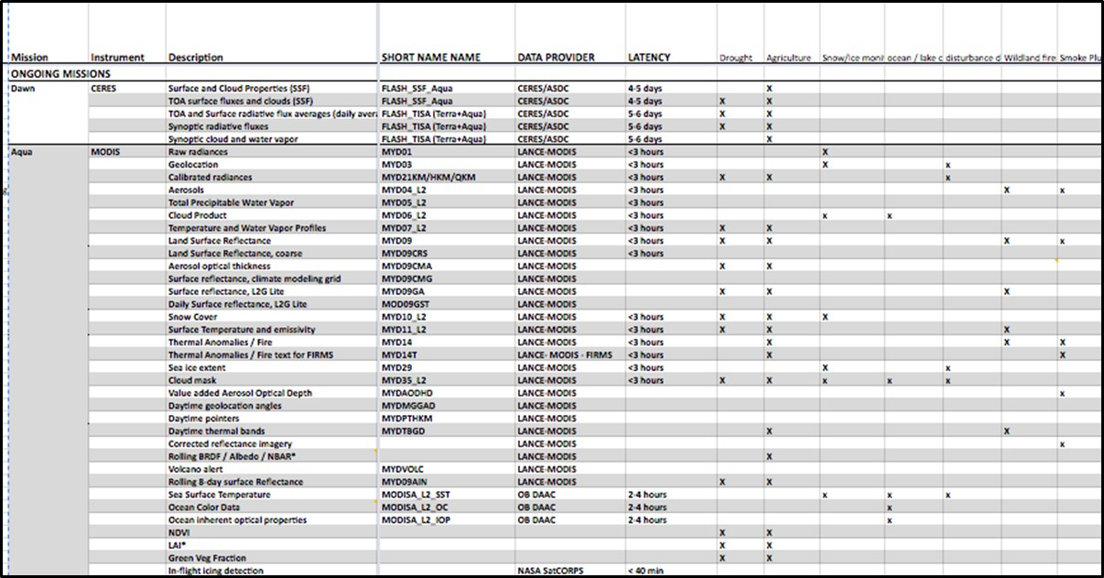
Inventory: http://tinyurl.com/nhmv9ky
Notes:
Screenshot of google sheet

Slide 9
Discoverability and Usability
Inventory is one step to increasing access to NRT datasets but Discoverability and Usability are critical.
Discoverability includes ways in which the community can determine which data are available and where they can be obtained.
Usability is the ability to easily visualize or integrate the data into analysis tools to facilitate data use
EOSDIS already has services that can help users discover and visualize data. These include:
Common Metadata Repository (CMR)
Global Imagery Browse Services (GIBS)
Earthdata Search Client
Worldview

Slide 10
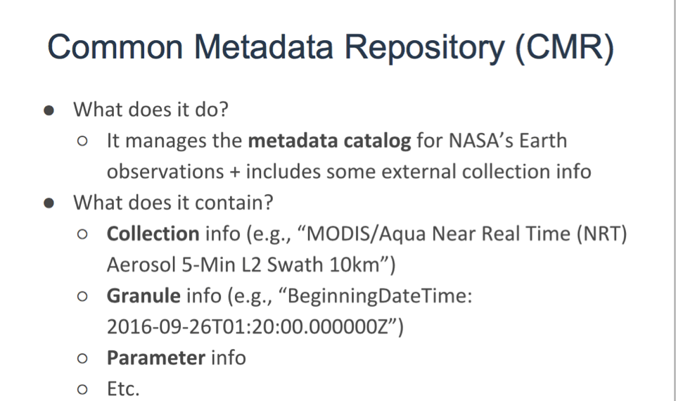
CMR metadata supports various standards (such as such as ISO 19115-1, ISO 19115-2, ECHO 10, DIF 9, or DIF 10) and supports OpenSearch compliant queries enabling by other search clients.
Notes:
Overview of CMR

Slide 11
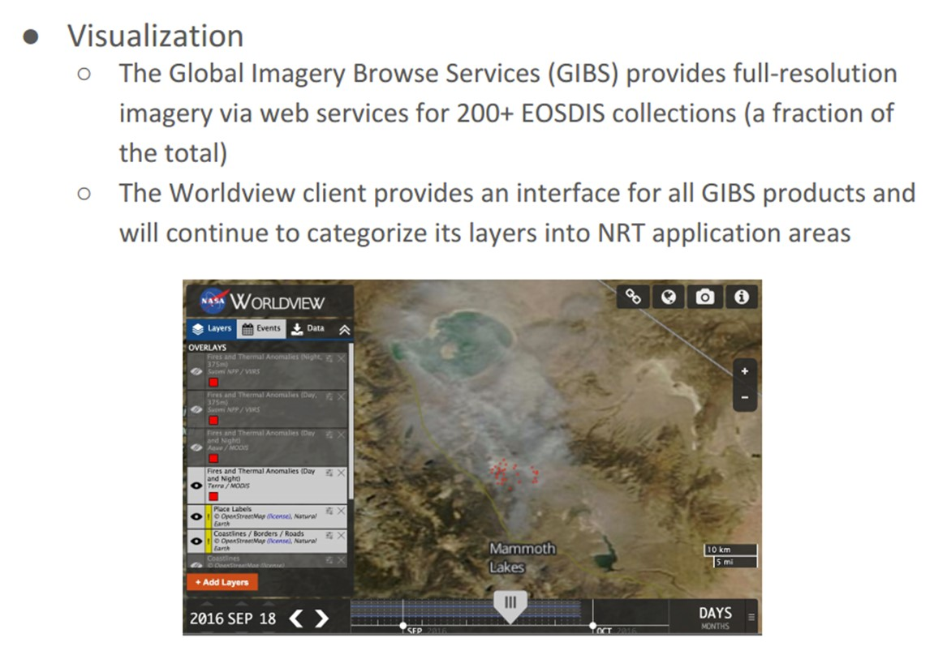
Global Imagery Browse Services (GIBS)

Slide 12
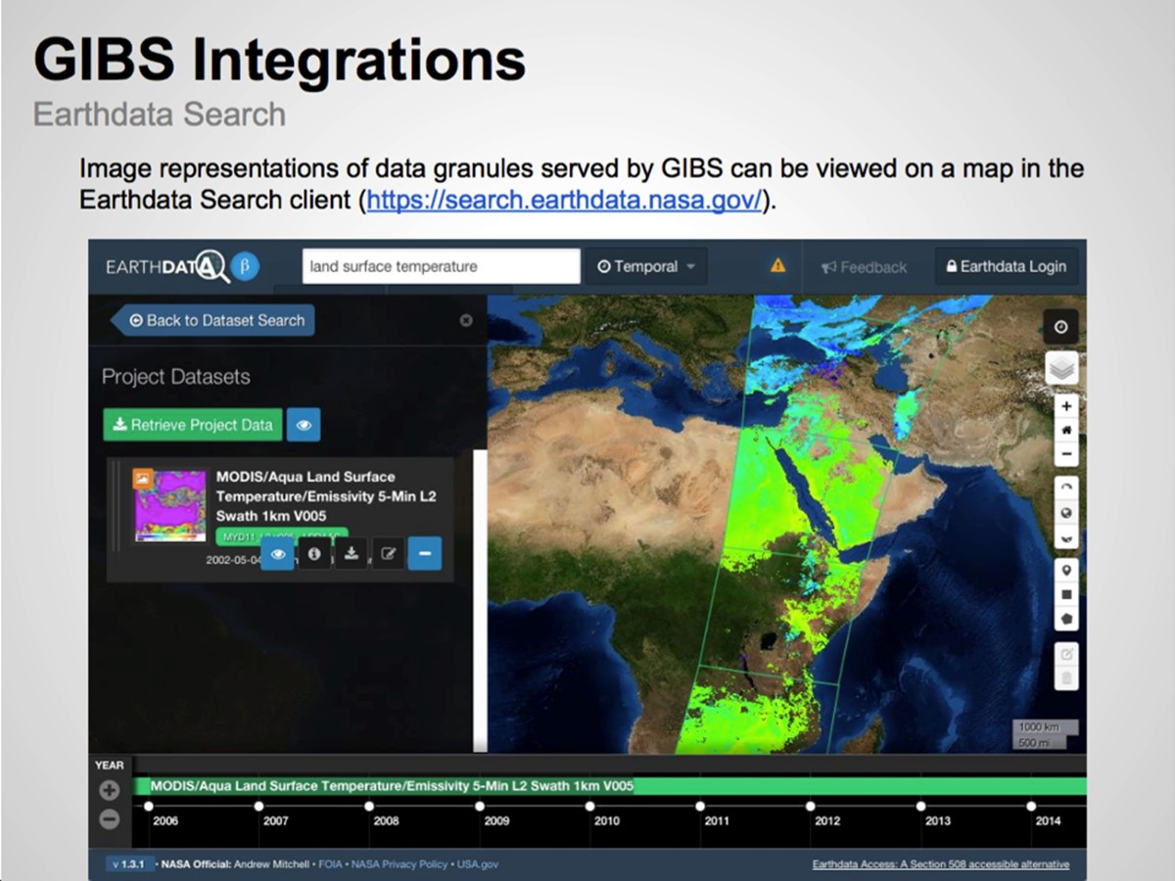

Slide 13
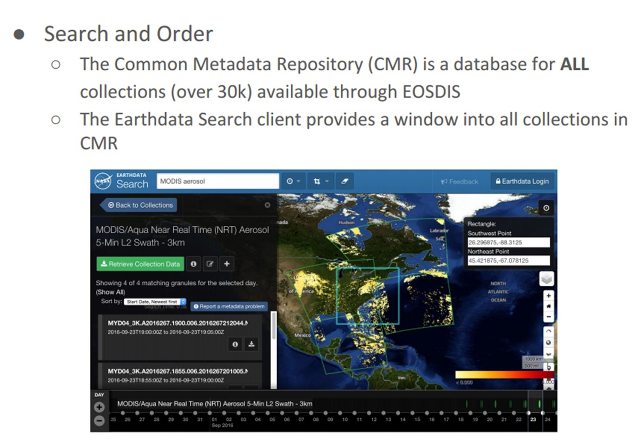

Slide 14
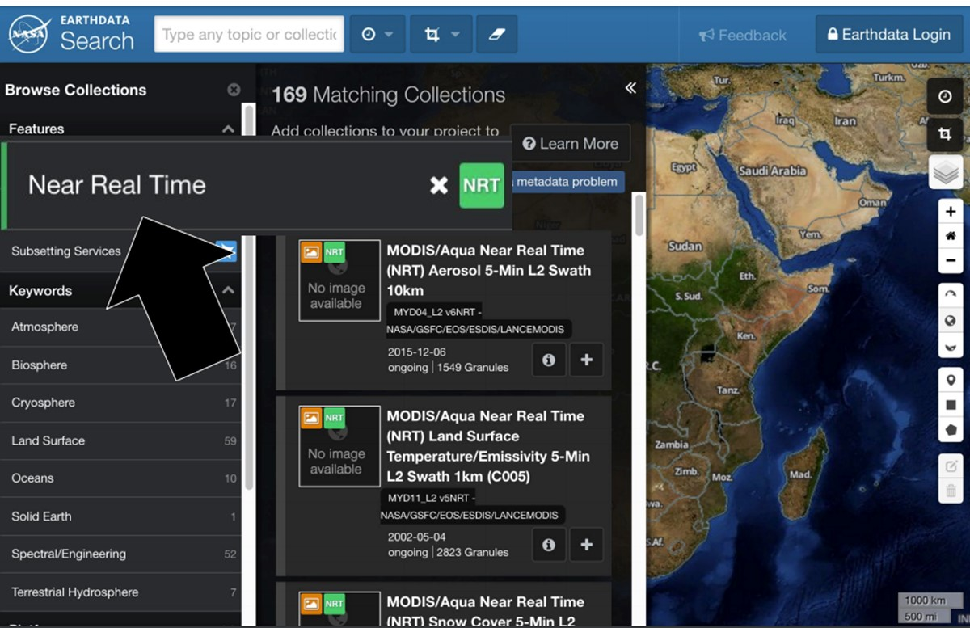
Existing Approach https://search.earthdata.nasa.gov/

Slide 15
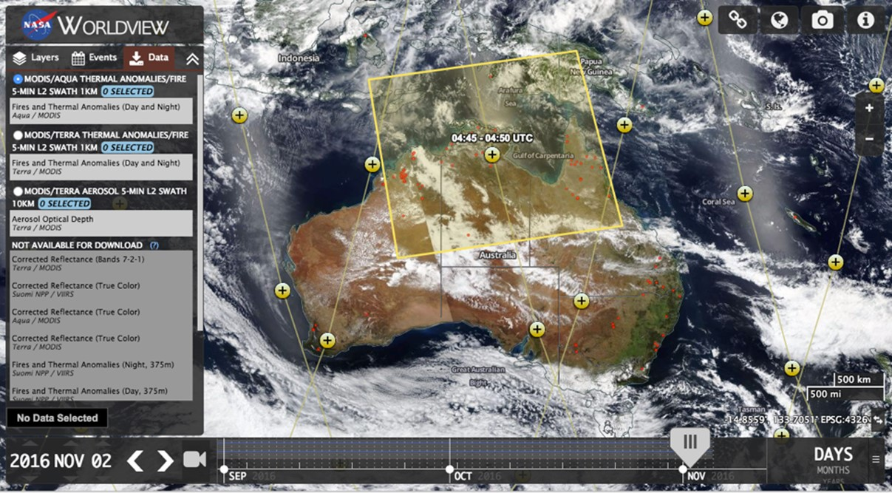
https://worldview.earthdata.nasa.gov/

Slide 16
Recommendations on Data Discoverability
Require all NASA programs producing NRT Earth observation data to register data in the CMR at the collection level.
Systematic modeling products, such as GMAO products should add imagery to GIBS as appropriate
Develop a set of managed CMR metadata tags to i) distinguish low latency products from other products and ii) utilize keywords from NASA’s Global Change Master Directory to identify application areas and facilitate searches by application area
Develop a process to evaluate applications products, value added low-latency products that use NASA data and non-NASA satellite data.
Those that met this criteria should be added to CMR at the Collection level

Slide 17
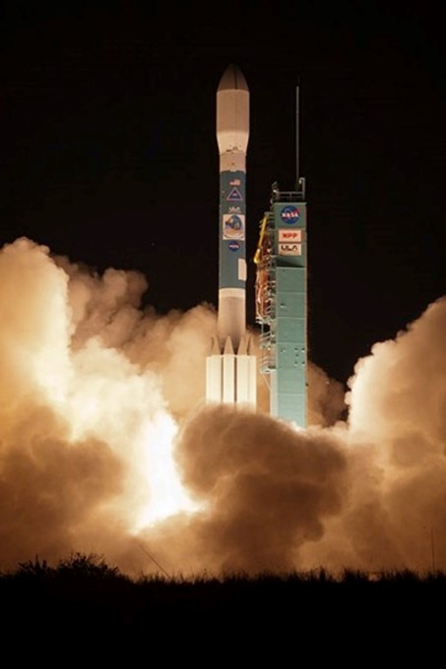
Recommendations on how to engage new missions
New missions should survey communities to determine the value of low latency products.
If NRT products would be useful, missions should conduct a latency trade study – to help determine cost / benefit.
ESD flight projects should add latency to Earth Venture solicitations and directed mission requirements.

Slide 18

Recommendation to form a Latency Working Group
To carry forward recommendations and conduct strategic engagement and planning
engage with programs and be an advocacy group for the NRT data producers
review the progress towards improved data discoverability and usability

Slide 19
Next Steps
Latency Working Group
Determine pathway for getting Collection Level metadata, for systematic NASA data, in to CMR and by default into the Earthdata Search Client (and other data portals)
Determine criteria and pathway for deciding if other products should be added in to CMR
To view the NRT Inventory: http://tinyurl.com/nhmv9ky
Contact? support@earthdata.nasa.gov with NRT workshop in the subject line
Case study on workflow for a real event e.g. Hurricane Matthew, Louisiana Floods….

