Slide 1
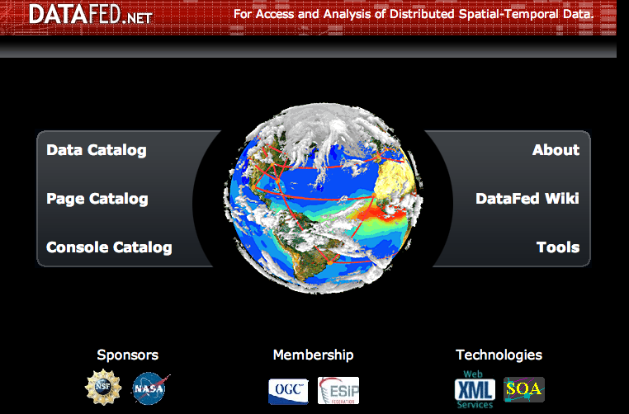
The Federated Data System, DataFed
Rudolf Husar, Washington University, St. Louis
Presented at the Air Quality Breakout Session
ESIP Winter Meeting, Jan 10, 2013, Washington DC

Slide 2
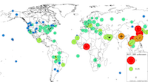








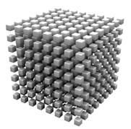
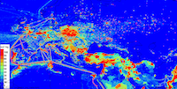

Information Infrastructure
Data Sharing Infrastructure
Std. Servers
Adaptors
Data Pool
Std. Tools
User Tools
Benefits
Monitorig Network
Informing the Public
Satellite
Health Effects
Model
Climate Impact
Science & Education
Emission
DataFed is an implementation of the GEOSS data sharing paradigm
DataFed also includes client applications for data browsing, exploration and analysis
These flexible tools can be used on any dataset form anywhere on the Web.
Notes:
DataFed also includes a set of client applications for browsing, exploring and analyzing air quality observations. These cloud-based tools can be used on any of the datasets in the Data Pool.
By design such web-based tools can also be created by any other client in this interoperable air quality data data network (ADN).
I will spare you ….

Slide 3
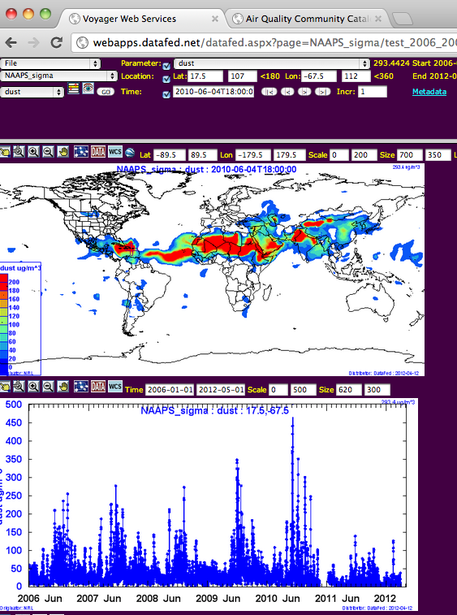
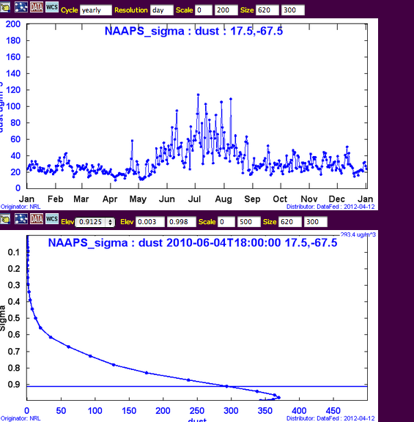
Datafed Browser and Programming Environment
Seasonal Cycle View
Spatial View
Vertical Profile View
Time Series View

Slide 4
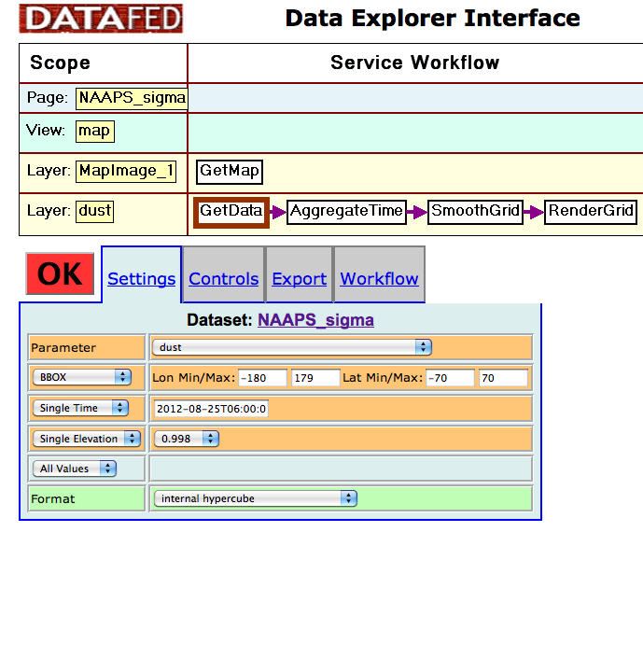
Service Oriented Programming
Notes:
The flexibility of the DataFed client software facilitated by Service Oriented Architecture.
Data are accessed, processed and displayed by a set of service modules chained together in a workflow program.
Each DataFed Tools is a specific workflow program within the same programming environment.

Slide 5
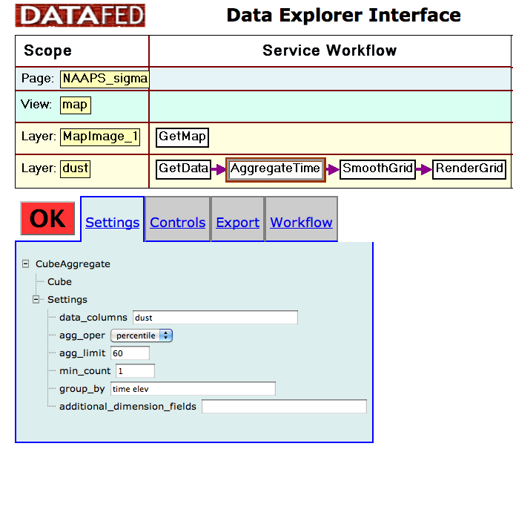
Service Oriented Programming

Slide 6
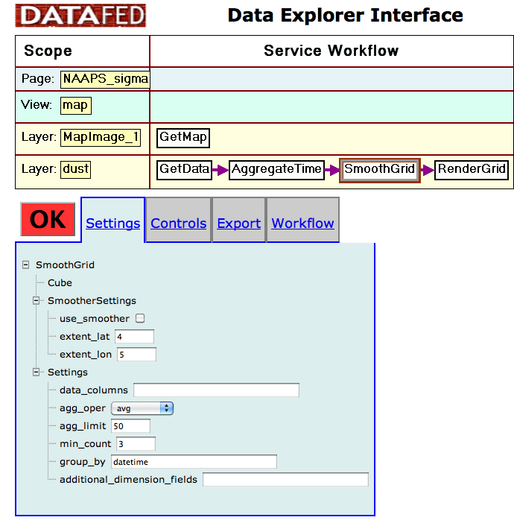
Service Oriented Programming
Notes:
Each module is a web service with specific input, output and control conditions

Slide 7
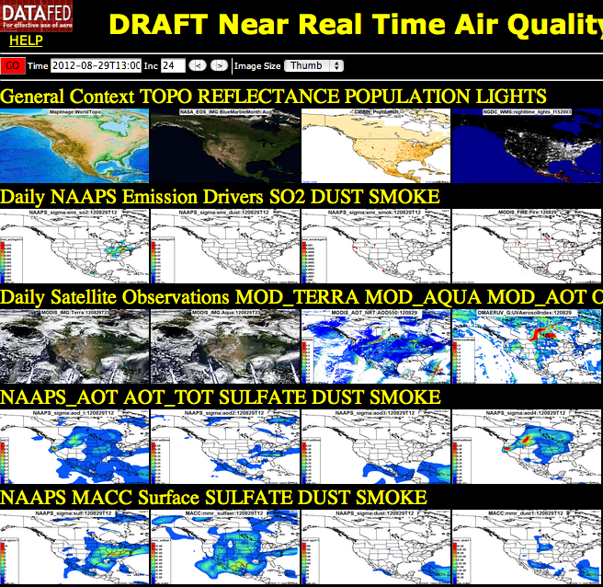

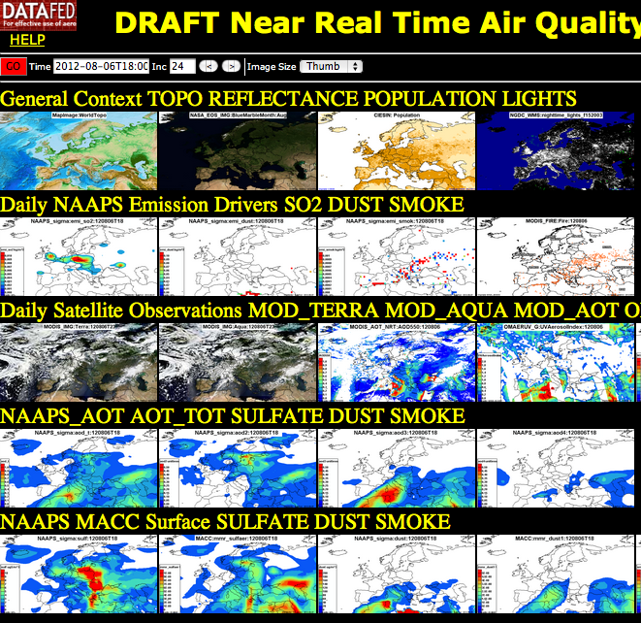
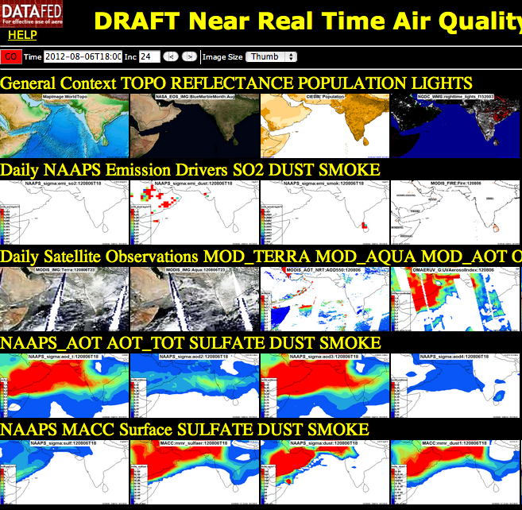
Tools: Near Real Time Consoles
Notes:
Consoles are spatial representations of multisensory Observations, emissions and models.
All the maps are synchronized spatially and in time, so the user can move the searchlight of her attention to any region or time.

Slide 8
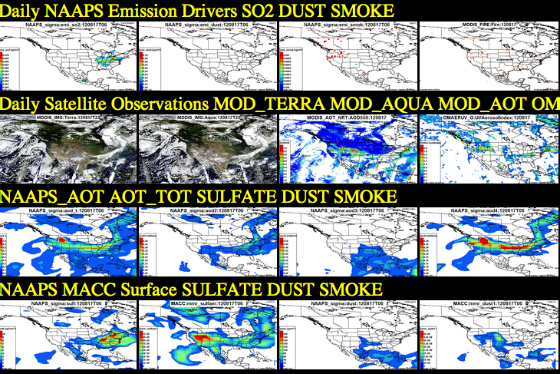
Application: August 2012 Western US Fires
Notes:
A smoke event such as occurred this in August 2012 over the Western US, can be examined through the emissions, satellite observations and models.

Slide 9
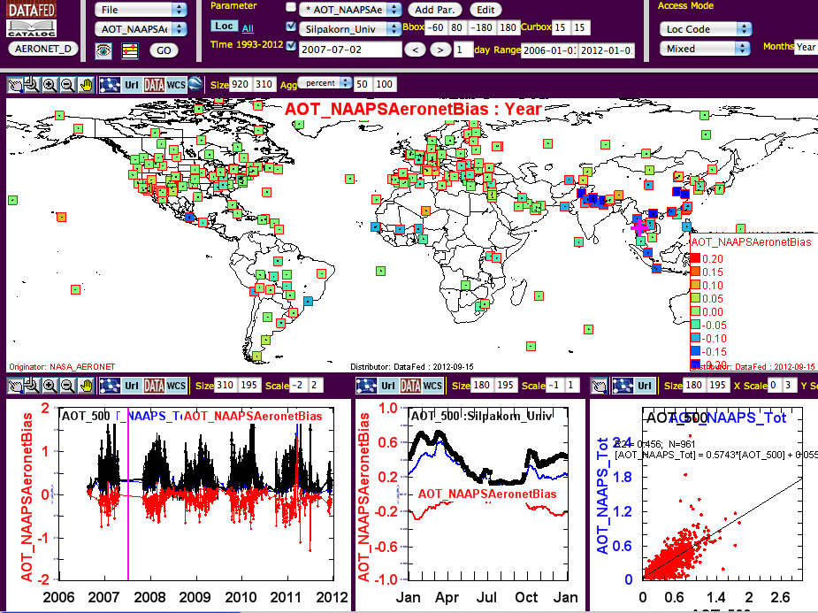
Tools: Model Evaluation Tool
Notes:
A more specific tool was developed to evaluate models. Specifically model-observation bias spatially and by season.
Here we show the calculated bias of the NAAPS model total Aerosol Optical Thickness as compared to the Aeronet AOT.

Slide 10
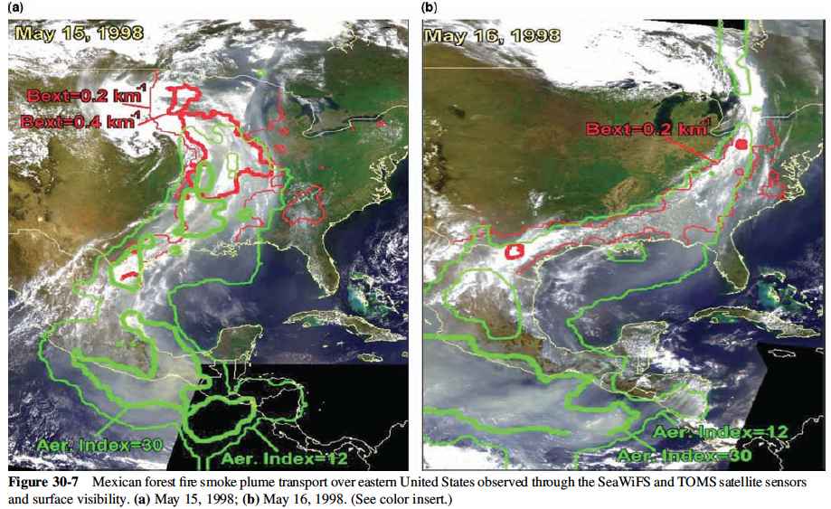
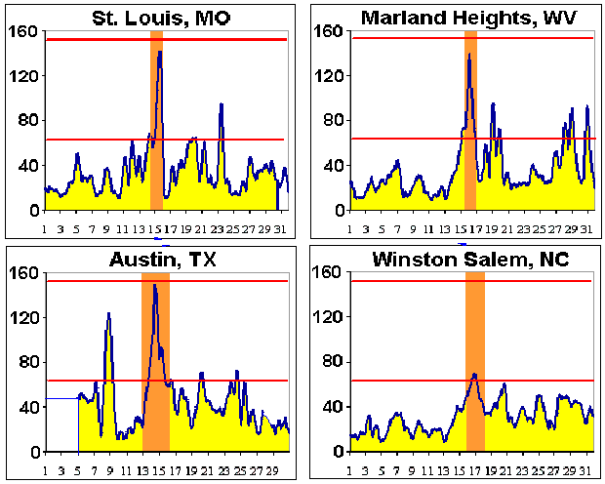
EPA Application: Exceptional Event An Uncontrollable Sources Causes AQ Violation
Smoke Event
Notes:
An exceptional event (EE) is when an uncontrollable or extra jurisdictional source causes violation of the National Ambient Air Quality Standard.
The granddad of EEs is the 1998 Mexican Smoke event that caused the highest measured regional PM concentrations over the Eastern US.
------------------------
Since time immemorial, smoke from forest fires, wind-blown dust storms and other ‘exceptional events’ have punctuated the air quality with extreme concentrations of atmospheric particulates and gases.
However, historically the spatio-temporal pattern of air quality during such events was sparse and patchy. This has changed dramatically during the sensing revolution of the 1990s, in particular through the near-real-time availability of color satellite images. Satellites the became the primary sensory inputs for event detection and spatio-temporal characterization.
Satellite observations were also responsible for formally including Exceptional Events into the AQ management process. When combined with routine surface-based monitoring data …
In the past, the definition and documentation of events has been subjective, dependent on the analyst, the is event type etc.
The routine overall characterization of detected events is accomplished by the rich real-time data through delivered through the Analysts Consoles
Objective event definition is now possible through spatio-temporal statistical parameters derivable from routine monitoring data
Scenario:
Smoke form Mexico causes record PM over the Eastern US.
Goal:
Detect smoke emission and predict PM and ozone concentration
Support air quality management and transportation safety
Impacts:
PM and ozone air quality episodes, AQ standard exceedance
Transportation safety risks due to reduced visibility
Timeline:
Routine satellite monitoring of fire and smoke
The smoke event triggers intensified sensing and analysis
The event is documented for science and management use
Science/Air Quality Information Needs:
Quantitative real-time fire & smoke emission monitoring
PM, ozone forecast (3-5 days) based on smoke emissions data
Information Technology Needs:
Real-time access to routine and ad-hoc data and models
Analysis tools: browsing, fusion, data/model integration
Delivery of science-based event summary/forecast to air quality and aviation safety managers and to the public
and their causes is still poorly understood and largely unpredictable.

Slide 11
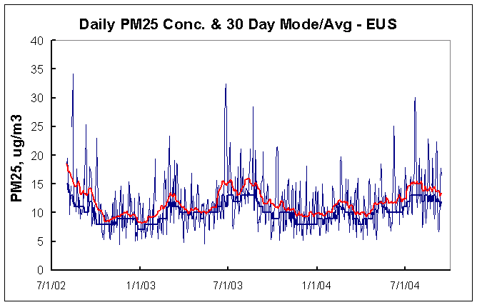
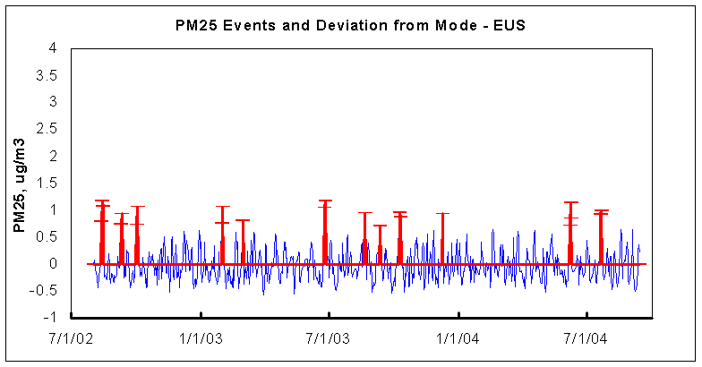
Tools: Automatic Event Detection
EUS Daily Average
50%-ile, 30 day 50%-ile smoothing
Event : Deviation > x*percentile
Deviation from %-ile
Notes:
Air quality events can be detected as anomalies, compared to a set baseline condition.
Calculating the baseline and setting trigger values are flexible.

Slide 12
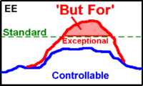
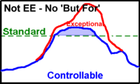
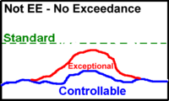
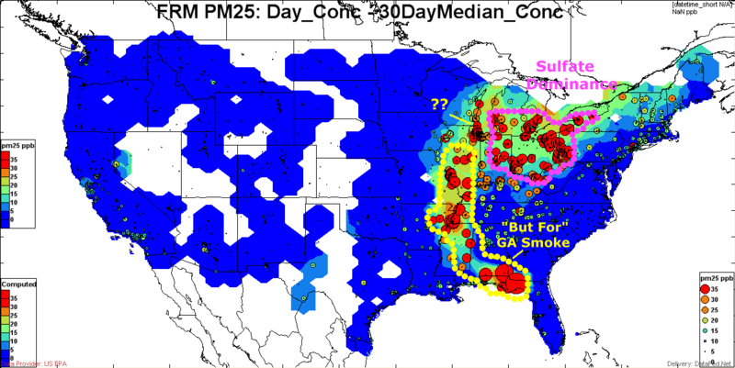
Exceptional Event: Formal Regulatory Definition
Notes:
An EE occurs when the exceedance happens only due to the increment of the uncontrollable source.
Such samples can be flagged as EE and will not count in the calculation of compliance with NAAQS.
Exceedance would happen without EE increment – no EE flag
Large uncontrollable impact but no exceedance – no EE flag
In this example, exceedances are measured over the Mississippi Valley as well as over the Ohio Valley.
However, only the yellow marked region is eligible for EE flag from a wildfire in Georgia.

Slide 13
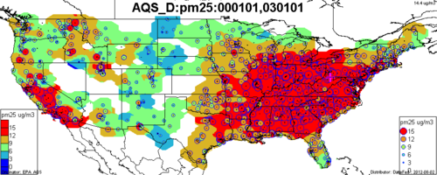
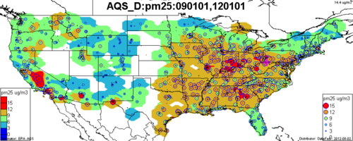
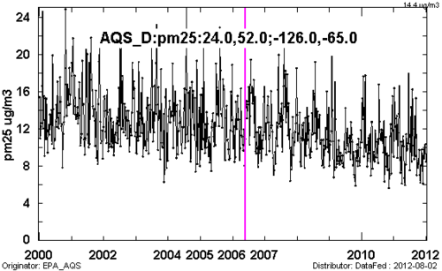
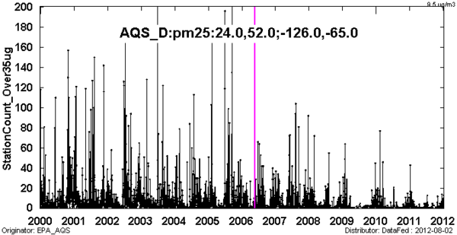
AQ Trend and Pattern Analysis 2000-2012: 40% Decline of US PM 2.5
Yearly Avg. PM2.5, 2000-2003
Yearly Avg. PM2.5, 2000-2003
In the 2000-12 period, the avg. PM2.5 conc. declined over the Eastern and Western US.
Over the entire US, the PM 2.5 decline was a remarkable 40%, from 14 to 10 ug/m3
The count of >35 ug observations has declined by factor of 3
~14 ug/m3
~10 ug/m3
Daily Avg. PM2.5, 2000-2012
There are much fewer exceedances – fewer EE flags

