Slide 1


Creating Documentation and Metadata:
Metadata for Discovery
Lola Olsen¹, Tyler Stevens²,
1 National Aeronautics and Space Administration (NASA)
2 Wyle Information Systems (NASA Contractor)
Notes:
Modules should be 3-7 minutes long

Slide 2
Overview
Introduction to Discovery Level Metadata
Components of Discovery Level Metadata
Examples of Discovery Level Metadata
Notes:
Overview Module: Voiceover Script for Slide 2
As a high level overview, we'll touch upon these topics in this module:
(1) Introduction to Discovery Level Metadata; (2) Components of Discovery Level Metadata; (3) Examples of Discovery Level Metadata

Slide 3
Discovery Level Metadata
A data set description (metadata) that provides the essential information to determine if a particular data set meets the users’ needs.
  Conveys to the user the nature and content of the data.
  Contains a set of quantitative and/or qualitative measurements and distinguishes that set from other similar measurement sets.
Discovery level metadata will usually contain less information than other types of metadata (i.e. use metadata, granule metadata)
A controlled keyword vocabulary is essential to provide a normalized discovery of data.
Notes:
Voiceover Script for Slide 3
There are different types of metadata serving different purposes, including metadata for access and use, granule level metadata, and discovery level metadata.
Discovery level metadata may be the first type of metadata users see when searching for Earth science data. When users begin an initial search for data, they generally want a data set that meets their particular research needs. Being able to easily determine and distinguish between different data sets is crucial. This is where discovery level metadata comes into play. It provides the essential information for the user to distinguish between two or more different data sets. Free-text search and a controlled search using a science keyword vocabulary helps users search for data. More importantly, controlled keywords help users normalize their search, discovery and subsequently provide more relevant and focused search results.

Slide 4
Categories of Discovery Level
Metadata
What: Title of Data Set and Keywords Describing the Data Set
Why: Description and Purpose of the Data Set
When: Temporal Coverage of the Data Set
Who: Data Set Creator and Contact
Where: Geographic Extent and Location of Data Set Coverage
How: How the Data Set was Created and How to Access the Data
Notes:
Voiceover Script for Slide 4
There are six categories that users should see in discovery level metadata. They are the what, why, when, who, where, and how of the data set being described.
What: The data set should have a concise title and keywords that clearly describe the science parameters being measured, studied, and/or analyzed.
Why: A summary of the analysis being performed and the results of the analysis. An abstract and purpose should be provided to help users determine if the data set is useful for their needs. The purpose describes the purpose of the data set to the users.
When: Temporal coverage provides users with information on the start and stop date of the data collection.
Who: Personnel who created the data set or are the technical point of the contact for more information about the data set. This information is important if users need more information about the data set.
Where: The geographic coverage and spatial location of the study area/coverage of the data set.
How: Information on how the data set was created, statistical/mathematical/technological procedures used to create the data set. The “How” also includes information on how to access and/or purchase the data set.

Slide 5
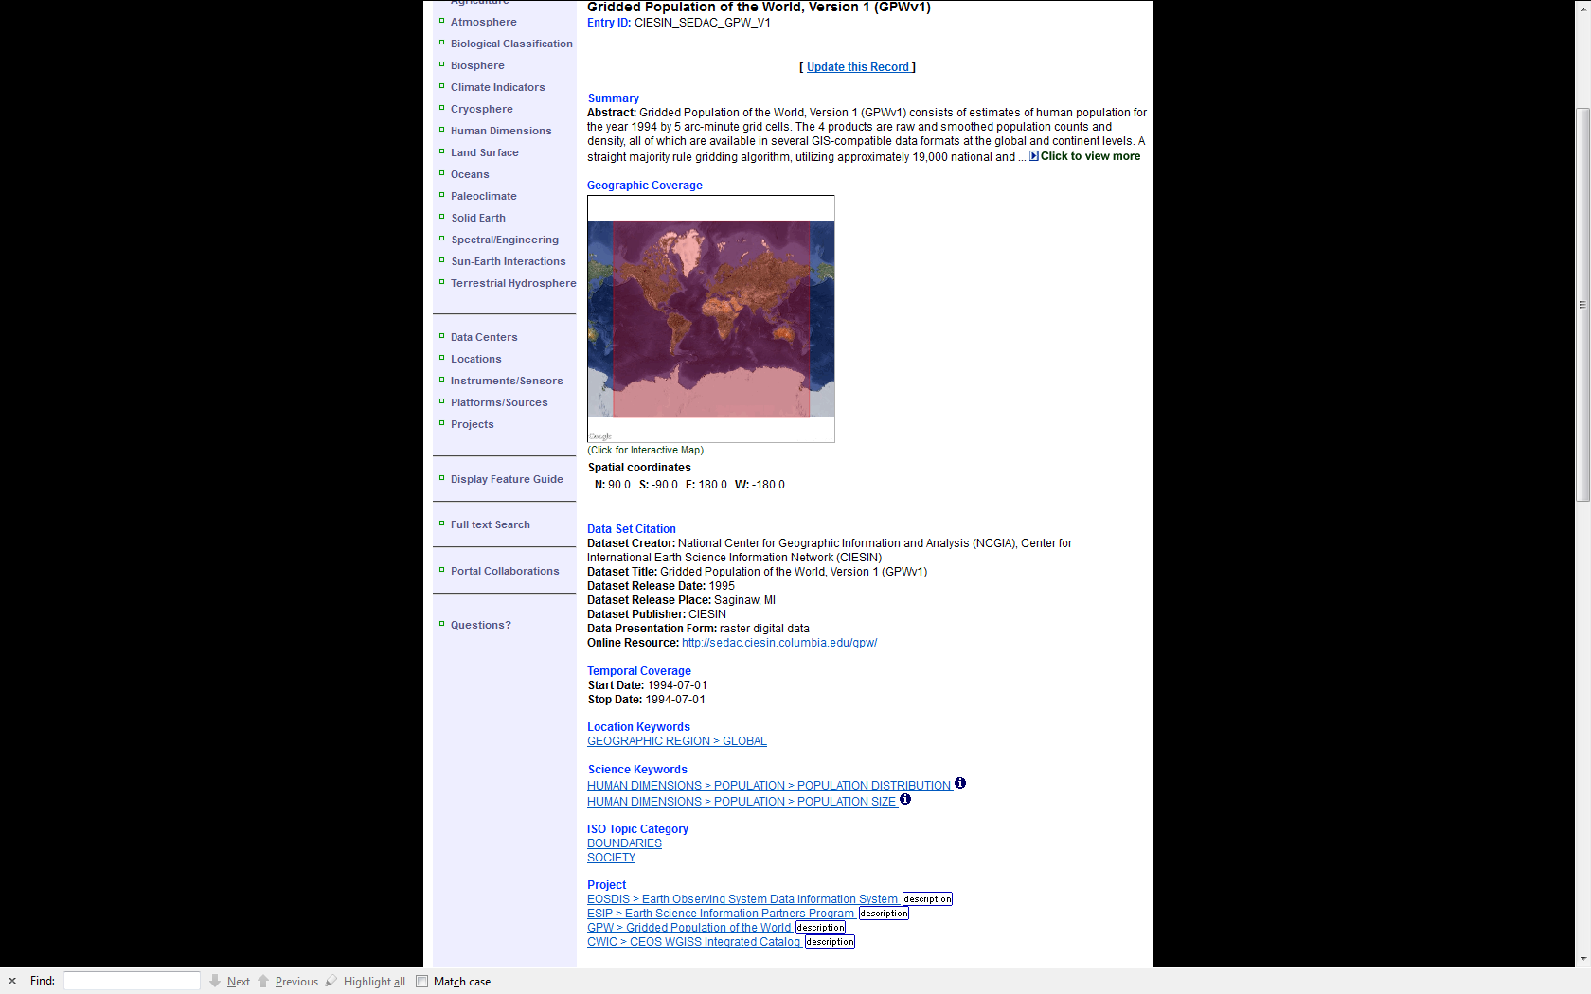
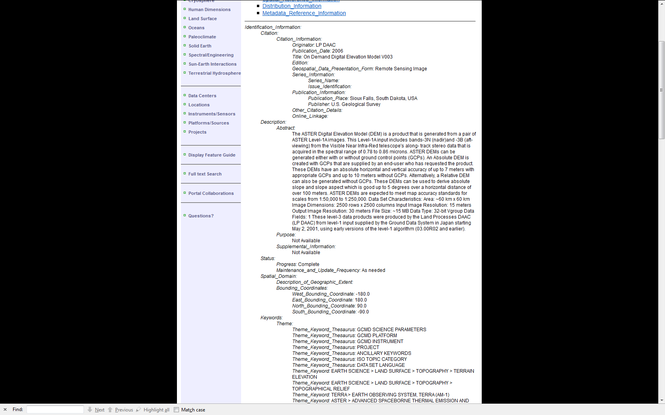
Examples of Discovery Level Metadata
Directory Interchange Format (DIF)
Federal Geographic Data Committee (FGDC)
Notes:
Voiceover Script for Slide 5
There are several different examples and “views” of discovery level metadata. On the left is a discovery level metadata record in DIF format, and on the right is the same metadata record in Federal Geographic Data Committee (FGDC) format. Other formats of discovery level metadata (not shown) include ISO and Dublin Core.
The Directory Interchange Format (DIF) is a metadata standard developed and used by NASA and the international community.
The Federal Geographic Data Committee (FGDC) Content Standard for Digital Geospatial Metadata (CSDGM) is the current U.S. Federal metadata standard.

Slide 6
Relevance to Data Management
Discovery level metadata makes it easier to find relevant data in data inventory systems.
Being able to find and distinguish data from other similar data sets makes maintaining a data inventory easier.
Creating and maintaining metadata is part of a data management lifecycle.
Notes:
Voiceover Script for Slide 6
Now that you have seen what this module has covered, you might be wondering why these topics are important for data management. To answer that question, please consider the following:
Metadata is a crucial part of the data management lifecycle and discovery metadata makes it easier for users to find relevant data in data inventory systems.
After using discovery level metadata to find a particular data set, more detailed metadata can be used to get additional detailed information on a data set, including data lineage.
The time and effort should be put into properly documenting data sets so they can be easily discoverable in data/metadata inventory systems.

Slide 7
References and Resources
Federal Geographic Data Committee (FGDC). Geospatial Metadata. http://www.fgdc.gov/metadata.
National Aeronautics and Space Administration (NASA). Global Change Master Directory. http://gcmd.nasa.gov.
Taylor, Mark. 2000. “Developing Spatial Data Infrastructures – The SDI Cookbook”. Global Spatial Data Infrastructure Association. http://www.gsdi.org/pubs/cookbook/chapter03a.html.
Notes:
Voiceover Script for Slide 7
We've collected some additional resources that might you might find helpful should you need more information about some of the areas that we've covered briefly.
[see text in document]

Slide 8
Other Relevant Modules
Creating documentation and metadata
Publishing Metadata to GCMD
Notes:
Voiceover Script for Slide 8
The modules of the ESIP Data Management Course have been designed to complement and supplement each other. In light of this plan, we think you might find the following, related modules relevant to you and why as you gain a better understanding of data management:
The modules are as follows: Creating documentation and metadata, and Publishing Metadata to GCMD.

