Slide 1

Introduction to ESIP
Session on Early Career Data Professionals
Anne Wilson
SciDataCon 2014, New Dehli
November 3, 2014

Slide 2

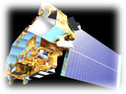


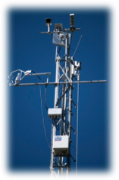




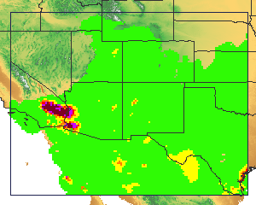

ESIP Vision
To be a community of leaders promoting the collection, stewardship and use of Earth science data, information and knowledge that is responsive to societal needs.

Slide 3
ESIP Community
Multiple Science Domains
Data Providers
Cross-Agency
Users
Data Archives
Application
Developers
Tool & System
Developers
Academia
Corporate
Notes:
Benefits of Engaging with Community:
Enhance staff knowledge through peer knowledge exchange
Take away new technologies
Identify new collaborations
Leverage scarce resources through reuse, repurpose
Help define community best practices

Slide 4
ESIP Core Values
Agility
Collaborative
Collegial
Community-driven
Innovative
Neutral
Open
Participatory
Voluntary

Slide 5
Membership count
Type I: data centers (23)
NASA DAACs
NOAA (NGDC, NODC, NCDC)
Type II: researchers and tool developers (72)
Academia
Government labs
Type III: application developers (61)
Commercial
Nonprofit
Educational
Type IV: strategic partners (2)
NASA
NOAA

Slide 6
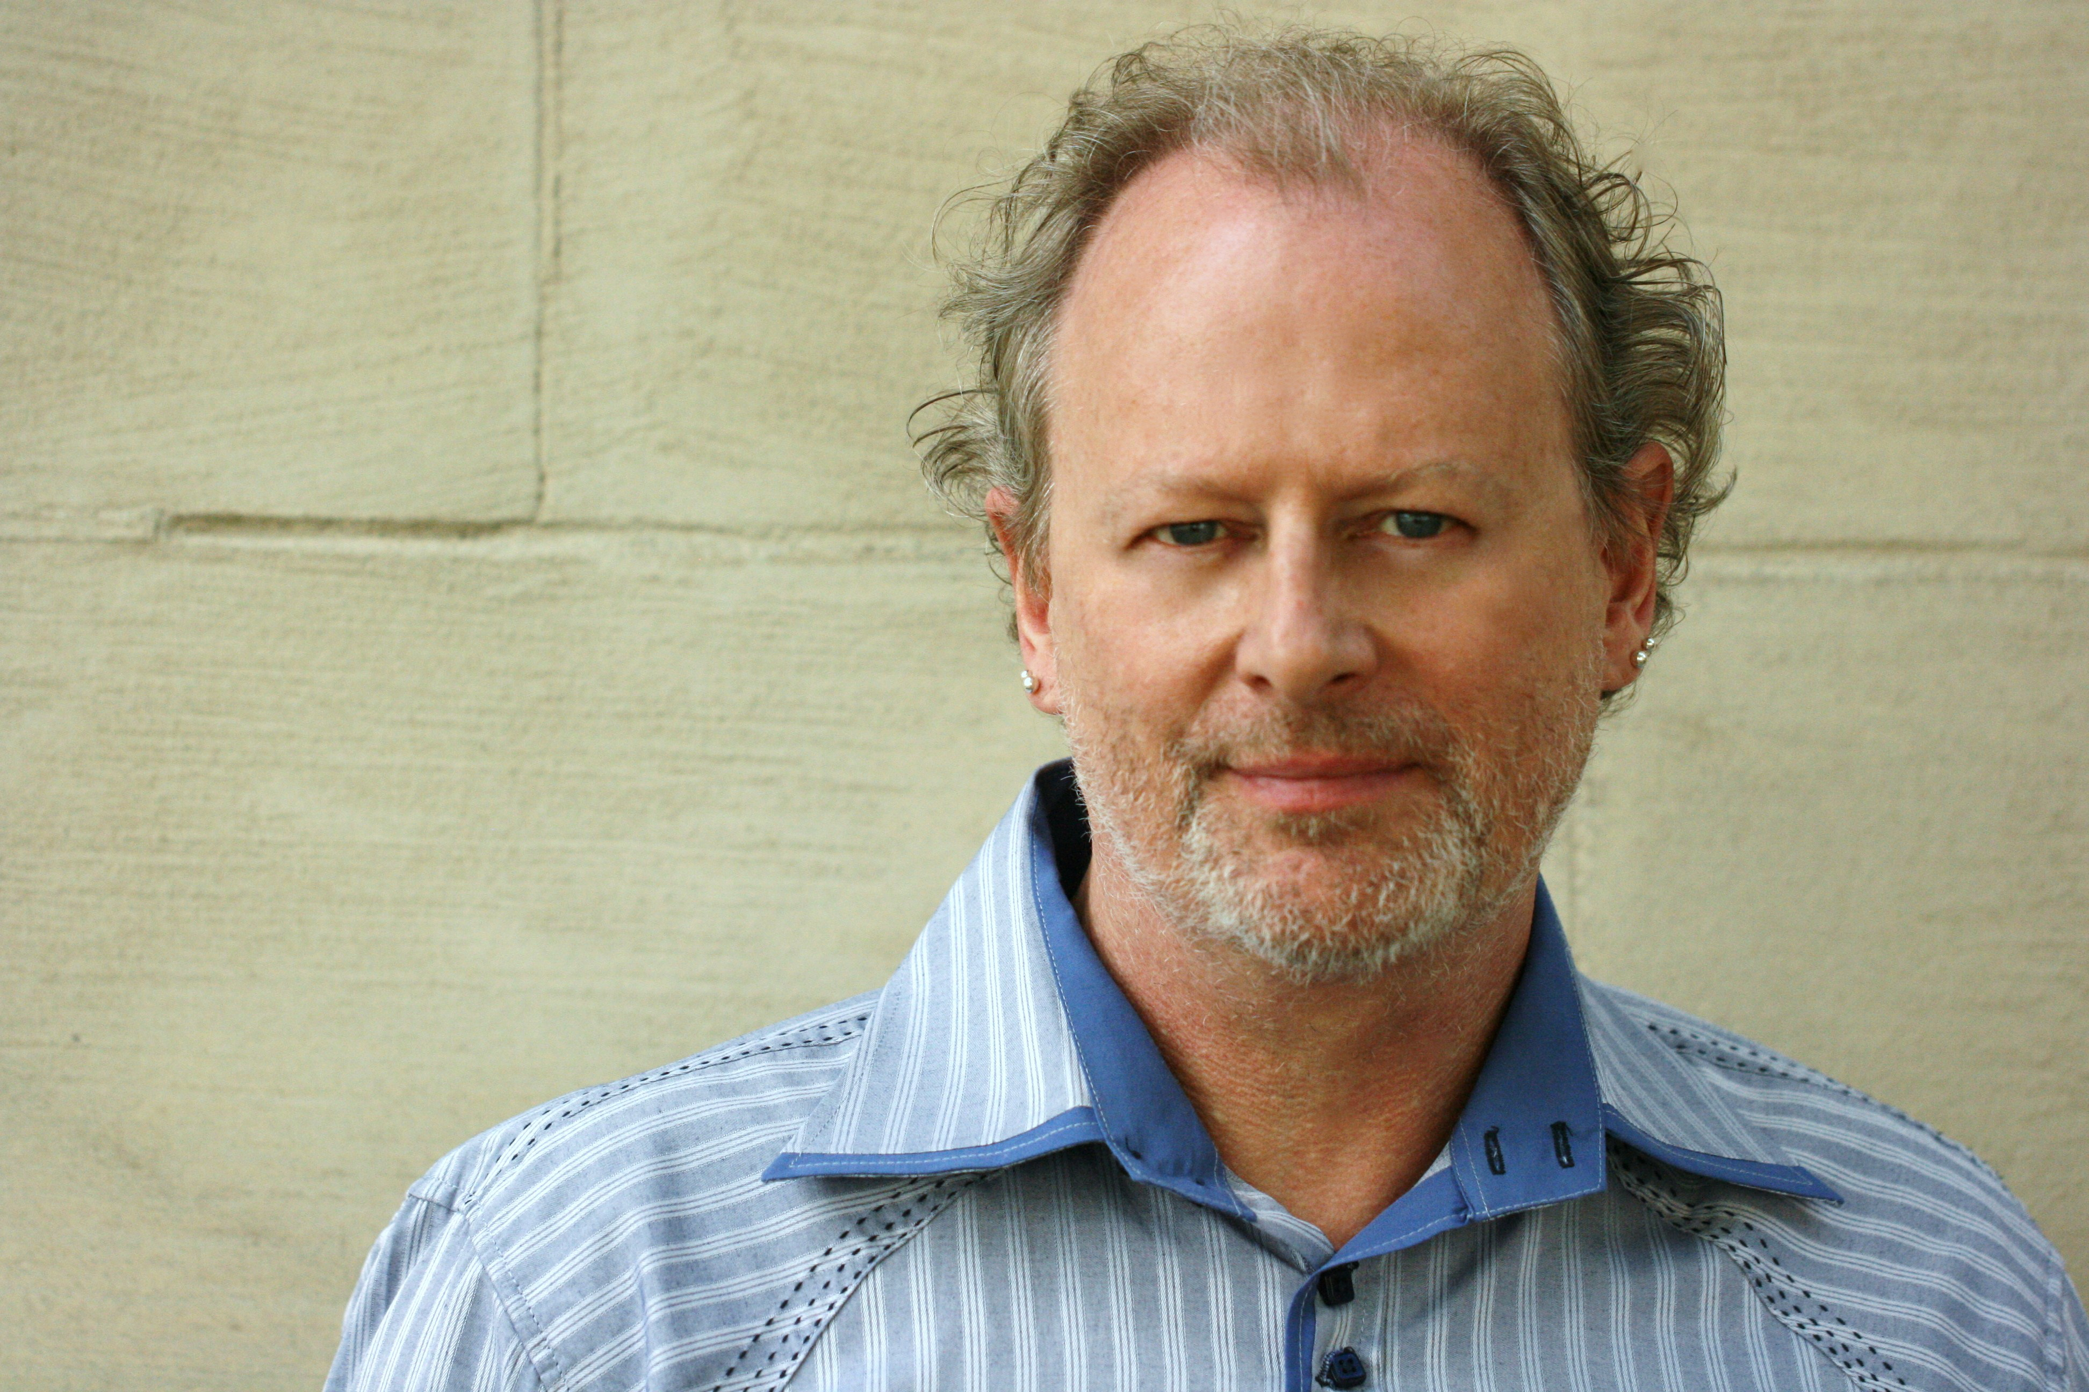
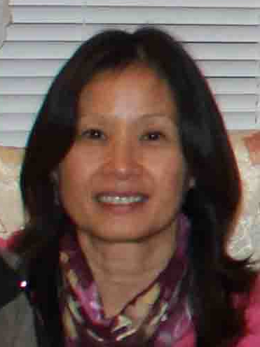
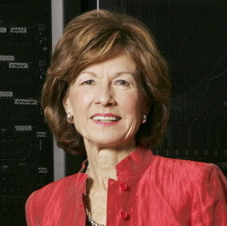

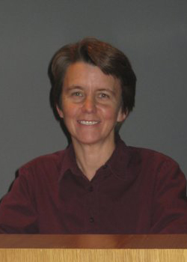
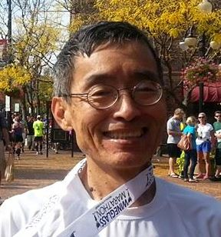
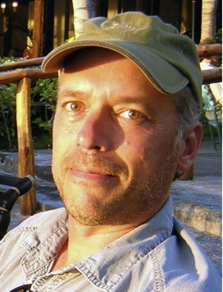

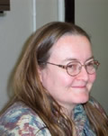

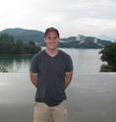

ESIP Leadership
President & Vice President
ESIP Type Reps
Peter Fox
Emily Law
Sara Graves
Ken Keiser
Margaret Mooney
Administrative Committee Chairs
Bill Teng
Bruce Caron
Tyler Stevens
Standing Committee Chairs
Ruth Duerr
Roberta Johnson
Matt Austin
Christine White
Notes:
ESIP works cross agencies, cross sectors, and cross science domains.
Sara is CODATA Secretary General, Chair of this session.

Slide 7
Collaboration Area Structure
Clusters
Working
Groups
Committees
Least
Formality
Most

Slide 8
Collaboration Area Structure
ESIP Clusters
Agriculture & Climate
Cloud
Decisions
Disasters
Discovery
Documentation
Earth Science Data Analytics
Energy & Climate
Info Quality
Science Software
Semantic Web
Features of Clusters
Formed by sending VP email
For any reason
Ends when the last person hangs up
Clusters
Formality
Least
Most

Slide 9
Collaboration Area Structure
Features of Working Groups:
Created by Assembly or Committee
Task-oriented
Budget
ESIP Working Groups
Data Study
Drupal
Climate Education
Visioneers
Clusters
Working
Groups
Formality
Least
Most

Slide 10
Collaboration Area Structure
Standing Committees
Data Stewardship
Education
Information Technology and Interoperability
Products and Services
Administrative Committees
Constitution and Bylaws
Finance and Appropriations
Partnership
Features of Committees
Chair elected by Assembly
Chair serves on Executive Committee
Budget
Clusters
Working
Groups
Committees
Least
Formality
Most

Slide 11
ESIP is a bottom up, grassroots organization

Slide 12
ESIP Groups
Standing Committees
Data Stewardship
Education
Information Technology and Interoperability
Products and Services
Administrative Committees
Constitution and Bylaws
Finance and Appropriations
Partnership
Working groups
Air Quality
Climate Education
Energy & Climate
Visioneers
Clusters
Cloud Computing
Decisions
Discovery
Documentation
Drupal
Earth Science Collaboratory
Geospatial
Open Source
Semantic Web
Visualization
Student Fellows
And Yours?

Slide 13
Governance
Assembly
1 partner, 1 vote
Annual meeting in Jan.
Leadership elected from Assembly representatives
Committee
Chair elected by Assembly
Chair serves on Executive Committee
Working group
Created by Assembly or Committee
Task-oriented
Cluster
Self-forming
For any reason
Ends when the last person hangs up

Slide 14
Facilitating Connections at a Variety of Levels
Data
Systems
Organizational
Human
In Person Meetings
Website, Wiki, Commons
Telecons/Web Meetings
Support staff to ESIP Collaboration areas
Notes:
ESIP supports connections at the data and systems levels by providing a neutral venue to build relationships at the human and organization level. Fdn staff has birds eye view to link communities and organizations to each other…

Slide 15
Things ESIP Does
Community-generated Best Practices (e.g. Citation)
Testbed (e.g. Identifiers, Ontology)
Community Conventions (e.g. Discovery)
Professional Development
Technical Workshops
Non-technical Workshops (e.g. Evaluation, Communication)
Data Management Short Course/Workshops
Outreach
Education (e.g. annual teacher workshop on climate change)
Professional Societies (e.g. AGU, GSA)
International Efforts (e.g. GEO, ISRSE)
Provide Venue for Collaboration and Connections
Both virtual and in-person
Support with suite of collaboration tools
Provide mini-grants to make stuff happen
Notes:
Testbed activities:
Digital Identifiers Evaluation
Deploy a Testbed Portal
Esri Geoportal Server: Discovery Services and Clients: Interoperability Testing, Advertisement, and Assessment of Data to Service Broker
A Classification and Annotation Scheme for Data and Service Quality
Drupal Metadata Editing Tool Suite
Data Stewardship: Metadata and Identifier Mapping
ESIP Ontologies in the Cloud: Semantic Web Focus
ESIP DOES not build infrastructure – it enables other to leverage the work across the community to build better infrastructure

Slide 16
ESIP Online
Home page
http://esipfed.org
Wiki
http://wiki.esipfed.org
Commons
http://commons.esipfed.org
GitHub
https://github.com/ESIPFed
Facebook
http://tinyurl.com/esip-facebook
Twitter
#esipfed, @ESIPFed, @ESIPPres

