Slide 1


Responsible Data Use:
Citation and Credit
Matthew Mayernik
National Center for Atmospheric Research
Version 1.0
Review Date
Notes:
Modules should be 3-7 minutes long

Slide 2
Growing Visibility of Data Citations
2009 AGU position statement:
  “The scientific community should recognize the professional value of such [data] activities by endorsing the concept of publication of data, to be credited and cited like the products of any other scientific activity, and encouraging peer-review of such publications.”
2009 AMS Ad Hoc Committee on Data Stewardship Prospectus:
  AMS should “[d]evelop a plan for citing data referenced in publications and preserving data links for the long term.”

Slide 3

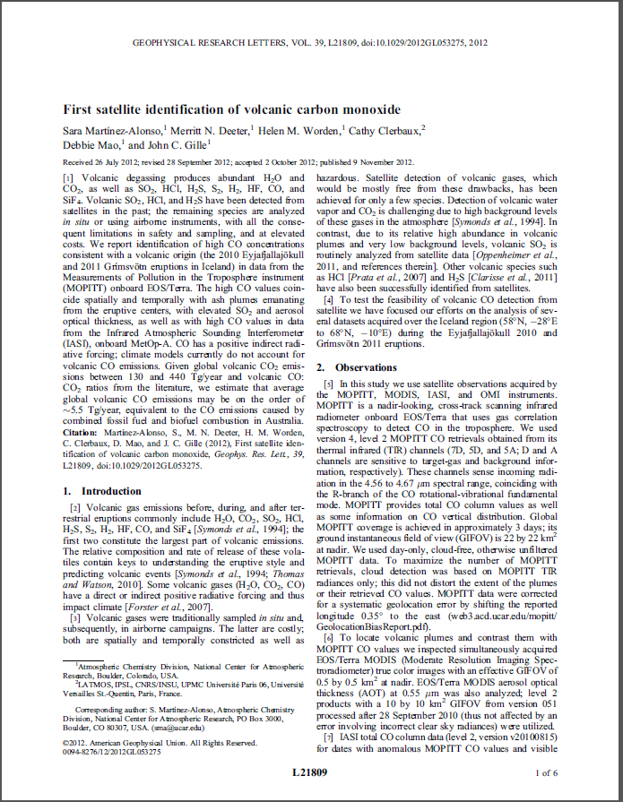
Purpose of Data Citations
Connect publications to their underlying data
Give scientists and data centers credit for producing and curating data sets
Understand how data are used
Track the products that derive from data
Facilitate data and science transparency and reproducibility

Slide 4
How are Data Citations different than Publication Citations?
Differences in citing data vs. publications
  Data sets are extremely variable in structure, representation schemes, and access mechanisms, unlike traditional scholarly publications.
  Data sets are often highly dynamic, changing or growing regularly, whereas scholarly articles do not change once published
  Data sets are often hierarchical composites of data and metadata files, software, and other related documents.
  Authorship is a problematic notion in relation to data sets, particularly in distributed and collaborative work.

Slide 5

Data Citation Initiatives
Many research centers are beginning to assign actionable web identifiers to data (such as DOIs, ARKs, and Handles).
  Actionable identifiers uniquely locate resources that are available online
  Actionable identifiers can potentially enable data use to be tracked more efficiently
  Actionable identifiers facilitate data transparency and reproducibility by directly linking to the data that led to results
DataCite - an international consortium of libraries and research organizations that promote and provide registration services for DOIs and citations for data

Slide 6
Data Citation Recommendations
ESIP Data Stewardship Committee recommendations
  Required citation elements: Author. Release date. Title. Version. Archive/Distributor. Locator/Identifier. Access date and time.
  Optional citation elements: Subset Used; Editor, Compiler, or other important role; Distributor, Associate Archive, or other Institutional Role; Data Within a Larger Work
Example citation in ESIP format:
  Zwally, H.J., R. Schutz, C. Bentley, J. Bufton, T. Herring, J. Minster, J. Spinhirne, and R. Thomas. 2003. GLAS/ICESat L1A Global Altimetry Data V018, 15 October to 18 November 2003. National Snow and Ice Data Center. Data set accessed 2011-07-21 at doi:10.3334/NSIDC/gla01.

Slide 7
Other Data Citation Recommendations
International Polar Year policy
  Data citations “should include the following elements as appropriate”:
    Author or investigator, Publication date, Title, Dates used, Editor or compiler, Publication place, Publisher, Distributor or associate publisher, Distribution medium or location, Access date, Data within a larger work.
DataCite
  Recommended minimum citation elements:
    Creator. PublicationYear. Title. [Version]. Publisher. [ResourceType]. Identifier.

Slide 8

Conclusion
Work with your data center to:
  Develop appropriate citations for your data
  Assign identifiers to data
  Find citations for existing data
Work with collaborators to:
  Decide when data citations are appropriate
  Provide each other with citation information for data
Work within your research institutions to:
  Make citing data a regular practice in your labs/groups
  Promote the value of data citations in tenure and promotion committees

Slide 9
References
American Geophysical Union. 2009. AGU Position Statement: The Importance of Long-term Preservation and Accessibility of Geophysical Data. http://www.agu.org/sci_pol/positions/geodata.shtml
American Meteorological Society. 2009. AMS Ad Hoc Committee on Data Stewardship Prospectus. http://www.unidata.ucar.edu/staff/mohan/Data%20Stewardship%20Prospectus.pdf
Ball, A. & M. Duke. 2011. “How to Cite Datasets and Link to Publications.” DCC How-to Guides. Edinburgh: Digital Curation Centre. http://www.dcc.ac.uk/resources/how-guides
Duerr, R., et al. 2011. “On the utility of identification schemes for digital earth science data: an assessment and recommendations.” Earth Science Informatics, 4(3): 1-22. http://dx.doi.org/10.1007/s12145-011-0083-6
Parsons, M.A. 2011. “Data Citation.” Presentation at GeoData 2011, Broomfield, CO, 3 March 2011. http://http://tw.rpi.edu/media/latest/ParsonsDataCitation.pdf
Parsons, M.A., R. Duerr, and J.-B. Minster. 2010. “Data Citation and Peer Review.” Eos Transactions, AGU 91(34): 297-298. http://dx.doi.org/10.1029/2010EO340001

Slide 10
Resources
Federation of Earth Science Information Partners (ESIP). 2011. “Interagency Data Stewardship/Citations/provider guidelines.” http://wiki.esipfed.org/index.php/Interagency_Data_Stewardship/Citations/provider_guidelines
International Polar Year 2007-2008 Data Policy. 2008. Version 1.2. http://classic.ipy.org/Subcommittees/final_ipy_data_policy.pdf
DataCite. http://datacite.org
DataCite Metadata Search – a service for discovering data sets http://search.datacite.org/
Identifiers:
  Digital Object Identifiers (DOIs) – http://www.doi.org/
  Archival Resource Keys (ARKs) – https://wiki.ucop.edu/display/Curation/ARK
  Handles - http://www.handle.net/

Slide 11
Other Relevant Modules
Working with your archive organization
Advertising your data
Providing access to your data
Sponsor (e.g., Agency) or institution requirements

