Slide 1
SCIENCE DATA QUALITY DISCUSSION
Gilberto A. Vicente
NASA GES-DISC Science Data Manager
Telecom – Feb. 19th 2014

Slide 2
Agenda
Welcome and purpose. (2 min)
Review of the BF Winter ESIP data quality group initiative. (3 min)
The data quality matrix concept. (5 min)
General data quality requirements. (15 min)
Focus on the users. (15 min)
Data Quality Matrix - group inputs. (15 min)
Conclusion - what is next. (5 min)

Slide 3
DATA information QUALITY bOF
Brief overview/background (Gilberto Vicente)
  Data quality is an ill-posed problem
  USER DEPENDENT
  NOT UNICALLY DEFINED: MEAN DIFFERENT THINGS TO USERS AND PROVIDERS
  The “Data Container” The Data Quality Matrix
Quality as a Notion by Use (Chris Lynnes)
  The user inventory: Museum Curator, Operational user (Hotshot, Burn scar/Landslide), Ecologist and the Remote Science Researcher
  ACCURACY, RESOLUTION, COMPLETENESS, LATENCY, END OF USE
Moving Forward (Group participation)

Slide 4
The DATA QUALITY matrix CONCEPT
Need to be simple
  Based on generally accepted principles of data quality
  → Accuracy, consistency, completeness, integrity, accessibility (format)
  It set boundaries (rules for defining thresholds/dimensions for data quality metrics)
  It is less concern with contents and more with the way they should be described
  Satisfy the majority of data users and producers (80/20 rule)
  Readable (plain English)
  Useful and reproducible (go across agencies and disciplines)
  Small (1 to 2 pages document)
  Not looking for the perfect solution.
Need to be owned and adopted by the community (needs do come from within)

Slide 5
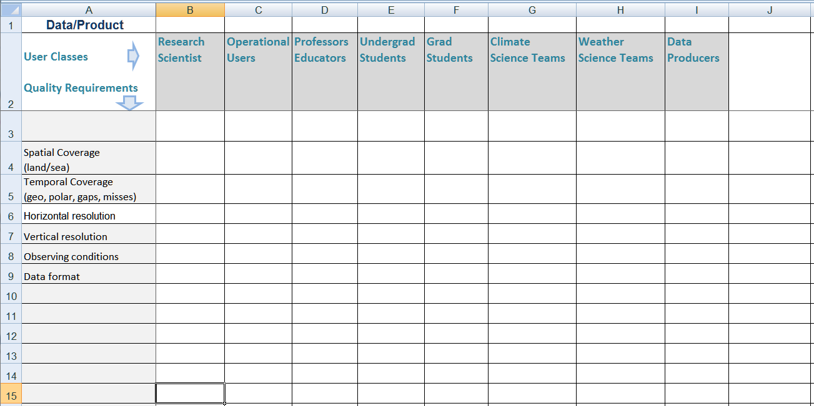
general data quality requirements
The consumer report approach
  List of requirements
  List of user classes
  Rate the requirements for each user category

Slide 6
Who are our users
General public
K-12 Teachers
Undergraduates
Graduate students
Professors
Education / Public Outreach specialists
Production Centers
Internal Data Providers
External Data Providers
Science Team
Cal/Va
QA and Testing
Data Analyst
Data Tech
Computer Scientist
Domain Scientist
Interdisciplinary Scientist
Operational User
Discipline-specific Modeler
Assimilation modelers
Climate Modelers
Web Services
Decision Support Systems
Data Analysis and Visualization Systems
From Chris Lynnes presentation: 2014 ESIP Winter meeting

Slide 7
Data Quality Matrix - group inputs
xxx
Your contribution

Slide 8
what is next
Monthly telecoms – 3rd week of the month
  March 20th (Thursday at 12pm)
  4th Annual Government Big Data Forum - March 19, Renaissance Hotel
  April 16st – Wednesday at 12pm
  May 21st – Wednesday at 12pm
  June 18th – Wednesday at 12pm
ESIP Summer Meeting, July 8-11
  Define the work scope
  List main priorities
  Prioritize expectations
  Present a prototype

