Slide 1

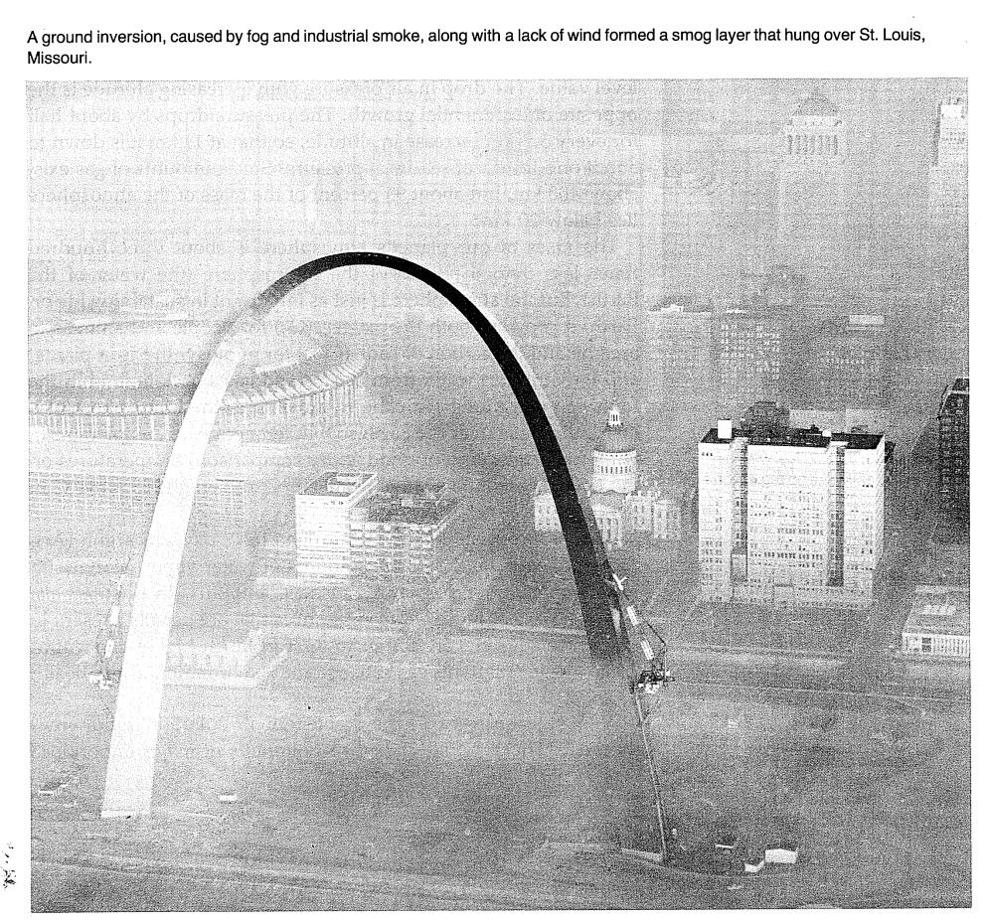
Ambient Air Quality Monitoring Networks
Jay R. Turner
Department of Energy, Environment and Chemical Engineering
Washington University in St. Louis
Air Quality Management
December 6-7, 2012
Mumbai, India
From: G. Gordon and W. Keifer (1980) The Delicate Balance: An Energy and the Environment Chemistry Module,
Harper & Row, New York.
Photo: Varun Yadav

Slide 2
Today’s Presentation
Status and perspectives on U.S. networks
Emphasis on particulate matter
Brief comments on networks in:
Hong Kong
Ulaanbaatar
Theme: Opportunities to learn from other networks, possibly leapfrog portions of the evolution path

Slide 3
U.S. Historical Perspective
Several air quality-related networks
Acidic deposition
Mercury
Criteria pollutants / NAAQS* Networks
National Air Monitoring Network (NAMS)
State/Local Air Monitoring Network (SLAMS)
Both NAMS/SLAMS operated by state/local agencies
Historical emphasis on monitoring compliance with NAAQS
* NAAQS = National Ambient Air Quality Standards (CO, NO₂, O₃, Pb, PM, SO₂)

Slide 4
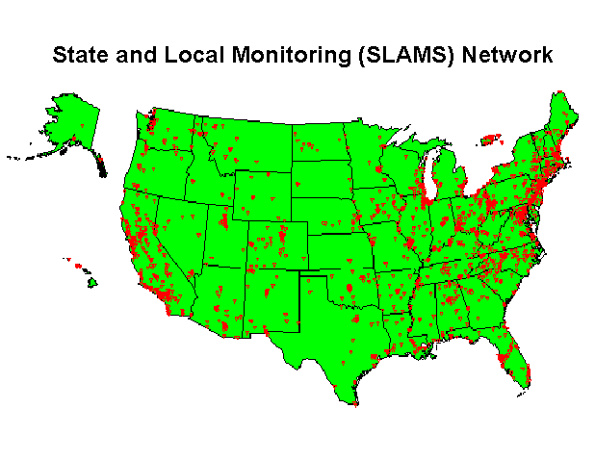
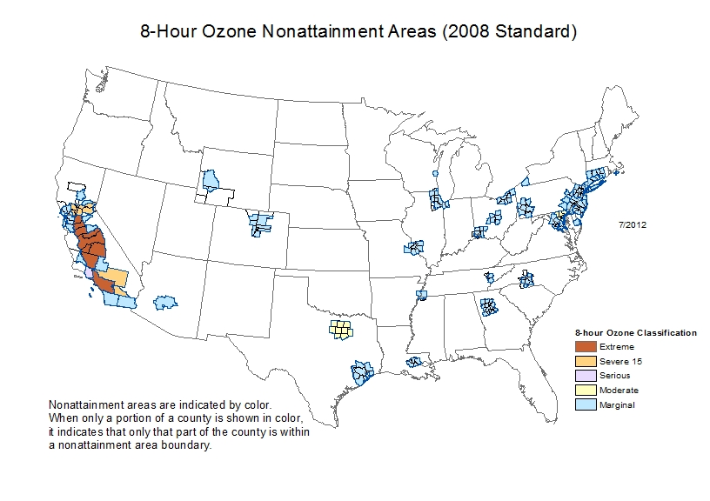
State and Local Monitoring Network (NAAQS Compliance)

Slide 5
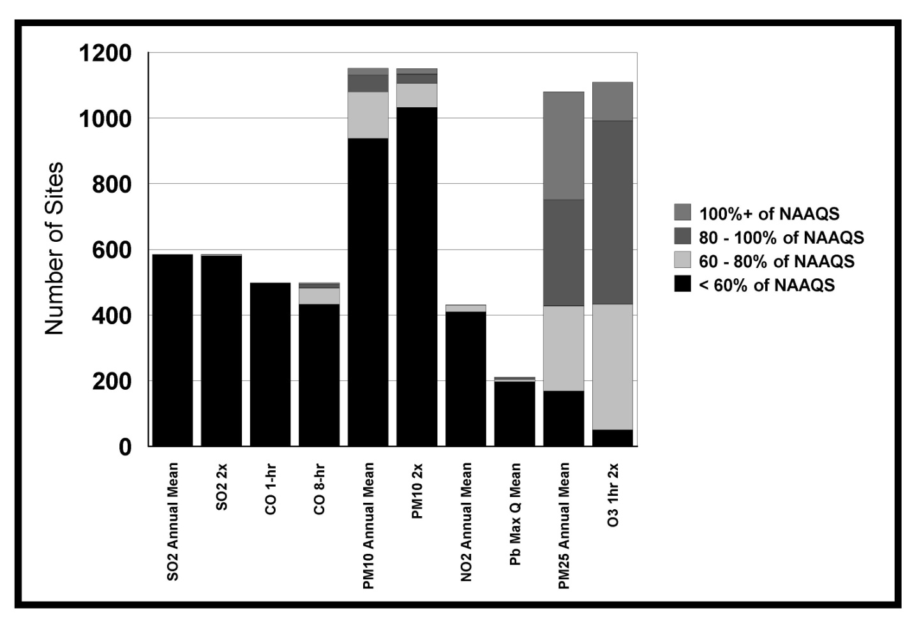
U.S. Historical Perspective
With notable exceptions (especially ozone), historically viewed as stovepipes
By pollutant
By site
“Networked” through shared operational details (methods, QA,…)

Slide 6
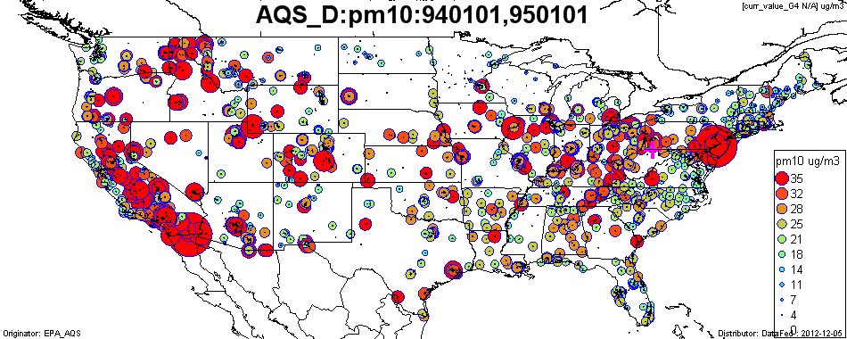
Example – PM₁₀ Compliance
Focus in the late 1980s to late 1990s
monitoring concentrated in…
Large urban areas (often a PM_{2.5} issue)
High “dust” environments
Near large industrial sources
Desert communities
Ski resort communities!
Map Source: R. Husar, CAPITA,
Washington University in St. Louis

Slide 7
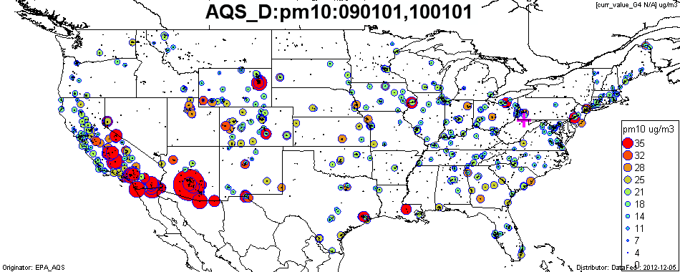
PM₁₀ Network has Evolved
1994
2009
Map Source: R. Husar, CAPITA, Washington University in St. Louis

Slide 8
Particulate Matter National Ambient Air Quality Standard (NAAQS)
Revisions in 1988, 1997, and 2006
green = current
red = phased out
PARTICULATE MATTER NAAQS | 1970 |  |  |  |  |  |  |  |  |  | 1980 |  |  |  |  |  |  |  |  |  | 1990 |  |  |  |  |  |  |  |  |  | 2000
total suspended particulate (TSP)
PM-10, annual average, 50 μg/m³
PM-10, 24-hour average, 150 μg/m³
PM-2.5, annual average, 15 μg/m³
PM-2.5, 24-hour average, 65 μg/m³
PM-2.5, 24-hour average, 35 μg/m³

Slide 9
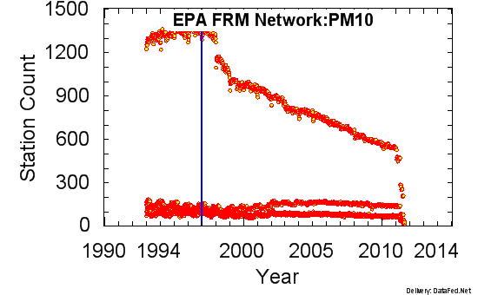
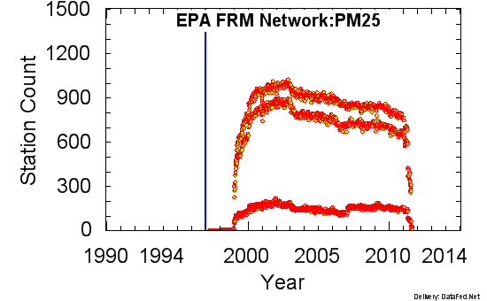
Network Changes over Time
Drivers…
Primarily by competing needs for resources
New or revised air quality standards
Secondarily by rational network assessments
Daily
1-in-3
1-in-6
Daily
1-in-3
Daily
DataFed Wiki (http://datafedwiki.wustl.edu/index.php/AQS_D_Coverage)

Slide 10
Beyond Compliance Monitoring
Compliance with air quality standards (NAAQS)
Data for setting bottom-up source-oriented standards (air toxics)
Public awareness and information (e.g., Air Quality Index, AQI)
Track accountability of emission control programs and long term trends in general
Provide data for atmospheric science studies (e.g., chemical transport model validation)
Provide data for health studies

Slide 11
Network Evolution
Greater appreciation for the monitors as a network
Single pollutant
→ Multi-pollutant (collocated measurements)
Single site
→ Multi-site (including space-time coupling on various spatial scales)
Crucial towards, e.g.
Chemical transport model validation
Health effects studies
Building conceptual models (tomorrow’s session) including local versus regional contributions

Slide 12
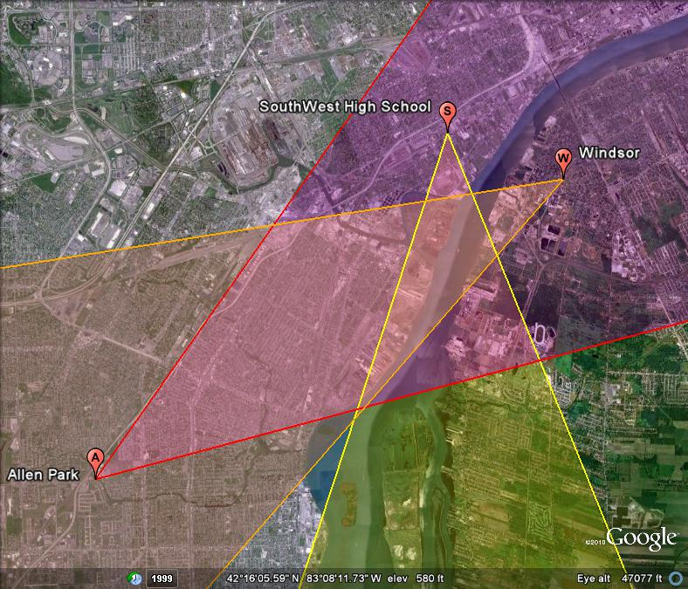
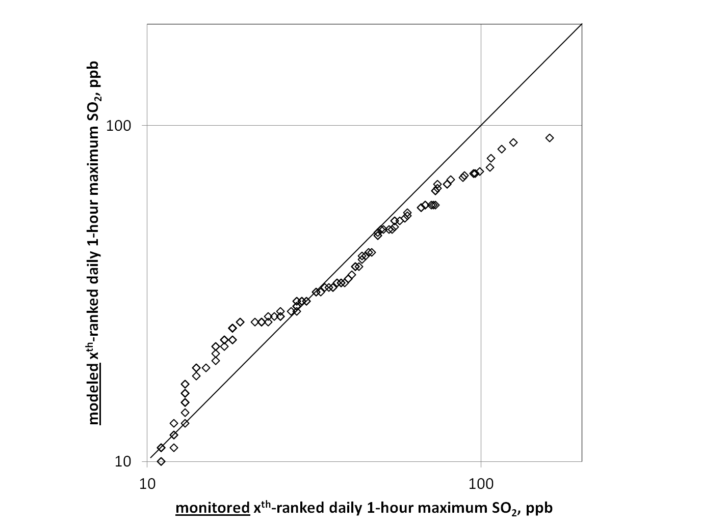
Identifying Emission Source Regions
Detroit SO₂

Slide 13
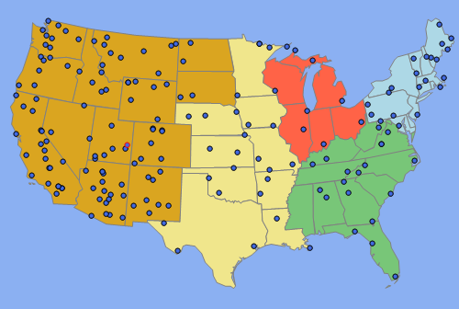
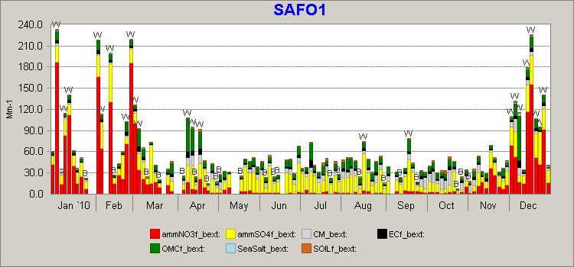
Interagency Monitoring of Protected Visual Environments (IMPROVE)
Year 2010
Contribution of ambient particulate
matter composition to light extinction
(visibility reduction)
light extinction, Mm⁻¹

Slide 14
Rational Network Evolution “Sounds Great”, “Let’s Do It” … “Slow Down”
An infrastructure project (like highways, etc.)
Large financial investment, fixed sites
Numerous stakeholders, often with seemingly competing interests
Comfort in the status quo (a static network)
Moving monitors largely to respond to new standards, e.g., change in PM_{2.5} daily standard
Avoiding inhomogeneities that may arise when moving sites, changing technology, etc.
Regulatory mandates and constraints (e.g., speciation)

Slide 15
Proactive Network Evolution in the U.S.
Objectives
Timely data reporting for public alerts, including forecasting
Emission strategy development - supporting air quality model evaluation
Accountability – assessing progress of implemented rules and programs through tracking long term trends of criteria and non-criteria pollutants and their precursors
Epidemiological studies – underpin NAAQS review
Research support
Ecosystem assessments
Compliance monitoring

Slide 16
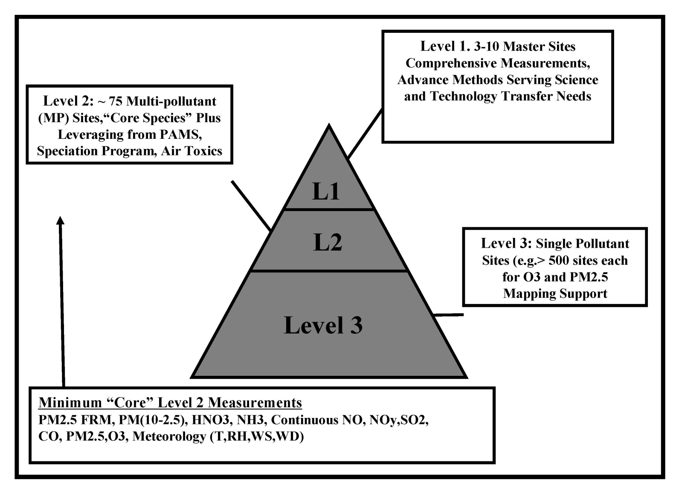
Proposed National Core (Ncore) Platform
Scheffe et al.., J A&WMA, 2009

Slide 17
NCore Implementation
Focus on implementing Level 2
Began Jan 1, 2011, 63 urban sites and 17 rural sites
×

Slide 18
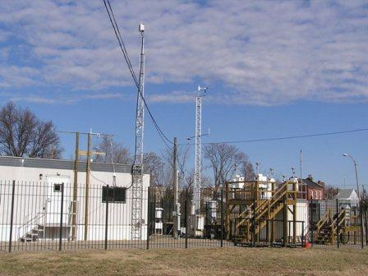
National Core (NCore) Network
Multi-pollutant sites
Advanced measurement systems for particles, pollutant gases and meteorology
Beyond criteria pollutants (e.g. NOy)
Trace level (well below NAAQS)
High time resolution (e.g. 5-min for SO₂)
NCore site in St. Louis, MO

Slide 19
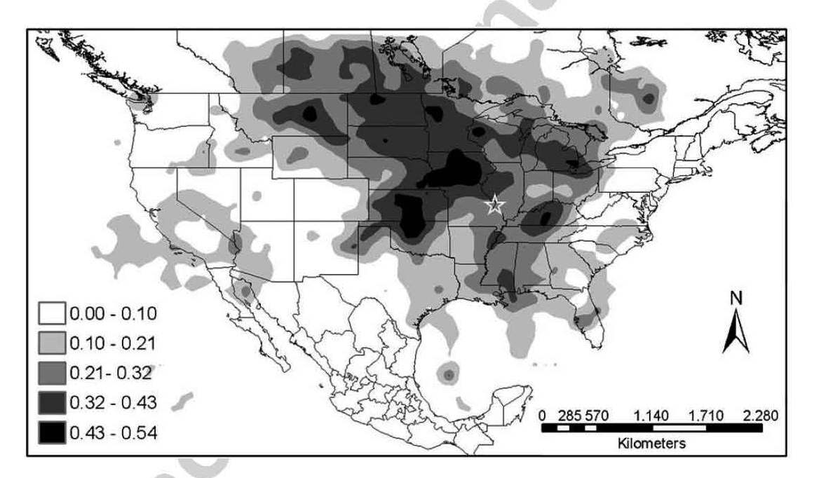
Secondary Nitrate - formed from atmospheric chemistry of NO_{x} and NH₃ emissions - interpretation: nitrate transported from areas with high NH₃
Nitrate Potential Source Contribution Function (PSCF) analysis, Lee and Hopke (2006)
Chemical Speciation Network Data (1-in-3 day)

Slide 20
Secondary Nitrate - formed from atmospheric chemistry of NO_{x} and NH₃ emissions - nitrate transported from areas with both high NO_{x} and NH₃
Nitrate Potential Source Contribution Function (PSCF) analysis, incremental probability compared to seasonal climatology
Chemical Transport Modeling for nitrate
2001-02, 2002-03 wintertime nitrate
daily averages, CY 2002
Sonoma Technology, Inc.
ENVIRON, Inc.

Slide 21
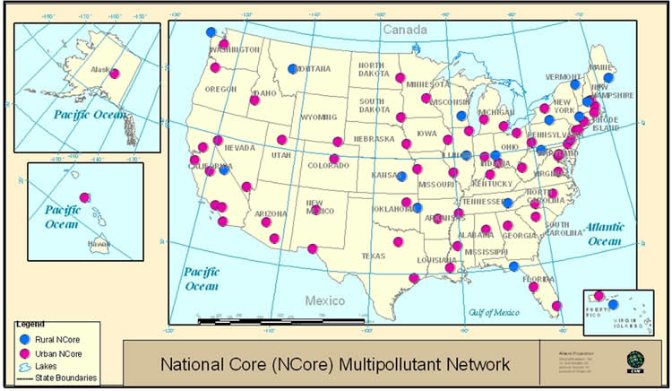
NCore Network – July 2011

Slide 22
NCore Implementation
Crux is guidance and technical support to the state and local monitoring agencies
Training videos
Standard operating procedures
Implementation documents
Workshops and training sessions
Synergistic activities, e.g.
Restructuring of QA responsibilities to emphasize more local ownership
Tools to readily detect and assess inhomogeneities between filter and continuous PM mass measurements

Slide 23
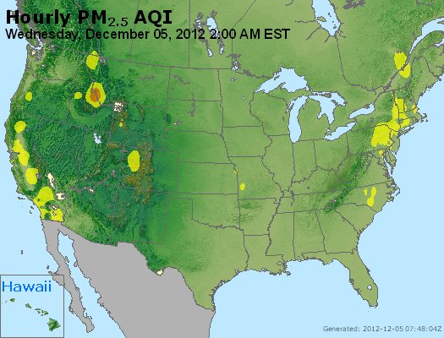
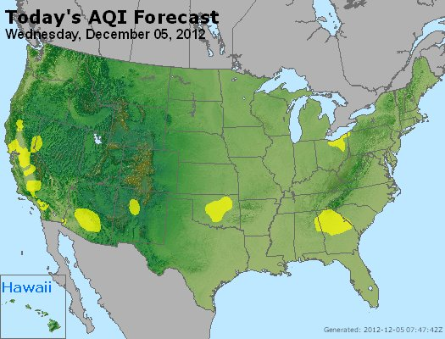
The Good: Air Quality Index (AQI)
Reporting
Forecasting
Source: AirNOW

Slide 24
Designing/Rethinking AQ Networks
Regardless of spatial scales…
What are the monitoring objectives?
Influences locations, equipment, operation
What are the available resources?
Funding, manpower (skilled and non-skilled)
Constrains location, equipment, operation
Formal design framework to arrive at -
Data Quality Objectives (DQO)
Measurement Quality Objectives (MQO)
Quality Assurance Project Plans (QAPP)

Slide 25
Network Considerations - Operations
Sample collection and analysis
Centralized lab, multiple labs
Operations documentation
Quality Assurance / Quality Control (QA/QC)
Data validation and reporting
Local versus centralized “ownership”
Centralized data repository
Monitoring oversight
The “QA Conundrum”…

Slide 26
The Quality Assurance Conundrum
Oversight often viewed as a threat
Especially external audits
Key elements to effective oversight
Embed in all aspects of project
Start early, even before measurements start (e.g., systems audits)
Develop supportive relationships
Do not overcomplicate operations
Do a few tasks well, rather than many tasks poorly
Show everyone involved how data are being used

Slide 27
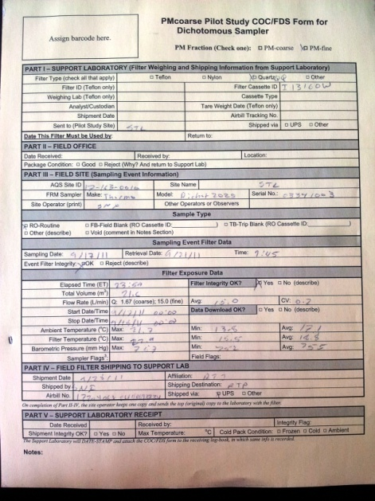
Ownership & Accountability - Example
PM_{2.5} Chemical Speciation Network (CSN)
Sample collection by state/local/tribal agencies (SLT)
Chemical analysis mostly by a centralized lab with the project “national contract” (RTI)
Process all samples and metadata (field operations logsheets)… flag/void data
QA on the data for site-specific internal consistency (e.g. IC SO₄ vs. XRF S)… flag/void data
Upload data to ftp site for SLT review
After time window for SLT review, post to Air Quality System (AQS) database
Considered robust, but still has flaws…

Slide 28
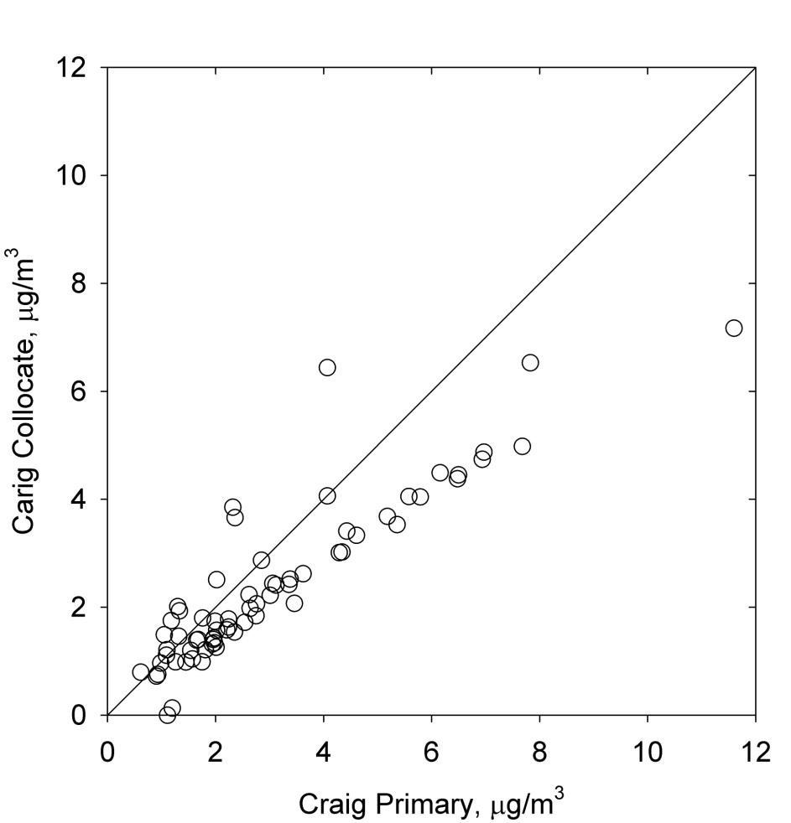
Ownership & Accountability - Example
Collocated organic carbon
GT Craig, Cleveland, OH
After change to URG 3000N
Oct 2009 – Mar 2011
18 months operation with systematic bias
EPA recently changed Primary QA Organization (PQAO) designations under national contract from analytical lab (RTI) to SLT

Slide 29
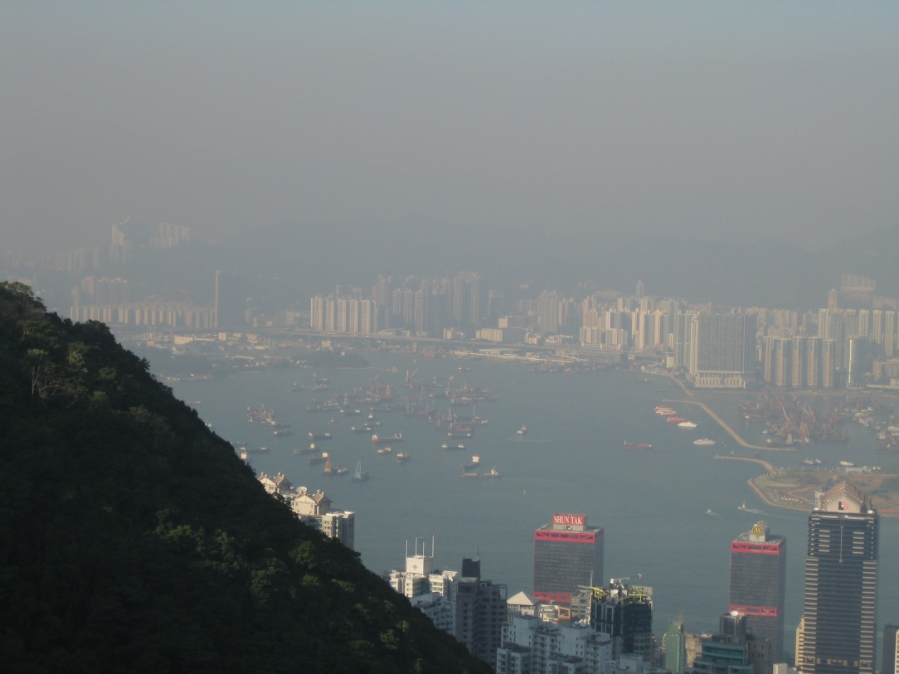

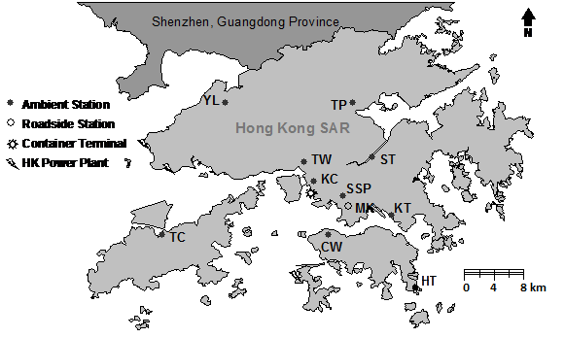
Hong Kong

Slide 30
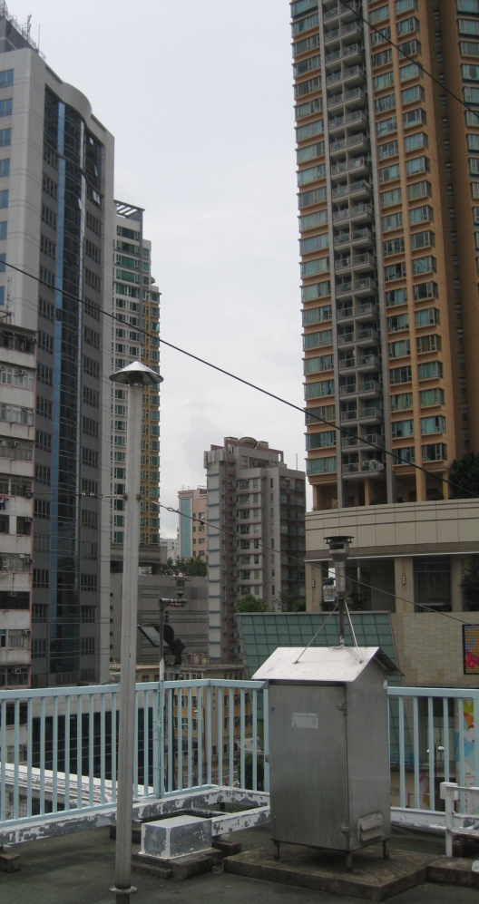
Hong Kong PM₁₀ Mass Network
Compared to the Air Quality Objectives
Hourly data set for 15+ years
50°C TEOM
Method continuity over time
Measures nonvolatile mass, biased low compared to ambient concentrations
Technology change will introduce inhomogeneities in the time series, (perhaps minor with, e.g., FDMS TEOM)

Slide 31
CUSUM Analysis Example:
Identifying the Site with Inhomogeneity
site pair
CW in common
Inhomogeneity at CW site in early 2002 a reduction of ~5 μg/m³

Slide 32
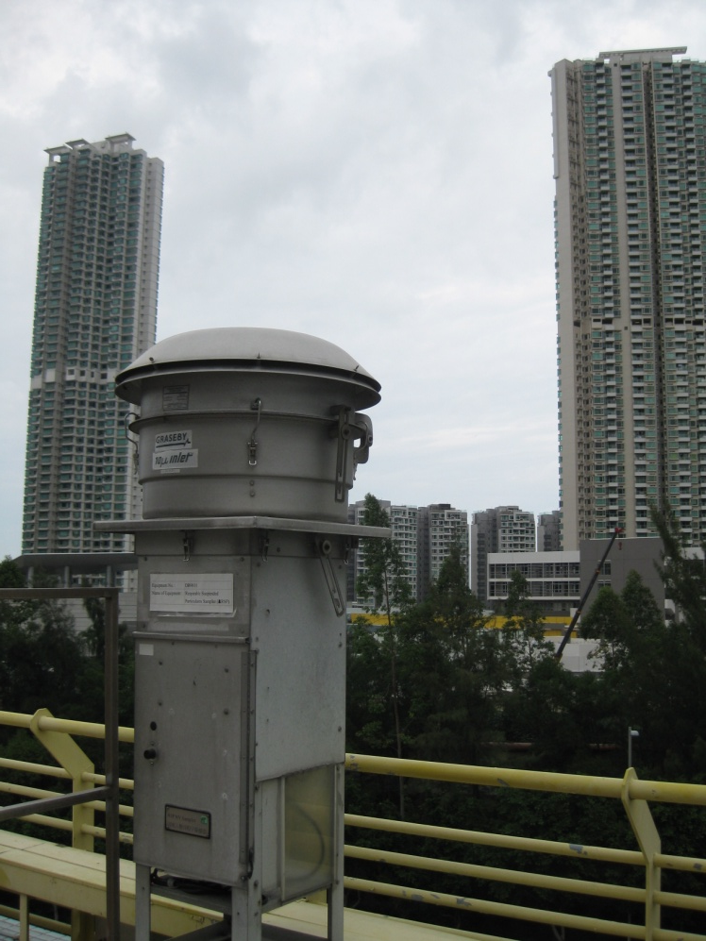
Hong Kong PM₁₀ Speciation Network
Long time series (15+ years)
High volume sampler
Measurement artifacts for nitrate and organic carbon
Sampling not synchronized across sites
Can’t assess day-specific spatial variability
Can construct a daily time series for Hong Kong region, at least for regional scale components
(tomorrow’s presentation)

Slide 33
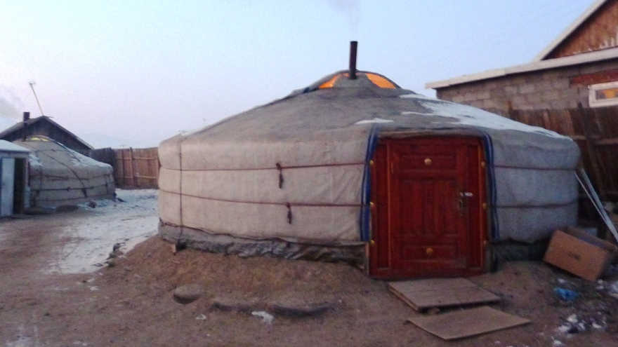
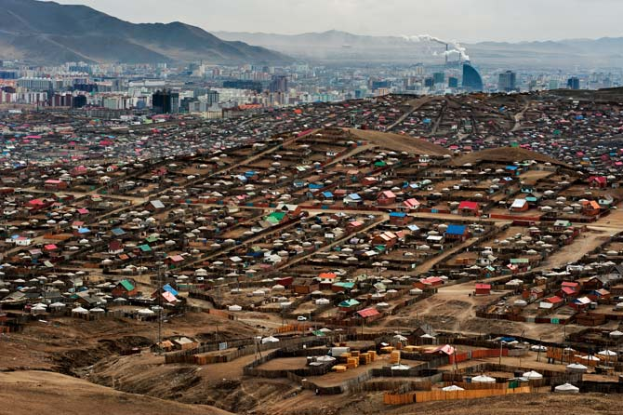
Ulaanbaatar
Recently installed a multi-site network for criteria gases, PM_{2.5} and PM₁₀ (all continuous)
No routine PM speciation
QA challenges
Institutional
Instrument performance in climate where not tested (extreme cold)
Top Photo: Rufus Edwards (UC Irvine)
Bottom Photo: Mark Leong (National Geographic)

Slide 34
Summary - Contemporary Network Design
Design for multiple pollutants
Air quality modeling, source apportionment, health effects studies
Design for flexibility / sustainability
Pollutant levels and spatial scales of influence change over time
Capitalize on technology evolutions
Design for observation platform synergy
Satellite data, etc.
Design for data accessibility
Among the best QA measures is a range of stakeholders looking at the data

Slide 36
The Quality Assurance Conundrum
Despite these efforts, need to develop a culture where it is okay to make mistakes but they must be revealed and remedied (“we’re all in this together”)
Common issues
Hiding operations problems
Not following established protocols
Routine procedures, QA/QC checks
Falsifying documentation (e.g., sample collection dates, QA/QC data)
Falsifying data
Examine data “early and often” to identify issues

Slide 37
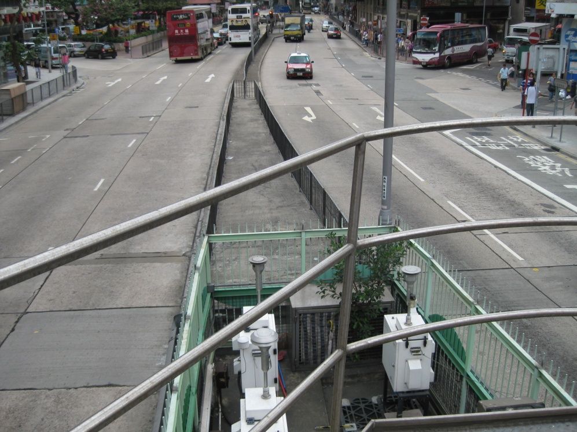
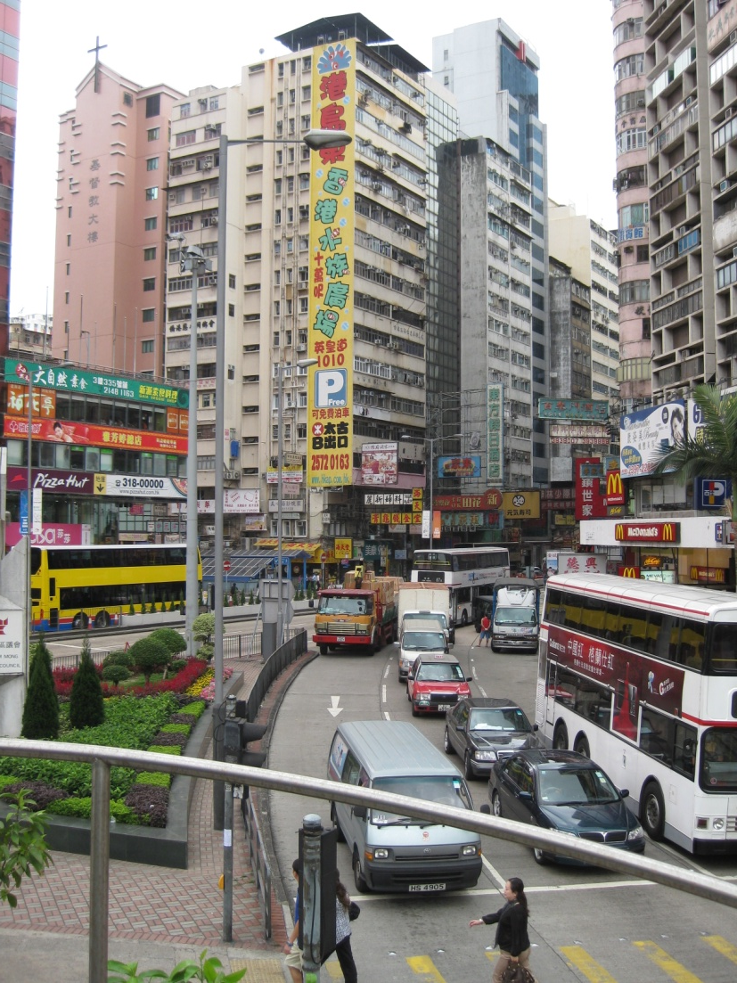
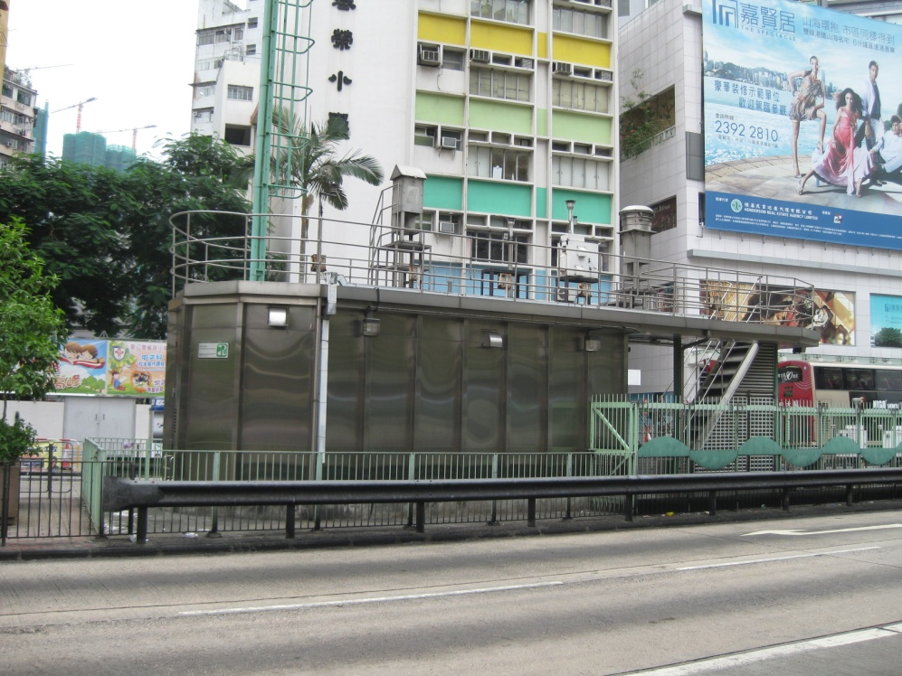

Slide 38
Sites in context
Urban/rural
Roadside/general
Industrial/baseline

Slide 39
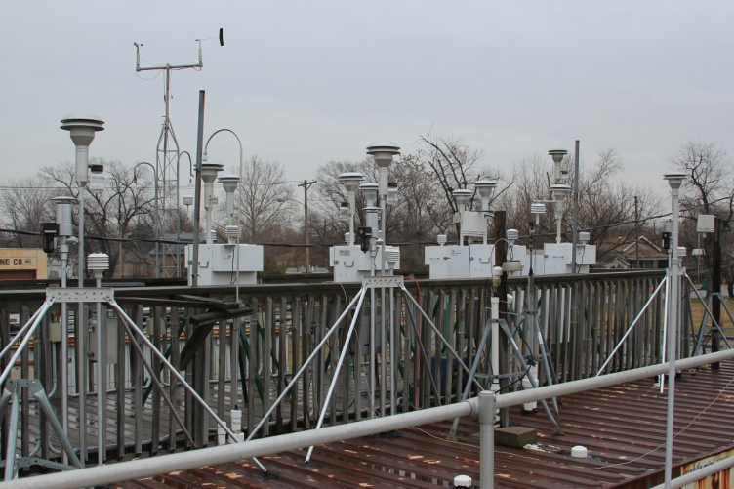
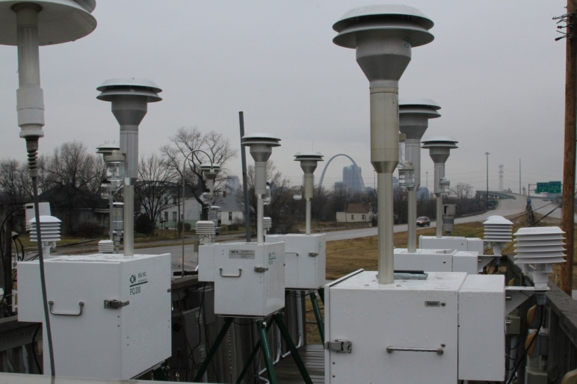
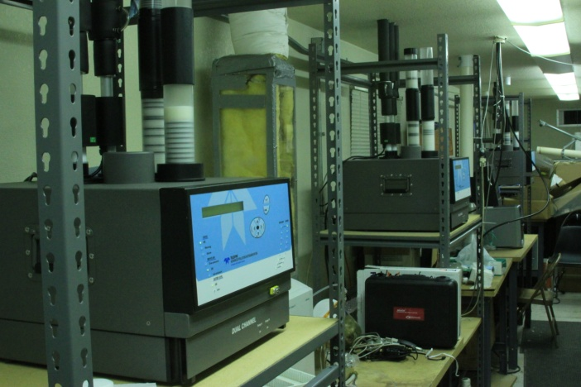
Support Services
Sample analysis, e.g., elemental analysis by ICP-MS
Field studies infrastructure
East St. Louis site as a platform for USEPA Federal Equivalency Testing (FEM) of PM mass monitors
e.g., Thermo (FDMS TEOM, SHARP), Grimm, Teledyne API

Slide 40
Towards Defining a Urban Scale Baseline
And Site-Specific Excess
A
B
C
D
E
conc.
network-wide baseline
urban-scale contributions
surface winds
regional-scale contributions
metro core (emissions perspective)
downwind distance

Slide 41
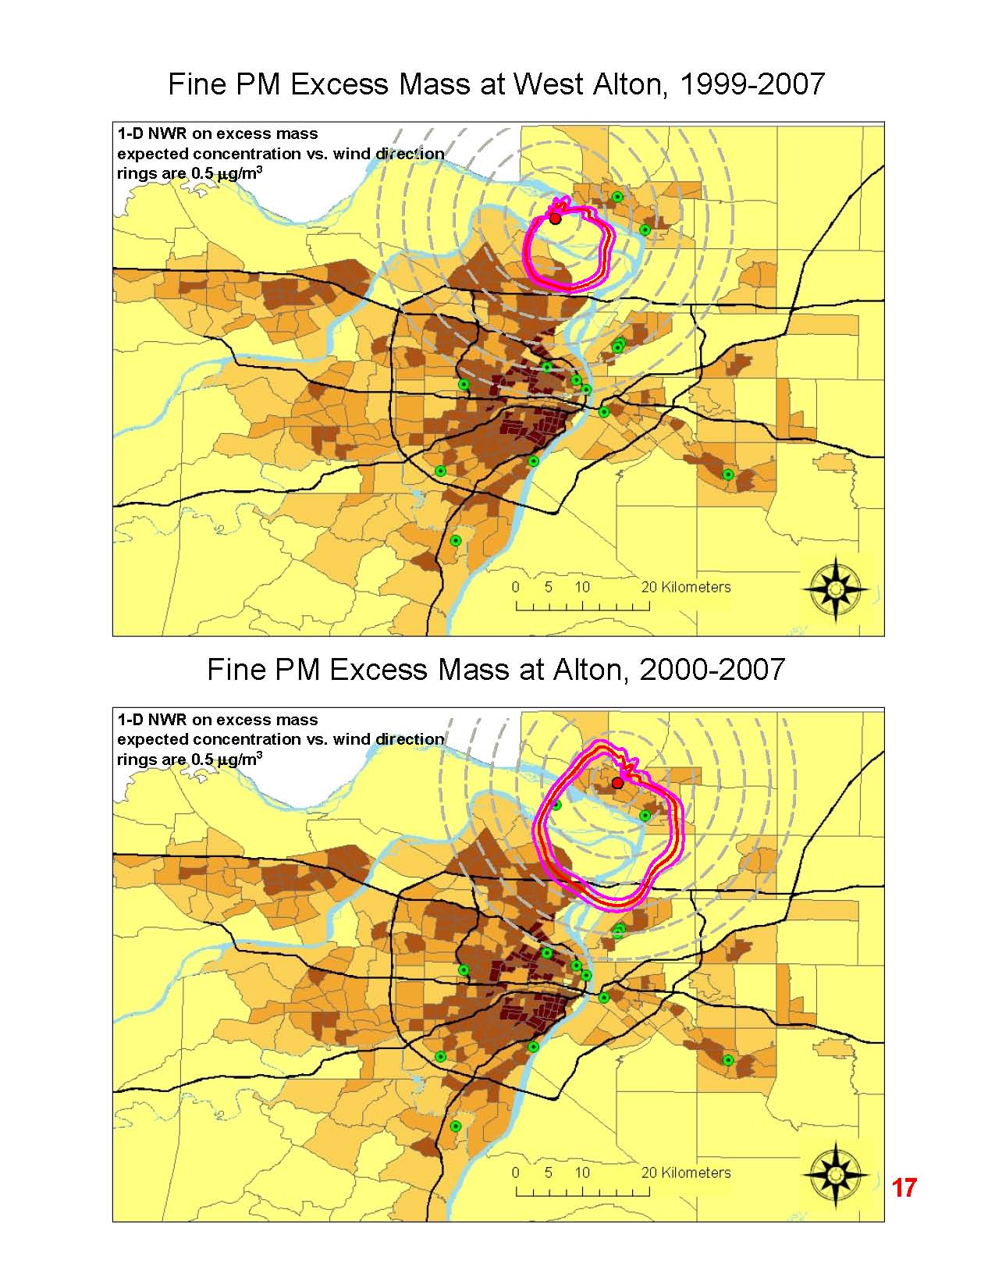
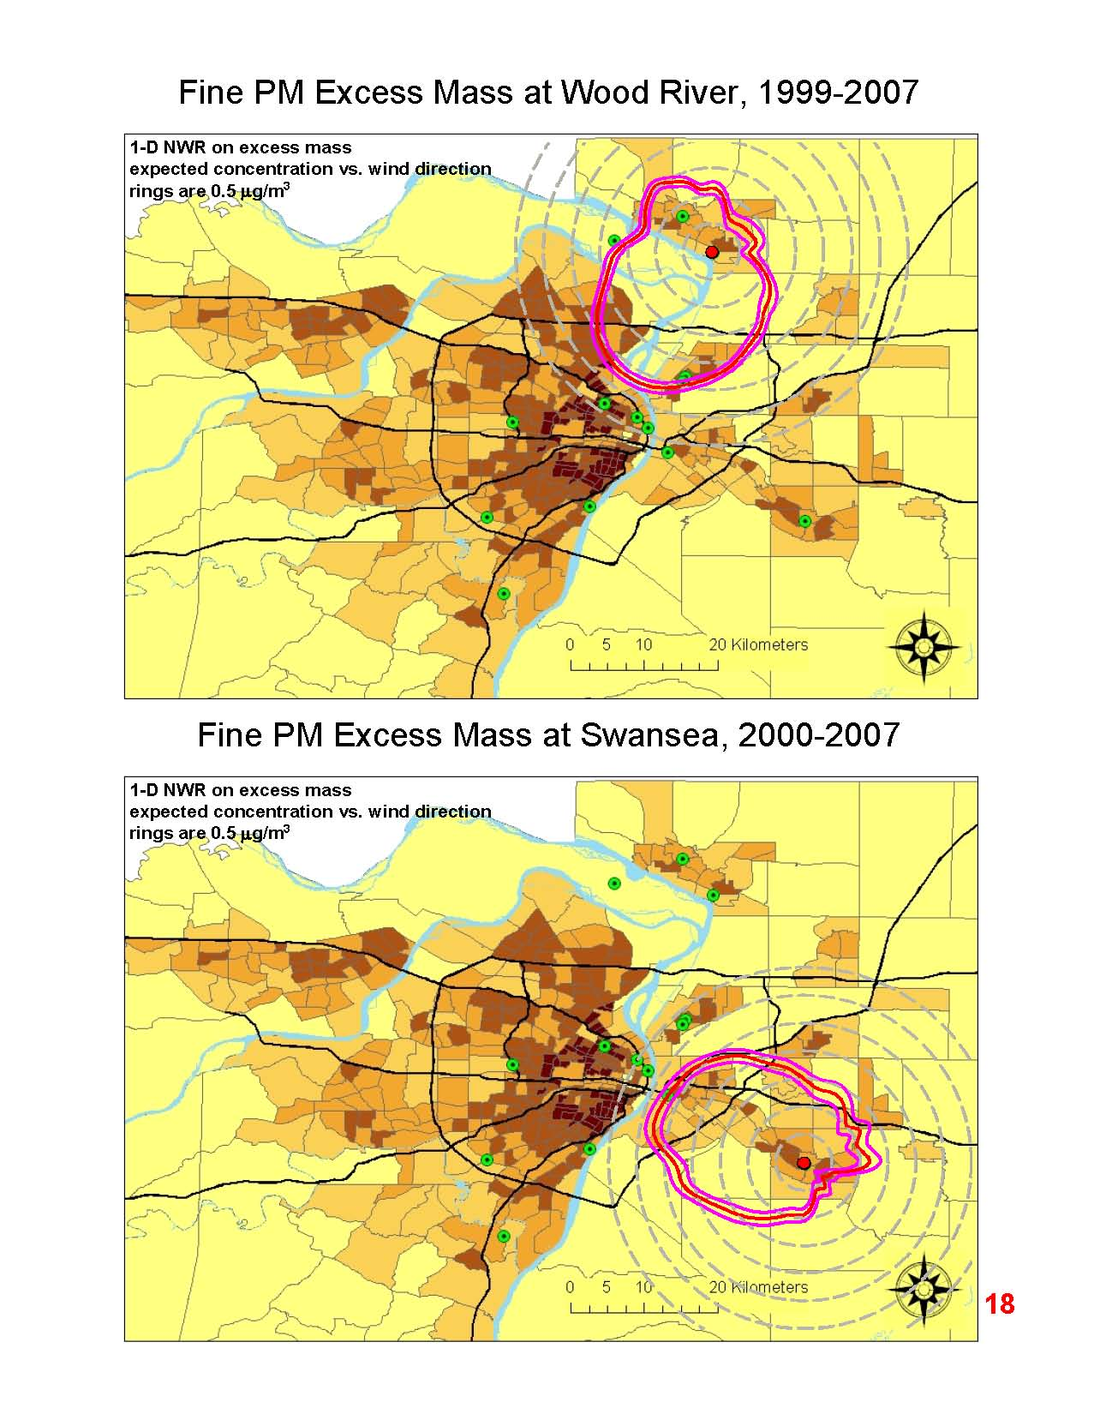

Slide 42
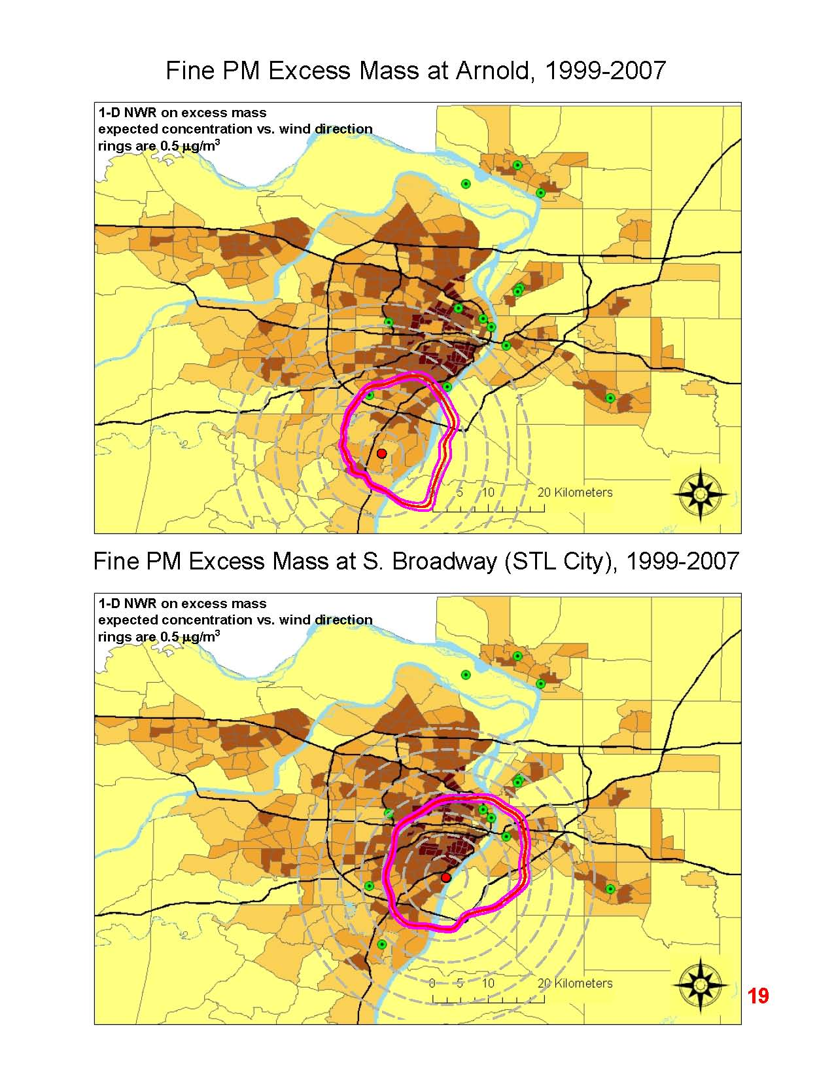
We can quantify the urban/industrial plume(s) emanating from St. Louis and impacting the more suburban sites

Slide 43
in
CUSUM Analysis Example:
Identifying the Site with Inhomogeneity
site pair
CW in common
Inhomogeneity at CW site in early 2002 a reduction of ~5 μg/m³

