Slide 1
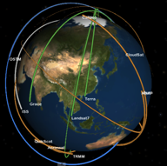
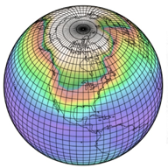



Obs4MIPs
Obs4MIPs
Robert Ferraro
Jet Propulsion Laboratory
This project is collaboration between NASA and DOE, and is overseen by an International Task Team constituted under the WCRP Data Advisory Council
Jet Propulsion Laboratory
California Institute of Technology
Notes:
Heavy emphasis and acknowledgement given to speaker - *Stephens :)

Slide 2

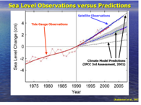

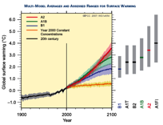
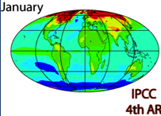
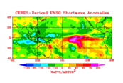
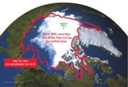
Initial Sentiments Behind obs4MIPS
Under-Exploited Observations for Model Evaluation
How to bring as much observational scrutiny as possible to the CMIP/IPCC process?
How to best utilize the wealth of satellite observations for the CMIP/IPCC process?

Slide 3
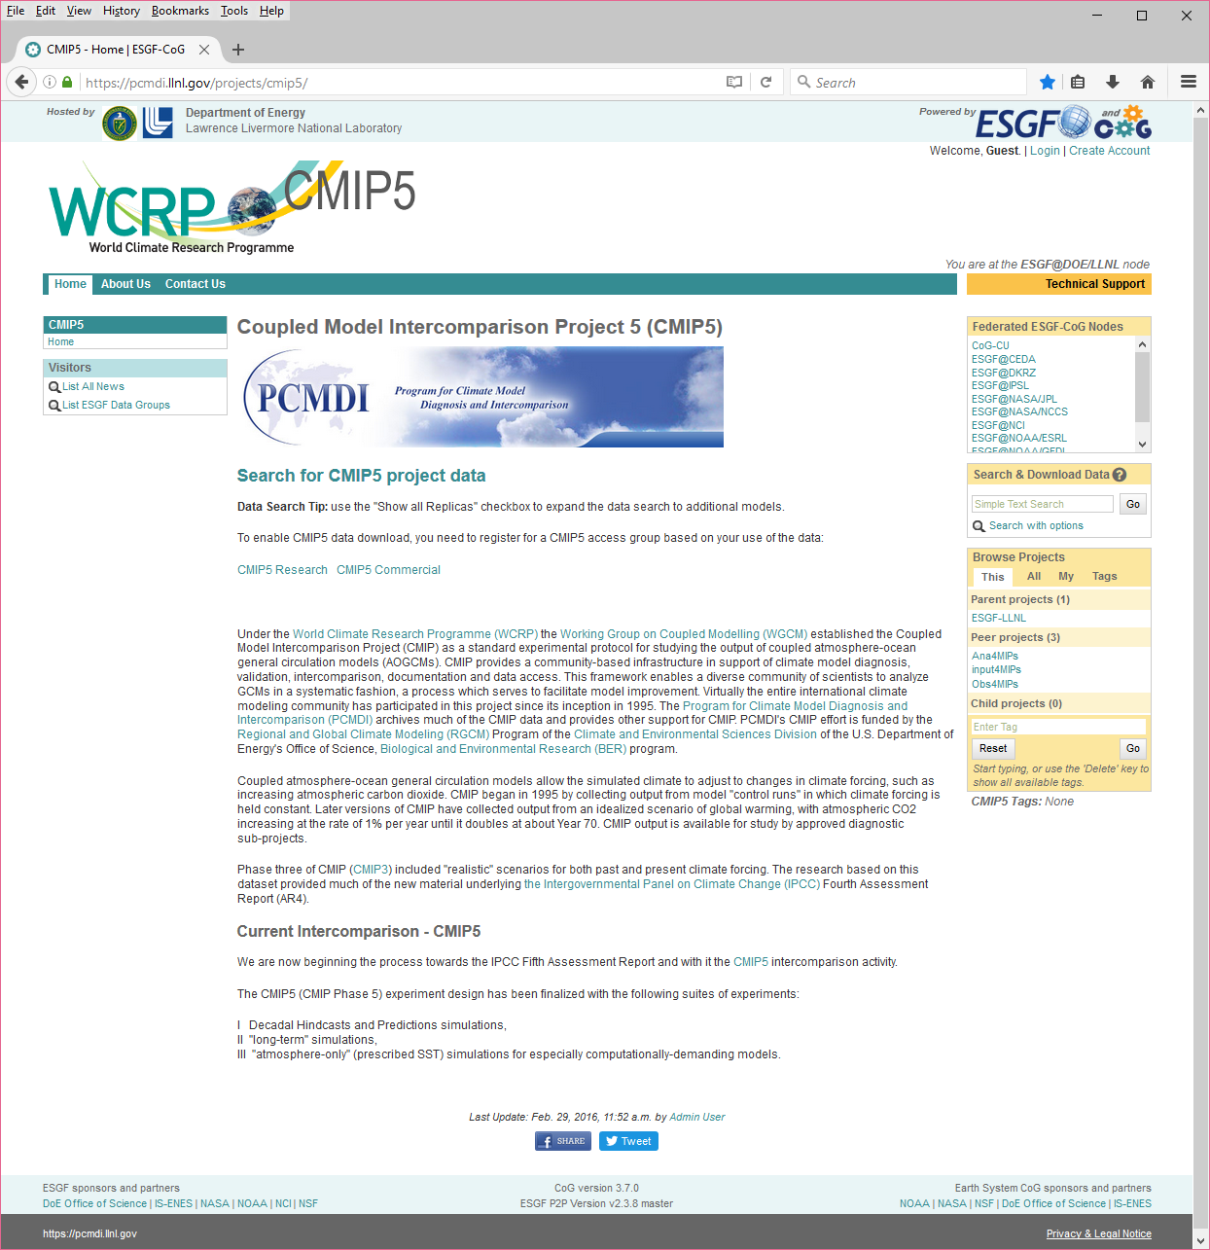
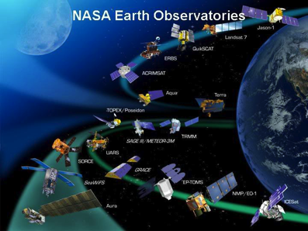

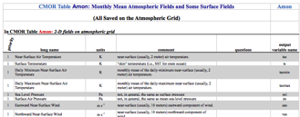
Model and Observation Overlap
Taylor et al. 2008
Example: NASA – Current Missions ~14
Total Missions Flown ~ 60
Many with multiple instruments
Most with multiple products (e.g. 10-100s)
Many cases with the same products
Over 1000 satellite-
derived quantities
~120 ocean
~60 land
~90 atmos
~50 cryosphere
Over 300 Variables in
(monthly) CMIP Database

Slide 4
What’s the Problem?
Finding what you need …
  Fit for Purpose
Understanding what you found
  Data Format
  Metadata
  Documentation
Is it any good?
  Provenance
  Error Characteristics
  Uncertainties

Slide 5
Data Quality – Obs4MIPs Approach
Curated specifically for model evaluation on the ESGF
  Finding data, fit for purpose
Potential contributions are review by a task team before being accepted
  Provenance, Quality
Specific format, metadata convention, and metadata content are required
  Understanding what you’ve got
Evidence of prior use for model evaluation is required (peer reviewed literature)*
  Fit for purpose
Uncertainty characterization is required, with per datum error/uncertainty quantification desired
  Quality

Slide 6
Concluding Remarks
Our approach is to provide data and documentation
tailored to the customer
Many issues to sort out going forward …
Like how to handle in-situ data …
Does this approach scale? We’ll see …
Find obs4MIPs at
https://www.earthsystemcog.org/projects/obs4mips/
Or Google “obs4MIPs”

Slide 7
Acknowledgements
Obs4MIPs Task Team Members
  Peter Gleckler, co-chair, PCMDI/DOE
  Duane Waliser, co-chair, JPL/NASA
  Sandrine Bony, IPSL
  Mike Bosilovich, GSFC/NASA.
  Helene Chepfer, IPSL
  Veronika Erying, DLR
  Robert Ferraro, JPL/NASA
  Pierre-Phillipe Mathieu (ESA)
  Roger Saunders, UKMO
  Jörg Schulz, EUMETSAT
  Karl Taylor, PCMDI/DOE
  Jean-Noël Thépaut, ECMWF
  Jerry Potter, PCMDI/DOE, GSFC/NASA
  Ex-Officio
  Tsengdar Lee, NASA
  Renu Joseph, DOE
  Pierre-Philippe Mathieu, ESA
  Michel Rixen, WMO
  Otis Brown, WDAC
Part of this work was performed at the Jet Propulsion Laboratory, California Institute of Technology
under a contract from NASA

