Slide 1



Local Data Management:
Advertising your data
Nancy Hoebelheinrich
Knowledge Motifs LLC
Version 1.0
[Reviewed
August 2012]
Notes:
Modules should be 3-7 minutes long

Slide 2

Overview:
Why & How advertise your data?
Why advertise?
  “Advertising” your data goes beyond word of mouth notice
  Can be required by funding agencies & institutions
  Can jumpstart your career
How advertise?
  By publishing descriptive information about your data
  Using an increasing number of methods
  With the help of the data center / archive where you are storing your data
http://www.lindsayburoker.com/wp-content/uploads/2012/03/advertising-ebooks-authors.jpg

Slide 3
Beyond word of mouth:
Public information about your data
Can help a potential user find your data and learn enough to decide whether they can re-use it for their own work
Can help you establish your credibility & reputation:
Are often the means by which agencies & institutions evaluate grant proposals
Make your work more discoverable and well-known, thus leading to future opportunities for collaboration
Factors for hiring & tenure by academic institutions often include:
Surveys of journals & publications in which your papers / data are published
The reputation of journals & publications in which your data are included or mentioned in citations
The number of times your data are used by others

Slide 4

Required by agencies & institutions?
Many government agencies require the “dissemination” of your data publicly by:
Describing how your data will be “shared”
Reporting the publication of metadata to funding agencies
Publishing information about data in journals and publications, publicly available data catalogs on government portals or registries, and agency websites
Image credit: http://www.lindsayburoker.com/wp-content/uploads/2012/03/advertising-ebooks-authors.jpg
Notes:
Descriptions of how data will be “shared” are usually found in a data sharing and/or data management plan
Places for publishing information about your data:
in journals and publications, and
in publicly available data catalogs on government portals or registries, and agency websites
Purpose: To make data products available

Slide 5

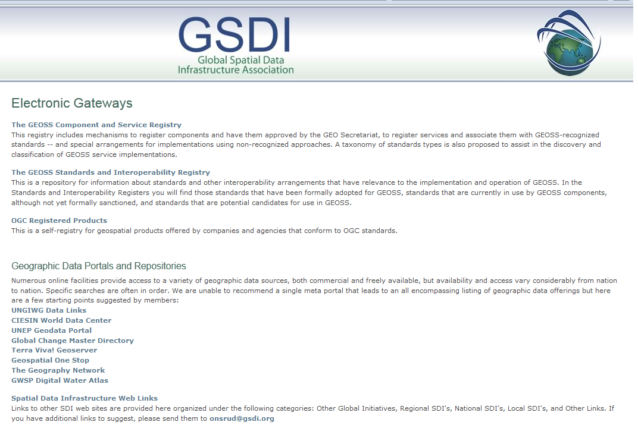
Formal Publication:
Formal ways to advertise your data
Journals & Publications, of course, but also
Public directories, data portals & metadata registries
Image credit: http://www.lindsayburoker.com/wp-content/uploads/2012/03/advertising-ebooks-authors.jpg

Slide 6
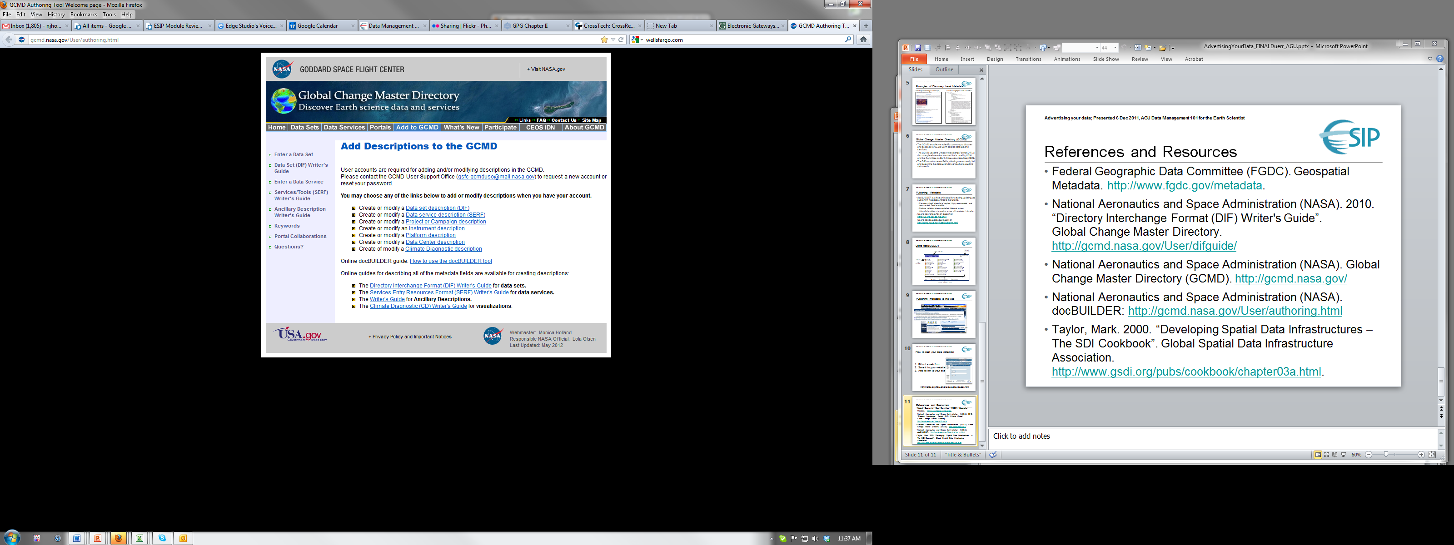
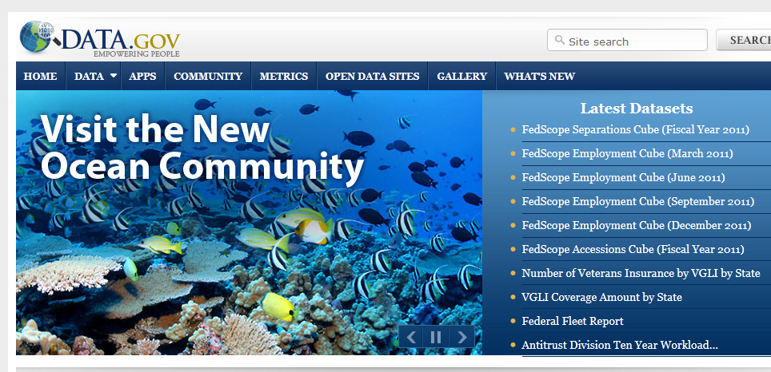
What are some relevant data portals
/ metadata registries for science data?
Global Spatial Data Infrastructure
  http://www.gsdi.org/ElectronicGateways (international coverage)
NOAA National Geophysical Data Center
  http://www.ngdc.noaa.gov/metadata (metadata registry)
Global Change Master Directory (metadata registry)
  http://gcmd.nasa.gov/index.html
ECHO (The EOS Clearinghouse)
  http://en.wikipedia.org/wiki/EOSDIS (metadata registry
    for NASA’s Earth Observing System Data)
Data.gov http://www.data.gov/ (U.S. Federal data)

Slide 7

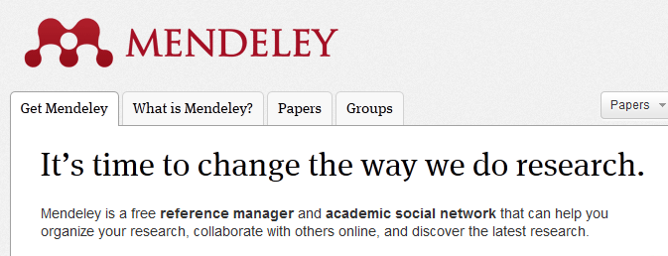
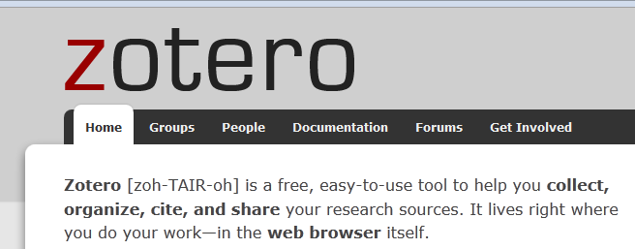
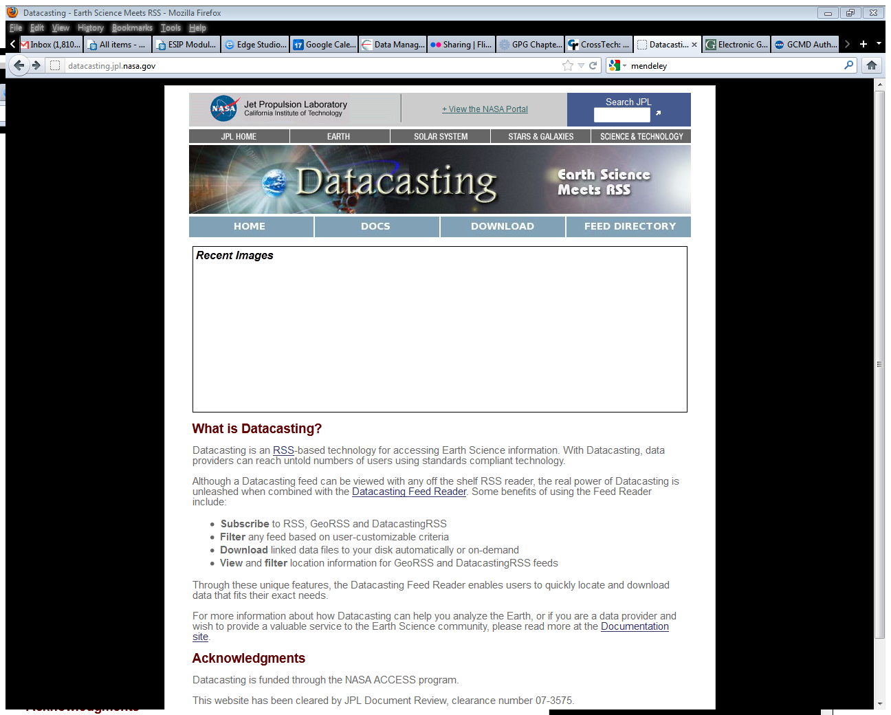
Informal ways to advertise your data
Informal Publication:
Domain specific blogs
Project Websites
Notification services:
  Twitter – announce at conferences!
  LinkedIn, Facebook – you decide when to announce!
  Mendeley, Zotero – via reference managers & academic social networks – list your own data sets!
Datacasting tools & services – broadcast to the Web via RSS feeds
Notes:
Another example of datacasting tools is: NSIDC’s Libre tool: http://nsidc.org/libre/share/collectioncaster.html

Slide 8
Resources
Data.gov http://www.data.gov/
ECHO (The EOS Clearinghouse): http://en.wikipedia.org/wiki/EOSDIS
Global Change Master Directory: http://gcmd.nasa.gov/index.html
Global Spatial Data Infrastructure: http://www.gsdi.org/ElectronicGateways
Mendeley: http://www.mendeley.com/
NASA JPL Datacasting service: http://datacasting.jpl.nasa.gov/
NOAA National Geophysical Data Center: http://www.ngdc.noaa.gov/metadata
NSIDC’s Libre tool: http://nsidc.org/libre/share/collectioncaster.html
Zotero: http://www.zotero.org/
****************************************
Image Credit for Social Media Tag cloud:
http://www.google.com/imgres?start=160&hl=en&client=firefox-a&sa=X&rls=org.mozilla:en-US:official&biw=1280&bih=918&tbm=isch&prmd=imvnsz&tbnid=zksN_g66OPb0-M:&imgrefurl=http://apievangelist.com/industries/advertising.php&docid=edVo09iumi9ShM&imgurl=http://kinlane-productions.s3.amazonaws.com/ap-evangelist-site/industries/Tag-Cloud-Advertising.png&w=843&h=421&ei=m-CzT8utAqquiQKEmvjuAQ&zoom=1&iact=hc&vpx=805&vpy=383&dur=4581&hovh=159&hovw=318&tx=143&ty=53&sig=103899861293055568303&page=7&tbnh=119&tbnw=238&ndsp=25&ved=1t:429,r:18,s:160,i:212
Notes:
References Module: Voiceover script
Within this module, we've made reference to a number of published information sources that we think you may want to review when you want more in-depth information. The most relevant references are listed here.

Slide 9
Other Relevant Modules
Metadata for discovery – more information on creating descriptive metadata for your data
Developing a citation for your data – tips on what information is necessary to create a citation for your data
Metadata for access & use – what information is necessary to both allow use of and protect your data
Advertising Your Data: Using portals & registries – more about how to publish metadata to specific data portals & registries
Advertising Your Data: Agency / institution requirements for publishing metadata – more specifics from key U.S. federal agencies
Notes:
Other Relevant Modules Module: Voiceover script
The modules of the ESIP Data Management Course have been designed to complement and supplement each other. In light of this plan, we think you might find the following, related modules relevant to you and why as you gain a better understanding of data management:

