Slide 1
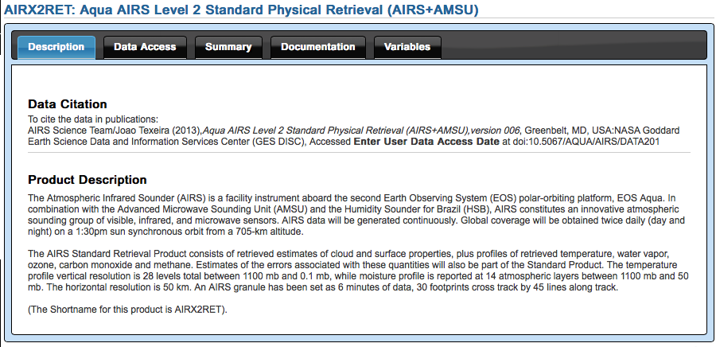
Description
Tools
Tool | HDF Access | OPeNDAP Access | netCDF via OPeNDAP
ArcGIS |  |  | Maps
Ferret |  | Plots | Plots
GrADS | Reads | Reads | Reads
HDFView | Reads
IDV |  | Maps | Maps
McIDAS-V |  | Maps | Maps
nco |  | Reads | Reads
Panoply | Maps | Maps | Maps

