Slide 1
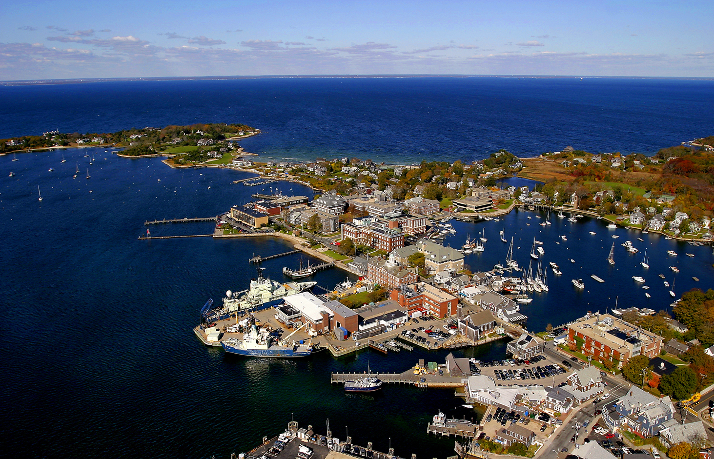
Carol Anne Clayson, WHOI
Information about the data is as important as the data itself
2017 ESIP summer meeting
Bloomington, IN
26 July 2017

Slide 2
What kinds of information? And why does it matter?
Uncertainty of data: describes doubt we have about the quantity we are measuring, given the result of a measurement and our estimate of the error distribution
Quality of data: complementary information
Confidence in uncertainty estimate
Conditions violating retrieval or measurement assumptions
Additional uses of uncertainty:
Data assimilation
Comparison of data/models

Slide 3
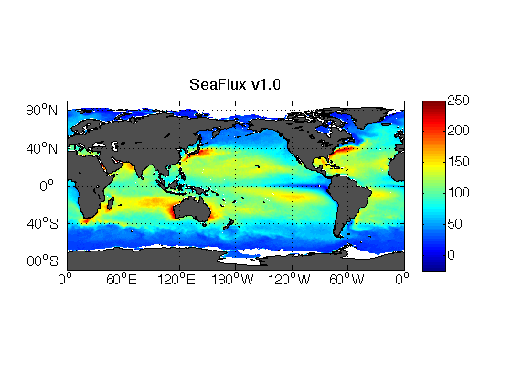
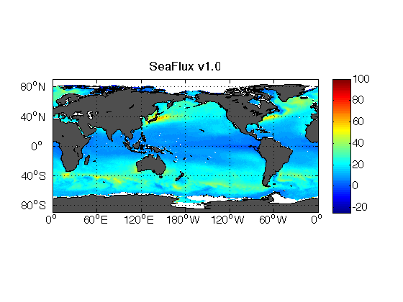

SeaFlux Climate Data Record
Near-surface air temperature, humidity, and winds
Roberts et al. (2010) neural net technique
SSM/I and SSMIS brightness temperatures
Gap-filling methodology -- use of MERRA variability – 3 hour
SST
Pre-dawn based on Reynolds OISST
Diurnal curve from parameterization
Needs peak solar radiation, precipitation from CERES instruments, GPCP microwave
Uses neural net version of COARE
1999 Latent Heat Flux
1999 Sensible Heat Flux

Slide 4
Uncertainty estimates of 10-year means

Slide 5
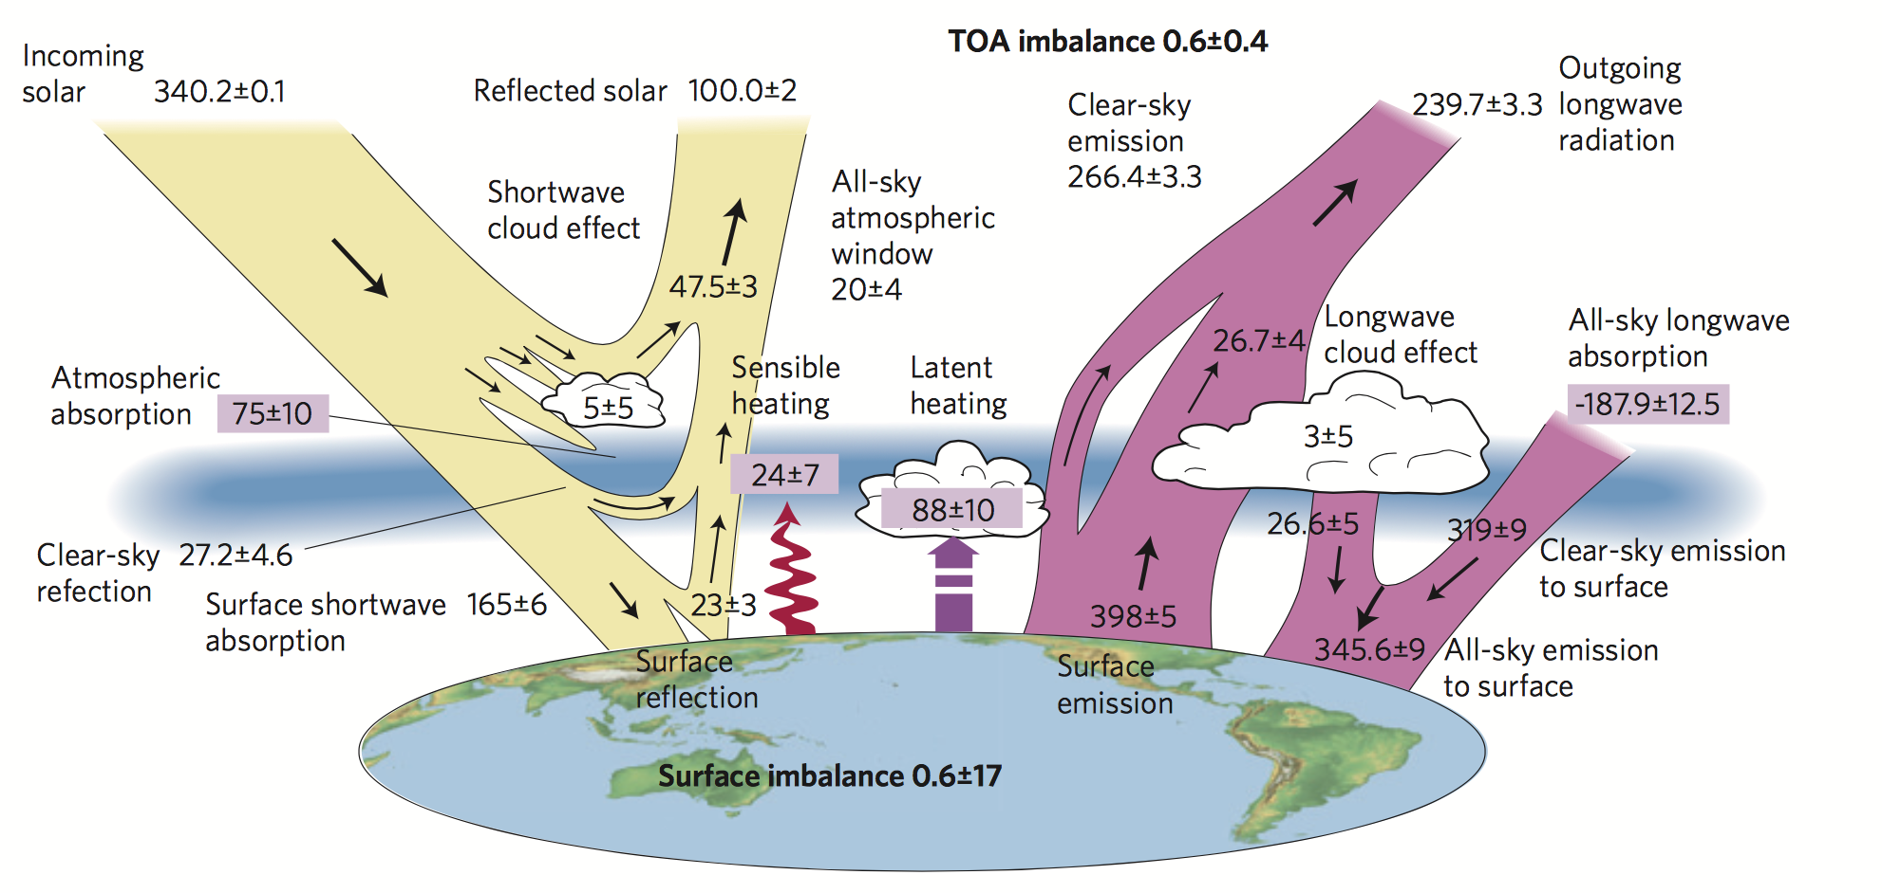
One estimate of the global heat budget
Stephens et al. 2012.

Slide 6
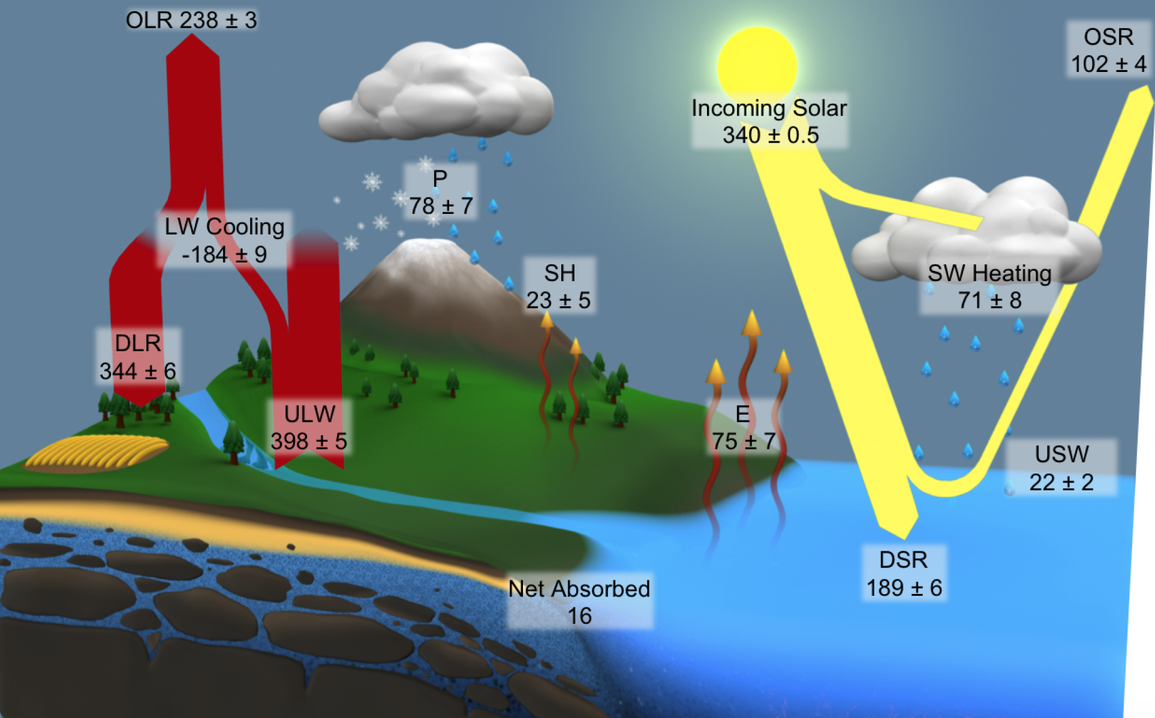

Original “closure” to quantitative adjustment
L’Ecuyer et al. 2015.
Revised estimate based on minimizing a cost function, including uncertainty estimates of each individual flux

Slide 7
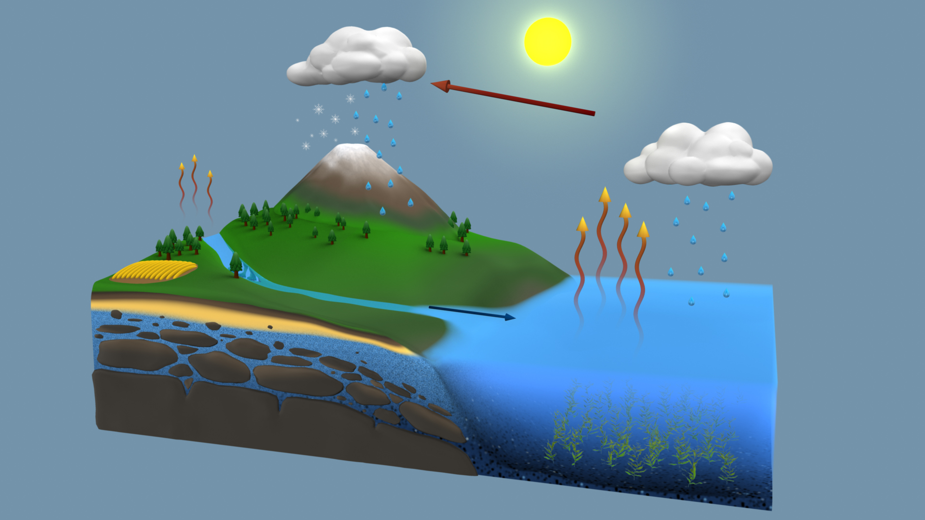
Global Mean Water Budgets
42.9 ±8.2
45.9 ±4.4
40
115.7 ±6.3
40
46.7 ±19.1
71.2 ±7.1
116.5 ±5.1
45.9 ±15.7
70.6 ±5.0
114
409.5 ±35.7
74
449.5 ±22.2
426
385.3 ±38.9
403.6 ±22.2
386
49.5 ±6.8
45.9 ±4.4
40
Global mean water fluxes (1,000 km³/yr) at the start of the 21st century
With simultaneous adjustment, we move away from Trenberth
Trenberth et al. (2011) for comparison
Rodell et al. 2015

Slide 8
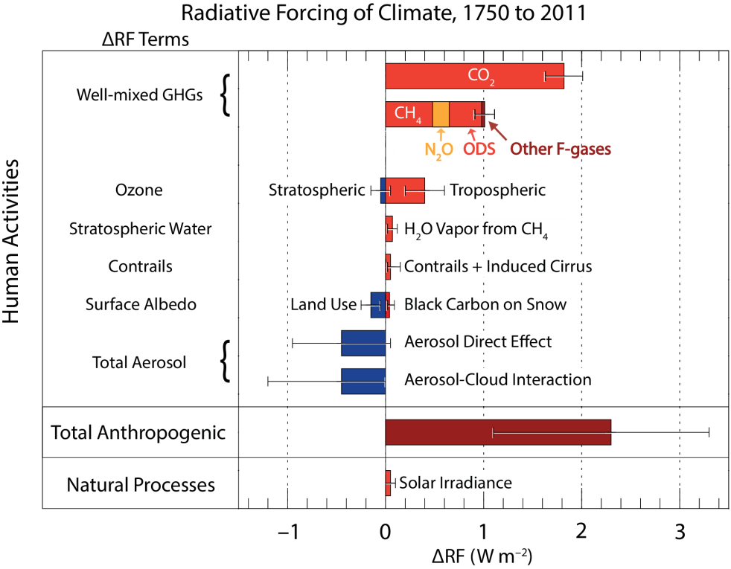
The use of uncertainty for future missions
What are greatest science needs? One argument: where uncertainty is highest
Need uncertainty targets: set quantifiable goals
After Fig. 8.15 of IPCC (2013)

Slide 9
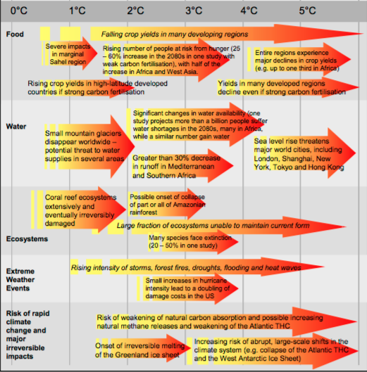
Past the science to public good
Compare costs:
Various degrees of adaption (given current levels of uncertainty)
New investments in climate science to reduce current levels of uncertainty
Reducing uncertainty in timing and magnitude of changes can reduce costs of mitigation and adaptation
“Uncertainty is a clear impediment to successful adaptation.”
Urgent and unplanned-for adaptation incurs significant extra costs
Conversely, investments in physical capital largely irreversible, so option value to deferring them

Slide 10
Thoughts on best practices
Include quantitative uncertainty information with dataset at each data point
Use propagation of errors when combining data
Quality flags shouldn’t be used to pass judgment based on uncertainty, but can be used to provide information about how well the uncertainty is known
Documentation should include information on uncertainty, how it was calculated, how it it varies across time/space scales
Validation should be of both data and uncertainty estimates

