Slide 1





Location Integration Project
Shane Crossman and Matthew Purss
Spatial Data Architecture
Geoscience Australia

Slide 2


Slide 3

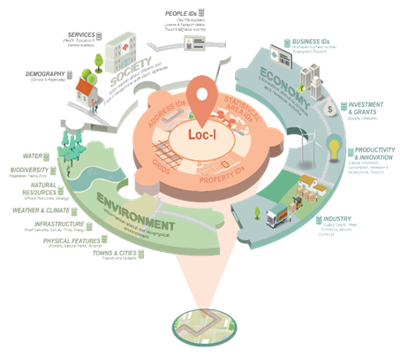
Loc-I is the jigsaw piece to connect society, economy and the environment layers
The Location Index creates a system to support:
Decisions based on fit for purpose data with
Known authoritative sources
Using best technology and
Available on demand from a device of choice
Enabler for linking spatial and non-spatial data

Slide 4
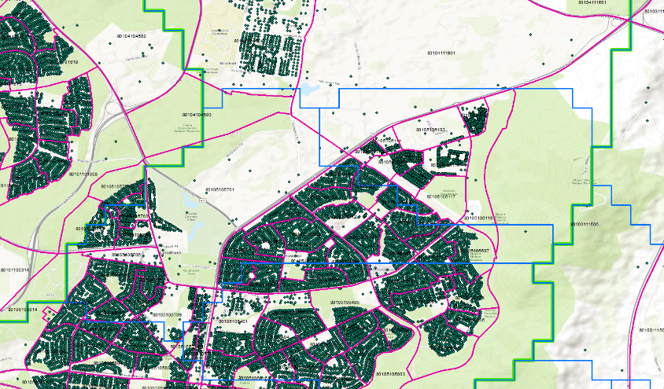

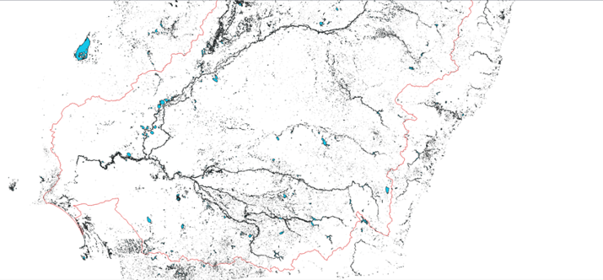
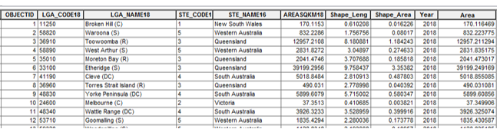
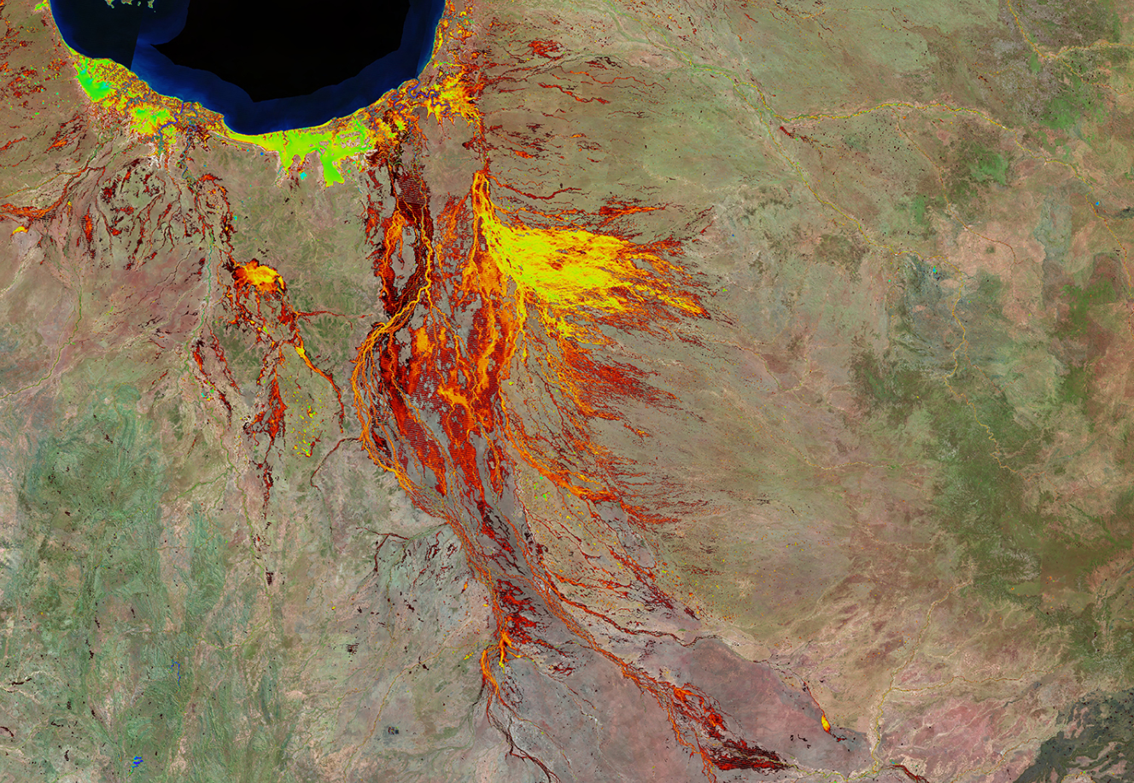
Challenge – how do you join multiple geographies and observations together that are not structured the same
Addresses
No coordinates
Geofabric
Area
DEA
Lat/Long
Stats

Slide 5

Challenge 1 – Data Integration
Accessed & FAIR,
not just Delivered or Downloaded
Findable: registered or Indexed in a searchable source
uniquely identified (PID), self-describable through metadata
Accessible: standardised protocols (open, free, universal) – HTTPS, FTP
authentication & authorisation procedures
Interoperable: agreed format, language & vocabularies
Re-usable: machine readable, known licence & security, provenance & standards
https://www.force11.org/group/fairgroup/fairprinciples

Slide 6
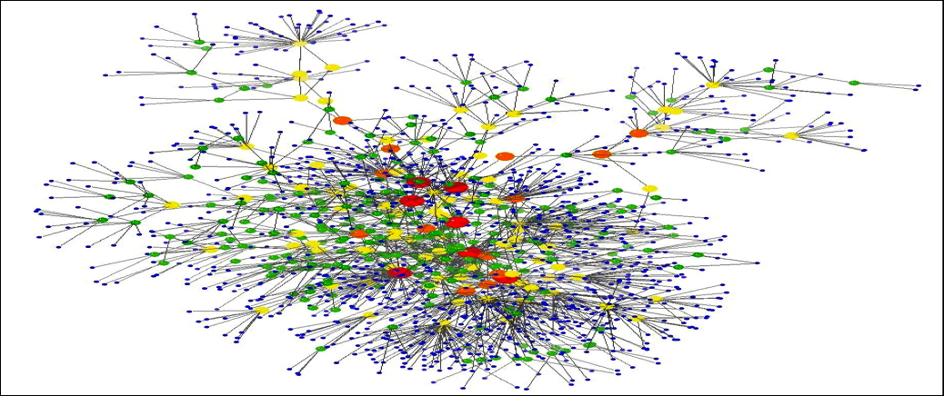
Goal – Semantic Integration of Linked Data
Power of Linked Data:
Discovery through the Web
Enable machine-to-machine communication
Easily extendable by linking to other Linked Data sources on the Web
Re-use beyond traditional client base and use cases
Enable consistent data mining of multiple spatial and non-spatial data without GIS software though Open Linked Data

Slide 7

Challenge 2 - Innovative Technologies
Test Linked Data and Discrete Global Grid System technologies
Build new innovative capability across multiple agencies
Implement a set of new tools for Semantic Integration of Data
Re-using existing tools & infrastructures (e.g. Research Vocabulary Australia)
Implement in the cloud and private repositories
Ensure Requirement for secure access and integration

Slide 8
Goal – Extendable Systems to re-use
Highly Scalable:
Elastic File Store and Load Balance for large datasets and volume requests
Secure:
Virtual Private Cloud; Highly secure network access
Flexible:
Code can be deployed by different users/custodians
Repeatable:
Infrastructure as code, GitHub code management
Easy to administer:
Code deployed as workflow through BitBucket pipelines

Slide 9
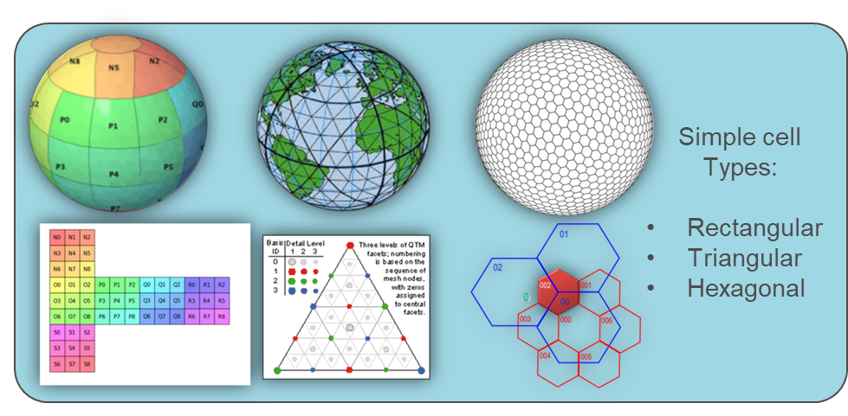
DGGS technologies
Fixed Cell Hierarchy
DGGS is agnostic to projection and data formats
Maths based does not require GIS queries

Slide 10

Challenge 3 - Social Architecture
Improved:
User experience and efficiency
Human-related processes
Institutional culture

Slide 11
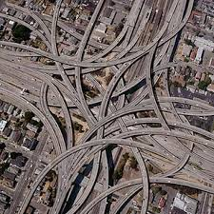
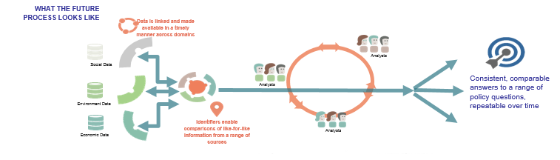
Goal – User Centric Focus and Improved Governance
Security& privacy - understanding the ethics and other constraining factors
Improving data integration workflows between Loc-I partner organisation
Ensuring data currency
Enabling multiple complex user requirements and use cases
Supporting user-centric approach
LOC-I

Slide 12
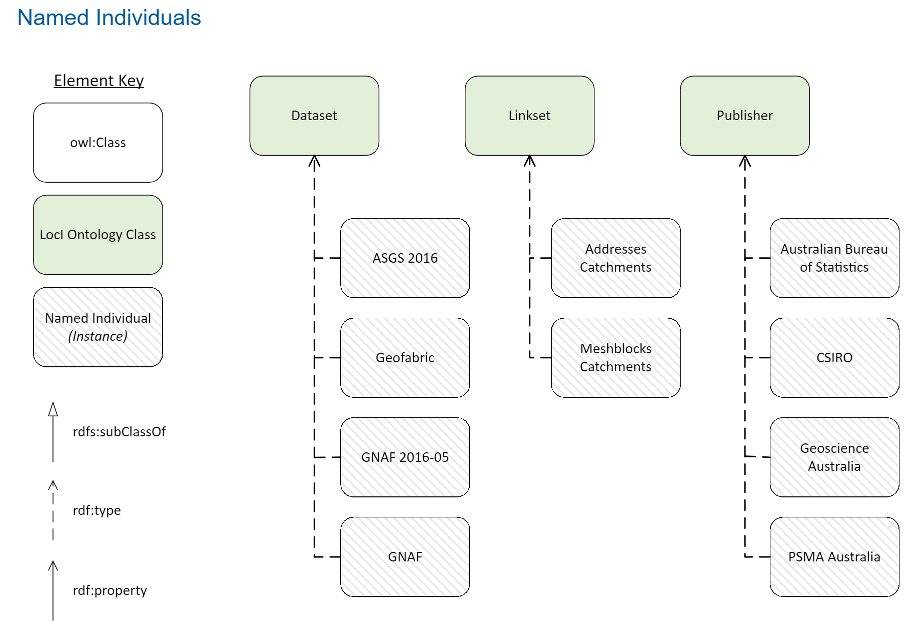
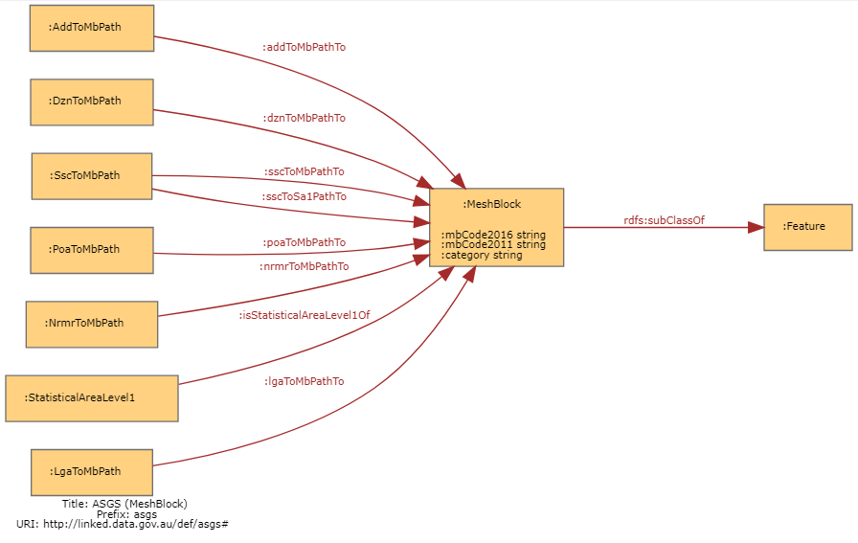
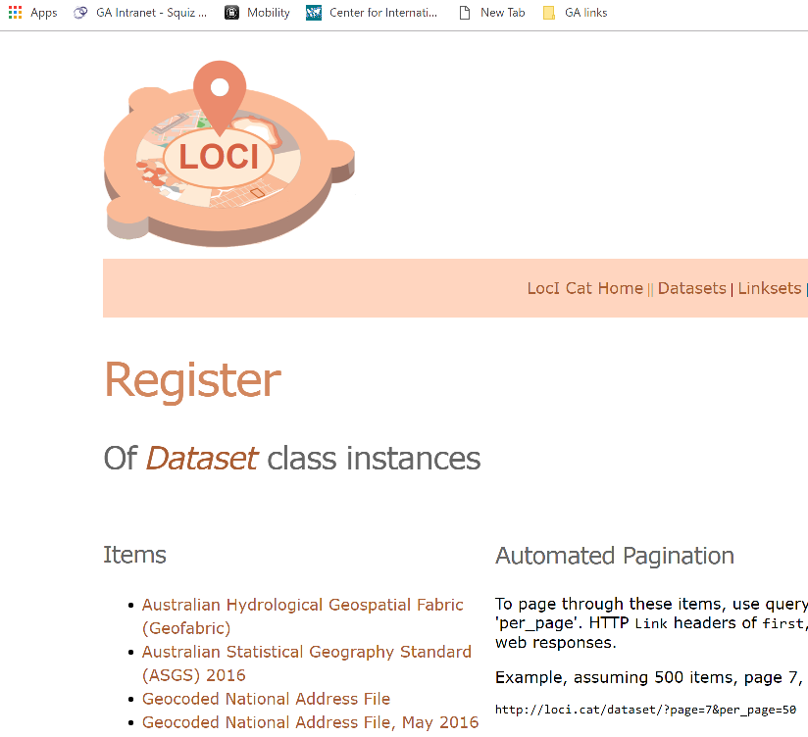
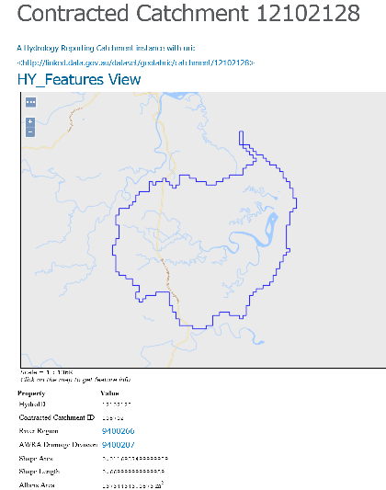
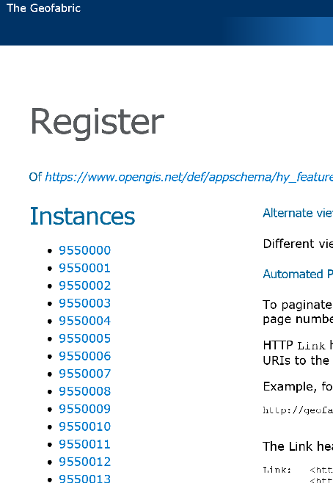
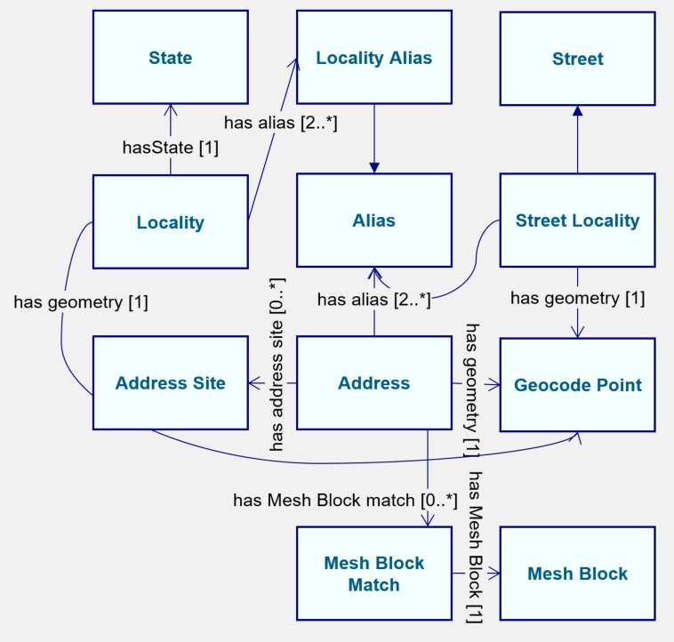
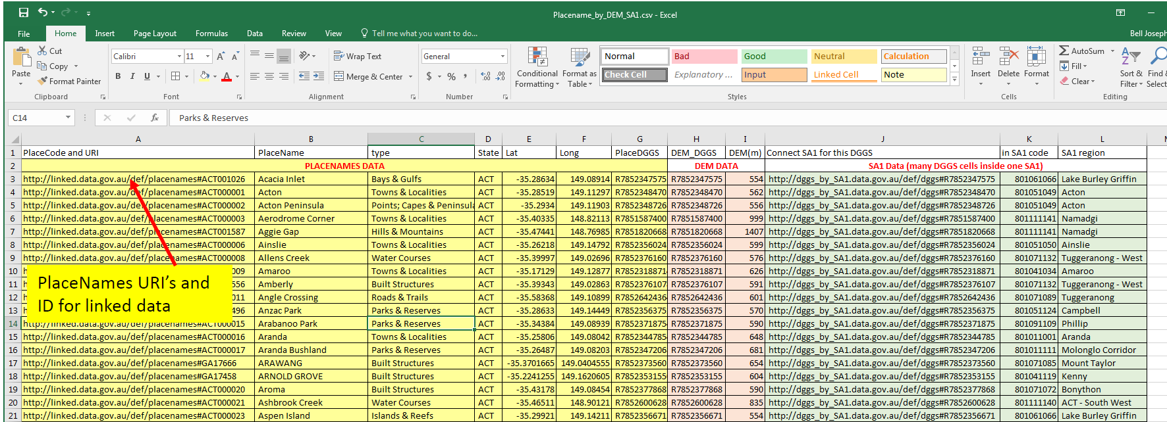
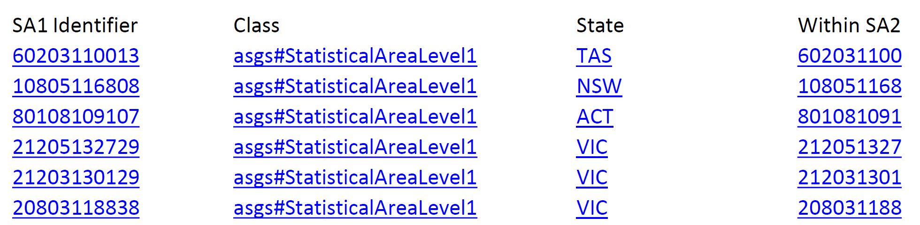
Bringing it all together
Ontology for each dataset
Individual Dataset Registries
Calculated indexes of linked datasets
Capability to query across datasets
Place Names
DEM
DGGS Index

Slide 13
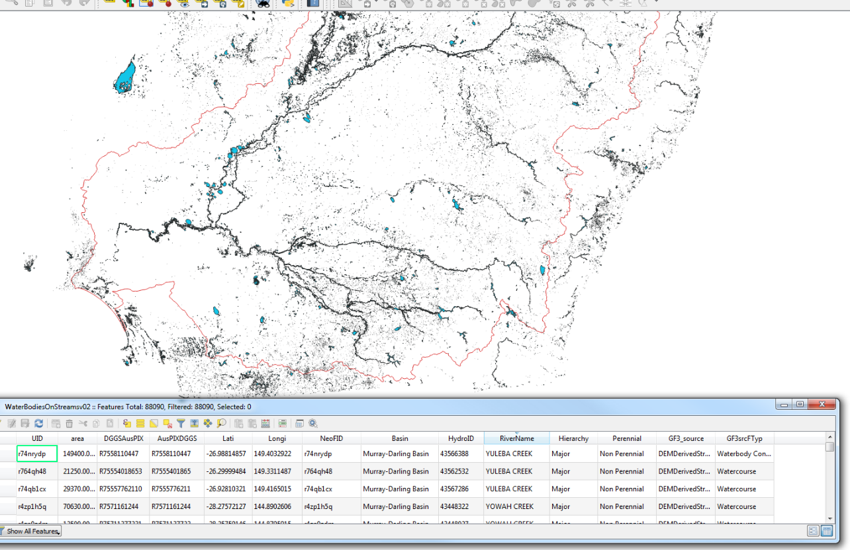
DEA: Assigning names to waterbodies on streams to WOfS
Consistent answers to a range of questions
Repeatable over time
Linking Little data to Big data
Days, not months
Raster & Vector data integrated
No reliance on complex schemas
DEA
Surface Water

Slide 14
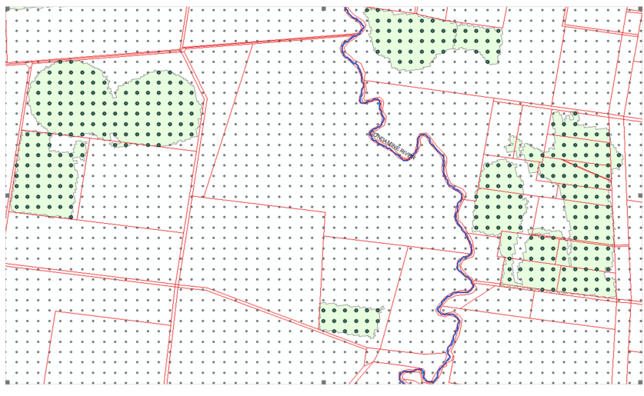
Matching DEA satellite data to land parcels
Green polygons irrigated area
Which land parcel/s are in the irrigated areas in
Red polygons
Land Parcels
DEA
Cadastre
DGGS matches location of information

Slide 15
Loc-I Progress
Year one: Learning Linked Data capabilities and techniques
Created and tested new infrastructure
Created Linked Data Index
Built capability for Linked Data and DGGS
Year two: Operationalisation of Linked Data infrastructure
Releasing Governance Framework
Developing APIs and other tools
Developing User Guides
Extending Linked Data Index and DGGS to other datasets

Slide 16
Benefits
Unlocking Data Potential:
enabling machine-to machine data integration, analysis and mining
remove needs for cross-agency data transfer
Accelerating Innovation:
developing protocols, tools, API for quick access to multi-agency data assets on IoT
testing new technologies for seamless data integration across multiple datasets and systems
Maximising Collaboration:
improving relationship across multiple sectors (government, research and industry)
developing common governance processes and workflows

Slide 17


