Slide 1



CEOS Land Product Validation Overview and Goals
Committee on Earth Observation Satellites CEOS
Working Group on Calibration and Validation WGCV
Land Product Validation Subgroup LPV
Pierre Guillevic, Miguel Román, Fernando Camacho de Coca,
Jaime Nickeson, Zhuosen Wang, & Christopher Justice
And LPV Focus Area leads
ESIP Winter Conference– January 11-13, 2017
Notes:
LPV established as subgroup in 2000.

Slide 2
CEOS > WGCV > LPV
Working Group on Calibration and Validation
CEOS - Committee on Earth Observation Satellites
31 CEOS Members (e.g. space agencies, research centers)
24 Associate Members (e.g. UNEP, WMO, GCOS)
CEOS coordinates civil space-based EO to benefit society
The Working Group on Calibration and Validation (WGCV) is one of 5 CEOS working groups
Land Product Validation (LPV) is one of 6 WGCV subgroups
Current LPV Officers:
Chair Miguel Román NASA GFSC
Vice-Chair Fernando Camacho EOLAB/U. of Valencia
Secretariat Jaime Nickeson SSAI/NASA GSFC
Protocol Dev. Pierre Guillevic UMD/NASA GSFC
Zhuosen Wang UMD/NASA GSFC
+ 11 Focus Areas with 2 co-leads each
Notes:
International associates include intergovernmental groups like GCOS, GEO, UN systems
WGCV subgroups Terrain Mapping, IR Visible Optical Sensors, SAR, Microwave, Atmospheric Composition

Slide 3
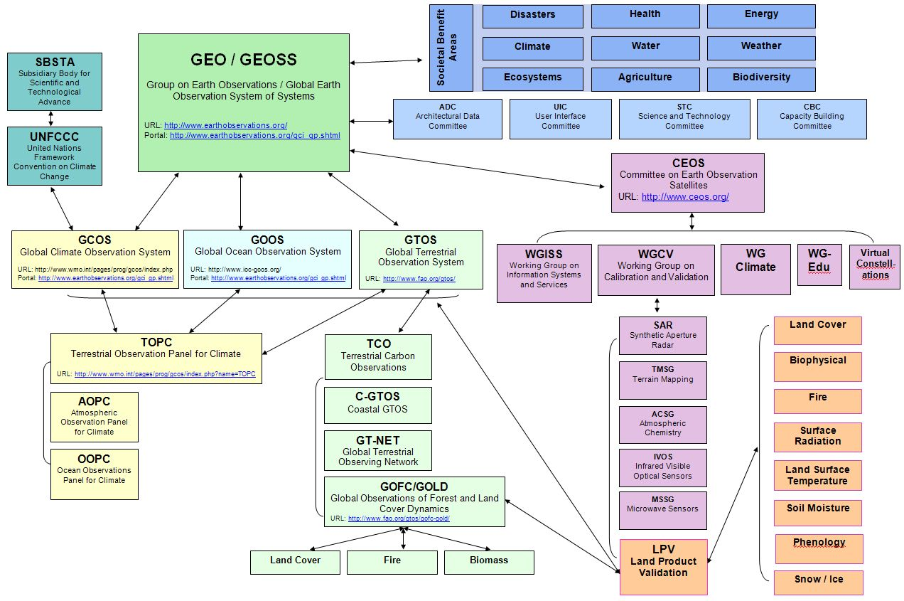


An international framework
Working Group on Calibration and Validation
www.ceos.org

Slide 4
LPV Focus Areas and Co-leaders
Working Group on Calibration and Validation
Snow Cover*, Sea Ice | Thomas Nagler (ENVEO, Austria) |  | Candidates identified
Surface Radiation (Reflectance, BRDF, Albedo*) | Zhuosen Wang (NASA GSFC) |  | Alessio Lattanzio (EUMETSAT)
Land Cover and Land Use Change* | Pontus Olofsson (Boston University) |  | Candidates identified
FAPAR* | Arturo Sanchez-Azofeifa (University of Alberta) |  | Nadine Gobron (JRC, IT)
Leaf Area Index* | Oliver Sonnentag (University of Montreal) |  | Hongliang Fang (Chinese Academy of Science)
Fire* (Active Fire, Burned Area) | Luigi Boschetti (University of Idaho) | Gareth Roberts (U. Southampton, UK) |  | Andrew Edwards (Charles Darwin U.)
Land Surface Temperature* (LST and Emissivity) | Pierre Guillevic (NASA GSFC) |  | Frank Goettsche (KIT, Germany)
Soil Moisture* | Michael Cosh (USDA ARS) |  | Candidates identified
Land Surface Phenology | Matt Jones (University of Montana) |  | Jadu Dash (University of Southampton, UK)
Vegetation Index | Tomoaki Miura (University of Hawaii) |  | Candidates identified
Above Ground Biomass* | Laura Duncanson (GSFC) | John Armston (UMD/UQ, Australia) |  | Mat Disney (U. College London, UK)
*Essential Climate Variable (ECV) as defined by GCOS
Co-lead: sitting, recently accepted, vacant, ex-officio
Notes:
Restructured a few years ago, now following essential climate variables. Several focus area co-leads presenting variable-specific results.

Slide 5
LPV Subgroup Objectives
Working Group on Calibration and Validation
To foster and coordinate quantitative validation of higher level global land products derived from remotely sensed data, in a traceable way, and to relay results to users.
To increase the quality and efficiency of global satellite product validation by developing and promoting international standards and protocols for:
Field sampling
Scaling techniques
Accuracy report and use
Data and information exchange
To provide feedback to international structures for:
Requirements on product accuracy and quality assurance
Terrestrial biophysical measurement standards
Definitions for future missions
Notes:
Formed in 2000 as part of NASA’s EOS validation program – validating MODIS land products

Slide 6
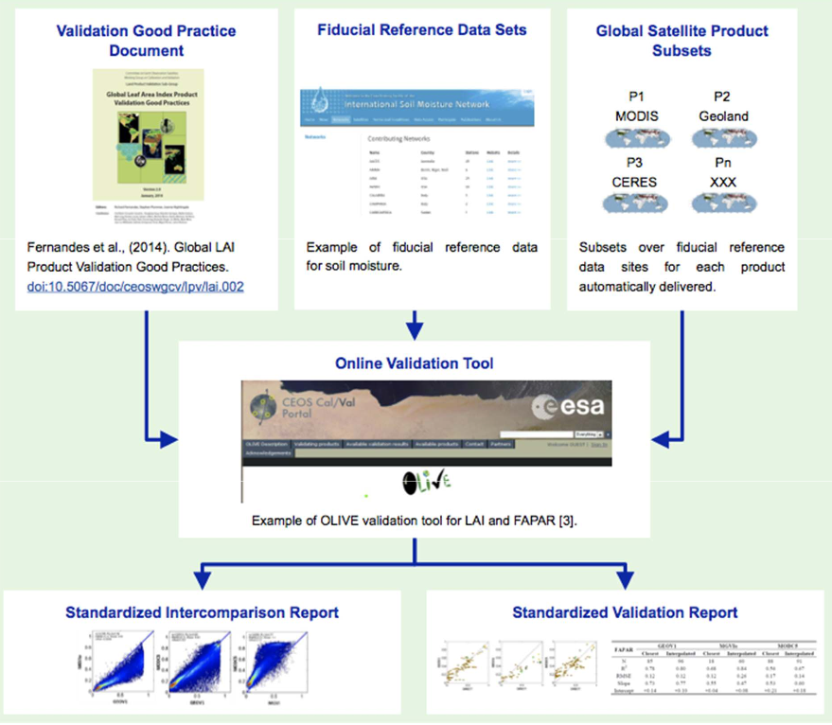
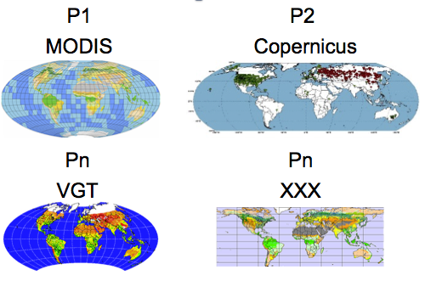
The LPV Validation Framework Lead coordinating Agency: NASA
Working Group on Calibration and Validation
Lead Agency: NASA
Lead Agencies: Various
Lead Agencies: USGS/NOAA
Lead Agencies: ESA/NASA/USGS

Slide 7
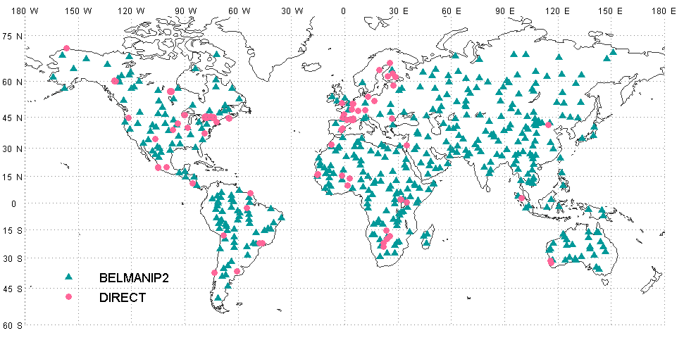

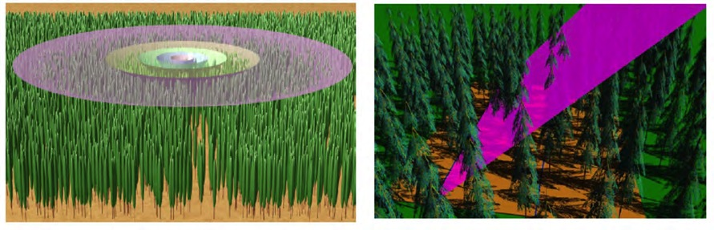
Working Group on Calibration and Validation
Leaf Area Index Validation Protocol
Location of reference LAI sites available for direct validation and inter-comparison studies.
https://lpvs.gsfc.nasa.gov
Depiction of spatial footprint of a LAI-2000 instrument as a function of zenithal view ring (left) and the TRAC instrument (right) for a given solar illumination condition.
Notes:
Formed in 2000 as part of NASA’s EOS validation program – validating MODIS land products

Slide 8
LPV validation requirements
Working Group on Calibration and Validation
(From Guillevic et al., RSE, 2012)
Characterize in situ measurements and validation datasets at satellite product resolution including uncertainty estimates
Characterize product uncertainties and identify issues with algorithm, ancillary data, geometric considerations, temporal drift

Slide 9
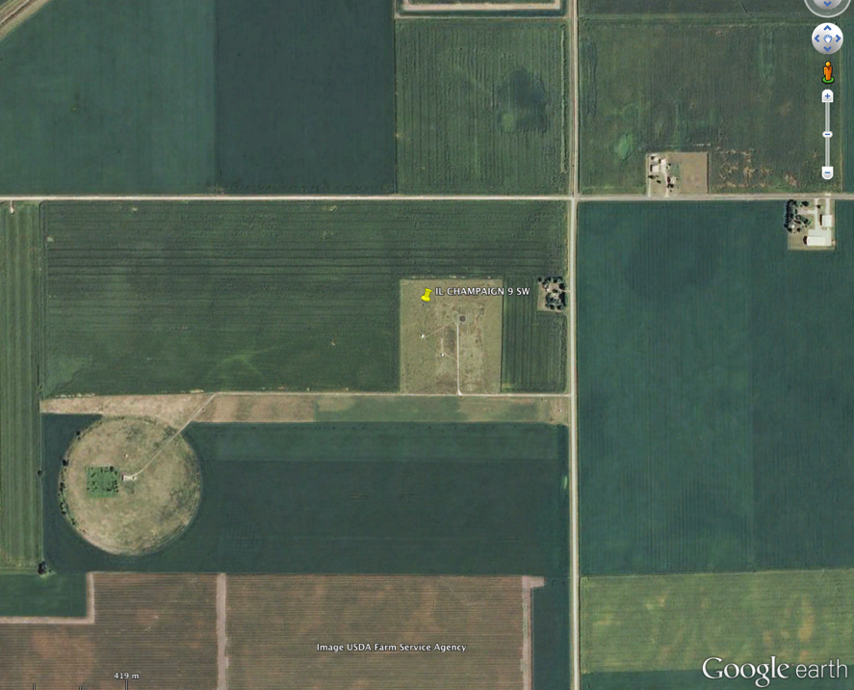
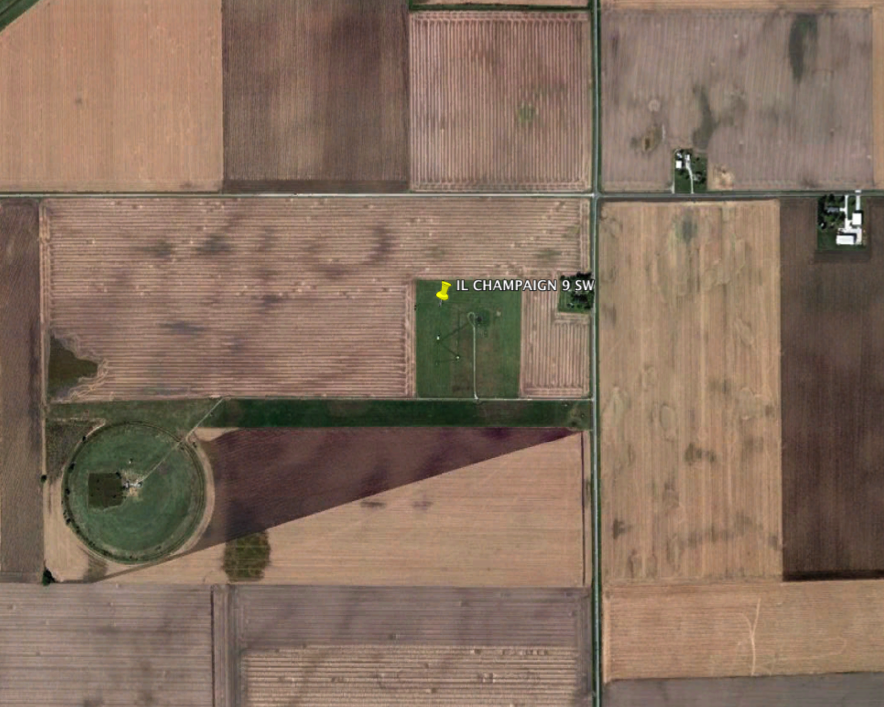
LPV validation challenges Example: Spatial vs. temporal variability
Working Group on Calibration and Validation
Before the harvest
After the harvest
Station 1
Station 1
Station 2
Station 2
1 km
After the harvest
Before the harvest
Bondville, IL: Temporal variations of the contribution of the surrounding area to coarse radiometric measurements over croplands

Slide 10
Working Group on Calibration and Validation
LPV validation challenges Critical need for ground truth
(From Guillevic et al., RSE, 2014)
VIIRS vs. MOD11 algorithms: similar poor performance over arid areas

Slide 11
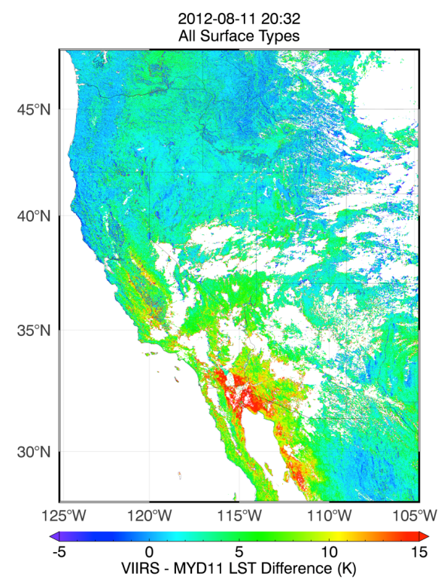
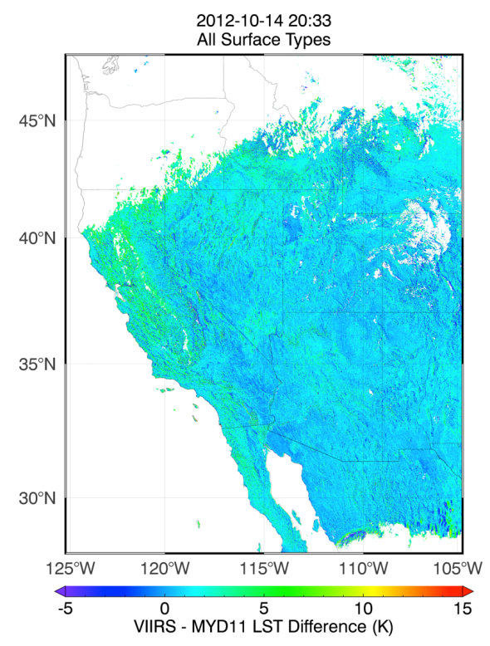
Working Group on Calibration and Validation
LPV validation challenges Example: Comparison with heritage products
Differences between VIIRS and MODIS LST
Aug. 11, 2012
Differences between VIIRS and MODIS LST
Oct. 14, 2012
(From Guillevic et al., RSE, 2014)

Slide 12
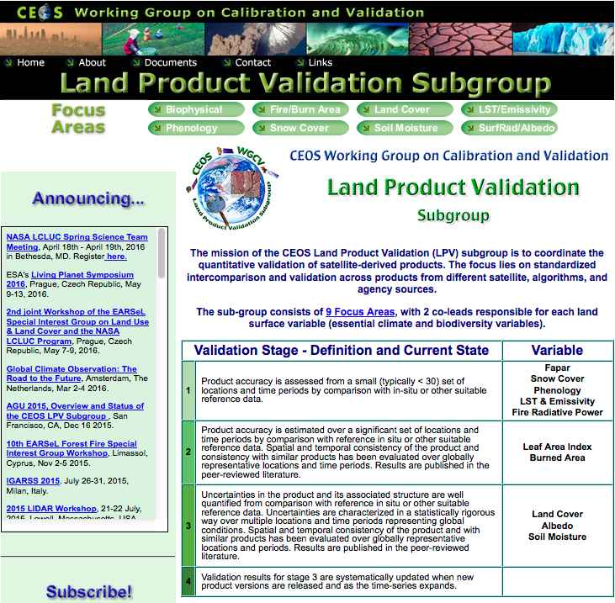
Working Group on Calibration and Validation
LPV Web Site
https://lpvs.gsfc.nasa.gov
Established in 2000
Subscribed member list has grown to nearly 600 members.
Over 500 visits/month
For each focus area:
Variable home page
Peer-reviewed papers
Community Collaboration
Operational Product database list
Protocols & best practice
12

Slide 13










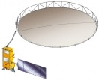









CEOS-LPV 5-Year Roadmap
Working Group on Calibration and Validation
<2016 2017 2018 2019 >2020
Vision
Operational Validation Framework: Land Product Characterization System (Lead Agencies: USGS/NOAA)
All missions support validation & validation is on-going
Uncertainty information determined through standard practices & protocols
Algorithms are iteratively improved based on validation results
Albedo, Burned Area, & LST Protocols
Phenology, ET, & Soil Moisture Protocols (Lead Agency: NASA)
CEOS Carbon Actions 7/8 (NASA CMS Program)
Biomass Protocol (Lead Agencies: NASA/ESA)
ECV protocols and procedures for Snow ECV (Lead Agency: ESA)
WGCV ACIX (Lead Agency: ESA)
Atmospheric Correction and VI Protocols (Lead Agencies: ESA/NOAA)
Field Campaigns and IOPs
New Missions
Biomass
Sustained Missions
a/b
a
b
Morning
c
Landsat 9
Afternoon
Terra/Aqua/S-NPP
JPSS-1
JPSS-2

Slide 14
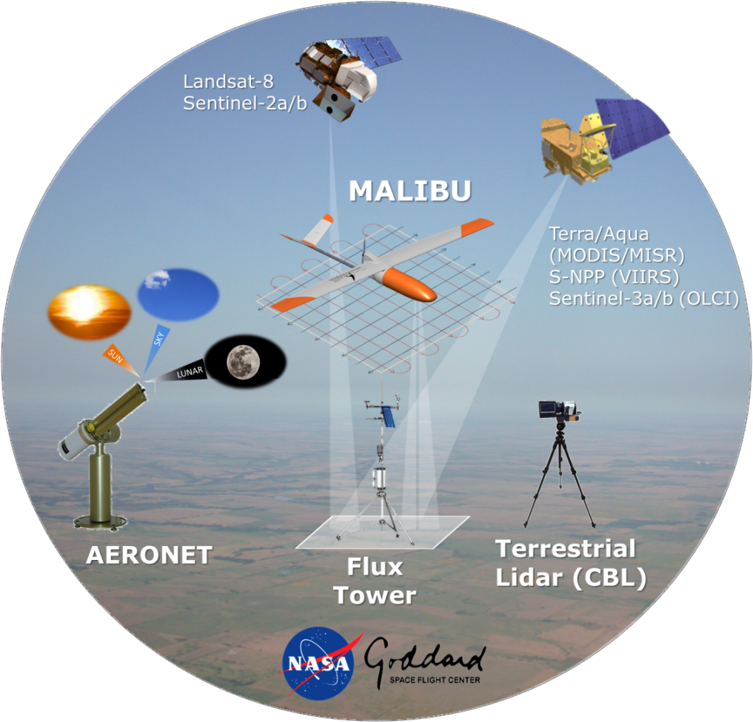
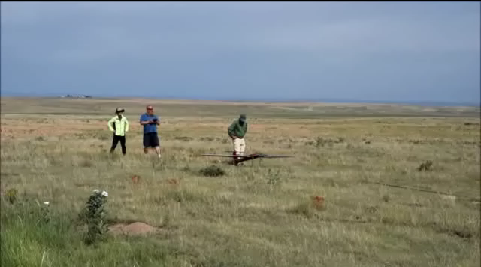

Working Group on Calibration and Validation
MALIBU Multi AngLe Imaging BRDF Unmanned aerial system
Objective
Multi-angular reference datasets for the assessment of ECVs, including satellite-derived BRF, albedo, VI, PRI, LAI/fAPAR, snow cover, and phenology metrics
Pawnee National Grasslands in June 2016
Table Mountain, Colorado in Nov. 2016
Benefits
A cost effective ($300 × Flight Hour), fully-exempted (FAA-S.333 & TCAN) platform, that follows CEOS WGCVprotocols
https://viirsland.gsfc.nasa.gov/Campaigns.html
B31B-0471 MALIBU: A High Spatial Resolution Multi-Angle Imaging Unmanned Airborne System to Validate Satellite-derived BRDF/Albedo Products. Wed, 14 Dec 2016 (8:00 - 12:20)

Slide 15
Conclusion
Working Group on Calibration and Validation
Role of CEOS-LPV
Coordinate validation efforts internationally
Foster collaboration and sharing information and data
Develop protocols and good practices for validation efforts
Recommendations for reporting and use of accuracy information
Need to develop and better represent the ground component to:
Improve current validation stages
Prepare evaluation of higher level products

Slide 16
https://lpvs.gsfc.nasa.gov

